Slide 1
Project
“চিরন্তন”

Slide 2
Submit By
Tareq Rahman Jisan
Session 2013-14
Computer Technology
AITVET

Slide 3
Special Thanks To
Ms. Afsana Hamid
&
Ms. Shamsunnahar Nasreen
Instructor
Computer Technology
AITVET

Slide 4
Introduction
This project develop by ASP.NET which back end programming language C# 5.0 and back end database Microsoft SQL Server 2008 R2 edition.
This project operate by IIS7 (Internet Information service 7) under centralized server machine, .NET Frame work 4.0 and Secure by windows firewall.
So we can strongly safe our data from external attack.
We are use Redundancy Array of Independent Disk (RAID) level 1.
So zero to unlimited user access their data at a time easily with proper speed.

Slide 5
Overview
Now we live in very advance and fastest world. So we have sort time but lot of work. In our country we are not aware about time because we can’t maintain our time. In every moment we lost our maximum valueable time on our way because our transport service can’t follow any proper rules and other problem is traffic jam.
So I make a solution for solve those problems. I make a virtual bus ticket counter. I mean online ticket counter (bus) which back end have a database. This database has eight accesses able permission.
These are
1) administrator head 2) administrator 3) passenger 4) bus’s owner 5) bus’s driver 6) bus’s stuff,
7) counter stuff 8) government stuff.

Slide 6
Algorithm
Step 1: Start.
Step 2: Insert Login_ID and Password.
Step 3: Search permission with Login_ID and Password. If not found then repeat Step 2.
If permission Found then go to Step 4.
Step 4: Process Permission.
Step 5: After Step 4 grant access selected data for selected user.
Step 6: If login out by the user than close connection and go to Step 2.

Slide 7
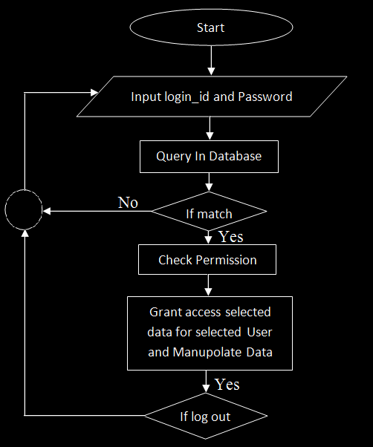
Flow Chart

Slide 8
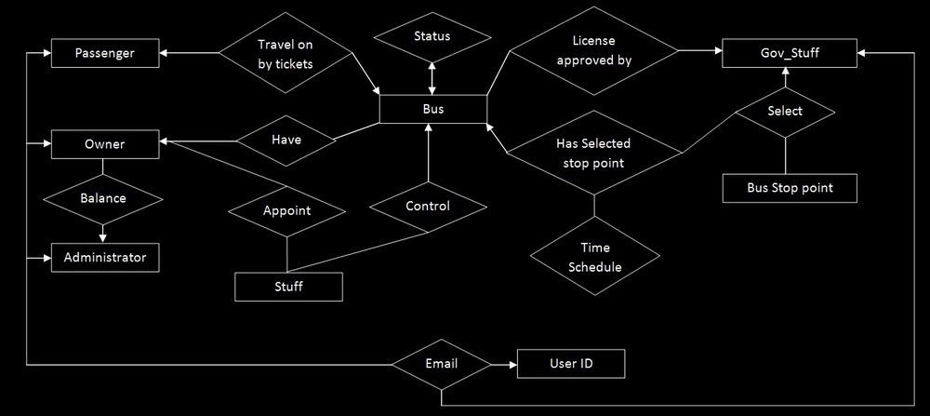
Entity
Relationship
Diagram

Slide 9
Requirements
Two 256 GB SSD for RAID level 1, 16 GB RAM, server machine, windows 10/ windows server 2016, Internet connection with real/dedicate Internet Protocol address . Smart phone /GPS only for bus, java script supported browser and mozila firefox must for driver/helper and recommend for other user.
[Only for primary testing]

Slide 10
Cost
Machine price about 128000 tk, internet bill 4000-5000 tk per month per Mbps, OS 13000 tk.
[Only for primary testing]
GPS device for bus price about 3500-4500 tk

Slide 11
Advantage
If we can actualization this project at first we can save our value able time. We can travel on bus safely. We can reduce 60% traffic jam in our city.

Slide 12
Disadvantage
As a result of the sudden emergence of this system will have some difficulty.

Slide 13
Thank You
More use of digital methods. But do not be relied upon please.

