Slide 1
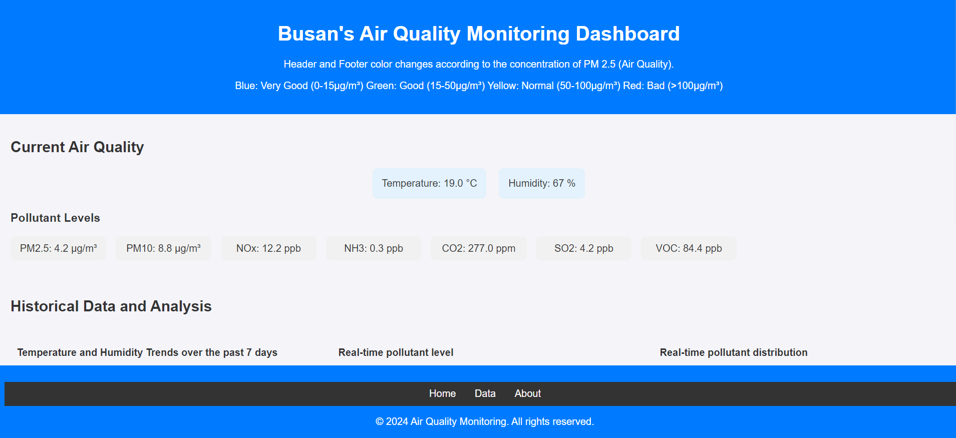
Final Project: Air Quality Monitoring Dashboard in Busan
11.19.24
Jisan Kim
Undergraduate student at Mechanical Engineering in Pusan National University Web Application Programming – 062
Dr. AICH SATYABRATA
Notes:
Hello, My name is Jisan Kim. I’ll introduce my final project, Air Quality Monitoring Dashboard in Busan.

Slide 2
Introduction – Top Requirements of Final Project
1. User Interface Design
Header, Footer, Navigation Bar (Home, Data, About), Main Dashboard
2. Data Display
Temperature (°C), Humidity (%), PM2.5 (µg/m³), PM10 (µg/m³), NOx (ppb), NH3 (ppb) , CO2 (ppm), SO2 (ppb), VOC (ppb)
3. Visual Representation
Line, Bar, Doughnut Chart
4. Real-time Data Updates
Notes:
There are several requirements for our final project. For the presentation, I’ll mention the status of my project depending on these four top requirements.

Slide 3
User Interface Design
All the components have been implemented: Header, Footer, Navigation Bar (Home, Data, About), and Main Dashboard.
Notes:
First of all, as the user interface design, the first screen includes dashboard, header, footer and navigation bar like this.

Slide 4
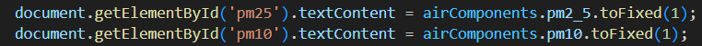
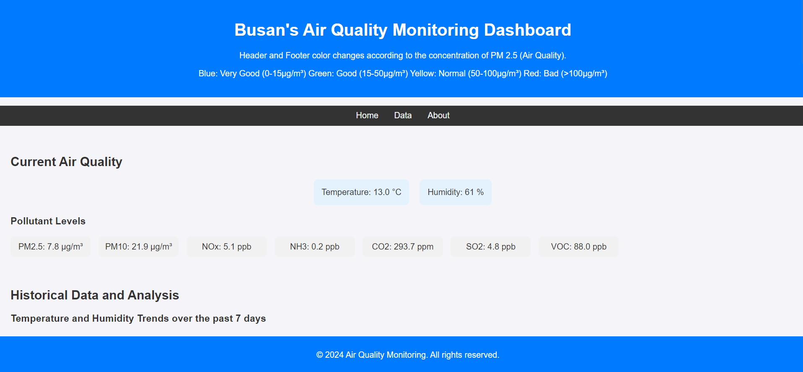
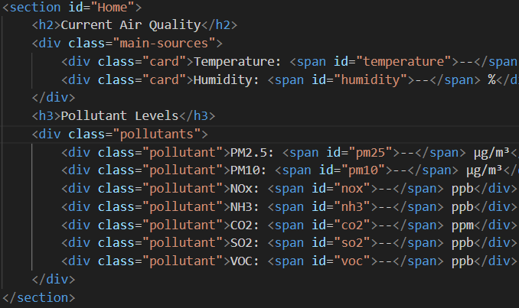
User Interface Design – Main Dashboard
Open Weather API
Get real-time values from the API, push it into the main dashboard.
Notes:
The main dashboard shows the numerical amount of each pollutant. The values had been taken by Open Weather API.

Slide 5
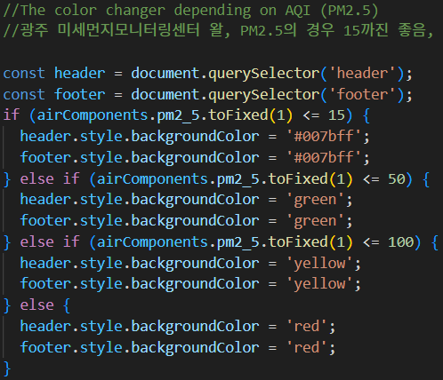
User Interface Design – Header & Footer
Implemented with <header> and <footer> tag.
Special Point!
The header & footer changes its color depending on the air quality index (AQI), specifically the concentration of PM 2.5.
Notes:
There is a special point with the header and footer. Depending on the air quality, specifically the concentration of PM2.5, the header and footer change their color from blue to red.

Slide 6
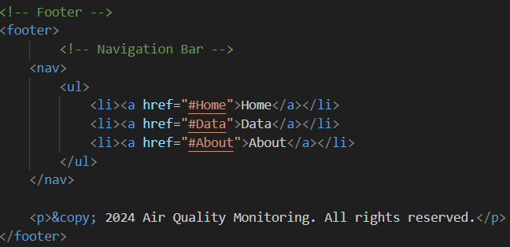
User Interface Design – Navigation Bar
The footer contains the navigation bar. Each options take a user to dedicated section of the page.
Implemented with <nav> and <section>. The scroll moves to each point by clicking the options.
Notes:
Next, the page is separated in three sections. If a user click the navigation bar, it takes the user to the dedicated section.

Slide 7
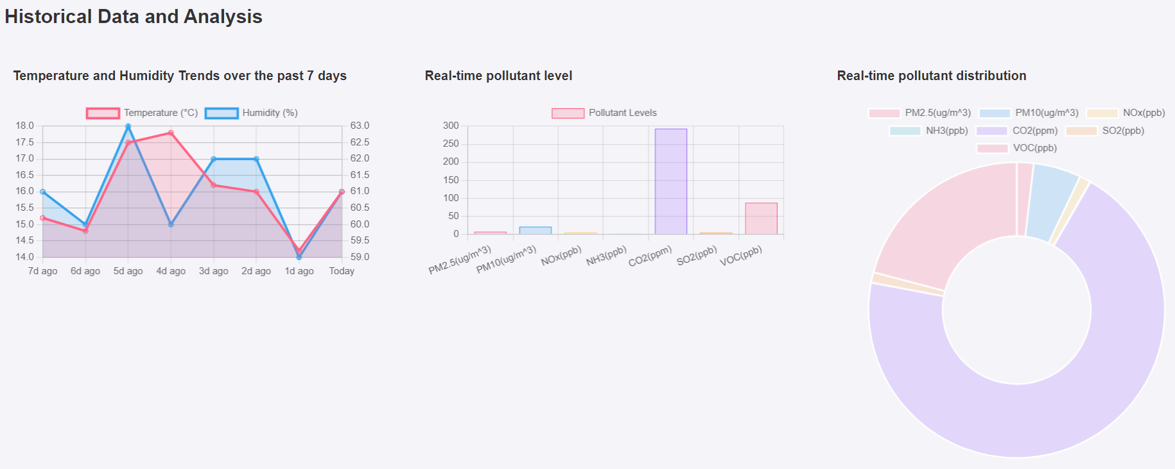
Data Display & Visual Representation
Chart.js has been used.
Notes:
For data display & visual representation, Chart.js has been used. I’ll explain one by one.

Slide 8
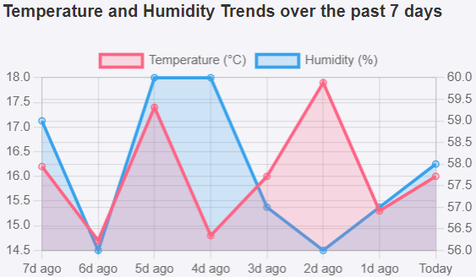
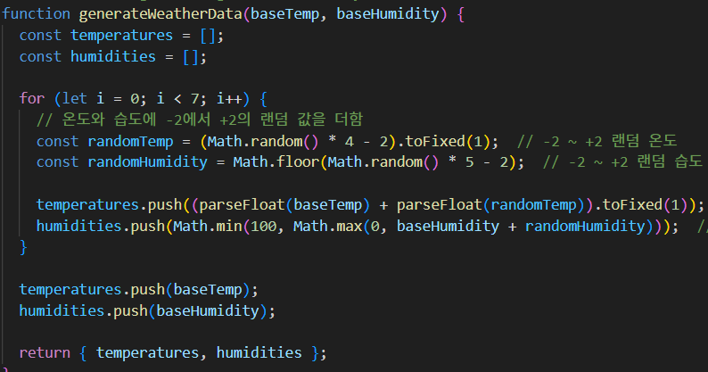
Data Display & Visual Representation – Line Chart
Initial plan: showing temperature & humidity of over 8 days including today in the line chart
Problem
Getting historical data is paid feature.
Solution
Generated random values by adding a range of -2 – 2 to today’s temperature & humidity.
Notes:
Line chart shows the temperature and humidity trends over the past 7 days. However, there was an issue that getting previous data was a paid feature. So, I implemented a function that generates seven random function by adding -2 to 2 to today’s data.

Slide 9
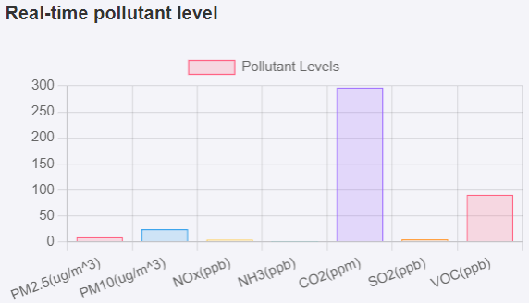
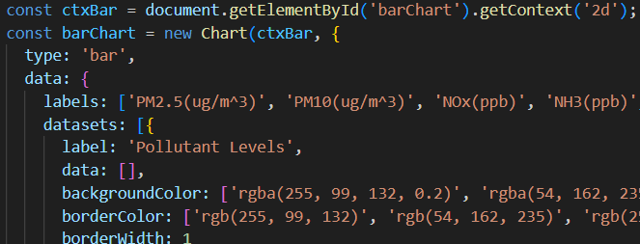
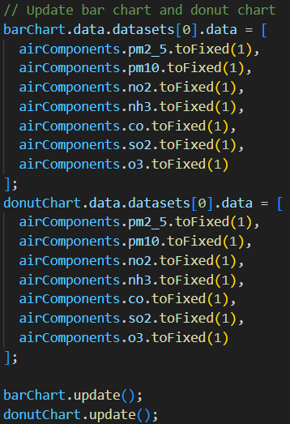
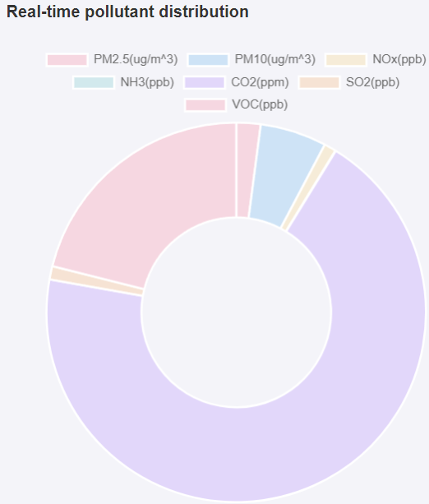
Data Display & Visual Representation – Bar & Doughnut Chart
update real-time data of each pollutant
Notes:
Next one is bar & doughnut chart. The bar chart shows the pollutant level, and the doughnut char shows the distribution of each pollutant. All the charts update their data periodically.

Slide 10


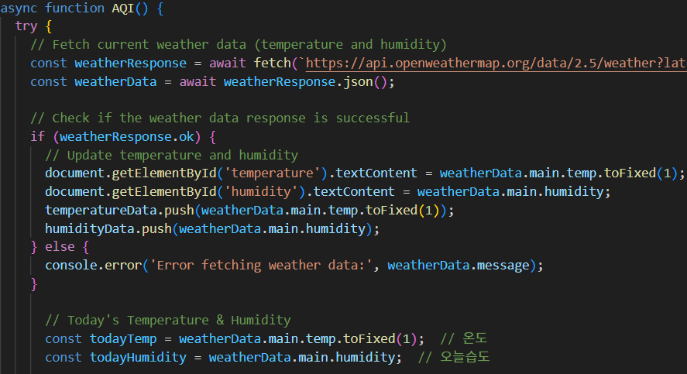
Real-time Data Update
All data updates every 30 minutes.
Notes:
These methods are for the real-time data update. 30 minutes of the interval has been set.

Slide 11
Future Plan
Show expected data
Not only indicating weather history, showing future data by clicking a button.
Enhance the design
Change the overall design of the page by like adding images, make the head of each section div to satisfy users’ aesthetic needs.
Notes:
From now on, I’m gonna focus on applying some minor features. For example, I’m planning to add weather forecast, specifically showing temperature & humidity of next 7 days, and utilize some images to enhance the design of the page.

Slide 12
Thank you!
Notes:
Thank you for listening to my presentation.
If you have any questions, please feel free to ask me.

