Slide 1
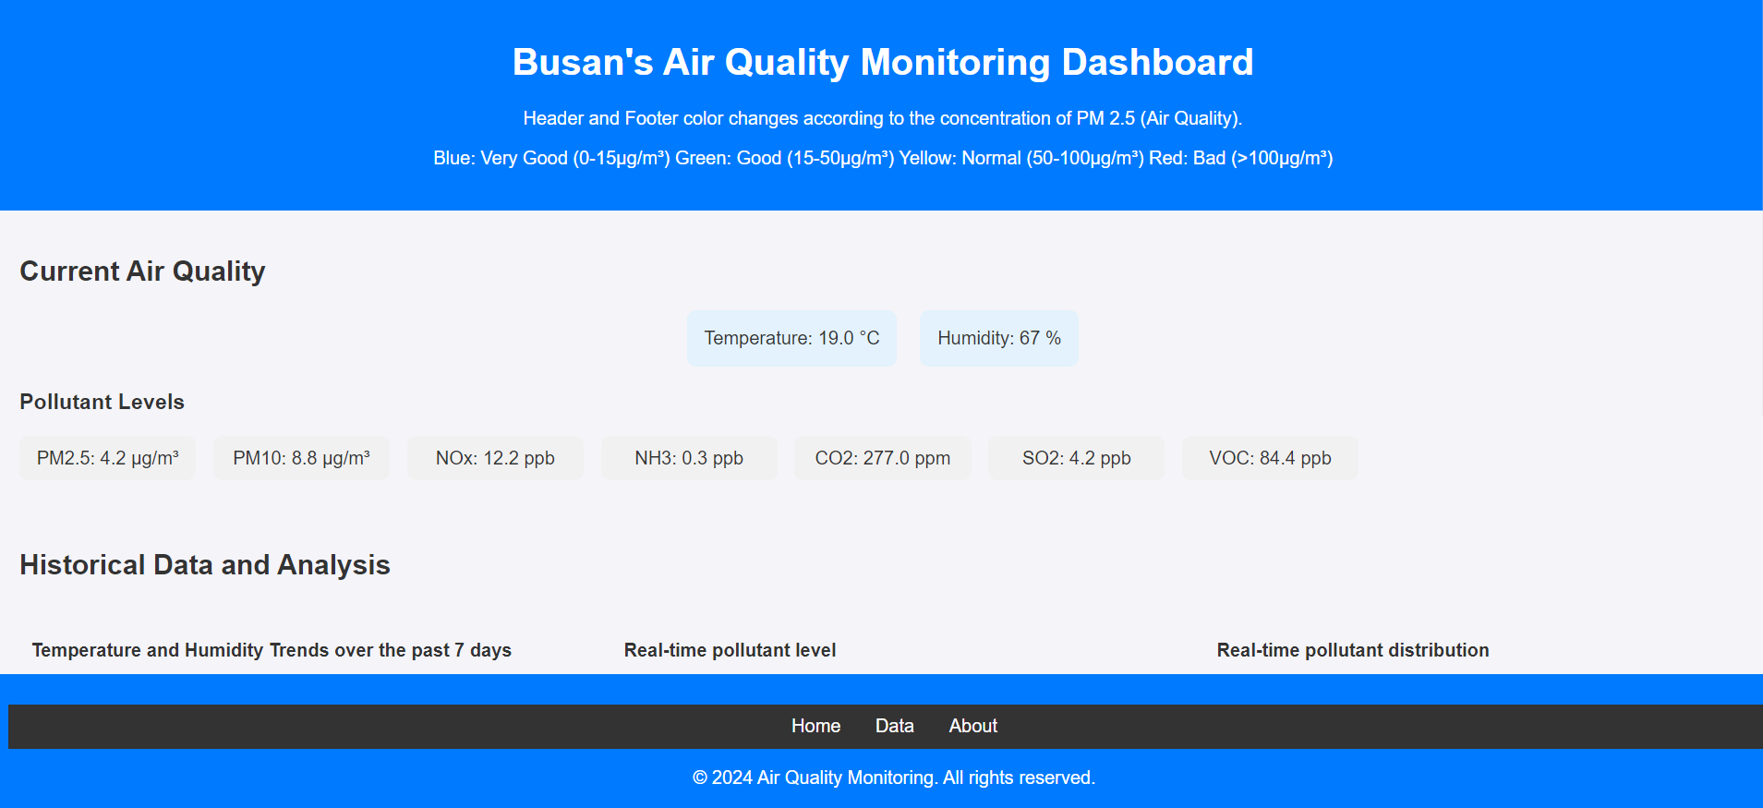
Final Project: Air Quality Monitoring Dashboard in Busan
11.19.24
Jisan Kim
Undergraduate student at Mechanical Engineering in Pusan National University Web Application Programming – 062
Dr. AICH SATYABRATA

Slide 2
Introduction – Top Requirements of Final Project
1. User Interface Design
Header, Footer, Navigation Bar (Home, Data, About), Main Dashboard
2. Data Display
Temperature (°C), Humidity (%), PM2.5 (µg/m³), PM10 (µg/m³), NOx (ppb), NH3 (ppb) , CO2 (ppm), SO2 (ppb), VOC (ppb)
3. Visual Representation
Line, Bar, Doughnut Chart
4. Real-time Data Updates

Slide 3
User Interface Design
All the components have been implemented: Header, Footer, Navigation Bar (Home, Data, About), and Main Dashboard.

Slide 4
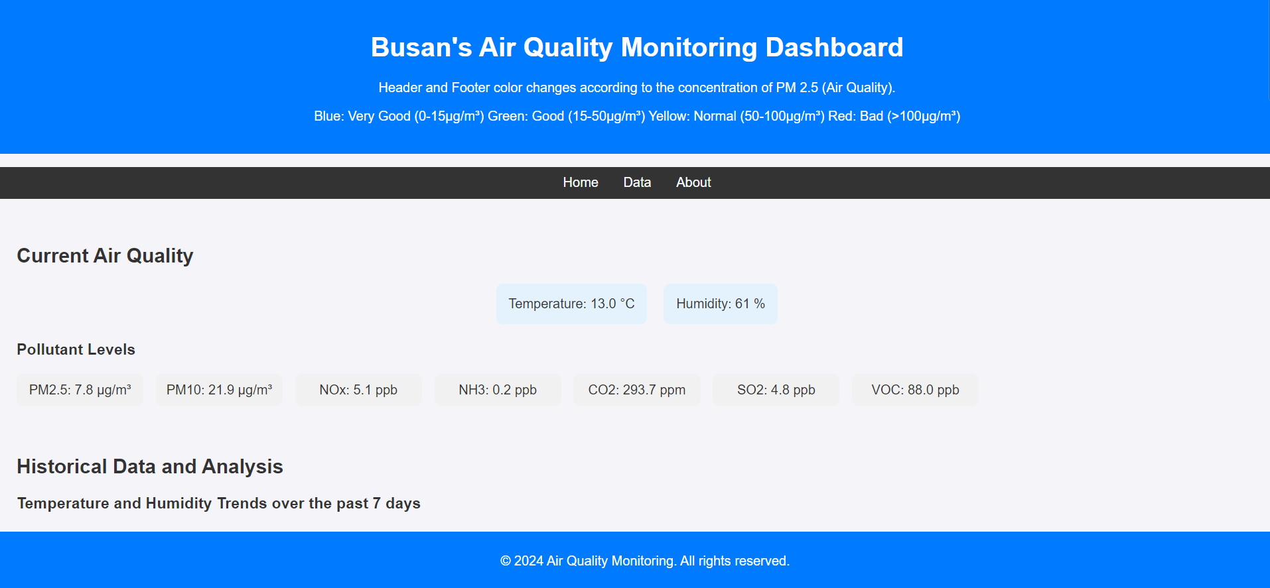
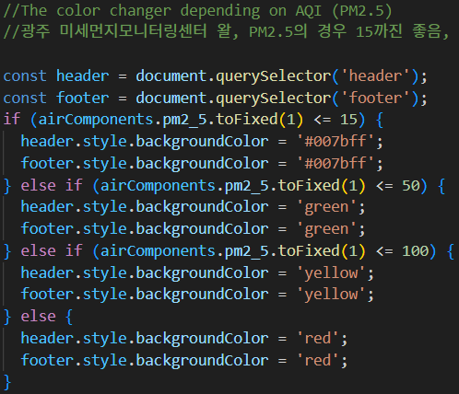
User Interface Design – Header & Footer
Implemented with <header> and <footer> tag.
Special Point!
The header & footer changes its color depending on the air quality index (AQI), specifically the concentration of PM 2.5.

Slide 5
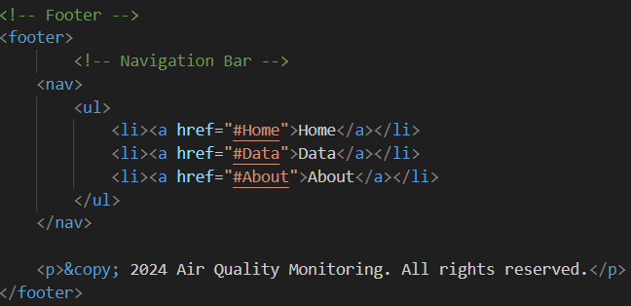
User Interface Design – Navigation Bar
The footer contains the navigation bar. Each options take a user to dedicated section of the page.
Implemented with <nav> and <section>. The scroll moves to each point by clicking the options.

Slide 6
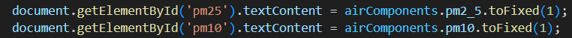
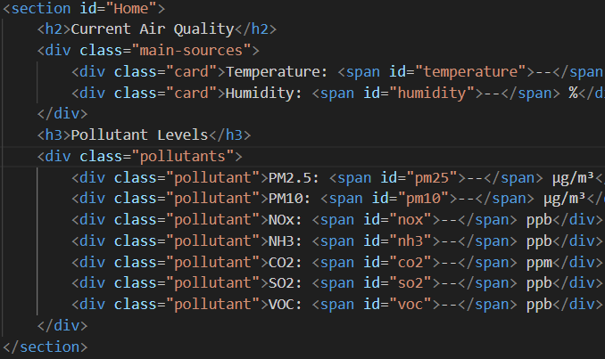
User Interface Design – Main Dashboard
Open Weather API
Get real-time values from the API, push it into the main dashboard.

Slide 7
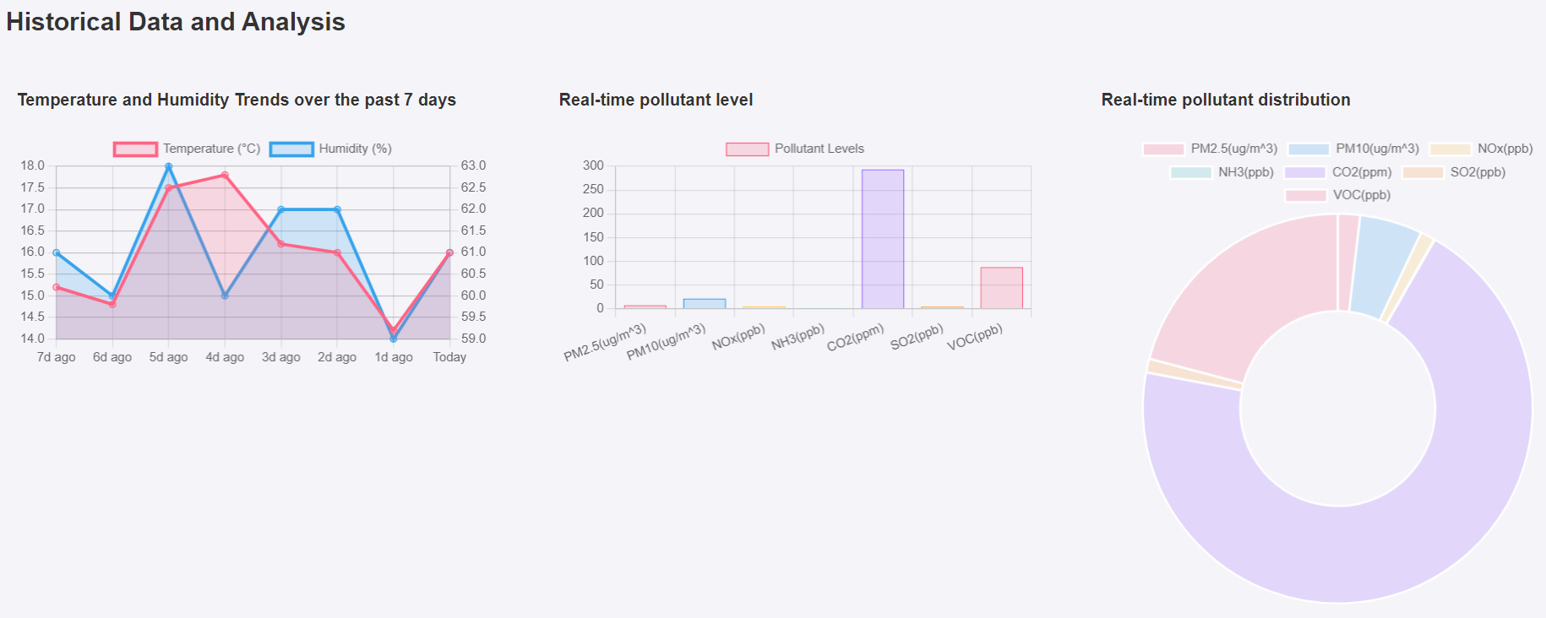
Data Display & Visual Representation
Chart.js has been used.

Slide 8
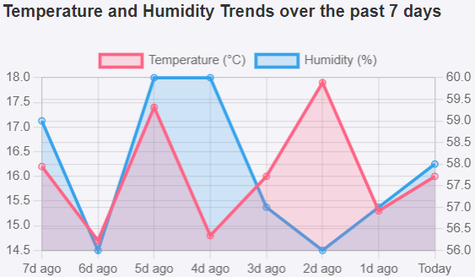
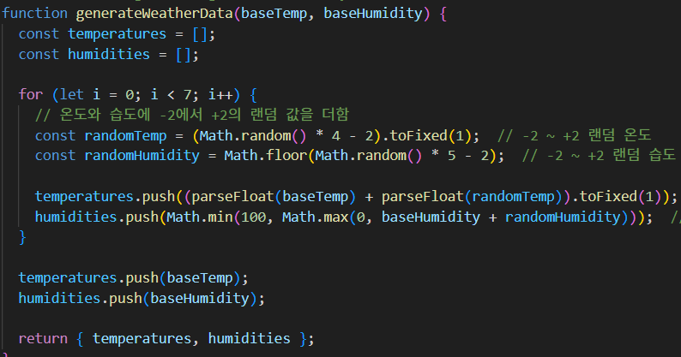
Data Display & Visual Representation – Line Chart
Initial plan: showing temperature & humidity of over 8 days including today in the line chart
Problem
Getting historical data is paid feature.
Solution
Generated random values by adding a range of -2 – 2 to today’s temperature & humidity.

Slide 9
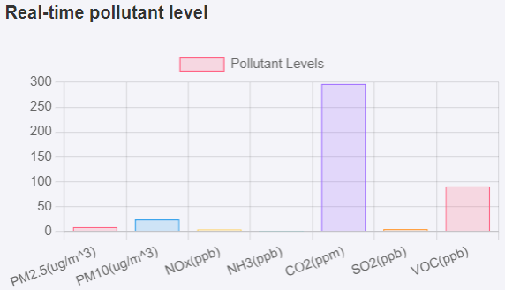
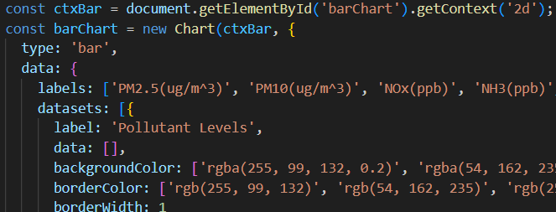
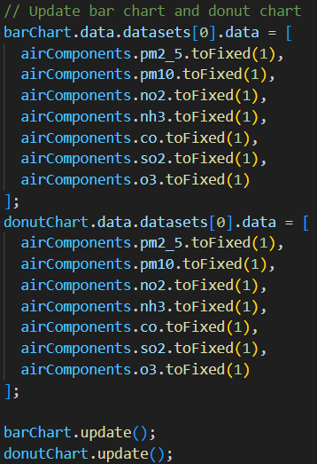
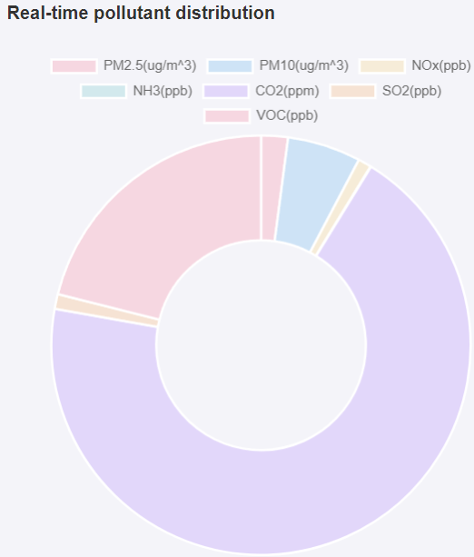
Data Display & Visual Representation – Bar & Doughnut Chart
update real-time data of each pollutant

Slide 10



Real-time Data Update
All data updates every 30 minutes.
Notes:
The manufacturing process is also a problem for many of these methods.
They are not designed to be easily made, and sometimes they need special materials that are hard to get in large amounts.
All these things together mean that these methods can not be made in big numbers at a reasonable cost, making them not so practical for widespread use.

Slide 11
Future Plan
Show expected data
Not only indicating weather history, showing future data by clicking a button.
Enhance the design
Change the overall design of the page by like adding images, make the head of each section div to satisfy users’ aesthetic needs.
Notes:
The manufacturing process is also a problem for many of these methods.
They are not designed to be easily made, and sometimes they need special materials that are hard to get in large amounts.
All these things together mean that these methods can not be made in big numbers at a reasonable cost, making them not so practical for widespread use.

Slide 12
Thank you!
Notes:
Thank you for listening to my presentation.
If you have any questions, please feel free to ask me.

