Slide 1
D3 - Data Driven Document
cse 6339
Jisa Sebastine

Slide 2
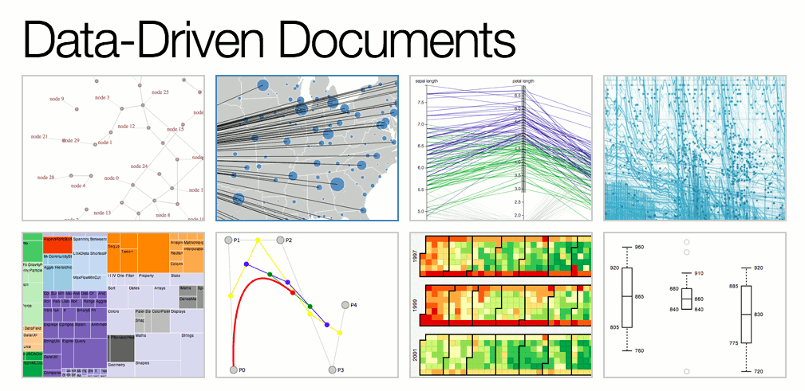

Slide 3
Introduction
Designers often employ multiple tools simultaneously on the web
HTML for page content
CSS for aesthetics
JavaScript for interaction
SVG for vector graphics
They all modifies shared representation of the page called the document object model (DOM).

Slide 4
D3
javacript library
visualisation tool
Features:
expressiveness
accessibility
transforms offer dramatic performance gains
enable animated transitions

Slide 5
Comparison
creation and deletion of elements
styling of existing nodes.
impossible with CSS, and tedious with jQuery
mechanism for adding or removing elements to match a dataset
XSLT - no high-level visual abstractions
Notes:
For data visualization, document transformers must handle the creation and deletion of elements, not just the styling of existing nodes.
This is impossible with CSS, and tedious with jQuery as it lacks a mechanism for adding or removing elements to match a dataset; data
must be bound to nodes individually (if at all), rather than through a high-level data join (see x3.2). This makes jQuery incapable of datadriven
transformations, and thus ill-suited for dynamic visualizations involving complex transitions. Extensible Stylesheet Language Transformations [41] (XSLT) is
another declarative approach to document transformation. Source data is encoded as XML, then transformed into HTML using an XSLT
stylesheet consisting of template rules. Each rule pattern-matches the source data, directing the corresponding structure of the output document
through recursive application. XSLT’s approach is elegant, but only for simple transformations: without high-level visual abstractions,
nor the flexibility of imperative programming, XSLT is cumbersome for any math-heavy visualization task (e.g., interpolation, geographic
projection or statistical methods).

Slide 6
Components of D3
selectors
operators
data join
enter and exit
transitions
eventhandlers
helper modules

Slide 7
Modules
D3 automatically manages transition
scheduling
D3.svg module provides various shapes suitable for charting

Slide 8
Modules contd..
Layouts
chord ,force, stack, treeemap
Behavious
zoom
Data processing utilities
cross,nest,parser etc
Notes:
Layouts supply reusable, flexible visualization techniques by generating abstract data structures.

Slide 9
Design
3 differentiating factors:
implicit or explicit transformation
deferred or immediate evaluation
access to a native representation

Slide 10
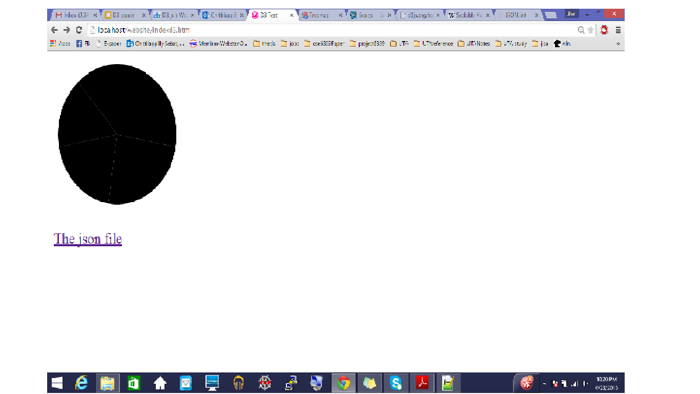
Sample code
d3.select("body").append("svg:svg")
.data([[1, 1.2, 1.7, 1.5, .7]])
.attr("width", 150)
.attr("height", 150)
.selectAll("path")
.data(d3.layout.pie())
.enter().append("svg:path")
.attr("transform", "translate(75,75)")
.attr("d", d3.svg.arc().outerRadius(70));

Slide 11
d3.json("http://localhost/website/num_topics.json" ,function(data){ d3.select("body") .append("svg") .selectAll("rect") .data(data) .enter() .append("rect") .attr("y",function(d,i){return i*24;}) .attr("width",function(d,i) {return 11*d.count;}) .attr("height",20) }); | [ {"count":44, "num_topics":0}, {"count":3, "num_topics":6}, {"count":22, "num_topics":10}, {"count":33, "num_topics":4}, {"count":44, "num_topics":0}, {"count":44, "num_topics":0} ] Output : http://localhost/website/indexd3.html

Slide 12
Example applications
Treemaps
The static treemap is 21 lines of JavaScript—a negligible increase over the 17 lines required for Protovis. Adding interaction and animation expands the specification to 54 lines.
NonContinguous Cartorams
This example requires 34 lines of JavaScript, not including data or comments. Stroke widths and colors are specified using CSS.
Bezier Curves
This example is 139 lines of JavaScript, not including comments. Some styles are set with CSS while others are set from JavaScript.

Slide 13
Results
twice as fast as Protovis and over three times as fast as Flash
Flash-based visualizations exhibit
2–2.5 times more frames per second than D3. Meanwhile, D3 shows improved scalability among browser-native tools
By limiting updates to the changing parts of a scene, D3 transforms provide greater scalability than Protovis
D3 also allows more control over document structure

Slide 14
Questions ?

Slide 15
Thank you

