Slide 1

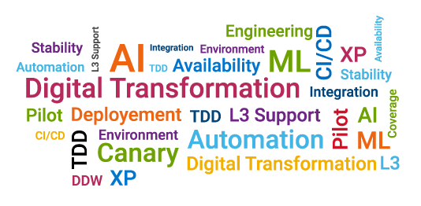
Team OSCAR
Jisa Sebastine, Gauri Wagle, Khushboo Rathi, HariChaitanya Kandula

Slide 2

Outline
Problem
Solution
Design and Implementation
Future Enhancements
Demo

Slide 3
Problem
Production Incidents have high impact on customers
Solving incidents is expensive considering effort and time
Resources require domain knowledge across multiple teams to resolve incidents

Slide 4
Solution
INCyclopedia
One stop shop to access past incidents and related knowledge base across multiple teams in DCE based on incident/keyword search

Slide 5
Future Enhancements
Filter Incidents based on Date Range
Add more meta Data for Incidents
Integrate TFS, Gitlab

Slide 6




Design
IncidentID/Keyword
API
API
OSC
DSA
FSC

Slide 7
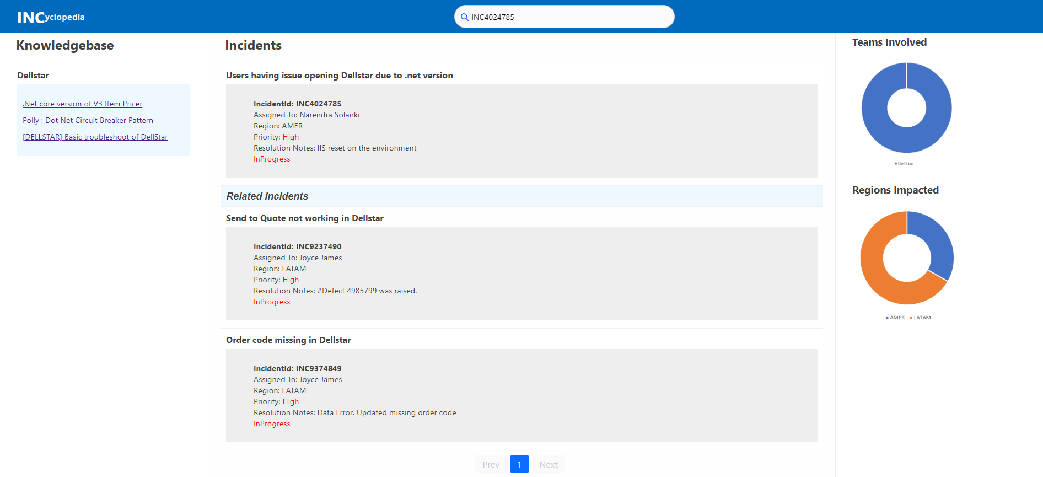
Project Snapshot(s)
Add screenshots (only if necessary)

Slide 8
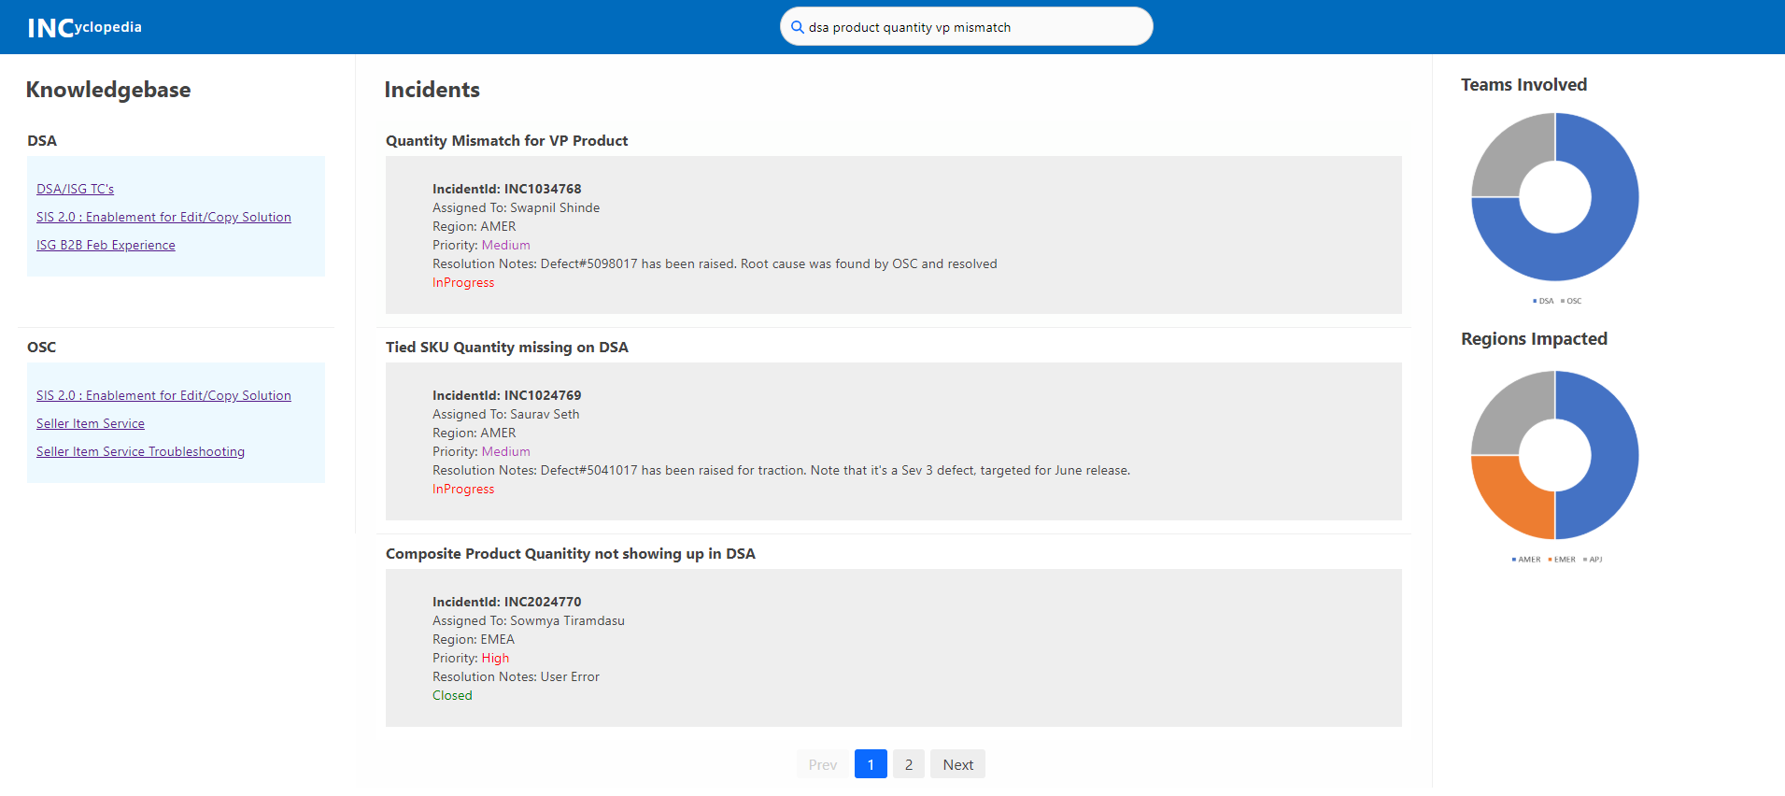
Project Snapshot(s)
Add screenshots (only if necessary)

Slide 9
Project Demo Recording (open the above link in Google chrome)

Slide 10
Questions?

Slide 11
Thank you

