Slide 1

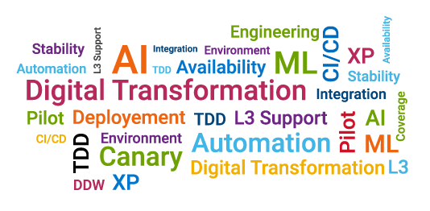
Team OSCAR
Jisa Sebastine, Gauri Wagle, Khushboo Rathi, HariChaitanya Kandula

Slide 2

Outline
Problem
Solution
Design
Demo
Future Enhancements

Slide 3
Problem
Production Incidents have high impact on customers
Solving incidents is expensive considering effort and time
Resources require domain knowledge across multiple teams to resolve incidents

Slide 4


Slide 5
Solution
One stop shop to access past incidents and related knowledge base across multiple teams in DCE based on incident/keyword search
Provide analytics based on past incidents

Slide 6




Design
IncidentID/Keyword
API
API
OSC
DSA
FSC

Slide 7
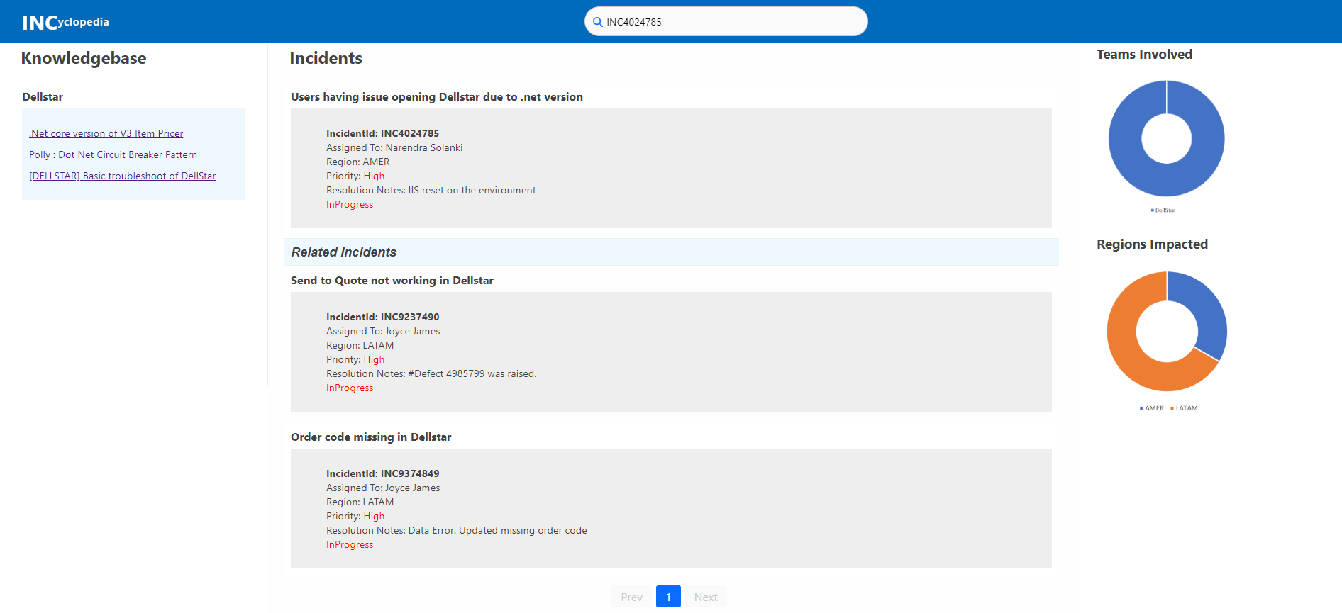
Project Snapshot(s)
Add screenshots (only if necessary)

Slide 8
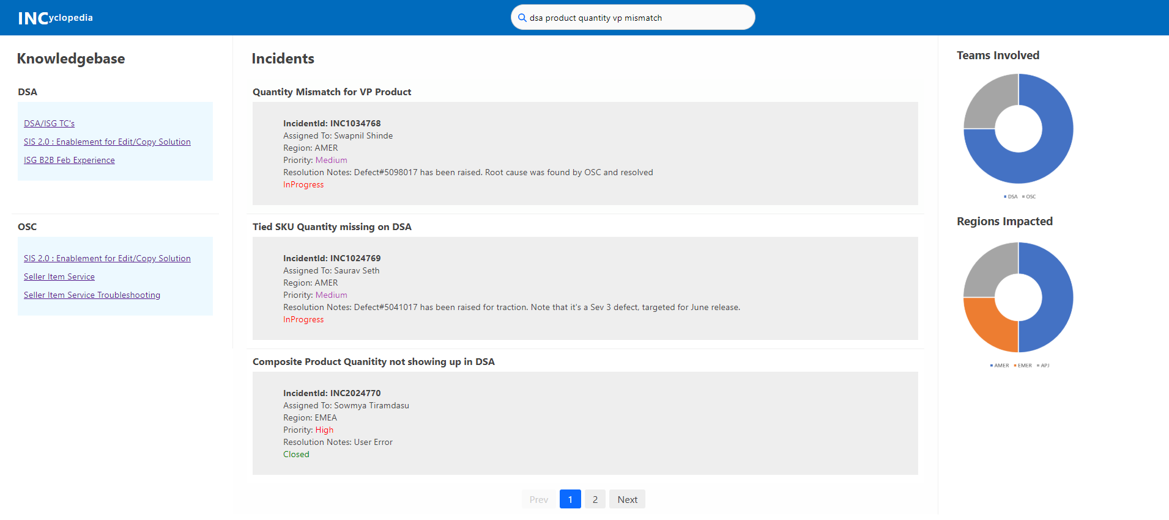
Project Snapshot(s)
Add screenshots (only if necessary)

Slide 9
Project Demo Recording (open the above link in Google chrome)

Slide 10
Future Enhancements
Integrate TFS, Gitlab, OneNote
Use metadata of incidents for analytics
Filter incidents based on date range
Notify the user of updates on previously saved searches
Get user feedback

Slide 11
Questions?

Slide 12
Thank you

