Slide 1
Advanced Programming Practice Segment Tree 2022 Fall, CSE4152
Sogang University

Slide 2
Assignment

Slide 3
1D sum
For given N integer elements and Q queries, please compute interval sum or modify the element. There are two types of queries: summing up elements in the interval and modifying the element.
N <=1000000 Q <= 10000
Input
5 // input N
1 2 3 4 5 // N elements
3 // Q queries
0 0 3 // 0 indicates computing the sum of the interval. The result is 10.
1 1 1 // 1 indicates modification. The second element is changed to 1
0 0 3 // The result is 9.
Hint: use an interval tree and the sum table together.

Slide 4
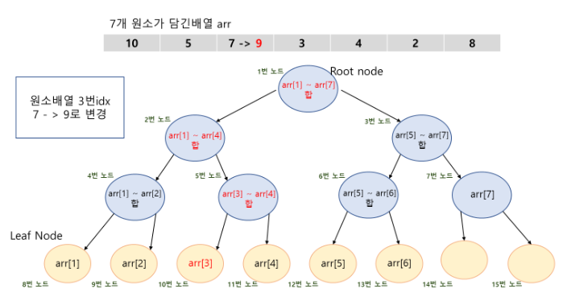
1D sum 채점용 TestCase
For given N integer elements and Q queries, please compute interval sum or modify the element. There are two types of queries: summing up elements in the interval and modifying the element.
N <=1000000 Q <= 10000
Input
7 // input N
10 5 7 3 4 2 8 // N elements
3 // Q queries
0 0 3
1 2 9
0 0 3

Slide 5
2D sum
For given NxM integer elements and Q queries, please compute 2D sums for given Q intervals.
N<=1000, M<=1000, Q <=1000
Input
5 3 // input N
1 2 3 4 5 // NxM elements
1 2 3 4 5
1 2 3 4 5
2 // Q queries
0 0 2 2 // 18
0 0 0 0 // 1
1 | 2 | 3 | 4 | 5
1 | 2 | 3 | 4 | 5
1 | 2 | 3 | 4 | 5
Array
1 | 3 | 6 | 10 | 15
2 | 6 | 12 | 20 | 30
3 | 9 | 18 | 30 | 45
PrefixSum Array

Slide 6
2D sum 채점용 TestCase
For given NxM integer elements and Q queries, please compute 2D sums for given Q intervals.
N<=1000, M<=1000, Q <=1000
Input
4 4 // input N
1 2 3 4 // NxM elements
2 3 4 5
3 4 5 6
4 5 6 7
1 // Q queries
1 1 2 3

