Slide 1
Project #1: User Program (1)
Operating System (CSE4070-01) Project
Fall 2022
Prof. Sungyong Park
TA: Kihyun Kim
Hamin Hwangbo

Slide 2
Contents
Prerequisites
Background
How User Program Works
Code Level Flow
Virtual Memory
System Calls
Requirements
Process Termination Messages
Argument Passing
System Calls
Suggested Order of Implementation
Evaluation
Documentation
Submission

Slide 3
Prerequisites

Slide 4
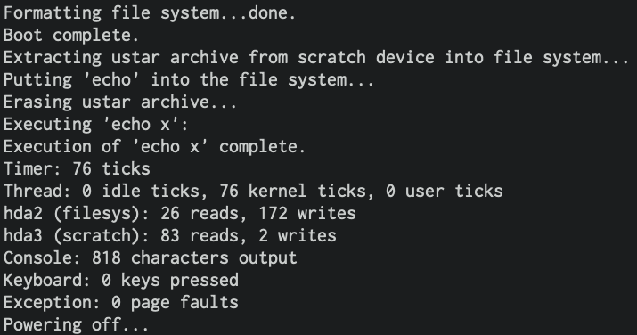
Background
Pintos is a simple OS which can boot, execute an application, and power off.
Run 'echo' application on Pintos first. (Run 'make' in src/examples and src/userprog first)
~/pintos/src/userprog $ pintos --filesys-size=2 -p ../examples/echo -a echo -- -f -q run 'echo x'
Do not miss to type "--" (two hyphens!).
It seems that the 'echo’ program has been run properly, but...

Slide 5
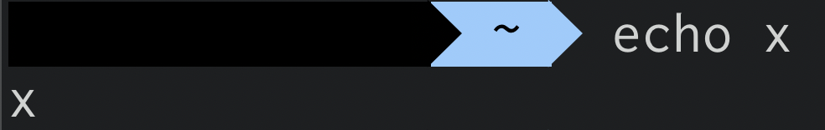
Background
Pintos is a simple OS which can boot, execute an application, and power off.
Run 'echo' application on Pintos first. (Run 'make' in src/examples and src/userprog first)
~/pintos/src/userprog $ pintos --filesys-size=2 -p ../examples/echo -a echo -- -f -q run 'echo x'
Do not miss to type "--" (two hyphens!).
We can not see the result of 'echo x'
because of lack of implementation.
We should be able to see 'x’.

Slide 6
How User Program Works
Consider the previous example more in detail
"--filesys-size=2": Make simulated Pintos disk which consists of 2MB
"-p ../examples/echo -a echo": Copy '../examples/echo' into the simulated disk and change the name from '../examples/echo' to 'echo'
"--" between echo and -f: Separate pintos' options and kernel arguments
"-f": Pintos formats the simulated disk.
"-q": Pintos will be terminated after execution of 'echo’.
"run 'echo x'": Pintos will execute 'echo' with argument 'x’.
~/pintos/src/userprog $ pintos --filesys-size=2 -p ../examples/echo -a echo -- -f -q run 'echo x'

Slide 7
Background
Why can't we see the result of 'echo' command?
It is because, in current Pintos, system call, system call handler, argument passing, and user stack have not been implemented.
Basically, current Pintos does not implement many OS functionalities, including those above.

Slide 8
How User Program Works
Procedure:
Pintos can load and run regular ELF(Executable & Linkable Format) executables.
To run a user program, we must copy (put) the user program to the simulated file system disk.
User Programs
Pintos
Simulated
Pintos disk
Pintos
QEMU
PUT
Linux (Ubuntu)
QEMU
User program
for Pintos
Ubuntu
Disk
H/W
CSPRO server

Slide 9
How User Program Works
Consider the previous example more in detail
'echo' is the application that writes arguments to the standard output.
Thus, 'echo' needs the I/O functionality provided by system call in the kernel.
And, it also needs user stack implementation which stores arguments and passes them to kernel.
But, Pintos has no implementation for system calls and user stacks.
~/pintos/src/userprog $ pintos --filesys-size=2 -p ../examples/echo -a echo -- -f -q run 'echo x'
That's why we were not able to see the result of 'echo x’.

Slide 10
Background
In this project, students will have to make the Pintos be able to execute user programs properly.
Students should work in the following directories and modify the following files:
 | Files to be modified | Referenced files
src/userprog | process.h / process.c syscall.h / syscall.c | pagedir.h / pagedir.c exception.h / exception.c
src/threads | thread.h / thread.c | synch.h / synch.c vaddr.h
src/devices | - | shutdown.h / shutdown.c input.h / input.c
src/lib | syscall-nr.h user/syscall.h user/syscall.c | -

Slide 11
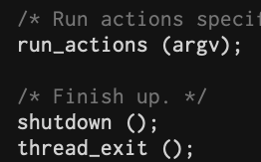
Code Level Flow
$ pintos --filesys-size=2 -p ../examples/echo -a echo -- -f -q run 'echo x'
threads/init.c
int main(){ … syscall_init(); … run_actions(argv); … }
threads/init.c
Static void run_actions(){ … {“run”, 2, run_task} … a->function (argv); }
threads/init.c
void run_task(){ … process_wait(process_execute(task)); ... }
'echo x'
userprog/process.c
tid_t process_execute(){ … thread_create(…, start_process, …); … }
userprog/process.c
static void start_process(){ … load(filename); …. }
userprog/process.c
bool load(filename, ){ … TODO: parse file name filesys_open(…); … setup_stack(esp); TODO: construct stack }
※ Go to 'Argument Passing'

Slide 12
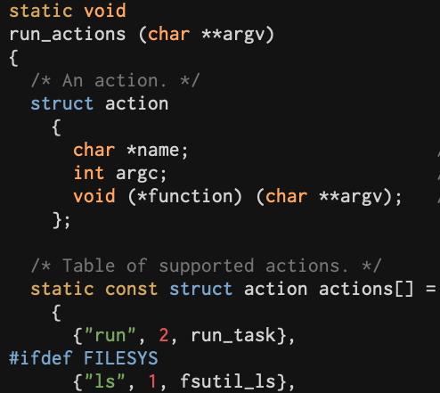
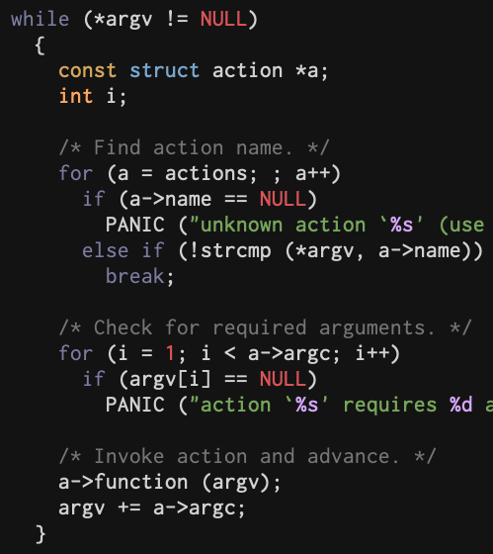
Code Level Flow
$ pintos --filesys-size=2 -p ../examples/echo -a echo -- -f -q run 'echo x'
threads/init.c
int main(){ … syscall_init(); … run_actions(argv); … }
threads/init.c
Static void run_actions(){ … {“run”, 2, run_task} … a->function (argv); }
threads/init.c
void run_task(){ … process_wait(process_execute(task)); ... }
'echo x'
userprog/process.c
tid_t process_execute(){ … thread_create(…, start_process, …); … }
userprog/process.c
static void start_process(){ … load(filename); …. }
userprog/process.c
bool load(filename, ){ … TODO: parse file name filesys_open(…); … setup_stack(esp); TODO: construct stack }
※ Go to 'Argument Passing'

Slide 13
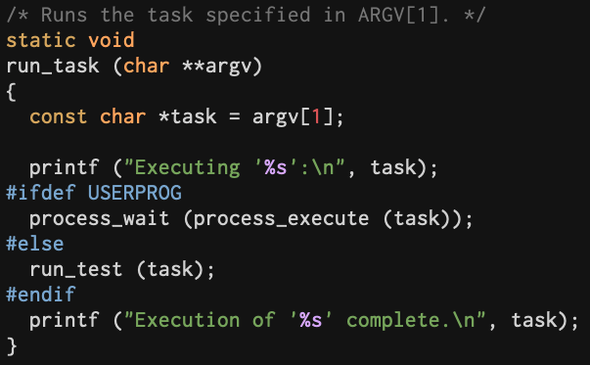
Code Level Flow
$ pintos --filesys-size=2 -p ../examples/echo -a echo -- -f -q run 'echo x'
threads/init.c
int main(){ … syscall_init(); … run_actions(argv); … }
threads/init.c
Static void run_actions(){ … {“run”, 2, run_task} … a->function (argv); }
threads/init.c
void run_task(){ … process_wait(process_execute(task)); ... }
'echo x'
userprog/process.c
tid_t process_execute(){ … thread_create(…, start_process, …); … }
userprog/process.c
static void start_process(){ … load(filename); …. }
userprog/process.c
bool load(filename, ){ … TODO: parse file name filesys_open(…); … setup_stack(esp); TODO: construct stack }
※ Go to 'Argument Passing'

Slide 14
Code Level Flow
$ pintos --filesys-size=2 -p ../examples/echo -a echo -- -f -q run 'echo x'
threads/init.c
int main(){ … syscall_init(); … run_actions(argv); … }
threads/init.c
Static void run_actions(){ … {“run”, 2, run_task} … a->function (argv); }
threads/init.c
void run_task(){ … process_wait(process_execute(task)); ... }
'echo x'
userprog/process.c
tid_t process_execute(){ … thread_create(…, start_process, …); … }
userprog/process.c
static void start_process(){ … load(filename); …. }
userprog/process.c
bool load(filename, ){ … TODO: parse file name filesys_open(…); … setup_stack(esp); TODO: construct stack }
※ Go to 'Argument Passing'

Slide 15
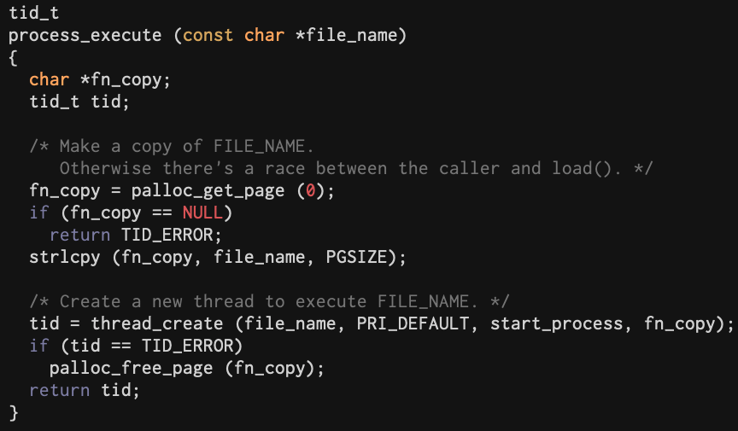
Code Level Flow
$ pintos --filesys-size=2 -p ../examples/echo -a echo -- -f -q run 'echo x'
threads/init.c
int main(){ … syscall_init(); … run_actions(argv); … }
threads/init.c
Static void run_actions(){ … {“run”, 2, run_task} … a->function (argv); }
threads/init.c
void run_task(){ … process_wait(process_execute(task)); ... }
'echo x'
userprog/process.c
tid_t process_execute(){ … thread_create(…, start_process, …); … }
userprog/process.c
static void start_process(){ … load(filename); …. }
userprog/process.c
bool load(filename, ){ … TODO: parse file name filesys_open(…); … setup_stack(esp); TODO: construct stack }
※ Go to 'Argument Passing'

Slide 16
Code Level Flow
$ pintos --filesys-size=2 -p ../examples/echo -a echo -- -f -q run 'echo x'
threads/init.c
int main(){ … syscall_init(); … run_actions(argv); … }
threads/init.c
Static void run_action(){ … {“run”, 2, run_task} … }
threads/init.c
void run_task(){ … process_wait(process_execute(task)); ... }
Options for pintos utility '-' for single character option '--' for multiple characters option (You can read option executing 'pintos --help')
Separator between pintos options and Pintos kernel arguments
userprog/process.c
tid_t process_execute(){ … thread_create(…, start_process, …); … }
userprog/process.c
static void start_process(){ … load(filename); …. }
userprog/process.c
bool load(filename, ){ … TODO: parse file name filesys_open(…); … setup_stack(esp); TODO: construct stack }

Slide 17
Code Level Flow
$ pintos --filesys-size=2 -p ../examples/echo -a echo -- -f -q run 'echo x'
threads/init.c
int main(){ … syscall_init(); … run_actions(argv); … }
threads/init.c
Static void run_action(){ … {“run”, 2, run_task} … }
threads/init.c
void run_task(){ … process_wait(process_execute(task)); ... }
“echo” , “x”
“x”
“echo”
<word align>
NULL
&“x”
&“echo”
&argv
2
0
userprog/process.c
tid_t process_execute(){ … thread_create(…, start_process, …); … }
userprog/process.c
static void start_process(){ … load(filename); …. }
userprog/process.c
bool load(filename, ){ … TODO: parse file name filesys_open(…); … setup_stack(esp); TODO: construct stack }
Setup user stack based on 80x86 calling convention

Slide 18
Virtual Memory
Pintos divides memory into two region, user memory and kernel memory.
If we use these memory areas directly, it's hard to manage memory.
For example,
① each process can damage each other.
② the process can corrupt kernel code that is critical to running the operating system.
app1
app1
app1
app1
①
②
app2
app2
app2
app2
kernel
kernel
kernel
kernel

Slide 19
Virtual Memory
To prevent these problems, operating systems adopt virtual memory system.
Because of virtual memory, each process can have its own memory area and use it as if the process occupies the whole memory.
Pintos also manages memory regions by virtual memory.
Virtual memory is also divided into two regions: user virtual memory and kernel virtual memory.

Slide 20
Virtual Memory: Launch Application
Physical Memory
↑ User
1 GB
↓ Kernel
0 GB

Slide 21
Virtual Memory: Launch Application
Virtual Memory
App1
Physical Memory
4 GB
pgd
Kernel virtual memory is global.
page
directory
for App1
Kernel ↑
PHYS_BASE
3 GB
User ↓
↑ User
1 GB
↓ Kernel
pgd
0 GB
0 GB

Slide 22
Virtual Memory: Launch Application
Virtual Memory
App1
Physical Memory
Virtual Memory
App2
4 GB
pgd
4 GB
pgd
Kernel virtual memory is global.
page
directory
for App1
page
directory
for App2
Kernel ↑
PHYS_BASE
3 GB
3 GB
User ↓
↑ User
1 GB
pgd
↓ Kernel
pgd
0 GB
0 GB
0 GB

Slide 23
Virtual Memory in Pintos
Each process has its own user virtual memory.
Pintos allocates 1 GB to kernel as global memory. (PHYS_BASE (3 GB) ~ 4 GB in virtual memory)
Memory unit is a page in Pintos, which is size of 4 KB.
User program can access physical memory by translating virtual address via page directory and page table. (Refer to A.7 'Page Table')

Slide 24
Virtual Memory
Functions for page
threads/vaddr.h
is_user_vaddr(), is_kernel_vaddr()
Check that given virtual address is user/kernel virtual address
ptov(), vtop()
Translate physical address to kernel virtual address and vice versa
threads/palloc.c
palloc_get_page()
Get page from user/kernel memory pool
userprog/pagedir.c
pagedir_create()
Create page directory
pagedir_get_page()
Look up the physical address that corresponds to user virtual address in page directory
pagedir_set_page()
Add mapping in page directory from user virtual address to the physical page

Slide 25
System Calls
As we've seen, Pintos divides memory into user virtual memory and kernel virtual memory to protect each process and kernel code.
Along with the concept of virtual memory, OS prevents user program from accessing the kernel memory which contains core functionalities.
Then, how user program uses kernel's functionality?
OS provides system calls to solve this problem.

Slide 26
System Calls
For safety, operating system provides two types of mode, user and kernel mode.
When user program is run in user mode, it can not access memory or disk.
These operations are performed in kernel mode.
OS provides system calls to enter kernel mode.
App1
App2
App3
User Memory Area
System Calls
Process
Scheduling
Memory
Management
File
System
Kernel Memory Area

Slide 27
System Calls
Pintos provides user level interface of system calls in 'lib/user/syscall.c' and skeleton of system call handler in 'userprog/syscall.c’.
Pintos User Programs
Pintos
User Programs
Pintos
User Memory Area
QEMU
System Calls
Pintos
Kernel
Kernel Memory Area
Linux (Ubuntu)
QEMU
H/W
27

Slide 28
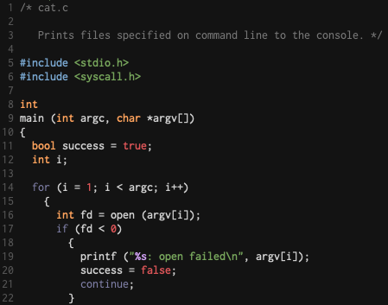
System Calls
Procedure of system call in Pintos
User programs call system call function.
open() system call
* source code: examples/cat.c

Slide 29
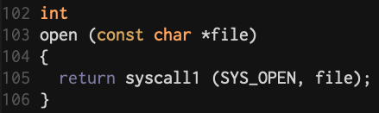
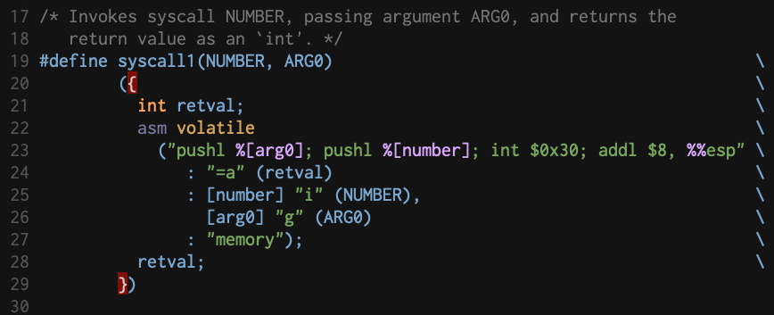
System Calls
Procedure of system call in Pintos
System call number and additional arguments are pushed on caller's stack.
Invoke interrupt for system call by using 'int $0x30' instruction
After returning from system call handler,
restore stack pointer.
User Stack
esp
Arguments
esp
System Call
Number
esp
* source code: lib/user/syscall.c

Slide 30
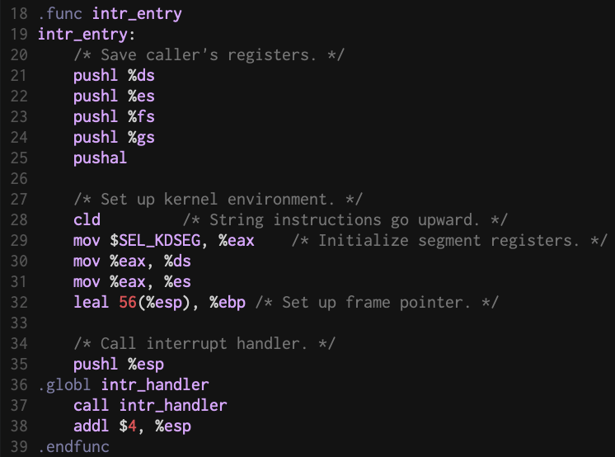
System Calls
Procedure of system call in Pintos
Set the stack for interrupt and call interrupt handler
Call interrupt handler
* source code: threads/intr-stubs.S

Slide 31
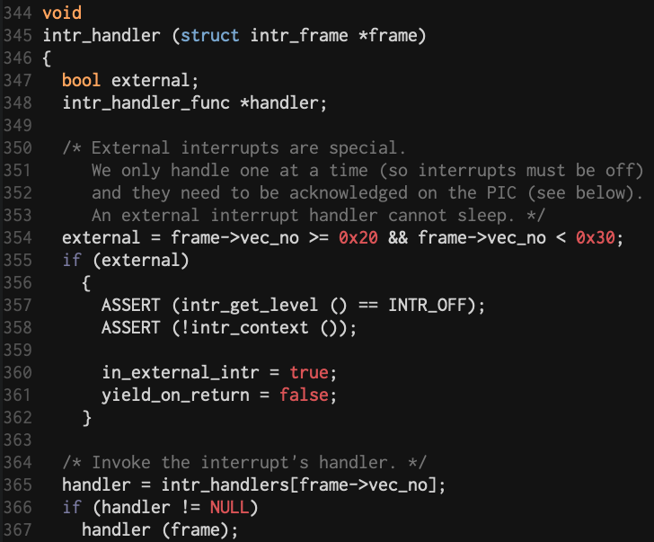
System Calls
Procedure of system call in Pintos
intr_handler() calls system call hander.
Interrupt handler for system call handler has already been registered while Pintos was booting.
※
※ Refer to the following function calls:
1) main() in 'threads/init.c' calls syscall_init() which is in 'userprog/syscall.c'
2) syscall_init() calls intr_register_int() in 'threads/interrupt.c'
* source code: threads/interrupt.c

Slide 32
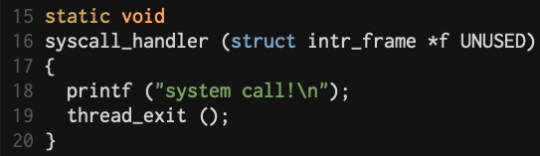
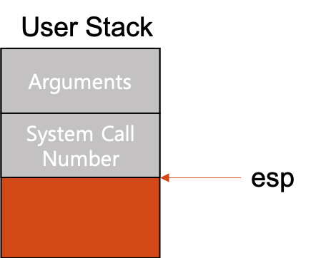
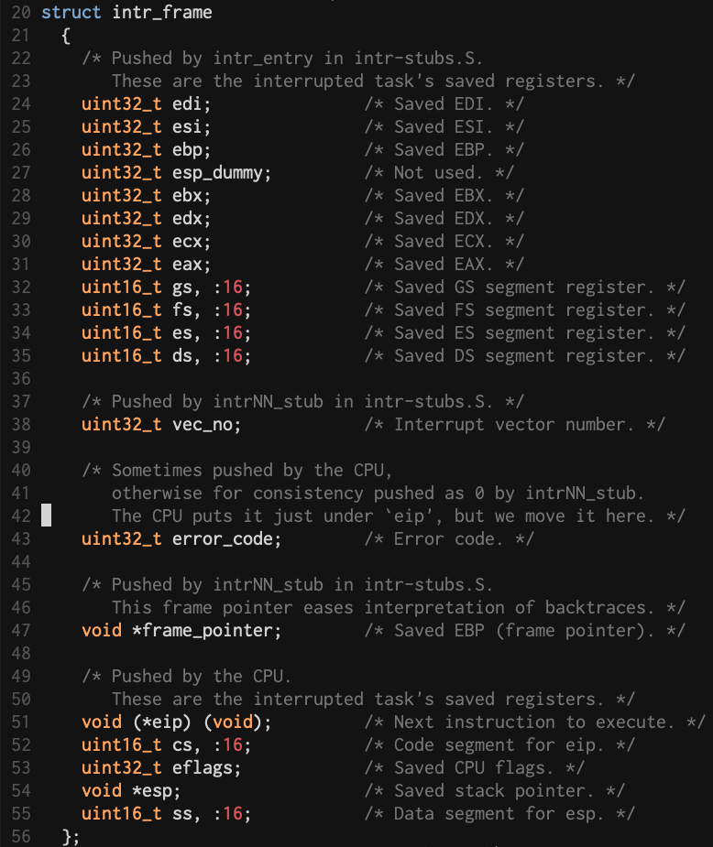
System Calls
Procedure of system call in Pintos
syscall_handler() gets control, and it can access the stack via 'esp' member of the struct intr_frame (in threads/interrupt.h).
80x86 convention stores return value of system call in EAX register so that we can store the return value in 'eax' member of the struct intr_frame.
※ Pintos provides skeleton of system call handler.
We will develop this in this project!
* source code: userprog/syscall.c

Slide 33
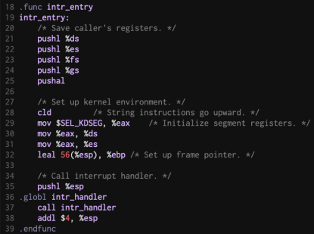
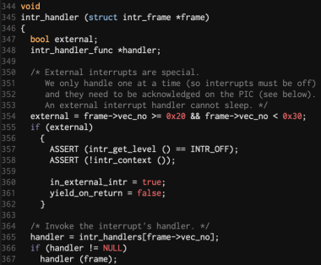
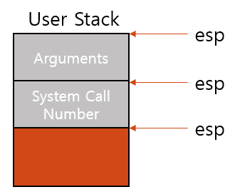

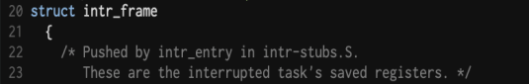
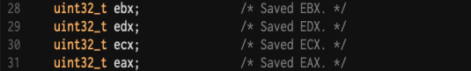

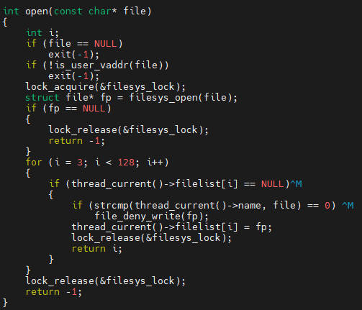
System Calls
user API
open
syscall1(open, file)
intr_handler
syscall_handler
open
kernel API

Slide 34
Requirements

Slide 35
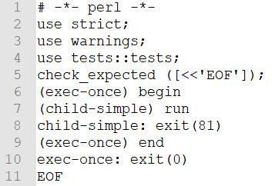
Process Termination Messages
When user program is terminated, kernel prints termination messages. Output form is as follows:
Refer to Pintos manual 3.3.2
Process Name: exit(exit status)\n
Refer to the following functions threads/thread.c: thread_exit() userprog/process.c: process_exit()
<tests/userprog/exec-once.ck>

Slide 36
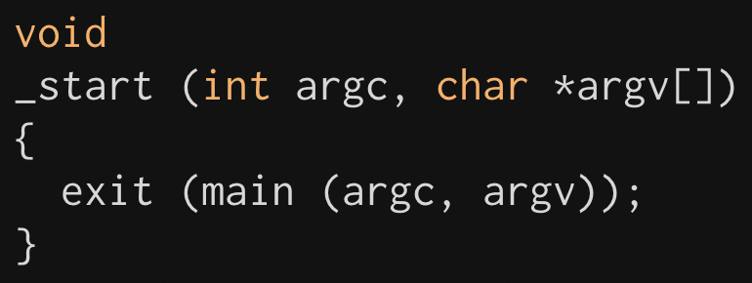
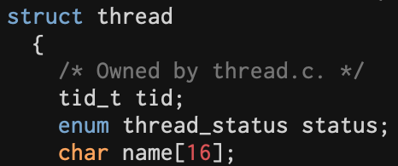
Process Termination Messages
How is user program terminated?
When ELF user program runs, _start() in lib/user/entry.c is called at first.
After executing the program, exit() system call is called.
Pintos only provides exit() system call API, but the exit() system call has not yet been implemented.
How can we get a process name?

Slide 37
Process Termination Messages
How is the user program terminated?
Flow of function calls exit() in lib/user/syscall.c -> syscall1 (SYS_EXIT, status) in lib/user/syscall.c -> syscall_handler() in userprog/syscall.c -> thread_exit() in threads/thread.c -> process_exit() in userprog/process.c Refer to slide pg. 25-29

Slide 38
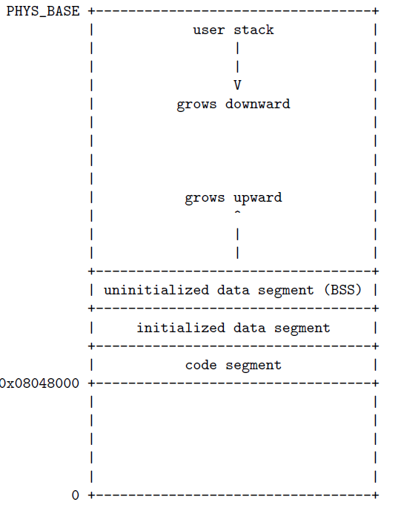

Argument Passing
User program can have multiple arguments.
Parse the arguments and allocate it to memory according to 80x86 calling convention
Refer to the next slides and Pintos manual 3.5
Assume that the length of arguments is less than 4 KB
Test programs use less than 128 Bytes as arguments.
<User virtual memory in Pintos>

Slide 39
Argument Passing
“/bin/ls -l foo bar” will be parsed into “/bin/ls”, “-l”, “foo”, “bar”
You can start implementation of argument passing after the following function.
userprog/process.c : static bool setup_stack(void **esp)
Refer to 'Code Level Flow' in the previous chapter
0xC0000000 (PHYS_BASE)
- 0x00000004
-------------
0xBFFFFFFC

Slide 40
Argument Passing
“/bin/ls -l foo bar” will be parsed into “/bin/ls”, “-l”, “foo”, “bar”
Push arguments at the top of the stack

Slide 41
Argument Passing
“/bin/ls -l foo bar” will be parsed into “/bin/ls”, “-l”, “foo”, “bar”
Push address of each argument
NULL pointer sentinel
(required by C standard)

Slide 42

Argument Passing
“/bin/ls -l foo bar” will be parsed into “/bin/ls”, “-l”, “foo”, “bar”
result of hex_dump() : This function is very useful for debug (in src/lib/stdio.c).
foo\0
bar\0
0xbffffff8
0xbffffffc
Top of the stack

Slide 43
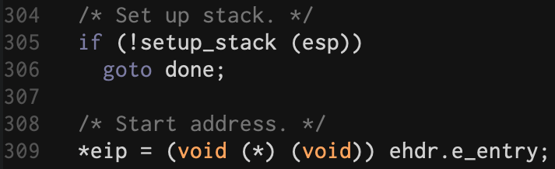
Argument Passing
In userprog/process.c, there is setup_stack() which allocates a minimal stack page (4KB).
Since the given code only allocates stack page, we need to make up the stack after setup_stack().
Make up the stack referring to "3.5 80x86 Calling Convention" in Pintos manual
Write codes here!

Slide 44
System Calls
Students will have to implement the following system calls (Requirements of each system call are described in Pintos manual 3.3.4.)
halt, exit, exec, wait, read(stdin), write(stdout) (※ Pintos exec is different from UNIX exec()
Two new system calls (fibonacci, max_of_four_int)
read and write are special case in this project.
System calls related with file system don't need to implement in this project.
create, remove, open, filesize, read, write, seek, tell, close
But, read and write should perform standard input/output at least.

Slide 45
System Calls: General System Calls
halt()
Terminate Pintos by calling shutdown_power_off()
exit()
Terminate the current user program, returning status to the kernel

Slide 46
System Calls: General System Calls
exec()
Create child process
Refer to process_execute() in userprog/process.c
wait()
What wait() system call should do is wait child process until it finishes its work.
Check that child thread ID is valid
Get the exit status from child thread when the child thread is dead
To prevent termination of process before return from wait(), you can use busy waiting technique* or thread_yield() in threads/thread.c.
* Busy waiting means the codes do nothing and just keep checking condition over and over

Slide 47
System Calls: General System Calls
write() and read()
Not full implementation, but at least read from STDIN, write to STDOUT.
File Descriptor of STDIN, STDOUT
STDIN = 0, STDOUT = 1
Use the following function to implement read(0)
pintos/src/devices/input.c: uint8_t input_getc(void)
Use the following function to implement write(1)
pintos/src/lib/kernel/console.c: void putbuf(…)

Slide 48
System Calls: Code Level Flow
When ELF executable (user program) is finished, exit() system call is called.
After exit() system call, it returns to process_wait().
* lib/user/entry.c

Slide 49
System Calls: Source Codes
lib/user/syscall.h and lib/user/syscall.c
APIs for system calls are already given in Pintos code.
You don't have to add something for system call APIs.
userprog/syscall.h
There is only one prototype syscall_init() which registers system call interrupts when Pintos was booted.
You can write prototype of system calls in this file.
userprog/syscall.c
You must make syscall_handler() handle system calls.
If you have done argument passing, you can get system call number from intr_frame *f.
esp member of intr_frame *f points to system call number. (You can refer to lib/syscall-nr.h to check each system call number)
And then you can use switch statement to classify system calls. (What really these system calls do would be written here.)

Slide 50
Additional System Calls
Implement new system calls into Pintos
int fibonacci(int n)
Return N th value of Fibonacci sequence
int max_of_four_int(int a, int b, int c, int d)
Return the maximum of a, b, c and d
※ Use 'fibonacci' and 'max_of_four_int' as the name of new system calls.
Don't use other name to implement new system calls above.

Slide 51
Additional System Calls
Write user level program which uses new system calls
Make additional.c in pintos/src/examples
Write simple example by using new system calls
Name of execution file should be 'additional'
Usage : ./additional [num 1] [num 2] [num 3] [num 4] Function : Print the result of 'fibonacci' system call using [num 1] as parameter Print the result of 'max_of_four_int' system call using [num 1, 2, 3, 4] as parameter Example :
Run the following command to check your program works properly.
$ ./additional 10 20 62 40
55 62
pintos/src/userprog$ pintos --filesys-size=2 -p ../examples/additional -a additional -- -f -q run 'additional 10 20 62 40'
'additional' should be run on Pintos, not CSPRO server.

Slide 52
Additional System Calls
To compile newly added user program, "additional", you need to modify Makefile in src/examples.
Refer to how other user programs are written in Makefile

Slide 53
Additional System Calls: Source Codes
lib/user/syscall.h
Write prototype of 2 new system call APIs
lib/user/syscall.c
Define new syscall4() function for max_of_four_int() (lib/user/syscall.c)
Define fibonacci() and max_of_four_int() system calls APIs
lib/syscall-nr.h
Add system call numbers for 2 new system calls
userprog/syscall.h
Write prototype of 2 new system calls
userprog/syscall.c
Define fibonacci() and max_of_four_int() system calls
What really these system calls do would be written here.

Slide 54
Accessing User Memory
User program can pass an invalid pointer.
NULL pointer such as open (NULL); in tests/userprog/open-null.c
Unmapped virtual memory
Pointer to kernel address space
Invalid pointers must be rejected without harm to kernel or other running process.
It can be implemented in 2 ways:
Verify the validity of a user-provided pointer, then dereference it.
Check only that a user pointer points below PHYS_BASE, then dereference it. If the pointer is invalid, it will cause a “page fault”. You can handle it by modifying the code page_fault() in ‘userprog/exception.c’
Refer to Pintos manual 3.1.5

Slide 55
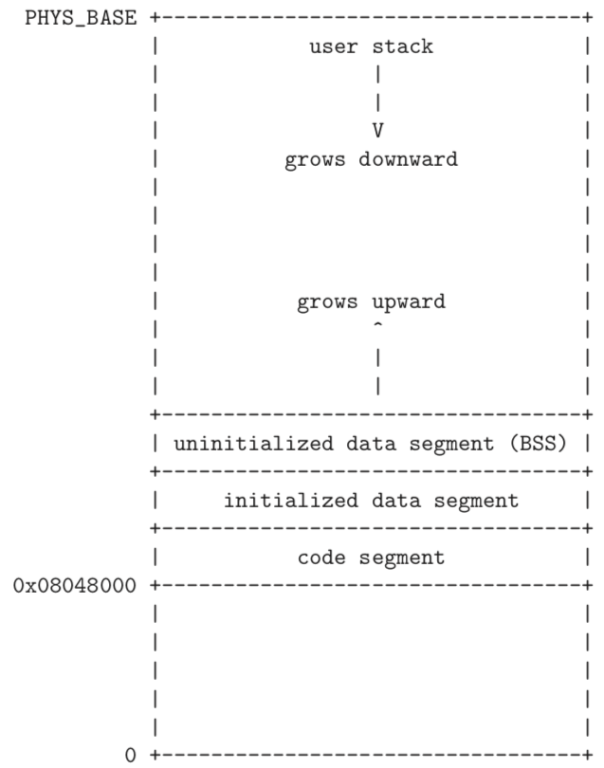
Accessing User Memory
0xc0000000 (3 GB)
Refer to Pintos manual 3.1.4
Mapped User Virtual Memory
Unmapped User Virtual Memory

Slide 56
Accessing User Memory
To verify the validity of a user-provided pointer, you can use functions in userprog/pagedir.c and threads/vaddr.h.
Check Unmapped virtual memory using pagedir_get_page()
Check pointer to kernel address space using is_user_vaddr() and is_kernel_vaddr()
Use these functions to verify the validity of given pointer

Slide 57
Suggested Order of Implementation
Refer to Pintos manual 3.2
You can not see the result until you implement core functionalities.
Students are highly encouraged to read/understand these slides and Pintos manual first, design the structures and then start to implement.
Argument Passing: After implementing it, check the result using hex_dump().
User Memory Access: Protect user memory accesses from system calls.
System Call Handler: Implement syscall_handler() to handle system call.
System Call Implementation: Implement exec(), exit(), write(), read() first, and then others.
Additional Implementation: Implement fibonacci(), max_of_four_int().
※ Refer to source codes in src/tests/userprog

Slide 58
Suggested Order of Implementation
Refer to Pintos manual 3.2
You can not see the result until you implement core functionalities.
Students are highly encouraged to read/understand these slides and Pintos manual first, design the structures and then start to implement.
Argument Passing: After implementing it, check the result using hex_dump()
User Memory Access: Make a plan for protecting user memory accesses from system calls
System Call Handler: Implement syscall_handler() to handle system call
System Call Implementation: Implement exec(), exit(), write(), read() first
Additional Implementation: Implement fibonacci(), max_of_four_int()
Refer to Code Level Flow src/userprog/process.c : load() Check parameters of load() If you want to check the dump values before implementing process_wait(), insert infinite loop in process_wait() to block process (You should finish to implement process_wait() later)
※ Refer to source codes in src/tests/userprog

Slide 59
Suggested Order of Implementation
Refer to Pintos manual 3.2
You can not see the result until you implement core functionalities.
Students are highly encouraged to read/understand these slides and Pintos manual first, design the structures and then start to implement.
Argument Passing: After implementing it, check the result using hex_dump()
User Memory Access: Make a plan for protecting user memory accesses from system calls
System Call Handler: Implement syscall_handler() to handle system call
System Call Implementation: Implement exec(), exit(), write(), read() first
Additional Implementation: Implement fibonacci(), max_of_four_int()
※ Refer to source codes in src/tests/userprog
Refer to src/threads/vaddr.h Recommend to implement the function which checks the validity of given address

Slide 60
Suggested Order of Implementation
Refer to Pintos manual 3.2
You can not see the result until you implement core functionalities.
Students are highly encouraged to read/understand these slides and Pintos manual first, design the structures and then start to implement.
Argument Passing: After implementing it, check the result using hex_dump()
User Memory Access: Make a plan for protecting user memory accesses from system calls
System Call Handler: Implement syscall_handler() to handle system call
System Call Implementation: Implement exec(), exit(), write(), read() first
Additional Implementation: Implement fibonacci(), max_of_four_int()
※ Refer to source codes in src/tests/userprog
src/userprog/syscall.c : syscall_handler() Check argument 'struct intr_frame' of syscall_handler() in syscall.c (struct intr_frame is in src/threads/interrupt.h)

Slide 61
Suggested Order of Implementation
Refer to Pintos manual 3.2
You can not see the result until you implement core functionalities.
Students are highly encouraged to read/understand these slides and Pintos manual first, design the structures and then start to implement.
Argument Passing: After implementing it, check the result using hex_dump()
User Memory Access: Make a plan for protecting user memory accesses from system calls
System Call Handler: Implement syscall_handler() to handle system call
System Call Implementation: Implement exec(), exit(), write(), read() first
Additional Implementation: Implement fibonacci(), max_of_four_int()
※ Refer to source codes in src/tests/userprog
Synchronization will be needed (You can use busy waiting) exit status is -1 when syscall_handler is terminated in abnormal way

Slide 62
Suggested Order of Implementation
Refer to Pintos manual 3.2
You can not see the result until you implement core functionalities.
Students are highly encouraged to read/understand these slides and Pintos manual first, design the structures and then start to implement.
Argument Passing: After implementing it, check the result using hex_dump()
User Memory Access: Make a plan for protecting user memory accesses from system calls
System Call Handler: Implement syscall_handler() to handle system call
System Call Implementation: Implement exec(), exit(), write(), read() first
Additional Implementation: Implement fibonacci(), max_of_four_int()
※ Refer to source codes in src/tests/userprog
Modify the followings: src/lib/syscall-nr.h src/lib/syscall.h src/lib/syscall.c

Slide 63
Evaluation
Refer to Pintos manual 1.2.1
21 of 76 tests in this project will be graded. (Refer to the test case list in the next slide)
Total score is 100 which consists of 80 for test cases and 20 for documentation.
Additional 2.5 points for each additional system call implementation. (5 points for fibonacci() and max_of_four_int() in implementation) ※ It will be calculated in development part (80%), so the total point will be 4 points (5*80%).
Grading script (make grade or make check in src/userprog) provided by Pinots will be used.
Refer to 'grade' and 'results' files in src/userprog/build after grading ('grade' file is only created when you use make grade)

Slide 64
Evaluation
Refer to Pintos manual 1.2.1
Test cases are classified in functionality test and robustness test.
Refer to the followings for checking each test case's point based on the test type
pintos/src/tests/userprog/Rubric.functionality
pintos/src/tests/userprog/Rubric.robustness
Functionality and robustness gets 50% of total score respectively. ☛ We do not follow the score ratio of test types shown in pintos/src/tests/userprog/Grading

Slide 65
Evaluation: Test Cases (21 tests)
Functionality
No. | Name | Point
1 | args-none | 3
2 | args-single | 3
3 | args-multiple | 3
4 | args-many | 3
5 | args-dbl-space | 3
6 | exec-once | 5
7 | exec-multiple | 5
8 | exec-arg | 5
9 | wait-simple | 5
10 | wait-twice | 5
11 | multi-recurse | 15
12 | exit | 5
13 | halt | 3
Total |  | 63
Robustness
No. | Name | Point
1 | exec-bad-ptr | 3
2 | exec-missing | 5
3 | sc-bad-arg | 3
4 | sc-bad-sp | 3
5 | sc-boundary | 5
6 | sc-boundary-2 | 5
7 | wait-bad-pid | 5
8 | wait-killed | 5
Total |  | 34
65

Slide 66
Evaluation
Refer to Pintos manual 1.2.1
If you see src/tests/userprog/Grading, functionality test set takes 35% and robustness test set takes 25% of total score.
But we do not follow this.
Each type of test set takes 50% respectively.
Thus, total score is
$\left(\frac{\text{Functionality} \text{points}}{\text{63}} × \text{5}\text{0}+ \frac{\text{Robustness} \text{points}}{\text{34}} × \text{5}\text{0}\right)$ $/$ 100 $×$ 80
Remaining 20 is for documentation

Slide 67
Documentation
Use the document file uploaded on e-class
Documentation accounts for 20% of total score. (Development 80%, Documentation 20%)

Slide 68
Submission
We provide the script 'submit.sh' to make tar.gz file which contains 'src' directory and document file. 학생들의 편의를 위해 pintos 디렉토리 내 submit.sh 스크립트를 제공합니다. 이 스크립트는 src 디렉토리와 document file을 포함한 tar.gz 파일을 생성합니다.

Slide 69
Submission
It is a individual project.
Due date : 2022. 10. 1 23:59
Submission
The form of submission file is as follows:
No hardcopy.
Copy will get a penalty (1st time: 0 Point and downgrading, 2nd time: F grade)
Name of compressed file | Example (ID: 20189999)
os_prj1_[ID].tar.gz | os_prj1_20189999.tar.gz

Slide 70
Submission
Contents
Pintos source codes (Only 'src' directory in pintos directory) 최소한의 용량을 위해 src 디렉토리만 압축파일에 포함합니다.
Document: [ID].docx (e.g. 20189999.docx; Other format is not allowed such as .hwp)
How to submit
Make tar.gz file.
Copy the document file ([ID].docx) to pintos directory.
Execute submit.sh script in the pintos directory and follow the instructions of the script. pintos 디렉토리 내의 submit.sh 스크립트를 실행하고 스크립트의 지시를 따르십시오.
Check that os_prj1_[ID].tar.gz is created.
Decompress os_prj1_[ID].tar.gz and check the contents in it. ($ tar -zxf os_prj1_[ID].tar.gz) (Only [ID].docx and src directory should be contained in the tar.gz file.)
For example, if your ID is 20189999, os_prj1_20189999.tar.gz should be created. To decompress the tar.gz file, execute tar -zxf os_prj1_20189999.tar.gz
Please check the contents of tar.gz file after creating it.
Upload the os_prj1_[ID].tar.gz file to e-class.
5% of point will be deducted for a wrong form and way to submit.
Late submission is not allowed.

Slide 71
Submission
Notice – ‘submit.sh’
The ‘submit.sh’ script should be executed on a directory where ‘src’ folder is located.
submit.sh 스크립트는 src 폴더가 위치한 디렉토리에서 실행되어야 합니다.
‘ID’ folder should not be in the directory. ('ID' folder will be removed after compressing process.)
해당 디렉토리에 ‘학번’ 폴더가 없어야 합니다. (압축 과정 중 '학번' 폴더를 생성하여 필요한 파일을 넣고 압축한 뒤 '학번' 폴더를 삭제합니다.)
‘ID.docx’ file should be located in the directory.
Also, report file with extensions other than ‘docx’ will not be compressed.
해당 디렉토리에 ‘학번.docx’ 파일이 있어야 함께 압축됩니다.
또한 ‘docx’ 이외의 확장자를 가진 보고서 파일은 압축되지 않습니다.
Be sure to backup your code in case of an unexpected situation.
만일의 경우를 대비해 반드시 코드를 백업하여 주세요.

Slide 72
Submission
Disclaimer
You must check the contents of the tar.gz file before submission.
제출하기 전, tar.gz 파일의 내용물을 반드시 다시 한 번 체크하기 바랍니다.
Any result produced from the 'submit.sh' script is at your own risk.
'submit.sh' 스크립트로 생성된 결과의 모든 책임은 사용자에게 귀속됩니다.

