Slide 1
Project #5: Pintos Filesystem
Operating Systems (CSE4070-01) Project
Fall 2022
Prof. Sungyong Park
TA: Kihyun Kim,
Hamin Hwangbo
Notes:
Class PT

Slide 2
Filesystem
2

Slide 3
Pintos Filesystem (overview)
application & library
User
Kernel
VFS (virtual file system)
Buffer cache
(general file system)
ext4
nova
XFS
F2FS
Device Driver
Hardware
HDD
SSD
…

Slide 4
Pintos Filesystem (on-disk layout)
pintos filesystem : 8MB
sector size : 512B
8MB / 512B = 16,384 sectors
myfile은 8번째 sector부터 시작이고, 사이즈가 1024B(2sectors)이네 !
file.c는 11번째 sector부터 시작이고, 사이즈가 1536B(3sectors)이네 !
myfile inode
file.c inode
root-dir inode
start : 8
length : 1024
…
start : 11
length : 1536
…
start : 6
length : 320
…
sector (512B)
on-disk inode
root-dir
on-disk
inode
bit map
root-dir
entries
7
Data Blocks
8
9
10
11
12
13
0
1
2
3
4
5
6
7 ~ 16,383
bitmap inode
root-dir entries
start : 2
length : 2048
…
filename | inode sector # | …
myfile | 7 | …
file.c | 10 | … …
: data sector (block)
: inode sector (block)
bitmap정보는 2번째 sector부터 시작이고, 사이즈가 2048B(4sectors)이네!
4

Slide 5

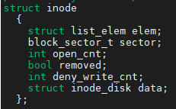
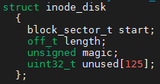
Pintos Filesystem (file structure)
file
inode : in-memory inode pointer
pos : file offset (position)
deny_write : write accessible or not
In-memory inode
sector : block number with inode
data : disk_inode data
remove : file removed or not
On-disk inode
start : start block number of file data
length : size of file (Byte)

Slide 6




Pintos Filesystem (directory & bitmap)
dir structure (in-memory)
inode : directory inode pointer
pos : directory entry offset
bitmap structure
free_map_file : store bitmap at disk in file format
bit_cnt : disk block number of filesystem
dir entry structure (on-disk)
inode_sector : inode’s disk block number
name : MAX length : 14
in_use : dir_entry in use or not

Slide 7
Pintos Filesystem (write code path)
f->eax = write( … )
file_write(*file, buffer, size)
Main Memory
inode_write_at(*file, buffer, size)
HDD
Write the data in user_buffer to disk (buffer cache → evict → disk)
Writes to disk blocks while looping in disk block(512B) units : block_write()
byte_to_sector() : Disk block number to write data to
sector_ofs : Disk block offset to write data to
In the case of partial write, read the target block and store in the bounce buffer

Slide 8
Pintos Filesystem (baseline) : 현재 pintos의 한계점
external fragmentation : N-block file cannot be allocated even though N-blocks are free.
Each inode is stored in 1-disk sector, limiting the number of block pointers that is can contain
eleminate this problem by modifying on-disk inode structure ( using direct, indirect, doubly indirect blocks and bitmap )
Use doubly-indirect block
The filesize is specified when the file is created
Implement file growth
Indexed inode make file growth possible whenever free space is available
No subdirectories
All files live in a single directory (root dir).
Make this to allow directory entries to point to files or to other directories.
14 char name : Directory, File의 이름은 14글자로 지정 (늘리는 것은 optional!!)
Dir, File자체의 name length는 14미만이지만, full path에 대해서는 처리를 해줘야 한다. Example : /home/myname/pintos/src/filesys/file.c (14보다 길이가 길다.)

Slide 9
Pintos Filesystem (working area)
filesystem translates these calls(creat, open, close, read, write, … ) into disk operations.
8MB filesystem
Working in pintor/src/filesys directory
fsutil.c : simple utilities for the file system that are accessible from the kernel command
filesys.c/h : top level interface to the file system
directory.c/h : translates file names to inodes. (directory structure is stored as a file)
inode.c/h : manage the data structure representing the file’s on-disk layout
free-map.c/h : mapping disk sector with bitmap (use lib/kernel/bitmap.c/h functions)
cache.c/h : we need to make source code file by our own and implement on it.
Notes:
본문

Slide 10
Extensible Files (External Fragmentation)
When inode_create or write/read, follow the existing fragmentation
To solve the problem, we need to make each data block accessible from the inode.
Modify the on-disk inode structure (direct, indirect, doubly indirect index structure)
Any design that does not suffer from external fragmentation is possible.
Indexed inodes allow files to grow whenever free space is available. (file growth)
7
8
9
14
on-disk inode
root-dir
on-disk
inode
bit map
root-dir
entries
Data Blocks
10
11
12
13
15
16
17
18
free space
ino
#1
#2
#3

Slide 11
Extensible Files (External Fragmentation)
When inode_create or write/read, follow the existing fragmentation
To solve the problem, we need to make each data block accessible from the inode.
Modify the on-disk inode structure (direct, indirect, doubly indirect index structure)
Any design that does not suffer from external fragmentation is possible.
Indexed inodes allow files to grow whenever free space is available. (file growth)
7
8
9
14
on-disk inode
root-dir
on-disk
inode
bit map
root-dir
entries
ino
#1
#2
#3
Data Blocks
10
11
12
13
15
16
17
18
free space

Slide 12
Subdirectory
Pintos filesystem baseline only have root directory and all files are under root directory
Modify the directory entry to point to a file or other directory.
The default file system has a 14-character limit on file names. (optional extend or not)
The full path filename must be much longer than 14 characters. (ex. /home/cse20201234/pintos/src/…)
Update existing system calls to use absolute or relative pathnames ( consider /, ., .. )
A directory can only be deleted if it contains no files or subdirectories (except '.' and '..’).
If you open a file, you must close it properly. (open_cnt = 0 → write back to disk)
check the function inode_open() or inode_reopen()
A directory can also be opened. Open directories must not be removed.
persistency
Even after booting again after termination, data should be well recorded.

Slide 13
Subdirectory (Syscall API)
(src/filesys/directory.c, directory.h 참고)
open : update the open syscall to open directories in addition
remove : update the remove syscall to delete empty directories in addition
bool chdir (const char *dir) : change the current working directory of the process to dir(param). (relative or absolute path)
bool mkdir (const char *dir) : create the directory name “dir” (relative or absolute path)
bool readdir (int fd, char *name) : read a directory entry from file descriptor fd, which must represent a directory
bool isdir (int fd) : return true if fd represent a directory, false if it represent an file.
bool inumber (int fd) : return the inode number of the inode associated with fd.
You can figure out more detail in Pintos Manual p53.

Slide 14
Synchronization (Protect Critical Section)
Critical Section
N Processes all competing to access to same file.
Each Process has a code segment, called critical section, in which the shared data is accessed
Problem: Ensure that when one process is modifying the specific file, no other process can access this file (critical section)
Using test case of Pintos, check code segment that should be considered as critical section
Protect this code segment using synchronization APIs.
ex) syn-read, syn-write
ex) lock, semaphore

Slide 15

Synchronization (Critical Section Example)
thread 1
thread 2
User
read
write
Kernel
Need synchronization
syscall_handler
read
write
file_read
file_write
/foo.txt
Notes:
file_write should not be performed.

Slide 16
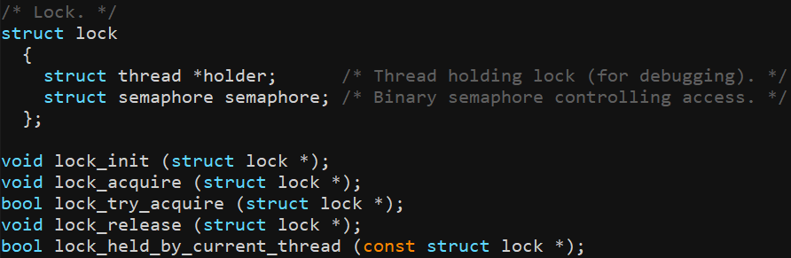
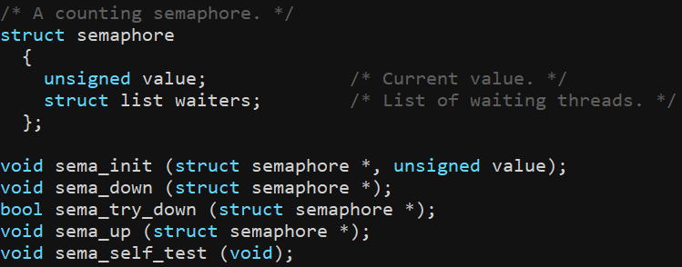
Synchronization APIs (See also p.67-68)
Lock
Semaphore

Slide 17
Suggested Order of Implementation
Extensible files : Handling with file growth test (growth in length .etc)
Subdirectories : multi level of directories
Synchoronization : Handling lock issues as usual
Buffer cache : Implement the buffer cache and integrate it into the existing filesystem.
Rest of test : Remainng mescellaneous items

Slide 18
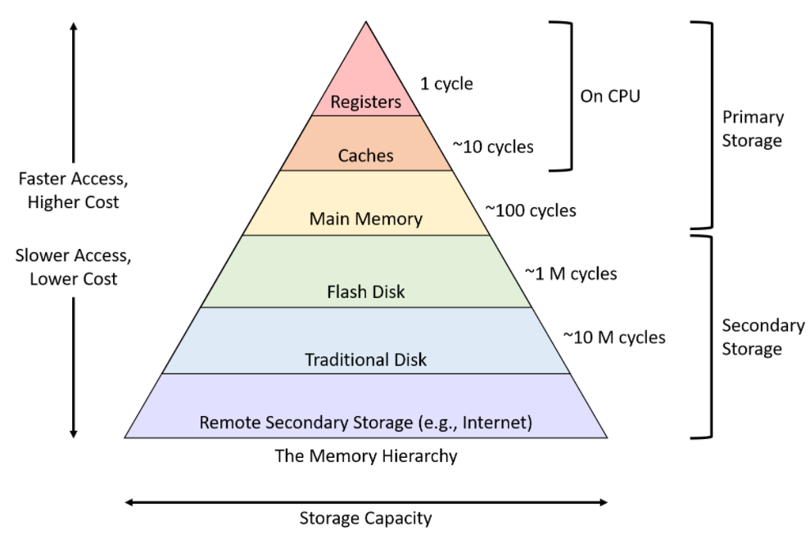
Buffer Cache

Slide 19
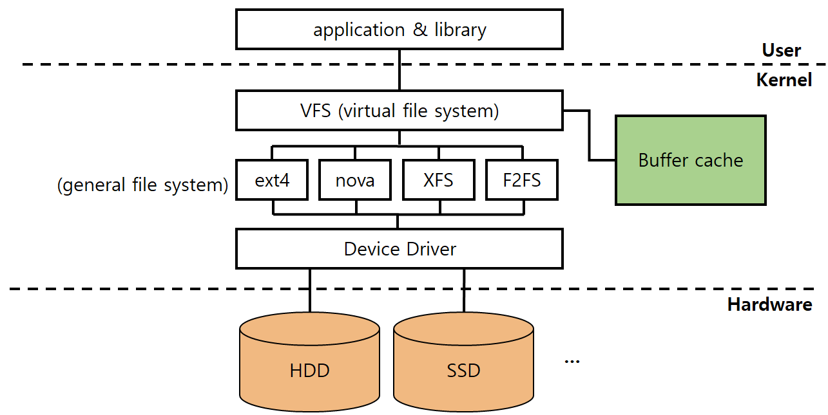
Buffer Cache
Reading from and writing to disk every IO is inefficient.
When a request is made to read or write a block, check to see if it is in the buffer cache.
If it is in cache, use the cached data without going to disk.
Otherwise fetch the block from disk into the cache
Use eviction algorithm : LRU, clock algorithm
cache size : 64 sector size (sector size is 512B, cache size is 512B * 64 = 32KB)
recommendation : integrating the cache into your design early.
page cache vs. buffer cache
https://naeti.tistory.com/91 (detail)
https://dhkoo.github.io/2019/03/08/cache/ (simple)

Slide 20
Buffer Cache
“When to evict the data from buffer cache?”
No free space in buffer cache
umount or os terminated
20

Slide 21
no free buffer
EVICT!!
Buffer Cache
“When to evict the data from buffer cache?”
No free space in buffer cache
umount or os terminated
buffer_cache_entry
disk
data
write request
…
free space buffer
: used
: free space
21

Slide 22
Buffer Cache
“When to evict the data from buffer cache?”
No free space in buffer cache
umount or os terminated
buffer_cache_entry
disk
data
write request
: used
: free space
22

Slide 23
Buffer Cache
“When to evict the data from buffer cache?”
No free space in buffer cache
umount or os terminated
buffer_cache_entry
disk
data
write request
: used
: free space
23

Slide 24
Buffer Cache
“When to evict the data from buffer cache?”
No free space in buffer cache
umount or os terminated
buffer_cache_entry
data (cached)
disk
: used
: free space
24

Slide 25

Buffer Cache
“When to evict the data from buffer cache?”
No free space in buffer cache
umount or os terminated
We are not persistent yet!
???
“filesystem umount or terminated”
buffer_cache_entry
disk
25

Slide 26
Buffer Cache
“When to evict the data from buffer cache?”
No free space in buffer cache
umount or os terminated
We are not persistent yet!
???
“filesystem umount or terminated”
buffer_cache_entry
disk
“flush”
26

Slide 27
Buffer Cache
“When to evict the data from buffer cache?”
No free space in buffer cache
umount or os terminated
Now we are persistent!
“filesystem umount or terminated”
disk
27

Slide 28
Buffer Cache
file to be modified
pintos/src/filesys/inode.c
files to be created
pintos/src/filesys/cache.h (you can choose code file name, cache.h, buffer_cache.h ~)
pintos/src/filesys/cache.c
data structure
Maximum 64 blocks (64 * 512B = 32KB)
functions
cache search
select victim (LRU, clock algorithm)
flush
write behind
When the filesystem is terminated, all dirty blocks should be flushed to the disk
When victim entry is selected, dirty block should be flushed to the disk

Slide 29
Buffer Cache (pintos/src/filesys/buffer_cache.c)
struct buffer_cache_entry{ bool valid_bit; bool reference_bit; // for clock algorithm bool dirty_bit; block_sector_t disk_sector; uint8_t buffer[BLOCK_SECTOR_SIZE]; //512 * 1B } #define NUM_CACHE 64 static struct buffer_cache_entry cache[NUM_CACHE] static struct lock buffer_cache_lock …
cache
buffer_cache_entry
buffer_cache_entry
buffer_cache_entry
disk
buffer_cache_entry
flushing
64 entries
buffer_cache_entry
caching
…
buffer_cache_entry
buffer_cache_entry
LRU, clock algorithm reference : https://yoon1fe.tistory.com/114

Slide 30
Buffer Cache (function example → src/filesys/buffer_cache.h)
void buffer_cache_init ();
void buffer_cache_terminate ();
void buffer_cache_read (block_sector_t, … );
void buffer_cache_write (block_sector_t, … );
struct buffer_cache_entry *buffer_cache_lookup (block_sector_t);
struct buffer_cache_entry *buffer_cache_select_victim ();
void buffer_cache_flush_entry(struct buffer_cache_entry*);
void buffer_cache_flush_all();

Slide 31
Evaluation and Submission

Slide 32
Evaluation
35 tests for project 5 will be graded.
Total score is 100 which consists of 80 for test cases and 20 for documentation
Grading script provided by Pintos will be used.
make grade or make check in src/filesys
Refer to “grade” and “results” files in src/filesys/build after grading
“grade” file is only created when you use make grade
Test cases are classified in extend file system (filesys extend)

Slide 33
Evaluation: Test Cases (35 tests)
filesys/extend
No. | Name | Point
1 | dir-empty-name | 3
2 | dir-mk-tree | 3
3 | dir-mkdir | 3
4 | dir-open | 3
5 | dir-over-file | 3
6 | dir-rm-cwd | 3
7 | dir-rm-parent | 3
8 | dir-rm-root | 3
9 | dir-rm-tree | 3
10 | dir-rmdir | 3
11 | dir-under-file | 3
12 | dir-vine | 3
filesys/extend
No. | Name | Point
13 | grow-create | 3
14 | gow-dir-lg | 3
15 | grow-file-size | 3
16 | grow-root-lg | 3
17 | grow-root-sm | 3
18 | grow-seq-lg | 3
19 | grow-seq-sm | 3
20 | grow-sparse | 3
21 | grow-tell | 3
22 | grow-two-files | 3
23 | syn-rw | 3
24 | dir-empty-name-persistence | 3
filesys/extend
No. | Name | Point
25 | dir-mk-tree-persistence | 3
26 | dir-mkdir-persistence | 3
27 | dir-open-persistence | 3
28 | dir-over-file-persistence | 3
29 | dir-rm-cwd-persistence | 3
30 | dir-rm-parent-persistence | 3
31 | dir-rm-root-persistence | 3
32 | dir-rm-tree-ersistence | 3
33 | dir-rmdir-persistence | 3
34 | dir-under-file-persistence | 3
35 | dir-vine-persistence | 3

Slide 34
Evaluation
Total score: filesys(extend) score / 105 x 80 (max score of filesys(extend) : 3 x 35 = 105)
Documentation
Use the document file uploaded on e-class.
Documentation accounts for 20% of total score. (Development 80%, Documentation 20%)

Slide 35
Submission
Make 'ID' directory and copy 'src' directory in the pintos directory and the document file ([ID].docx).
Compress 'ID' directory to 'os_prj5_[ID].tar.gz'.
We provide the script 'submit.sh' to make tar.gz file which contains 'src' directory and document file. 학생들의 편의를 위해 pintos 디렉토리 내 submit.sh 스크립트를 제공합니다. 이 스크립트는 src 디렉토리와 document file을 포함한 tar.gz 파일을 생성합니다.
Disclaimer
Any result produced from the 'submit.sh' script is at your own risk.
You must check the contents of the tar.gz file before submission.
'submit.sh' 스크립트로 생성된 결과의 모든 책임은 사용자에게 귀속됩니다.
제출하기 전, tar.gz 파일의 내용물을 반드시 다시 한 번 체크하기 바랍니다.

Slide 36
Submission
Notice – ‘submit.sh’
The ‘submit.sh’ script should be executed on a directory where ‘src’ folder is located.
submit.sh 스크립트는 src 폴더가 위치한 디렉토리에서 실행되어야 합니다.
‘ID’ folder should not be in the directory.
해당 디렉토리에 ‘학번’ 폴더가 없어야 합니다.
‘ID.docx’ file should be located in the directory.
Also, report file with extensions other than ‘docx’ will not be compressed.
해당 디렉토리에 ‘학번.docx’ 파일이 있어야 함께 압축됩니다.
또한 ‘docx’ 이외의 확장자를 가진 보고서 파일은 압축되지 않습니다.
Be sure to backup your code in case of an unexpected situation.
만일의 경우를 대비해 반드시 코드를 백업하여 주세요.

Slide 37
Submission
It is a personal project.
Due date : 2022 12. 26 23:59
Submission
The form of submission file is as follows:
No hardcopy.
Copy will get a penalty (1st time: 0 Point and downgrading, 2nd time: F grade)
Name of compressed file | Example (ID: 20189999)
os_prj5_[ID].tar.gz | os_prj5_20189999.tar.gz

Slide 38
Submission
Contents
Pintos source codes (Only 'src' directory in pintos directory) 최소한의 용량을 위해 src 디렉토리만 압축파일에 포함합니다.
Document: [ID].docx (e.g. 20189999.docx; Other format is not allowed such as .hwp)
How to submit
Make tar.gz file.
Copy the document file ([ID].docx) to pintos directory.
Execute submit.sh script in the pintos directory and follow the instructions of the script. pintos 디렉토리 내의 submit.sh 스크립트를 실행하고 스크립트의 지시를 따르십시오.
Check that os_prj5_[ID].tar.gz is created.
Decompress os_prj5_[ID].tar.gz and check the contents in it. ($ tar -zxf os_prj5_[ID].tar.gz) (Only [ID].docx and src directory should be contained in the tar.gz file.)
For example, if your ID is 20189999, os_prj5_20189999.tar.gz should be created. To decompress the tar.gz file, execute tar -zxf os_prj5_20189999.tar.gz
Please check the contents of tar.gz file after creating it.
Upload the os_prj5_[ID].tar.gz file to e-class.
5% of point will be deducted for a wrong form and way to submit.

