Slide 1
Power Reduction Technique for Smartphones

Slide 2
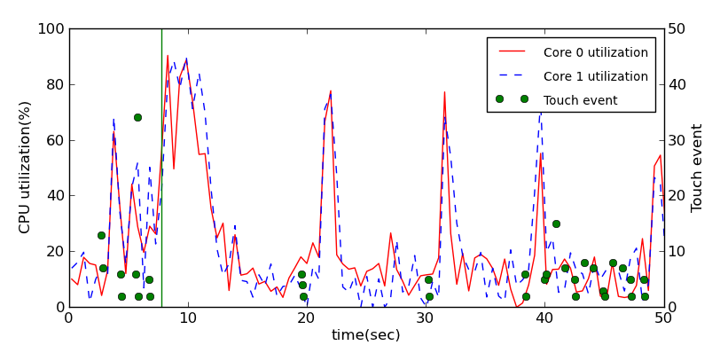
Motivation
Users are new workload in mobile system
Different from traditional CPU/Memory bound workloads

Slide 3
Background
Power consumption breakdown in the Smartphone
Hard to reduce the power consumption of both display and communication module
※A. Carroll and G. Heiser, “An Analysis of Power Consumption in a Smartphone” USENIX ATC 2010

Slide 4
Power management technique
CPU & GPU
Active Power
DVFS (P-state)
HotPlugging
Idle Power
CPU Idle state level control (C-state)
Tickless kernel
Display
Refresh rate switching
Brightness control
Smart display off
Power_{Total} = Power_{dynamic} + Power_{static}
= α•C•V²•f + V•I_{leak}

Slide 5
CPU power management technique

Slide 6
Dynamic Voltage Frequency Scaling (DVFS)
Adjust voltage and frequency
according to the performance request
Implementation
Driver
CPU specific implementation code by each vendor
Common interface
Governor
DVFS managing scheme
Commonly used by entire linux system such as Server, mobile etc

Slide 7
DVFS governor
Performance
Powersave
Frequency
Workload
Time
Frequency
Workload
Time

Slide 8
DVFS governor
Ondemand
Up frequency whenever load exists
Conservative
Sampling overhead
Frequency
Workload
Time
Sampling overhead
Frequency
Workload
Time

Slide 9
CPU hotplugging
Turn off unused CPUs
Implementation
Driver
CPU specific implementation code by each vendor
Common interface
No governor
Some DVFS governor use Hot plugging interface

Slide 10
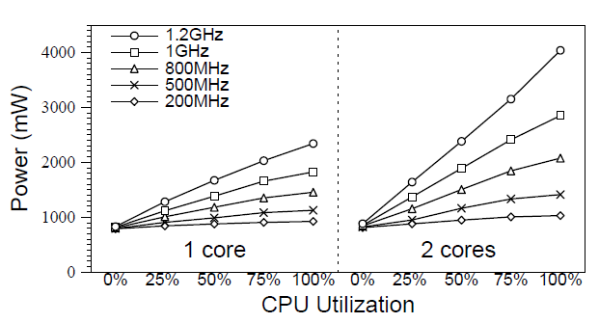
Power consumption
CPU utilization and frequency

Slide 11
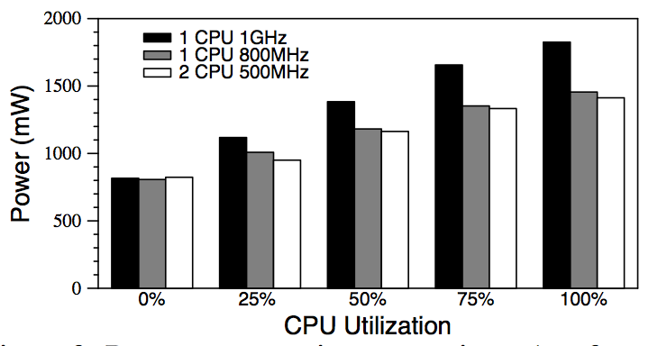
Power consumption
Power consumption comparison: 1 vs 2 cores

Slide 12
Mobile CPUs has multiple idle states
If entering more deep idle state
save more power
increase the enter-exit latency
increase residency time
Implementation
Driver
CPU specific implementation code by each vendor
Common interface
Governor
Ladder
step-wise approach
Under utilize the deep idle state using tickless kernel
Menu
pick the deepest possible idle state straight away
Considering
Energy break even point
Performance impact
Latency tolerance

Slide 13
Mobile CPUs has multiple idle states
ARM cortex IDLE mode
Run mode
Standby mode
WFI / WFE disable most of the clock in processors
Logic power up
Dormant mode
Core processor power down
Cache & RAM power up
Wake up by PMU (Power management unit)
Shutdown mode
Core processor & cache power down
CPU & cache state is saved
Wake up by PMU

Slide 14
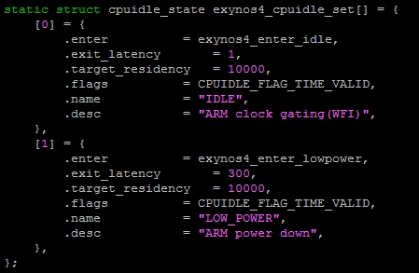
Mobile CPUs has multiple idle states
Exynos4 idle state
menu governor select best idle state among of them.

Slide 15
Display power management technique

Slide 16
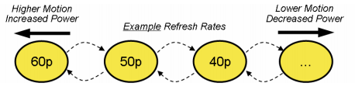
Display refresh rate switching
Reduce frame rate when unchanged scenes
LCD & LED has its own frame rate
60hz: 60 frames per second
Paper: System-Level Display Power Reduction Technologies for Portable Computing and Communications Devices
Both Nvidia & Intel has their own patents

Slide 17
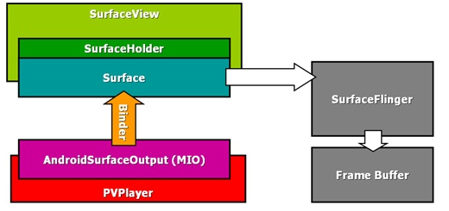
Display refresh rate switching
Google(Android) handle the unnecessary refresh using SW technique
SurfaceFlinger has its own buffer
Surface buffer comparison before writing Frame buffer

