Slide 1
“its okay to not be okay”
MENTAL HEALTH AWARNESS
Made and presented by: Faris Sajjad, Suhaib Mujeebudin, Rayan Sheikh

Slide 2
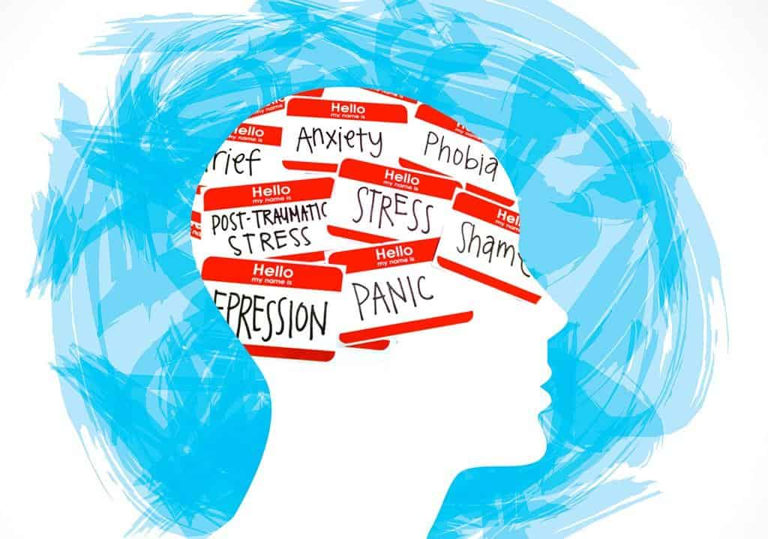
What Is Mental Health?
Mental health affects how we think, feel, and act which includes are emotional, psychological and social well-being.
Mental health problems are common but Help is available. People with mental health problems can get better and many recover completely
Notes:
NOTE: To change images on this slide, select a picture and delete it. Then click the Insert Picture icon in the placeholder to insert your own image.

Slide 3
Early warning signs
-Eating or sleeping too much or too little
-Having low or no energy
-Feeling sad or lonely
-Yelling or fighting with family and friends
-Hearing voices or believing things that are not true
-Thinking of harming yourself or others

Slide 4
How to avoid being mentally ill?
Cope with the stresses of life
-Sometimes you just need some time to relax.
Be physically healthy
-Participate in sports and workouts.
Have good relationships
-Never forget your family and friends in bad times.
Get a good night’s sleep
-Sleep is extremely important for your body to be healthy.

Slide 5
TWO MAIN REASONS FOR KIDS IN SCHOOL TO GET MENTALLY ILL.
Bullying
Study stress
One of the biggest reasons kids have a hard time in school.
Bullied children face an a big risk of social and emotional problems.
And those problems can go with them till adulthood.
The competition turns into a stressful task for kids in school
Having too much study adds a lot of stress, limits students' social life, and can limit students' time for fun

Slide 6
Stay safe and thank you for your time!

