Slide 1
CAPSTONE PROJECT TELECOM CHURN ANALYSIS
An analysis on churn rate in a mobile operator company, Mobicom
By – Jisha I V

Slide 2
Agenda
Project Synopsis
Understanding Data : Data Quality Report and Variable Profiling
Data Preparation : Outlier Treatment and Missing Value Imputation
Feature Engineering: Derived variables creation
Model Building
Final Model Validation
Top Line Questions of Interest

Slide 3
Project Synopsis
Background
Telecom industry level survey reports have been just released. Mobicom is concerned that Market environment of rising churn and declining ARPU will hit them hard as churn rate of customers is relatively high at Mobicom. Currently they are using a reactive strategy when the customer calls in to close the account.
Objective
Mobicom is planning to roll out targeted pro-active retention programs. To be able to effectively drive these retention strategies, a few questions of interest requires data-based insights and recommendations relating to customer churn.
Available Data
Data is provided by Jigsaw Academy for capstone project.

Slide 4
Understanding Data
A data quality report is created for all the variables with columns: variable name, Datatype, NoOfRecords, UniqueRecords, DataAvailablePercent, MissingPercent and summary details like Mean, Median etc. , and saved the file in the below location :
C:\Jig19936\CapstoneProject\final\dataQualityReport.csv
14 Predictor variables , having more than 15% missing values were omitted from the analysis.
Decile binning is used to find out trend in event rate for continuous variables. The variables which doesn’t possess any trend in event rate (and not important) were omitted. The analysis is stored in the below location as csv file :
C:\Jig19936\CapstoneProject\final\decile_continuous_data.csv
Event rate for each level in a categorical variable is computed. For categorical variables having a large no of levels, no of levels were reduced. Levels with similar event rate were clubbed together. The analysis is stored in the below location:
C:\Jig19936\CapstoneProject\final\profile_categorical_data.csv

Slide 5
Data Preparation
Outlier Treatment : Box plot analysis is used to identify and eliminate outliers from the data.
Missing Value Treatment :
For variables having less no of missing values, the entire row is deleted.
For continuous variables having large no of missing values, imputation is done based on churn rate association.
For categorical variables, level having similar churn rate as that of missing values were imputed.

Slide 6
Feature Engineering
Created new variables out of existing predictor variables to help us aid in model accuracy and answer some to line business questions.
Below are the variables and explanation:
1. optimal : ovrrev_Mean/totrev → used as a proxy for optimal and non-optimal plans, higher values indicate non-optimal customers.
2. netquality : comp_vce_Mean/plcd_vce_Mean → used to analyse the network quality .
3. rectal : Indicator variable derived from the variable “retdays” to understand whether a customer made a retention call or not.
4. month_dummy : Categorical variable created from the variable months, bases on event rate.

Slide 7
Model Building
Divided the total data into 70% train and 30% test datasets, and primary logistic regression model is built.
Made dummy variables for categorical variable levels having significance.
Several iterations were made by eliminating non-significant variables and model satisfying the below condition is finalized.
All the predictor variables have significant beta coefficients (<0.05 p values) with a proper sign
VIF(Variable Inflation factor) is less than 5
Least AIC value and good difference between null deviance and residual deviance.

Slide 8
Final Model Validation
Final Model performance and accuracy is validated based on the below criteria:
1. ROCR curve is plotted and the model yielded an AUC of 0.64 for the test dataset.
2.Confusion Matrix : An accuracy of 59.24% of accuracy is obtained for test data using confusion matrix analysis.
3. Kappa Matrix : 0.154 level of agreement is obtained for test data using kappa matrix analysis.
4. Gains table is obtained and observed that top 30% probability score can target 44.1% of customers likely to be churned.

Slide 9
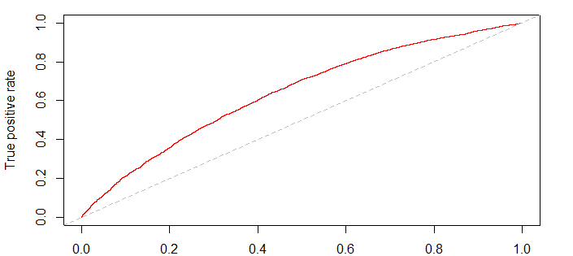
Final Model – ROCR Curve for Test data
AUC=0.64

Slide 10
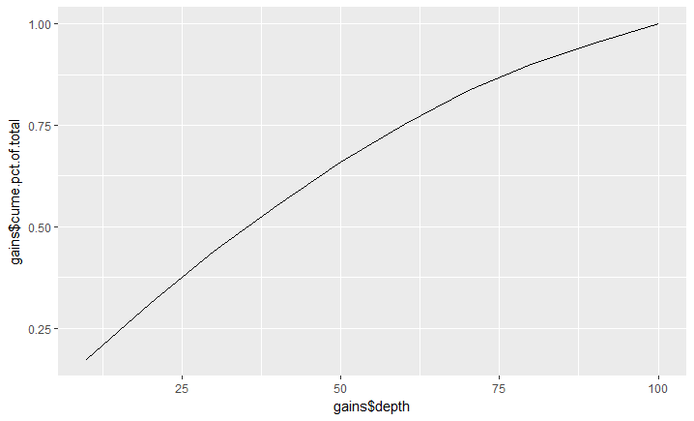
Final Model – Gains Chart

Slide 11
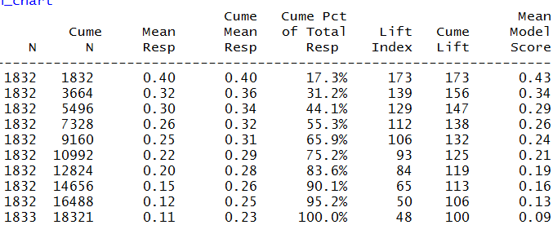
Final Model – Gains Table

Slide 12
Top Line Questions of Interest
What are the top five factors driving likelihood of churn at Mobicom?
Sl No | Variable | Beta Coeffients | Comments
1 | optimal | 6.9010064 | This is the ratio of mean overage revenue to total revenue (ovrrev_Mean/totrev ). Higher optimal value (indicates non-optimal customers) , greater churn.
2 | hnd_price_249.98 | (- )1.1528698 | Current handset price with level 249.98.Lesser churn for customers having a handset with price 249.98
3 | month_dummy11-12 | 1.1387547 | Categorical variable created for months with level 11-12. Greater churn for customers with months of service in between 11 - 12 months
4 | ethnic_C | 0.927658 | Ethnicity roll up code with level C, more churn
5 | netquality | (-)0.8501007 | Variable created to assess network quality. Greater the value, lesser the churn.

Slide 13
Top Line Questions of Interest
2. Validation of survey findings. a) Whether “cost and billing” and “network and service quality” are important factors influencing churn behavior.
Cost and billing : As per the final model , the variables rev_Range, ovrrev_Mean are significant. So we can say that cost and billing is one of the important factors influencing churn behavior.
Network and service quality : The derived variable which can explain network quality is “netquality” which is one among the top 5 factors influencing churn. Other factors those can relate to network quality and significant are : drop_vce_Range, comp_vce_Mean etc.
Service quality also one of the influencing factor as the variables retcal , and custcare_Mean are significant factors as per the model.
b) Are data usage connectivity issues turning out to be costly? In other words, is it leading to churn?
No variables related to data connectivity are significant. So data usage connectivity issues are not leading to churn.

Slide 14
Top Line Questions of Interest
3. Would you recommend rate plan migration as a proactive retention strategy?
Ans : Yes, the variable “optimal” is used as a proxy for optimal and non-optimal customers. Higher values indicate non-optimal customers. As per the model, it is observed that, higher optimal value, greater the chances of churn. ie, non-optimal customers have significantly higher odds of churn compared to optimal customers which is due to higher overage charges. So suitable optimal plan migration for non optimal customers can definitely reduce churn in Mobicom.

Slide 15
Top Line Questions of Interest
4. What would be your recommendation on how to use this churn model for prioritization of customers for a proactive retention campaigns in the future?
a. Targeting customers for rate plan migration : We can target customers who are likely to be churned (Probability>0.2335391) and whose optimal value is greater than 0.02 for rate plan migration. These customers were identified (considering test data as subscriber pool) and saved in the below location:
C:\Jig19936\CapstoneProject\final\TargetCustomers_ratePlanMigration.csv

Slide 16
Top Line Questions of Interest
b. Targeting low usage customers to offer better plans: As mean monthly minutes of use(mou_Mean) has an inverse relationship with churn, by increasing minutes of use, churn can be reduced. So, customers whose mou_Mean is less than median value will be targeted and offers will be given to increase their minutes of use. These customers from test data is identified and saved in the below location:
C:\Jig19936\CapstoneProject\final\TargetCustomers_low_mouMean.csv
C. Targeting customers for Annual offers: Another finding from the model is that, customers whose months of service is between 11-12 months have higher odds of churn. Identifying these customers and offering annual offers will reduce churn rate. . These customers from test data is identified and saved in the below location:
C:\Jig19936\CapstoneProject\final\TargetCustomers_annualOffers.csv

Slide 17
Top Line Questions of Interest
5. What would be the target segments for proactive retention campaigns? Falling ARPU forecast is also a concern and therefore, Mobicom would like to save their high revenue customers besides managing churn. Given a budget constraint of a contact list of 20% of the subscriber pool, which subscribers should prioritized if “revenue saves” is also a priority besides controlling churn. In other words, controlling churn is the primary objective and revenue saves is the secondary objective.
Ans : Considering test data as subscriber pool. Customers having top 20% of probability value is selected because of budget constrain which contain 31.2% of customers likely to be churned. Created Low, Medium and High segments and the below grid is formed for the selected customers :

Slide 18
Top Line Questions of Interest
Probability of churn | Revenue
 | Low | Medium | High
Low | 377 | 467 | 256
Medium | 397 | 670 | 398 (Target)
High | 255 | 507(Target) | 338(Target)
Customers having high churn rate and high revenue, high churn rate and medium revenue, medium churn rate and high revenue were targeted and those customer details were saved in the below location as .csv file : C:\Jig19936\CapstoneProject\final\TargetCustomers_proactiveRetention.csv

