Slide 1
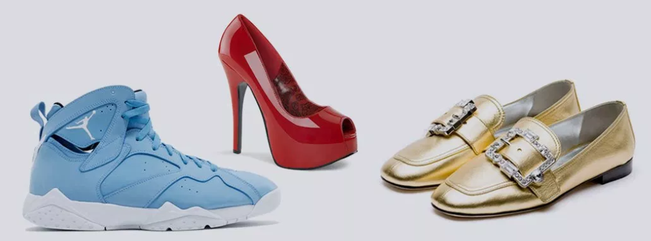
Capstone Project 1:
Women’s Shoe Prices
Jisha Karthik

Slide 2
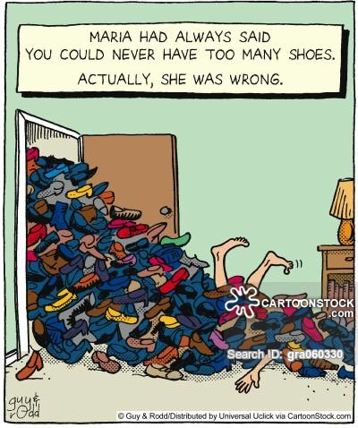
Topic : Women’s shoe prices data analysis
First there was Cinderella, then there was Carrie Bradshaw. On average, a woman owns 20 pairs of shoes at any given time. Many own more. The retail shoe industry is constantly growing, women's shoes controls nearly a quarter of the 342 billion dollar footware industry in US.
Questions:
What prices and brands sells more?
Which ones have the widest distribution of prices?
Is there a typical price distribution across brands?
Dataset
Women’s shoe prices dataset from Kaggle

Slide 3
Overview of Data
The dataset includes 33801 observations and 52 variables
Data features 35 categorical variables,16 numerical and one boolean column
The variables are basic features of product , price and merchants
Challenges
Dataset has NA’s and missing values
Checking and removing near zero variance variables
Final dataset contains 24 variables and 33800 observations

Slide 4

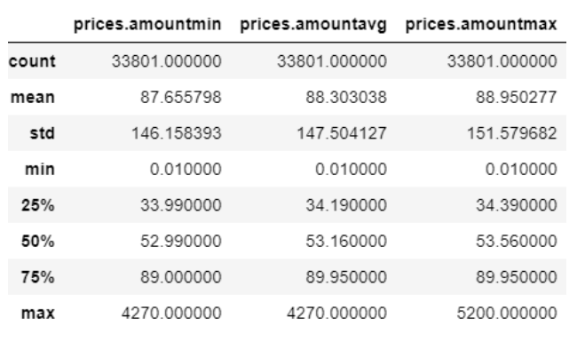
Price variables in data

Slide 5
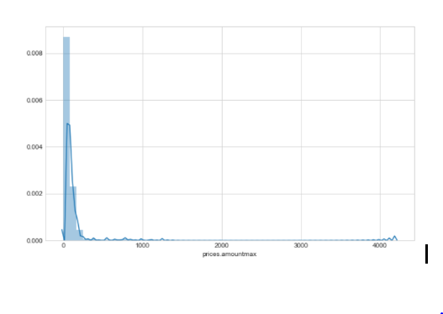
Sale price distribution

Slide 6
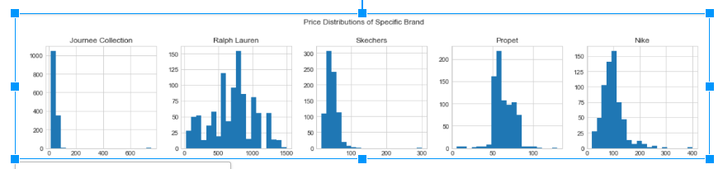
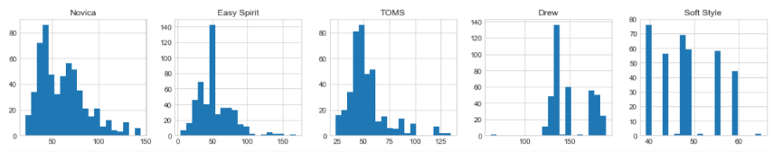
Price distribution of specific brands
Top 10 brands not showing price normal price distribution.

Slide 7
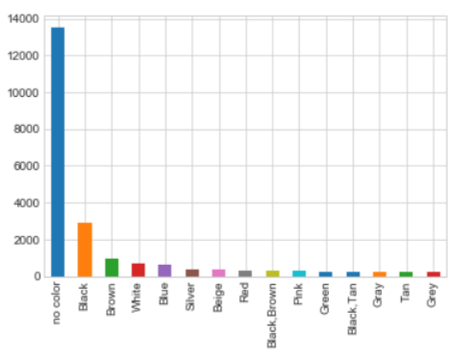
Popular colors
Black, Brown, White, Blue And Silver Is Popular Colors

Slide 8
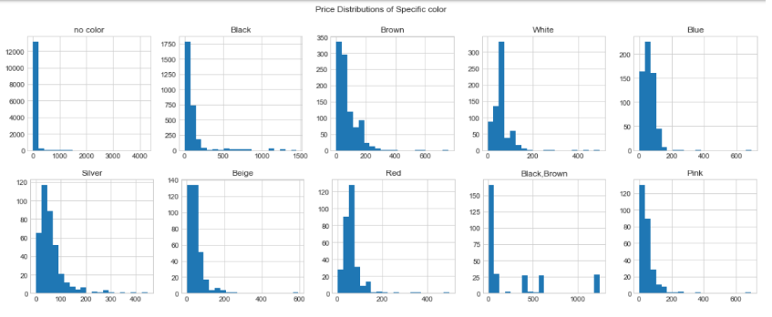

Slide 9
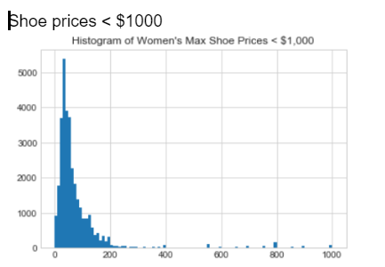

Slide 10
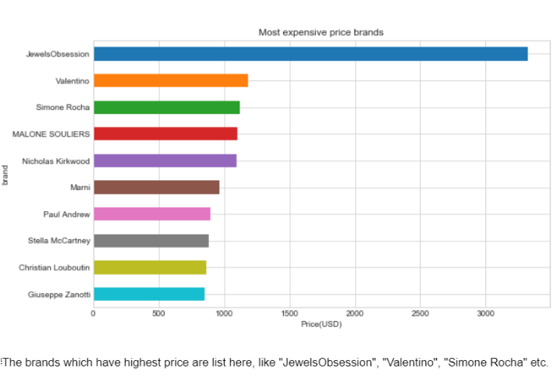

Slide 11
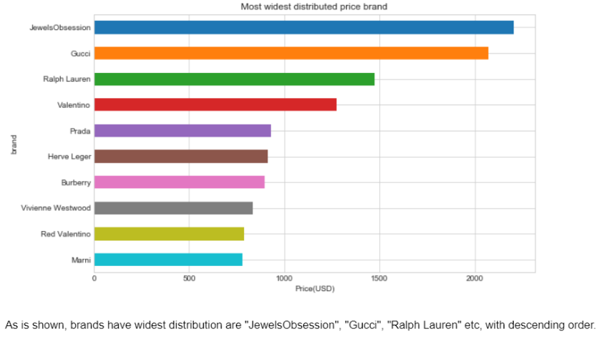

Slide 12
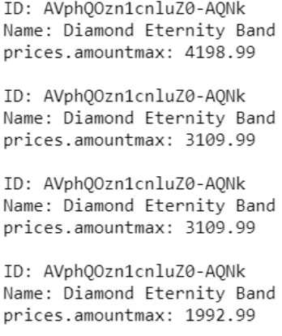
Diamonds in Shoe Box
Some of the very high priced items in the data are not shoes, they are wedding bands

Slide 13
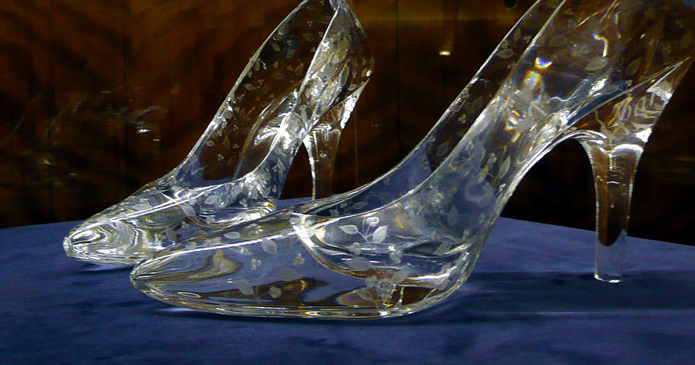
The average shoe price in our data is 88.24, median is 51.99. The more customers bought shoes cost between $29.99 and $119.95

Slide 14
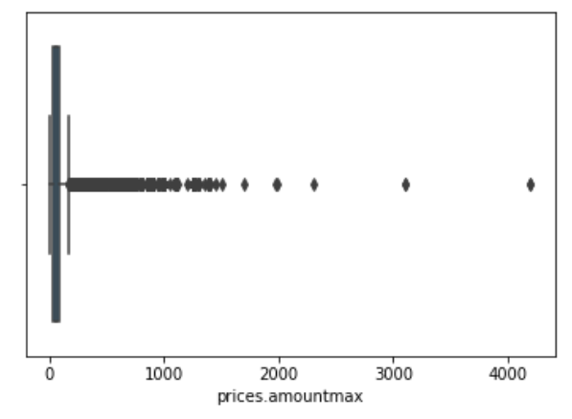
Outliers in data

Slide 15
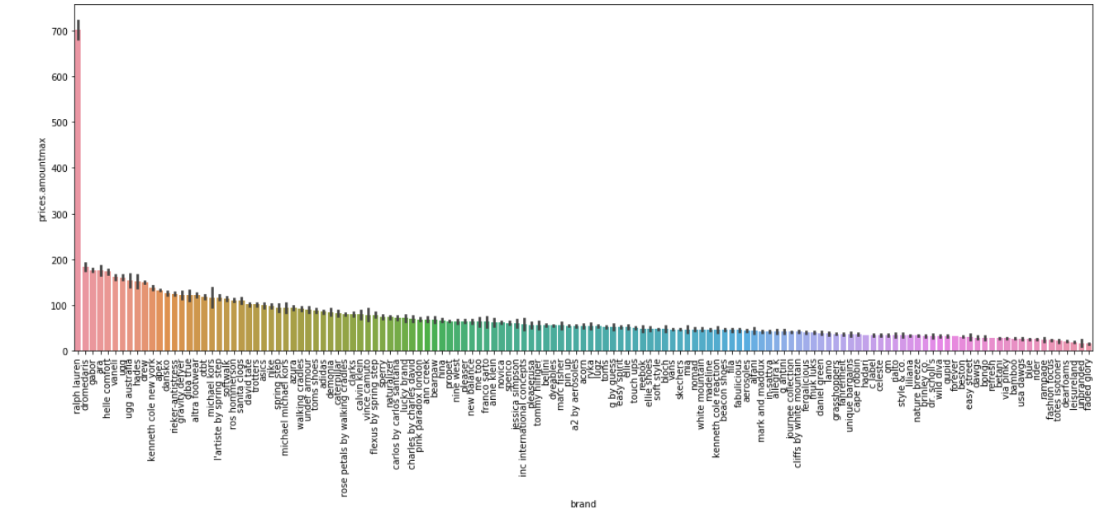
Average price by brand
All brands except Ralph Lauren has average price under $200

Slide 16
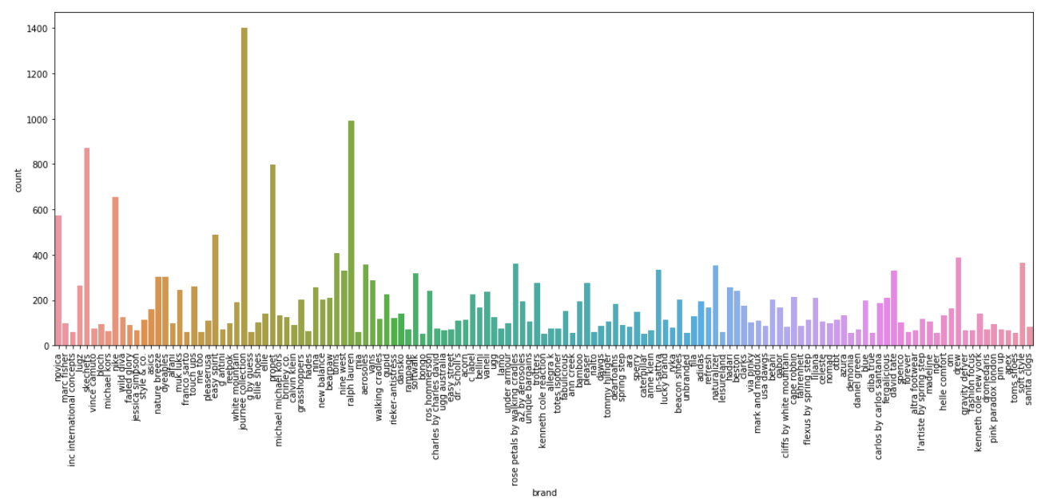
Brand popularity chart
Most selling brand Journee Collection with low average price
Second top selling brand Ralph Lauren with highest average price

Slide 17
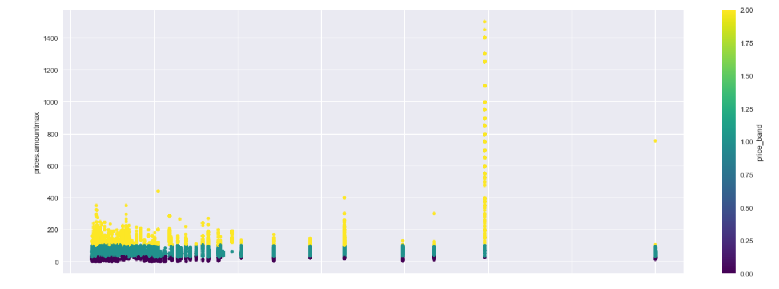
Price range
No. of shoes sold Price < 30 3828
Price >= 30 & <= 100
15943
Price > 100
4914

Slide 18
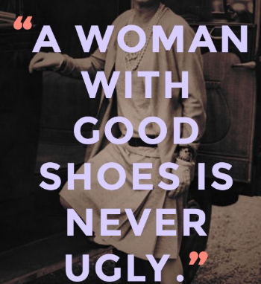
Good shoes sells better than cheaper price

Slide 19
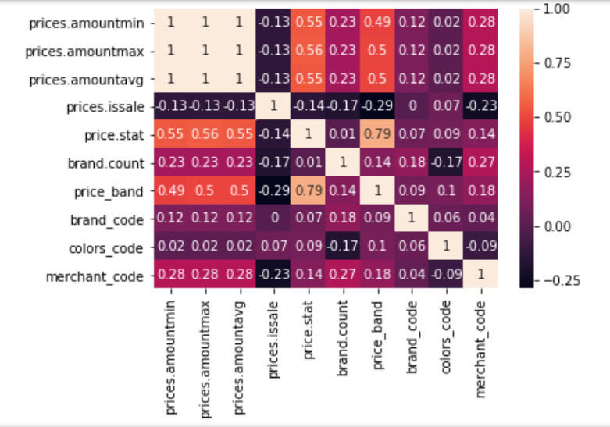
Correlation matrix

Slide 20
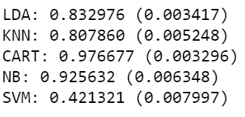
Brand name prediction
Models and Algorithms
LogisticRegression - LR
LinearDiscriminantAnalysis - LDA
KNeighborsClassifier - KNN
DecisionTreeClassifier - CART
GaussianNB - NB
SVC - SVM
Accuracy Rate

Slide 21
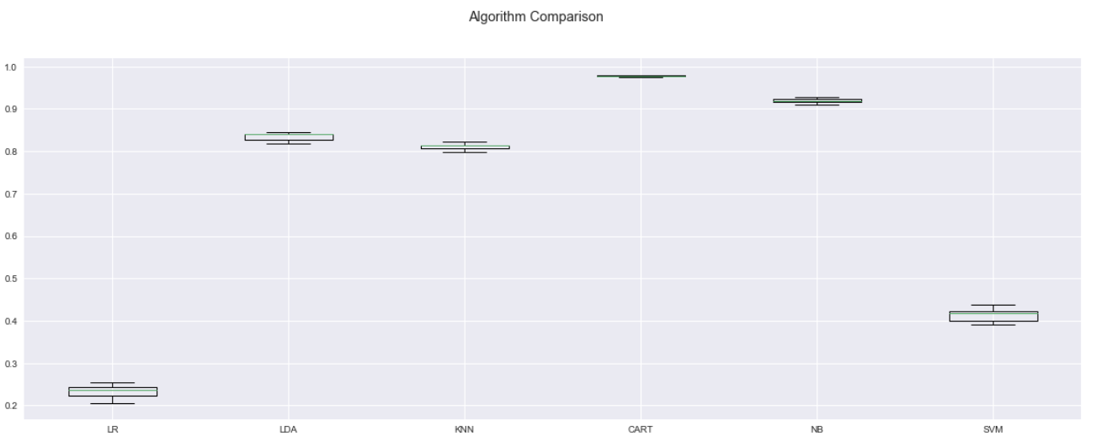

Slide 22
Prediction Model
DesitionTreeClassifier is the best predicting model with
F1 Score - 0.98

Slide 23
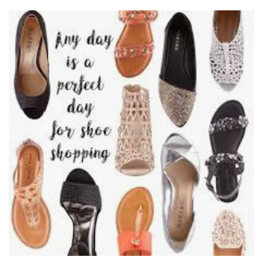
Thank you

