Slide 1
Encrypting Network Traffic
Notes:
This lesson covers the basics of security in an HDP environment.

Slide 2
Objectives
After completing this lesson, students should be able to:
Deploying Cloudera Manager
CDP Reference Architecture for Non-Production
CDP Reference Architecture for Production
Deploying CDP Runtime

Slide 3
Overview of Wire Communications
External to the CDP Cluster
Internal to the CDP Cluster
CDP Cluster
Client
1
WebHDFS
Nodes
Nodes
2
DataTransferProtocol
1
HTTPS
3
RPC
2
RPC
4
JDBC/ODBC
3
M/R Shuffle

Slide 4
Protocols for Wire Encryption
Encrypted Remote Procedure Call RPC using Java’s Simple Authentication & Security Layer (SASL)
Data Transfer Protocol Encrypted DTP using 3DES
Java Database Connectivity JDBC SASL Protocol’s Quality of Protection QOP
Hyper Text Transfer Protocol Secure HTTPS uses TLS
MapReduce Shuffle Utilizes HTTPS
Notes:
Encryption is applied to electronic information in order to ensure its privacy and confidentiality. Wire encryption protects data as it moves into and through Hadoop cluster over RPC, HTTP, Data Transfer Protocol (DTP), and JDBC.
The following describes how the data is protected as it is in motion:
Clients typically communicate directly with the Hadoop cluster and the data can be protected using:
RPC encryption: Clients interacting directly with the Hadoop cluster through RPC. A client uses RPC to connect to the NameNode (NN) to initiate file read and write operations. RPC connections in Hadoop use Java’s Simple Authentication & Security Layer (SASL), which supports encryption.
Data Transfer Protocol: The NN gives the client the address of the first DataNode (DN) to read or write the block. The actual data transfer between the client and a DN uses Data Transfer Protocol.
Users typically communicate with the Hadoop cluster using a Browser or a command line tools, data can be protected using:
HTTPS encryption: Users typically interact with Hadoop using a browser or component CLI, while applications use REST APIs or Thrift. Encryption over the HTTP protocol is implemented with the support for SSL across a Hadoop cluster and for the individual components such as Ambari.
JDBC: HiveServer2 implements encryption with Java SASL protocol’s quality of protection (QOP) setting. With this the data moving between a HiveServer2 over jdbc and a jdbc client can be encrypted.
Additionally within the cluster communication between processes can be protected using:
HTTPS encryption during shuffle: Staring in HDP 2.0 encryption during shuffle is supported. The data moves between the Mappers and the Reducers over the HTTP protocol, this step is called shuffle. Reducer initiates the connection to the Mapper to ask for data and acts as SSL client.

Slide 5
Java’s Simple Authentication & Security Layer (SASL)
SASL Connectivity
QOP
SASL ensures secure communication between the client and the daemons
Implements with Java SASL Protocol’s Quality of Protection – QoP
auth Authentication only
auth-int Authentication with integrity protection
auth-conf Authentication with integrity and privacy

Slide 6

Transport Layer Security (TLS)
CDP can be configured to use either HTTP or HTTPS
CDP HTTPS requires minimal configuration
Use Auto-TLS to manage the TLS certificates
Public Key Exchange
Hello!
b2i3&%t
Hello!
ENCRYPT
DECRYPT

Slide 7
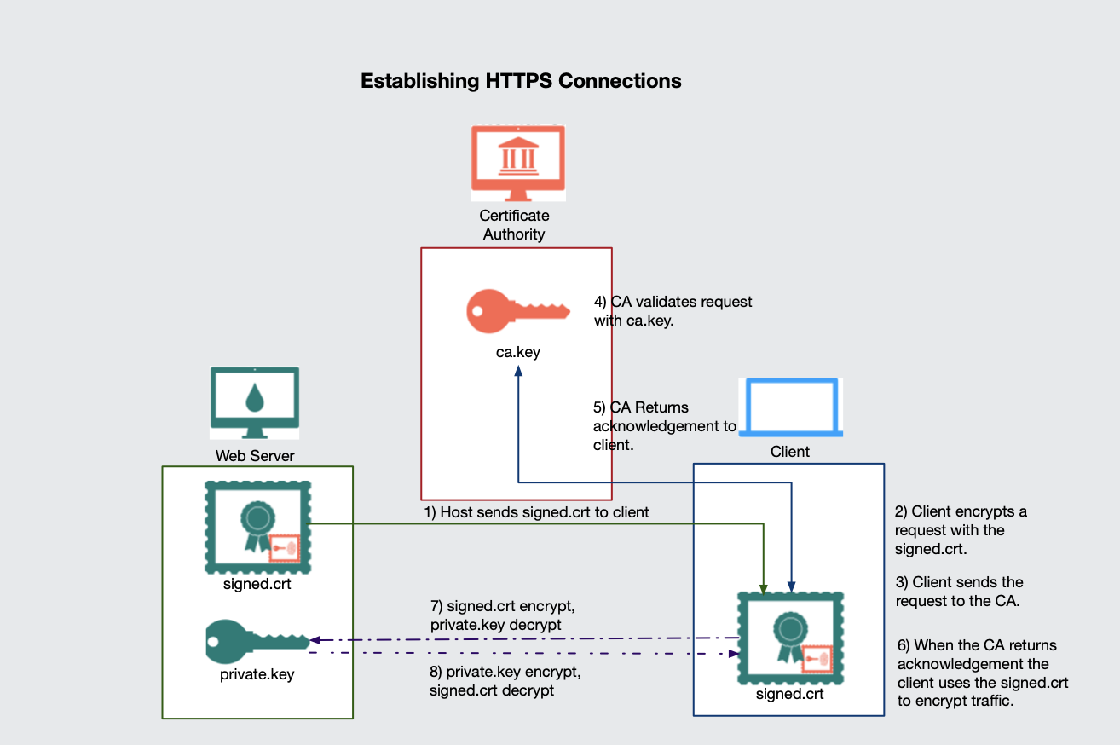
Establishing HTTPS Connections

Slide 8
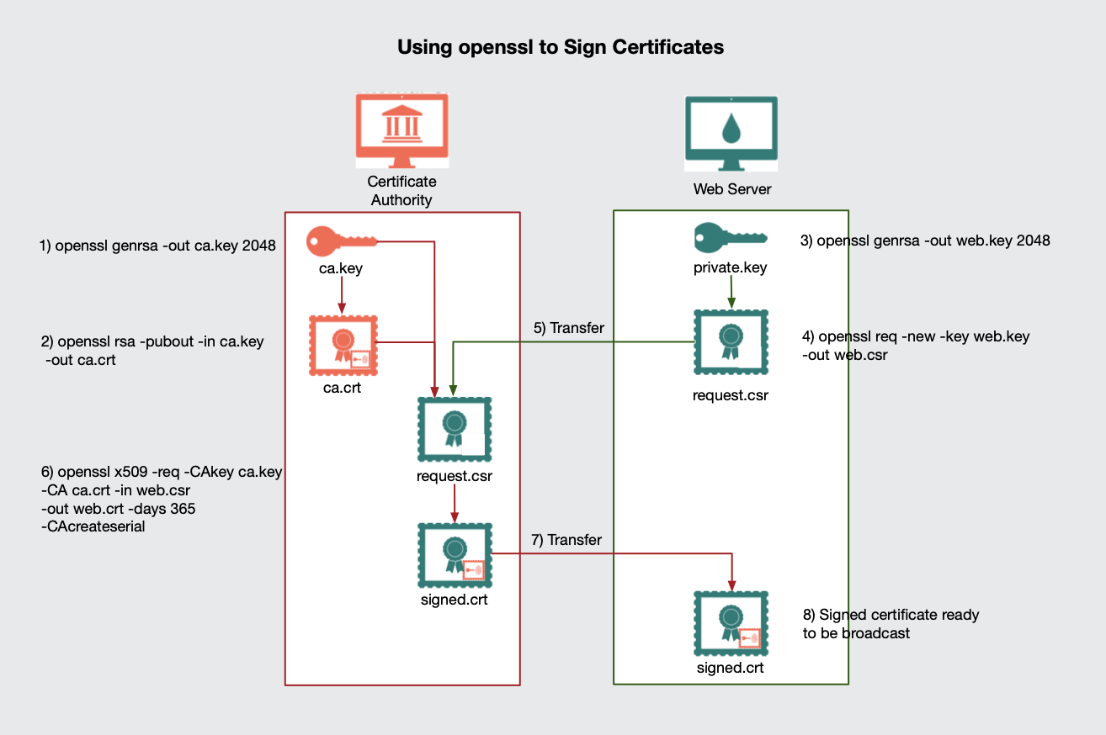
Signing Certificate Signing Requests

Slide 9
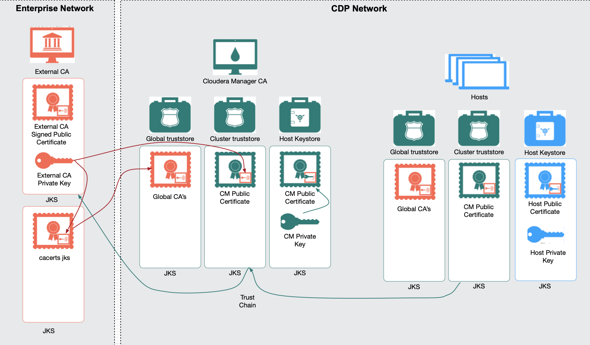
Introducing Auto-TLS Architecture

Slide 10
Cloudera Manager Auto-TlS
Auto-TLS can automate all the steps required to enable TLS encryption at a cluster level
Cloudera Manager can function as the Certificate Authority (CA) for all the certificates in the cluster
Can easily establish a trust chain to the enterprises’ existing CA.
Certificate renewal and deployment can be automated
Cloudera Manager now includes a Web UI for Auto-TLS.
AutoTLS includes a command line, this allows for the creation of scripts and execution by other automation tools.
Disclaimer: Auto-TLS Web UI handles many of the tasks required to manage TLS; however, there are lots of edge cases and speciality circumstances that Auto-TLS may not handle.

Slide 11
Three Deployments for Auto-TLS
Steps | CM as Root CA | CM as Intermediate CA | Existing Certs
Generate CSR | Automated | Automated | Manual
CSR Signed by CA | Automated | One-time | Manual
Deploy certificate to all hosts | Automated | Automated | Automated
Configuration for each service | Automated | Automated | Automated
Cluster restarts | Once | Once | Once
Configuration steps | Automated | Automated | Automated
New Service steps | Automated | Automated | Automated
New Host cert. generation | Automated | Automated | Manual

Slide 12
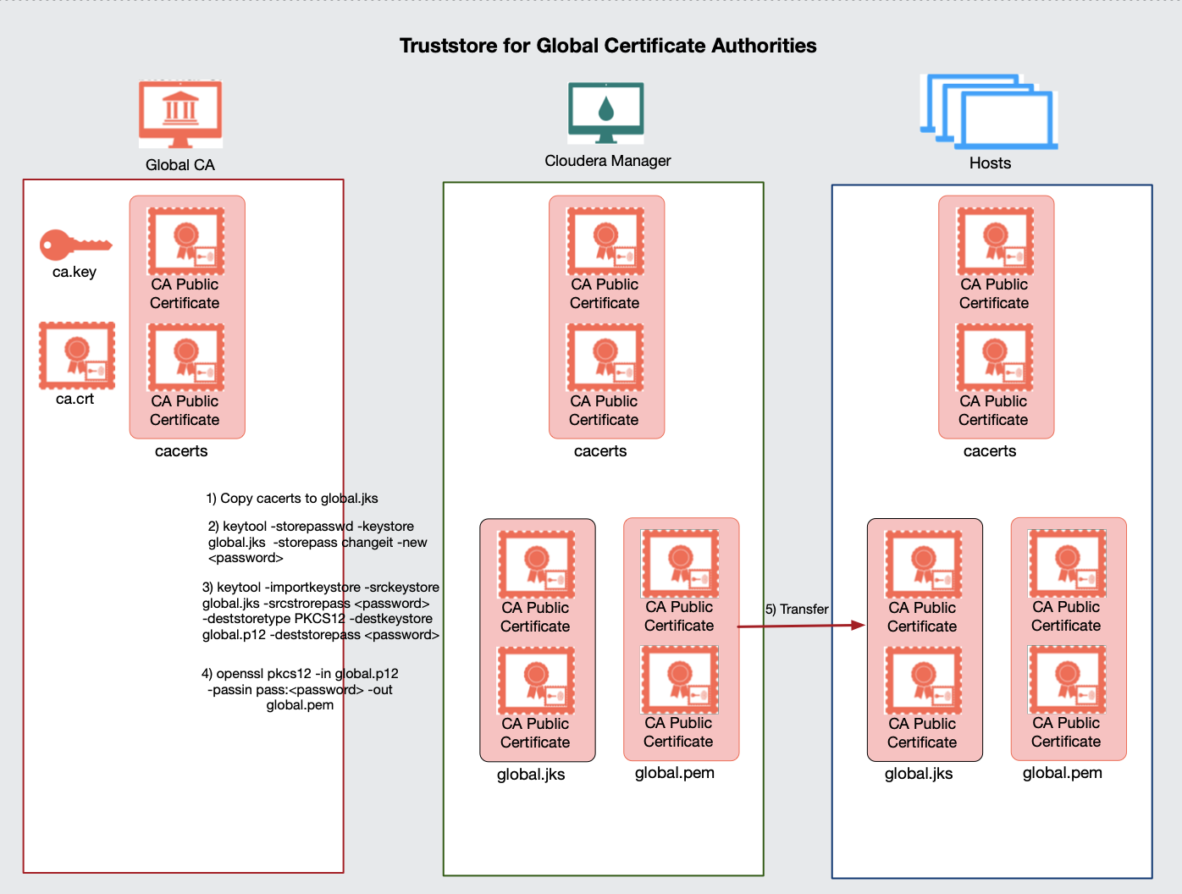
Creating Truststores for Global Certificate Authorities

Slide 13
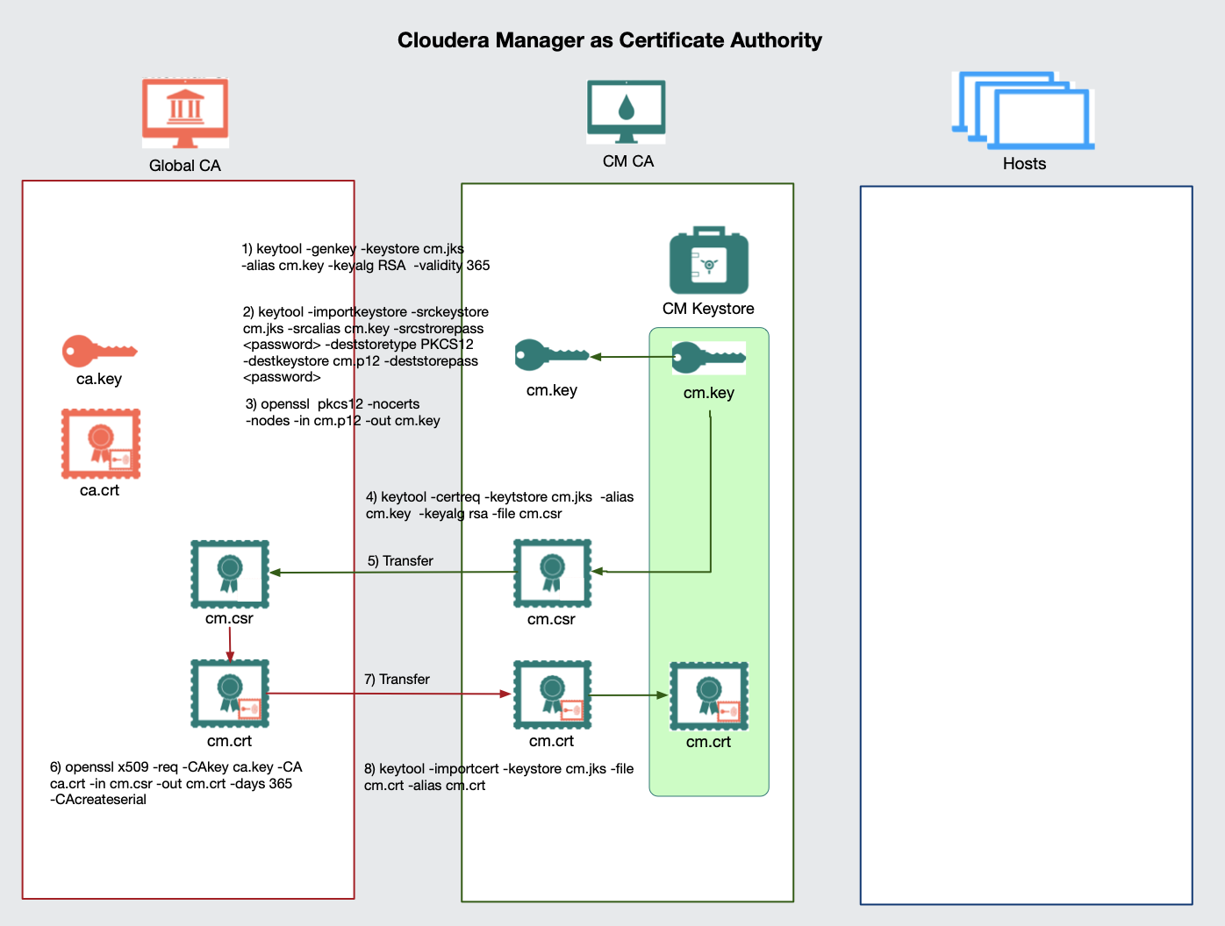
Assigning Cloudera Manager as a Certificate Authority

Slide 14
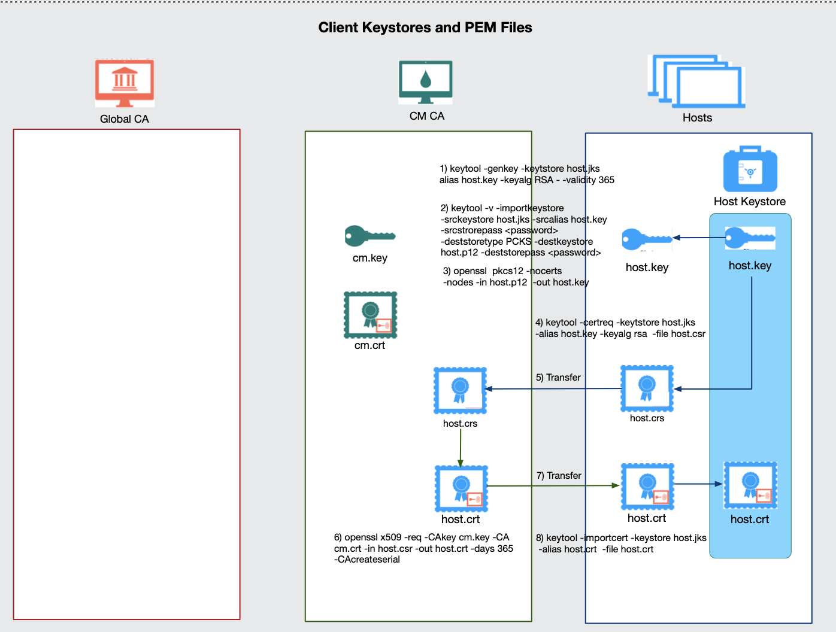
Using Cloudera Manager to Manage Keystores and Certificates

Slide 15
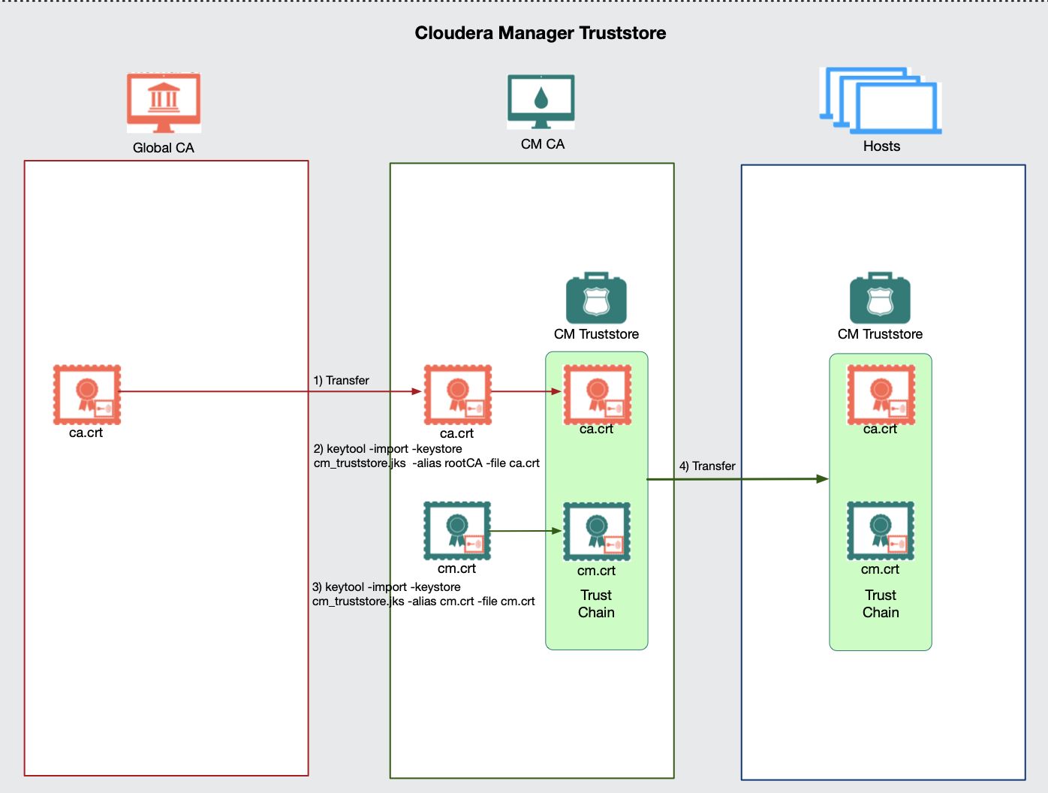
Creating Cluster Truststore

Slide 16
Auto-TLS Certificates and Keystores
Purpose | PEM | Java Keystore
List of global CA’s | cm-auto-global_cacerts.pem | cm-auto-global_truststore.jks
List of enterprise CA’s | cm-auto-in_cluster_ca_cert.pem | cm-auto-in_cluster_truststore.jks
Host private and signed public key | cm-auto-host_key.pem cm-auto-host_cert_chain.pem cm-auto-host_key_cert_chain.pem | cm-auto-host_keystore.jks
Password | cm_auto-host_key.pw

Slide 17
Exercise: Encrypting Network

Slide 18
Summary
After completing this lesson, students should be able to:
Deploying Cloudera Manager
CDP Reference Architecture for Non-Production
CDP Reference Architecture for Production
Deploying CDP Runtime

