Slide 1

Tools and Techniques for Sustainable Design
PRESENTED BY:
MOHD JEESHAN MS LALITA
1BY21IS087
1BY21IS088

Slide 2

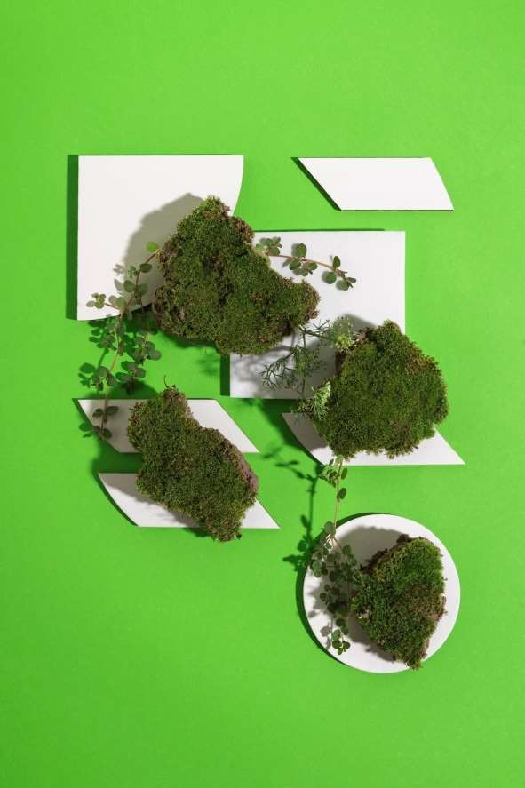
Sustainable Design
The aim of sustainable design is to create spaces that have a
more positive impact on our climate, environment and society.
Designers reduce waste by making products that are recyclable,
compostable and even better - endlessly reusable.

Slide 3

TOOLS FOR SUSTAINABLE DESIGN
BUILDING INFORMATION MODELING (BIM): BIM technology
allows architects to create detailed digital models of buildings, facilitating efficient design iteration and simulation. It enables energy analysis, daylighting studies, and material selection to align with sustainability goals.
ENERGY MODELING SOFTWARE: Energy modeling tools simulate the energy performance of a building, helping architects optimize insulation, HVAC systems, and lighting. These simulations inform design decisions that minimize energy consumption.

Slide 4


LIFE CYCLE ASSESSMENT (LCA):
LCA tools evaluate the environmental impact of building materials and systems throughout their lifecycle.
Architects can make informed choices by selecting materials with lower embodied energy and longer lifespan

Slide 5


SUSTAINABLE DESIGN TECHNIQUES:
PASSIVE DESIGN STRATEGIES:
Passive design utilizes the natural elements to achieve comfort. Techniques include orienting buildings for optimal sunlight, natural ventilation, and using thermal mass to regulate indoor temperatures.
RENEWABLE ENERGY INTEGRATION:
Architects can incorporate renewable energy sources such as solar panels and wind turbines into building designs. These systems generate clean energy and contribute to reduced reliance on fossil fuels.

Slide 6

Conclusion:
Examples of sustainable design include the Shanghai Tower in China and the Bullitt Center in Seattle. These buildings often involve the use of solar panels, self-balancing water systems, and eco-friendly materials in construction

Slide 7
Thanks!

