Slide 1
Unified Question Generation with Continual Lifelong Learning
-JiShengPeng

Slide 2
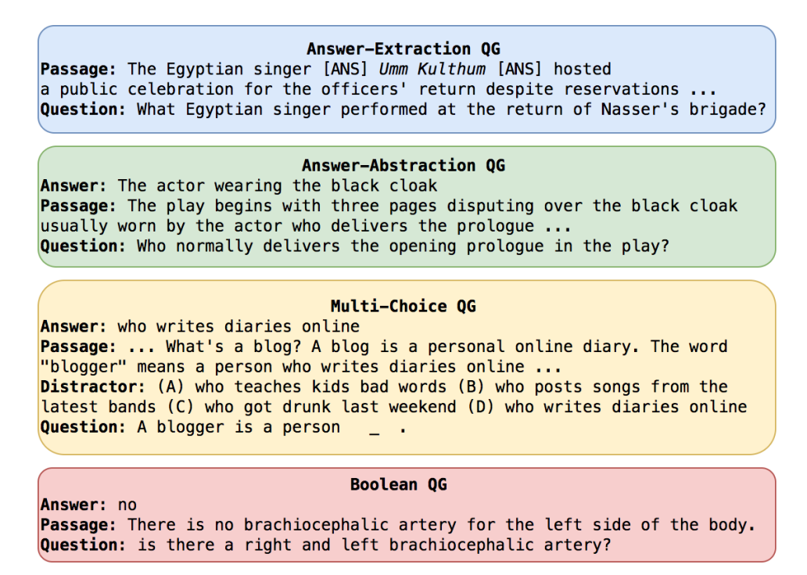
Abstract
What is Question Generation ? A task in NLP
aims at generating questions based on given answers and context
Q1 = 𝑎𝑟𝑔𝑚𝑎𝑥 𝑃 (𝑄|𝐶, 𝐴)
answer-extraction
answer-abstraction
multi-choice
boolean QG

Slide 3
Abstract
Problem: (resource-intensive and ungeneralizable)
be dedicated to specific QG formats and one dataset only
Our methods:
transform Q:different kinds of QG formats into a unified representation
continually learn QG tasks across different datasets (Lifelong Learning)
Put forward STRIDER to alleviate catastrophic forgetting
TF-IDF(measure the relevance between different datasets)
lots of experiments(improving Question Answering systems’ performance and Q:Resource consumption)

Slide 4
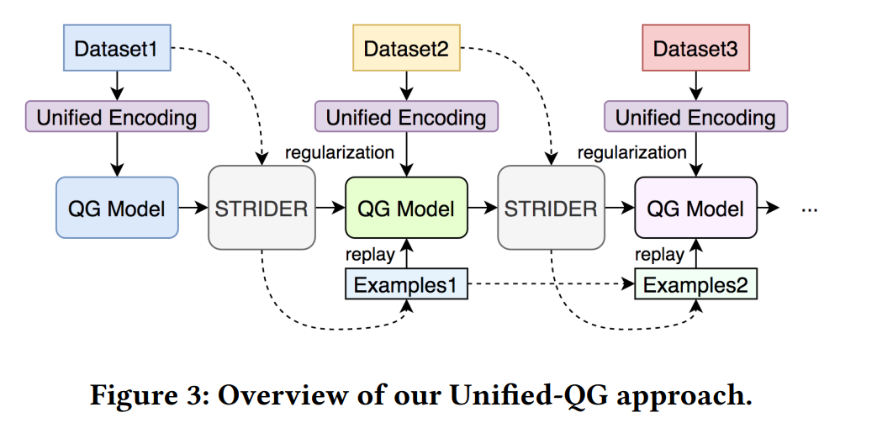
Architecture
Unified QG Encoding
T5 for QG as a backbone
SimilariTy RegularIzed Difficult Example Replay (STRIDER)

Slide 5
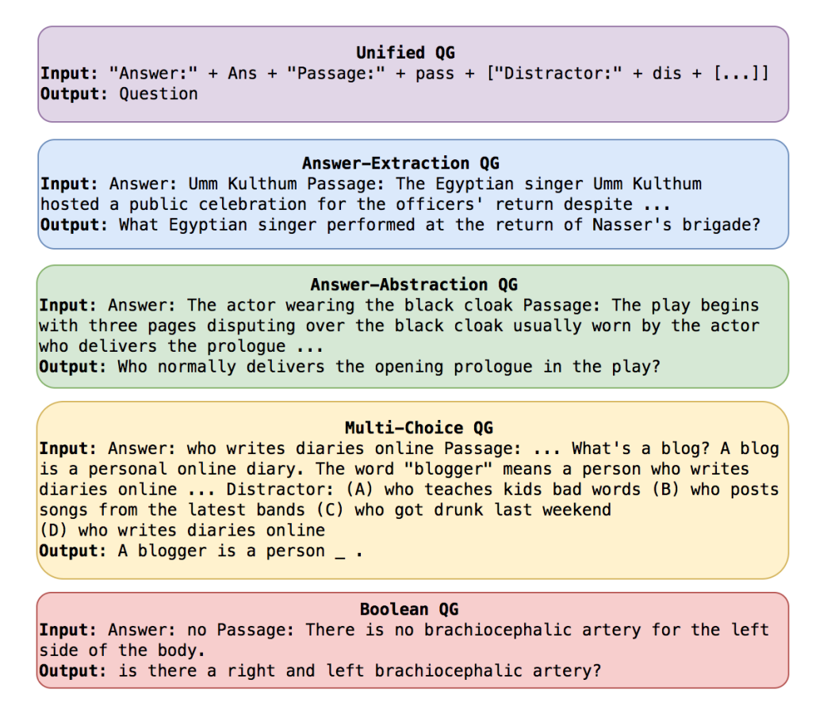
Architecture Encoding
Unified QG Encoding
Handling strings to be capable of feed the T5 model
Answer Passage Distractor ………
𝐷 = {(𝑥𝑖 , 𝑦𝑖)} 𝑖=0…n Key/value pair

Slide 6
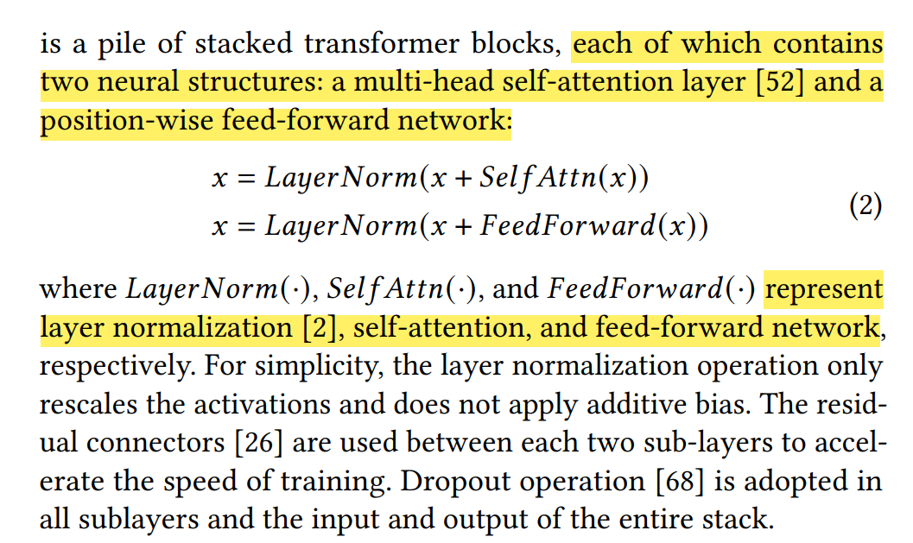
Architecture T5 for QG
The Architecture of T5 is based on Transformer
We used T5 as a backbone(Q:How to fine tune?)
Q:Is it followed by a model of our own design?

Slide 7
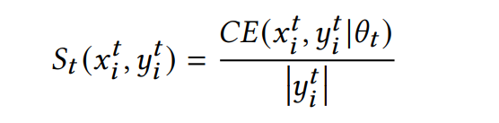
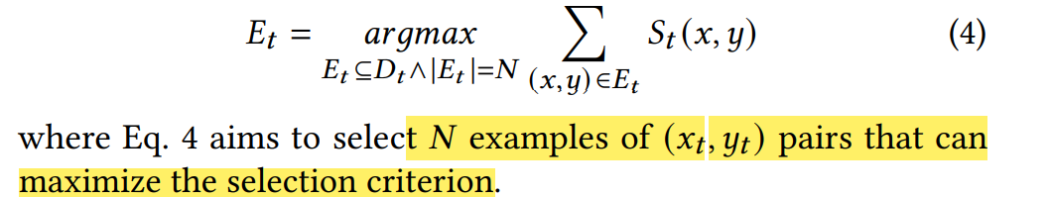
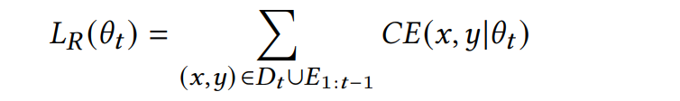
Architecture STRIDER (one part)
Difficult Example Replay
retain a small set of examples from the past training data
we propose a difficult example selection method
difficult training examples are more helpful for improving the current model
Q:How to get limit size?

Slide 8
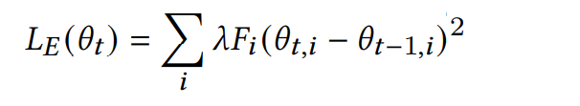
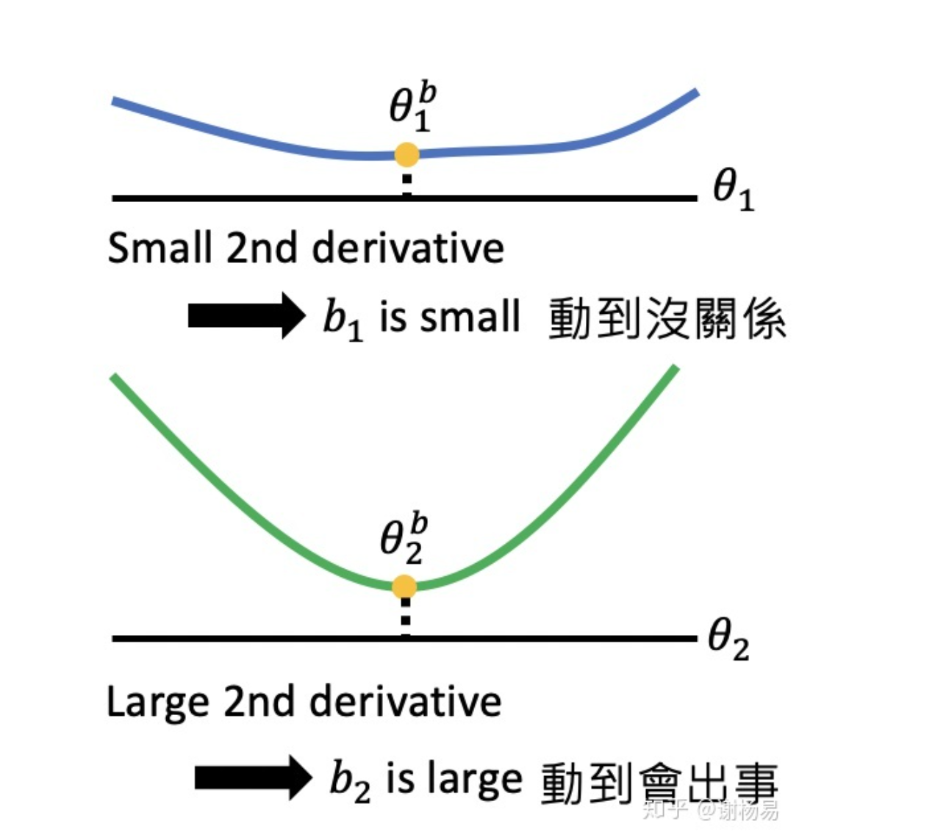
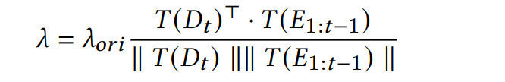
Architecture STRIDER (one part)
Be based on EWC
TF-IDF To calculate the similarity

Slide 9
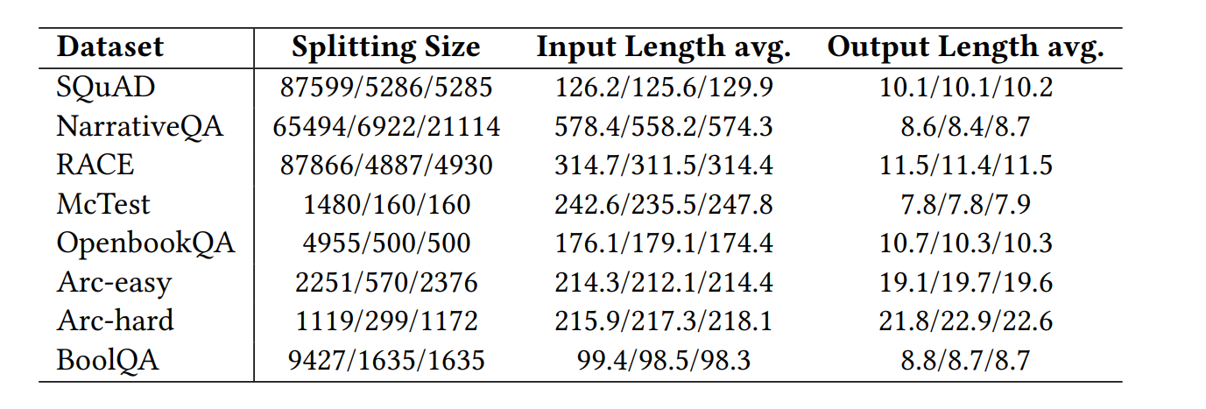
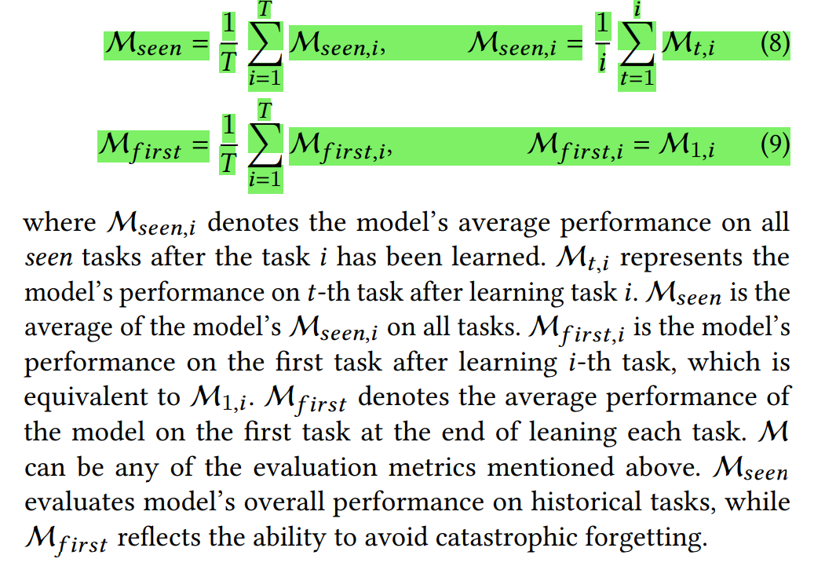
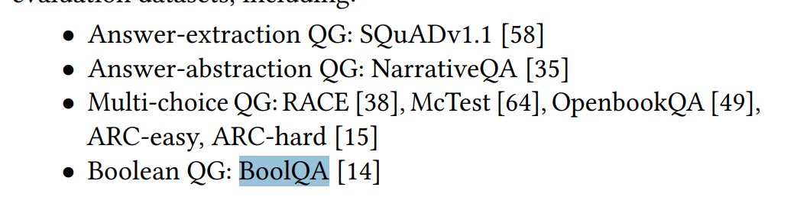
Experiment
Dataset
Evaluation Metrics
BLEU-1∼4
METEOR
ROUGE-L

Slide 10
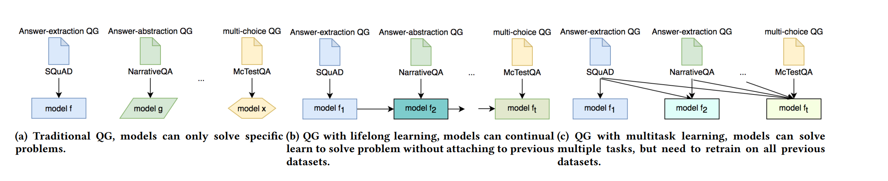
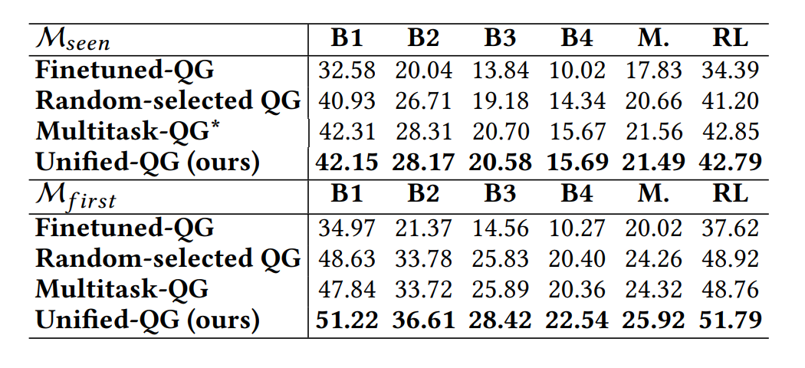
Experiment
Multitask-QG, a Finetuned-QG, and a Random-selected QG as our baseline.(Accuracy)
Effectiveness of Overcoming Catastrophic Forgetting Problem
Unified-QG vs. Dedicated-QG
compare STRIDER with several simplified versions

