Slide 1
ONLINE-TUTOR MANAGEMENT SYSTEM
MINI PROJECT
Department of MCA,MES College of Engineering ,Kuttippuram
25th OCTOBER 2023
PREPARED BY
JISHITHA M N(MES22MCA-2029)

Slide 2
GUIDED BY VASUDEVAN T V
ASSISTANT PROFESSOR
MASTER OF COMPUTER APPLICATIONS
MES COLLEGE OF ENGINEERING, KUTTIPPURAM

Slide 3
CONTENTS:-
Introduction
Modules
Product Backlog
Project Plan
User Story
Sprint
Data Flow Diagram

Slide 4
INTRODUCTION:-
In the digital world taking classes in the classroom are reduced because of the development of the internet. These days the internet-based learning platform is huge demand in business marketing.
Tutor management system is a project provide students an online portal to book tutor easily and at an affordable cost.
This application shows how many tutor available at the cost so that student can select their preferable choice. By doing this student from poverty family can select the lowest fees to have tuition with a standard level of quality tutor, only qualified people can be register as tutor. In this application by selecting based on their resume and certificate.
It includes process like registration of the student and tutor details
As the system is online the information is globally present to everyone. This makes the system easy to handle and feasible for finding the omission with updating at the same time

Slide 5
MODULES
ADMIN
LOGIN
APPROVE TEACHERS
BLOCK/UNBLOCK TEACHERS
BLOCK/UNBLOCK STUDENTS
ADD INSTRUCTIONS
CHAT WITH TEACHERS
VIEW COMPLAINT & SEND REPLY
VIEW FEEDBACK & RATING
ADD AND MANAGE SALARY DETAILS
PAYMENT HISTORY
TEACHER
SIGNUP
LOGIN
CHAT WITH ADMIN
VIEW INSTRUCTIONS FROM ADMIN
CHAT WITH STUDENT
VIEW REQUEST AND APPROVE
ADD STUDYMATERIALS
ADD TEST
ADD AND MANAGE QUESTIONS
VIEW SALARY DETAILS
VIEW RESULT

Slide 6
STUDENT
SIGNUP
LOGIN
VIEW TEACHER AND SEND REQUEST
SEND COMPLAINT AND VIEW REPLY
SEND FEEDBACK AND RATING
VIEW MATERIALS
ATTEND EXAM
VIEW RESULT
PAYMENT

Slide 7
DEVELOPMENT ENVIRONMENT
HARDWARE SPECIFICATION
Processor : Intel i3 or above
Hard Disk : 512 GB and above
RAM : 4 GB or above
SOFTWARE SPECIFICATION
Operating System : Windows 8 or above
Front End : HTML, CSS, Bootstrap and Javascript
Back End : Python
Framework : Django
Database : MySQL
IDE : Jet BrainsPycharm

Slide 8
Product Plan
ID | TASK NAME | START DATE | END DATE | PROJECT HOURS | STATUS
1 | Sprint 1 | 15/09/2023 | 12/10/2023 | 13 | Planned
2 | Sprint 2 | 13/10/2023 | 03/11/2023 | 14 | Planned
3 | Sprint 3 | 08/11/2023 | 30/11/2023 | 14 | Planned

Slide 9
Product Backlog
ID | PRIORITY | SIZE (Hours) | SPRINT | STATUS | NAME
1 | Medium | 8 | 1 | Planned | Registration
2 | Medium | 4 |  | Planned | Login
3 | High | 10 | 2 | Planned | Table Design
4 | High | 9 |  | Planned | Coding
5 | Medium | 4 | 3 | Planned | Testing data
6 | High | 6 |  | Planned | Output generation

Slide 10
USER STORY
User story ID | As < type of user> | I want to | So that I can
1 | ADMIN | Login | Login successful with correct Username and Password
2 | ADMIN | Approve Teachers | Approve teacher who are registered
3 | ADMIN | Block/Unblock Teacher | Block and Unblock Teacher
4 | ADMIN | Block/Unblock Student | Block and Unblock Student
5 | ADMIN | Add Instructions | Give instructions to the Teachers
6 | ADMIN | View feedback and rating | View feedback and rating from students
7 | ADMIN | View Complaint and reply | View complaints and send reply
8 | ADMIN | Chat with Teachers | Chat with Teachers

Slide 11
USER STORY
User story ID | As < type of user> | I want to | So that I can
9 | ADMIN | Add and Manage Salary | Add and Manage salary to teachers
10 | ADMIN | Payment history | View payment History
11 | TEACHER | Signup | Register with details
12 | TEACHER | Login | Login Successful with correct username and password
13 | TEACHER | View instructions from Admin | View instructions given by admin
14 | TEACHER | Chat with Students | Chat with student
15 | TEACHER | View request and approve | View requested students and approve them
16 | TEACHER | Add study materials | Upload study materials to corresponding subject
17 | TEACHER | Add test | Add test to students

Slide 12
USER STORY
User story ID | As < type of user> | I want to | So that I can
18 | TEACHER | Add and manage questions | Add and manage questions
19 | TEACHER | Payment history | View payment details of students
20 | TEACHER | View result | View results of test
21 | TEACHER | Chat with Admin | Chat with admin
22 | TEACHER | View salary | View salary details
23 | STUDENT | Signup | Register with details
24 | STUDENT | Login | Login successful with correct username and password
25 | STUDENT | Send feedback and rating | Send feedback and rating

Slide 13
USER STORY
User story ID | As < type of user> | I want to | So that I can
26 | STUDENT | Attend test | Attend test
27 | STUDENT | View result | View result of test that are attended
28 | STUDENT | payment | pay Tution fee
29 | STUDENT | View teacher and request | View teacher and send request
30 | STUDENT | View materials | View study materials

Slide 14
Project Plan
User Story ID | Sprint | Start Date | End Date | Days | Status
1 , 2 , 3 , 4,5 | Sprint 1 | 15/09/23 | 29/09/23 | 14 | Planned
11,12 , 13,14,15 |  | 30/09/23 | 12/10/23 | 13 | Planned
6,7,8,9,10 | Sprint 2 | 13/10/23 | 29/10/23 | 16 | Planned
16,17,18,19, 20 | Sprint 4 | 30/10/23 | 3/11/23 | 4 | Planned
21,22,23,24,25,26,27,28,29,30 | Sprint 3 | 8/11/23 | 30/11/23 | 22 | Planned

Slide 15
SPRINT PLAN
SPRINT 1:-
Backlog Item | Status and Completion date | Original Estimate in hours | Day 1 15/09 | Day 2 20/09 | Day 3 21/09 | Day 4 28/09 | Day 5 29/09 | Day 6 04/10 | Day 7 05/10 | Day 8 06/10 | Day 9 11/10 | Day 10 12/10
Form Design | 15/09/2023 | 2 | 2 | 0 | 0 | 0 | 0 | 0 | 0 | 0 | 0 | 0
Table Design | 28/09/2023 | 3 | 0 | 1 | 1 | 1 | 0 | 0 | 0 | 0 | 0 | 0
Coding | 06/10/2023 | 6 | 0 | 0 | 0 | 0 | 2 | 1 | 1 | 2 | 0 | 0
Testing & Validation | 12/10/2023 | 2 | 0 | 0 | 0 | 0 | 0 | 0 | 0 | 0 | 1 | 1
Total |  | 13 | 2 | 1 | 1 | 1 | 2 | 1 | 1 | 2 | 1 | 1

Slide 16
SPRINT 2:-
Backlog Item | Status and Completion date | Original Estimate in hours | Day 1 13/10 | Day 2 18/10 | Day 3 19/10 | Day 4 20/10 | Day 5 25/10 | Day 6 26/10 | Day 7 27/10 | Day 8 01/11 | Day 9 02/11 | Day 10 03/11
Form Design | 13/10/2023 | 2 | 2 | 0 | 0 | 0 | 0 | 0 | 0 | 0 | 0 | 0
Table Design | 18/10/2023 | 1 | 0 | 1 | 0 | 0 | 0 | 0 | 0 | 0 | 0 | 0
Coding | 01/11/2023 | 8 | 0 | 0 | 1 | 2 | 1 | 1 | 2 | 1 | 0 | 0
Testing & Validation | 03/11/2023 | 3 | 0 | 0 | 0 | 0 | 0 | 0 | 0 | 0 | 1 | 2
Total |  | 14 | 2 | 1 | 1 | 2 | 1 | 1 | 2 | 1 | 1 | 2

Slide 17
SPRINT 3 :-
Backlog Item | Status and Completion date | Original Estimate in hours | Day 1 08/11 | Day 2 09/11 | Day 3 10/11 | Day 4 15/11 | Day 5 16/11 | Day 6 17/11 | Day 7 22/11 | Day 8 23/11 | Day 9 24/11 | Day 10 29/11 | Day 11 30/11
Coding | 22/11/2023 | 9 | 1 | 1 | 2 | 1 | 1 | 2 | 1 | 0 | 0 | 0 | 0
Testing & Validation | 30/11/2023 | 5 | 0 | 0 | 0 | 0 | 0 | 0 | 0 | 1 | 2 | 1 | 1
Total |  | 14 | 1 | 1 | 2 | 1 | 1 | 2 | 1 | 1 | 2 | 1 | 1

Slide 18
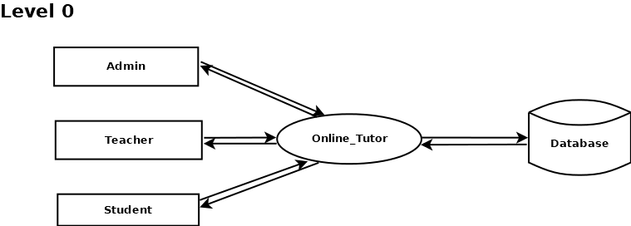
DATA FLOW DIAGRAM
Request
Response
Request
Request
Response
Response
Request
Response

Slide 19
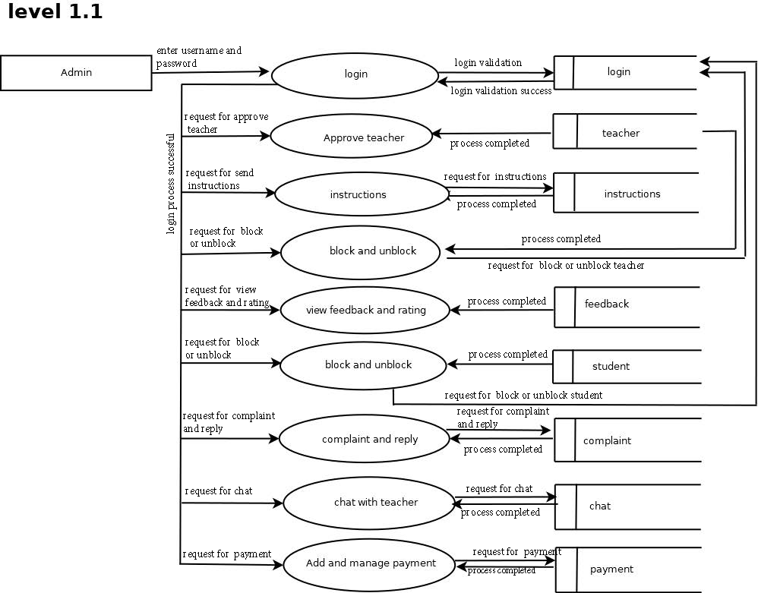
l
t

Slide 20
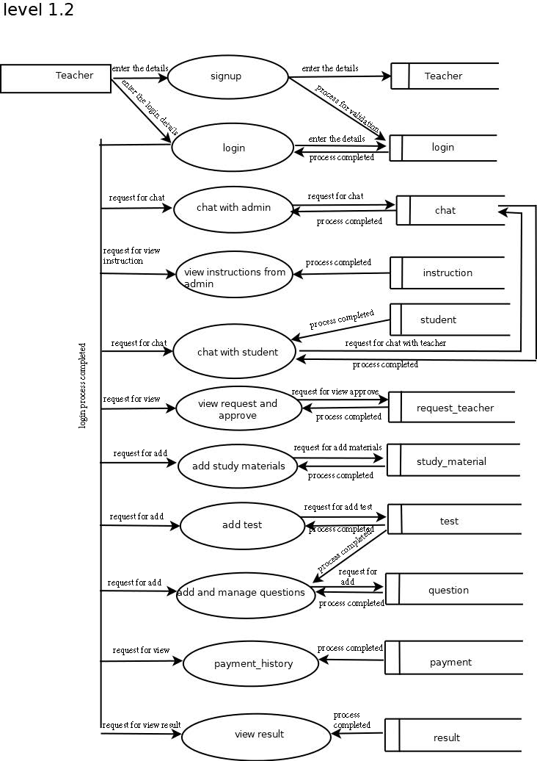

Slide 21
