Slide 1
Title
Internationalization
Internationalization under Spring framework
Walker Ji

Slide 2







outline
1
What is i18n
Why we use i18n
2
outline
Use i18n with Spring framework
3
Common issue
Common issue and solution
4

Slide 3
01
What is i18n

Slide 4
What is i18n
延迟符
Internationalization (i18n) is the process of designing an application
so that it can be adapted to different languages and regions,
without requiring engineering changes.

Slide 5
02
Why we use i18n

Slide 6
Why we use i18n
延迟符
Build once, sell anywhere
By configuring the locale, application will suit for anywhere without requiring engineering changes.
Reason
Modularity demands it
Don’t want to have to search through many files for words to translate, ease of translation
Non-Latin Characters
With the addition of localization data, the same executable can be run worldwide, for instance, Arabic and China, the direction of words is opposite

Slide 7

延迟符
How do we do internationalization?

Slide 8
03
Use i18n with Spring framework

Slide 9
Use i18n with Spring framework
延迟符
Theme
Localization
With theme, we can change the application’s style, like CSS, JS etc. .
With localization, we can change the message without any code change.

Slide 10
Use i18n with Spring framework
延迟符
Setup Spring framework under our IDE
Generate the language resources, such as language files, theme files
Generate the function to change the theme or language
Replace the hard code with Spring message code or theme code

Slide 11
Use i18n with Spring framework--Theme
延迟符
How we set theme under Spring framework?
Add ResourceBundleThemeSource, a class of Spring framework
Add resolver of different type, such as session, cookie, fixed
Add the controller to change the theme

Slide 12
Use i18n with Spring framework--Localization
延迟符
How we set localization under Spring framework?
Add ResourceBundleMessageSource, a class of Spring framework
Add resolver of different type, such as session, cookie, default
Add the controller to change the localization

Slide 13
Use i18n with Spring framework--Demo
延迟符
How we set localization under Spring framework?
Add ResourceBundleMessageSource, a class of Spring framework
Add resolver of different type, such as session, cookie, default
Add the controller to change the localization

Slide 14
04
Common issue

Slide 15
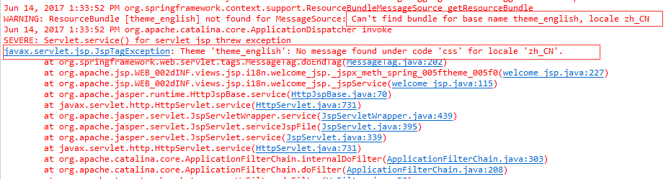
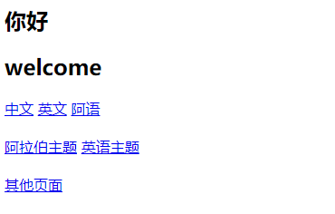

Common issue
延迟符
Issue 1
The bean id is not the default value, the default value is themeSource for ResourceBundleThemeSource, themeResolver for ThemeResolver
Issue 2
Because of the security of SpringMVC, the CSS, JS etc. files can’t access by the request
Solution1: we can add the except at web.xml
Solution2: we can add a filter at Spring’s configuration file
Issue 3
When we changed the type of the theme, and it’s not work, it’s maybe because of the style file is not at the same path according to the theme property file. So we need to reconcile the path of the file with the value defined by the theme property.

Slide 16
THANK YOU
THANK YOU
Walker Ji
PPT模板下载：www.1ppt.com/moban/ 行业PPT模板：www.1ppt.com/hangye/
节日PPT模板：www.1ppt.com/jieri/ PPT素材下载：www.1ppt.com/sucai/
PPT背景图片：www.1ppt.com/beijing/ PPT图表下载：www.1ppt.com/tubiao/
优秀PPT下载：www.1ppt.com/xiazai/ PPT教程： www.1ppt.com/powerpoint/
Word教程： www.1ppt.com/word/ Excel教程：www.1ppt.com/excel/
资料下载：www.1ppt.com/ziliao/ PPT课件下载：www.1ppt.com/kejian/
范文下载：www.1ppt.com/fanwen/ 试卷下载：www.1ppt.com/shiti/
教案下载：www.1ppt.com/jiaoan/ PPT论坛：www.1ppt.cn

