Slide 1
Title
Internationalization
Internationalization under Spring framework
Walker Ji

Slide 2

Introduction
Why we need theme, is i18n not enough?
Yes, as we know, the i18n will change the language for the region, but it only change the language, the style will keep as before.
Moreover, if we want to make our project suit for different regions’ style, such as China, English, or Arabic, we need theme to help us to do this.

Slide 3







outline
1
What is i18n
Why we use i18n
2
outline
Use i18n with Spring framework
3
Common issue
Common issue and solution
4

Slide 4
01
What is i18n

Slide 5
What is i18n
延迟符
Internationalization (i18n) is the process of designing an application
so that it can be adapted to different languages and regions,
without requiring engineering changes.

Slide 6
02
Why we use i18n

Slide 7
Why we use i18n
延迟符
Build once, sell anywhere
By configuring the locale, application will suit for anywhere without requiring engineering changes.
Reason
Modularity demands it
Don’t want to have to search through many files for words to translate, ease of translation
Non-Latin Characters
With the addition of localization data, the same executable can be run worldwide, for instance, Arabic and China, the direction of words is opposite

Slide 8

延迟符
How do we Implement i18n?

Slide 9
03
Use i18n with Spring framework

Slide 10
Use i18n with Spring framework
延迟符
Theme
Localization
With theme, we can change the application’s style, like CSS, JS etc. .
With localization, we can change the message without any code change.

Slide 11
Use i18n with Spring framework
延迟符
Setup Spring framework under our IDE
Generate the language resources, such as language files, theme files
Generate the function to change the theme or language
Replace the hard code with Spring message code or theme code

Slide 12
Use i18n with Spring framework--Theme
延迟符
How we set theme under Spring framework?
Add ResourceBundleThemeSource, a class of Spring framework
Add resolver of different type, such as session, cookie, fixed
Add the controller to change the theme

Slide 13
Use i18n with Spring framework--Localization
延迟符
How we set localization under Spring framework?
Add ResourceBundleMessageSource, a class of Spring framework
Add resolver of different type, such as session, cookie, default
Add the controller to change the localization

Slide 14
Use i18n with Spring framework--Demo
延迟符
Here is a demo of i18n and theme
You can follow the step to start your own international project

Slide 15
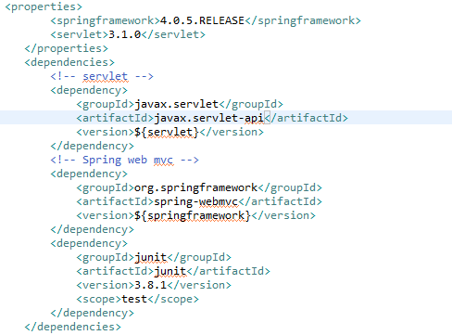
Setup project by Maven
Here we use Spring 4.0.5 version
We setup our web project by Maven, and it is very easy to configure our web project.
Here is the dependencies we will use.

Slide 16
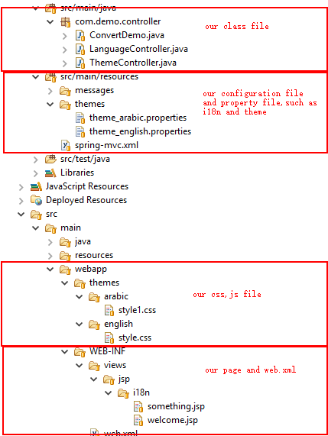
Our project structure

Slide 17
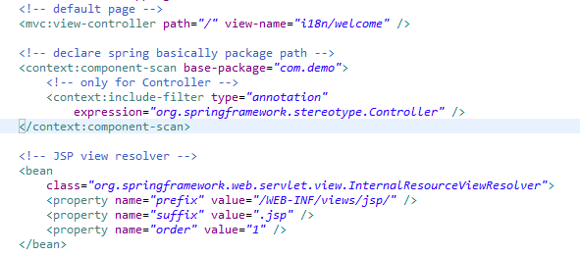
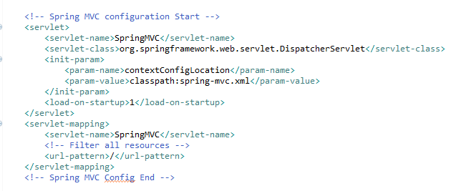
Configure the SpringMVC
The keyword “classpath:” make our web container find the configuration file under the web project classpath.

Slide 18
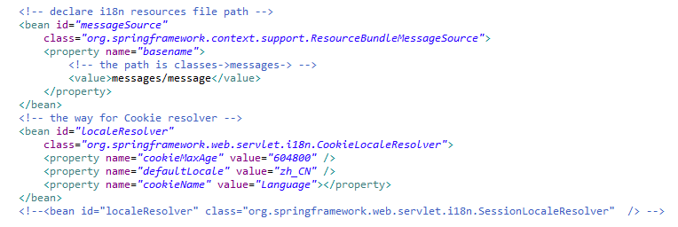
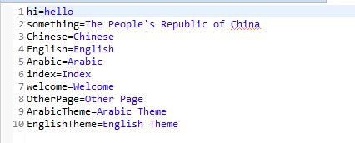
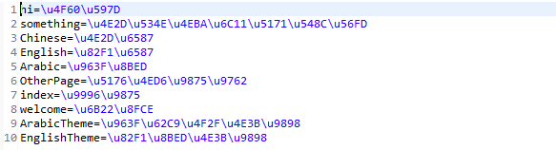
Configure i18n parameter
I18n has there resolver, and the configuration is all the same, here we use CookieLocaleResolver, witch is most widely used by web project.

Slide 19
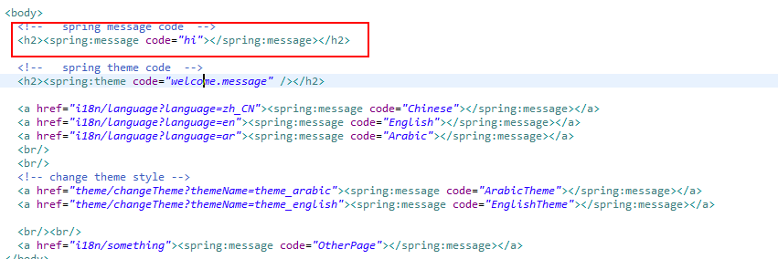
Configure i18n parameter
We need to import the spring markup
And then we use “<spring: message code = “your language code from property file ”></spring: message>” to implement the i18n function

Slide 20
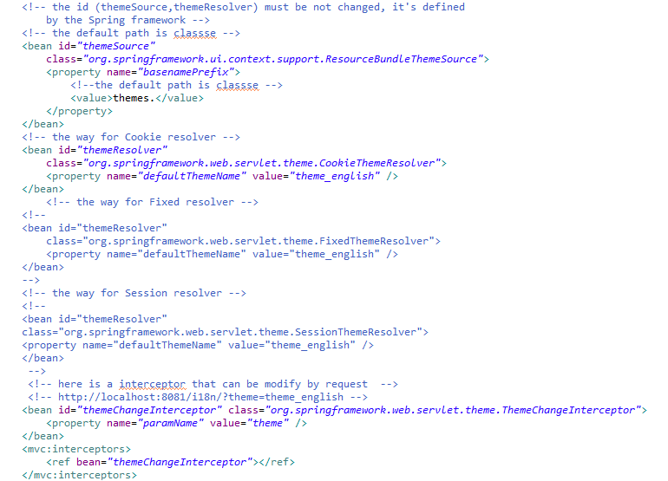
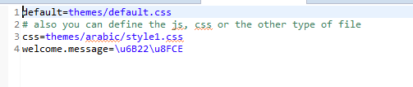

Configure theme parameter
Here list whole type of the configuration of theme, such as fixed, session, and cookie.
And here is also add a interceptor to change the theme by request.
Before each configuration, there is a comment that will tell you what is the use of this configuration.
The property file can contain the CSS, the JS, and the image you want to use, etc.

Slide 21
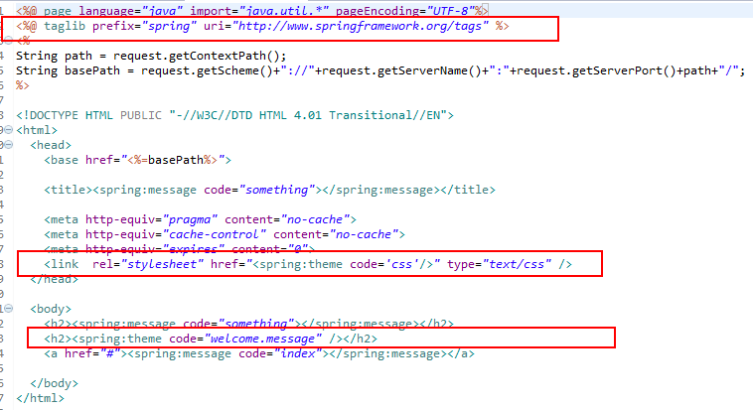
Configure theme parameter
We need to import the spring markup
And then we use “<spring: theme code = “your language code from property file ”></spring: theme >” to implement the theme function.
please kindly note that here we use theme code, not message code.

Slide 22
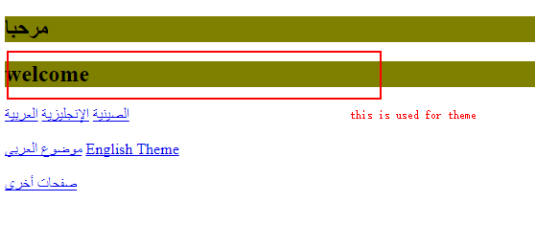
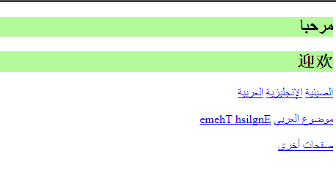
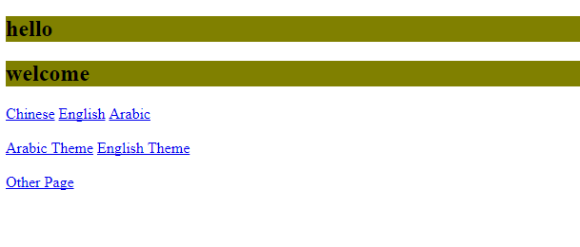
The result
延迟符
Scenario1
Scenario2
Scenario3
First, we use the default theme, and default language.
If we click the Arabic Theme, the page style will suit for Arabic.
When we click the Arabic, the language will change into Arabic, we don’t change any code. As you see, the page style is still for English.

Slide 23
04
Common issue

Slide 24
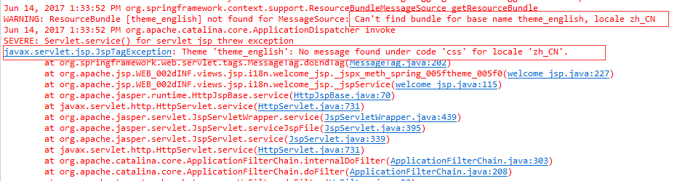
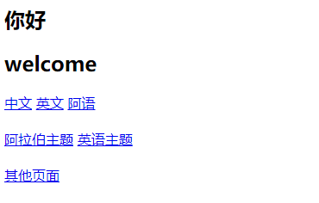

Common issue
延迟符
Issue 1
The bean id is not the default value, the default value is themeSource for ResourceBundleThemeSource, themeResolver for ThemeResolver
Issue 2
Because of the security of SpringMVC, the CSS, JS etc. files can’t access by the request
Solution1: we can add the except at web.xml
Solution2: we can add a filter at Spring’s configuration file
Issue 3
When we changed the type of the theme, and it’s not work, it’s maybe because of the style file is not at the same path according to the theme property file. So we need to reconcile the path of the file with the value defined by the theme property.

Slide 25
THANK YOU
THANK YOU
Walker Ji
PPT模板下载：www.1ppt.com/moban/ 行业PPT模板：www.1ppt.com/hangye/
节日PPT模板：www.1ppt.com/jieri/ PPT素材下载：www.1ppt.com/sucai/
PPT背景图片：www.1ppt.com/beijing/ PPT图表下载：www.1ppt.com/tubiao/
优秀PPT下载：www.1ppt.com/xiazai/ PPT教程： www.1ppt.com/powerpoint/
Word教程： www.1ppt.com/word/ Excel教程：www.1ppt.com/excel/
资料下载：www.1ppt.com/ziliao/ PPT课件下载：www.1ppt.com/kejian/
范文下载：www.1ppt.com/fanwen/ 试卷下载：www.1ppt.com/shiti/
教案下载：www.1ppt.com/jiaoan/ PPT论坛：www.1ppt.cn

