Slide 1
Motor control
fel

Slide 2
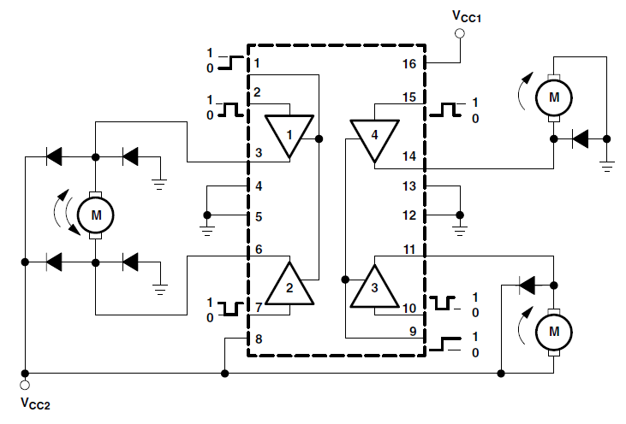
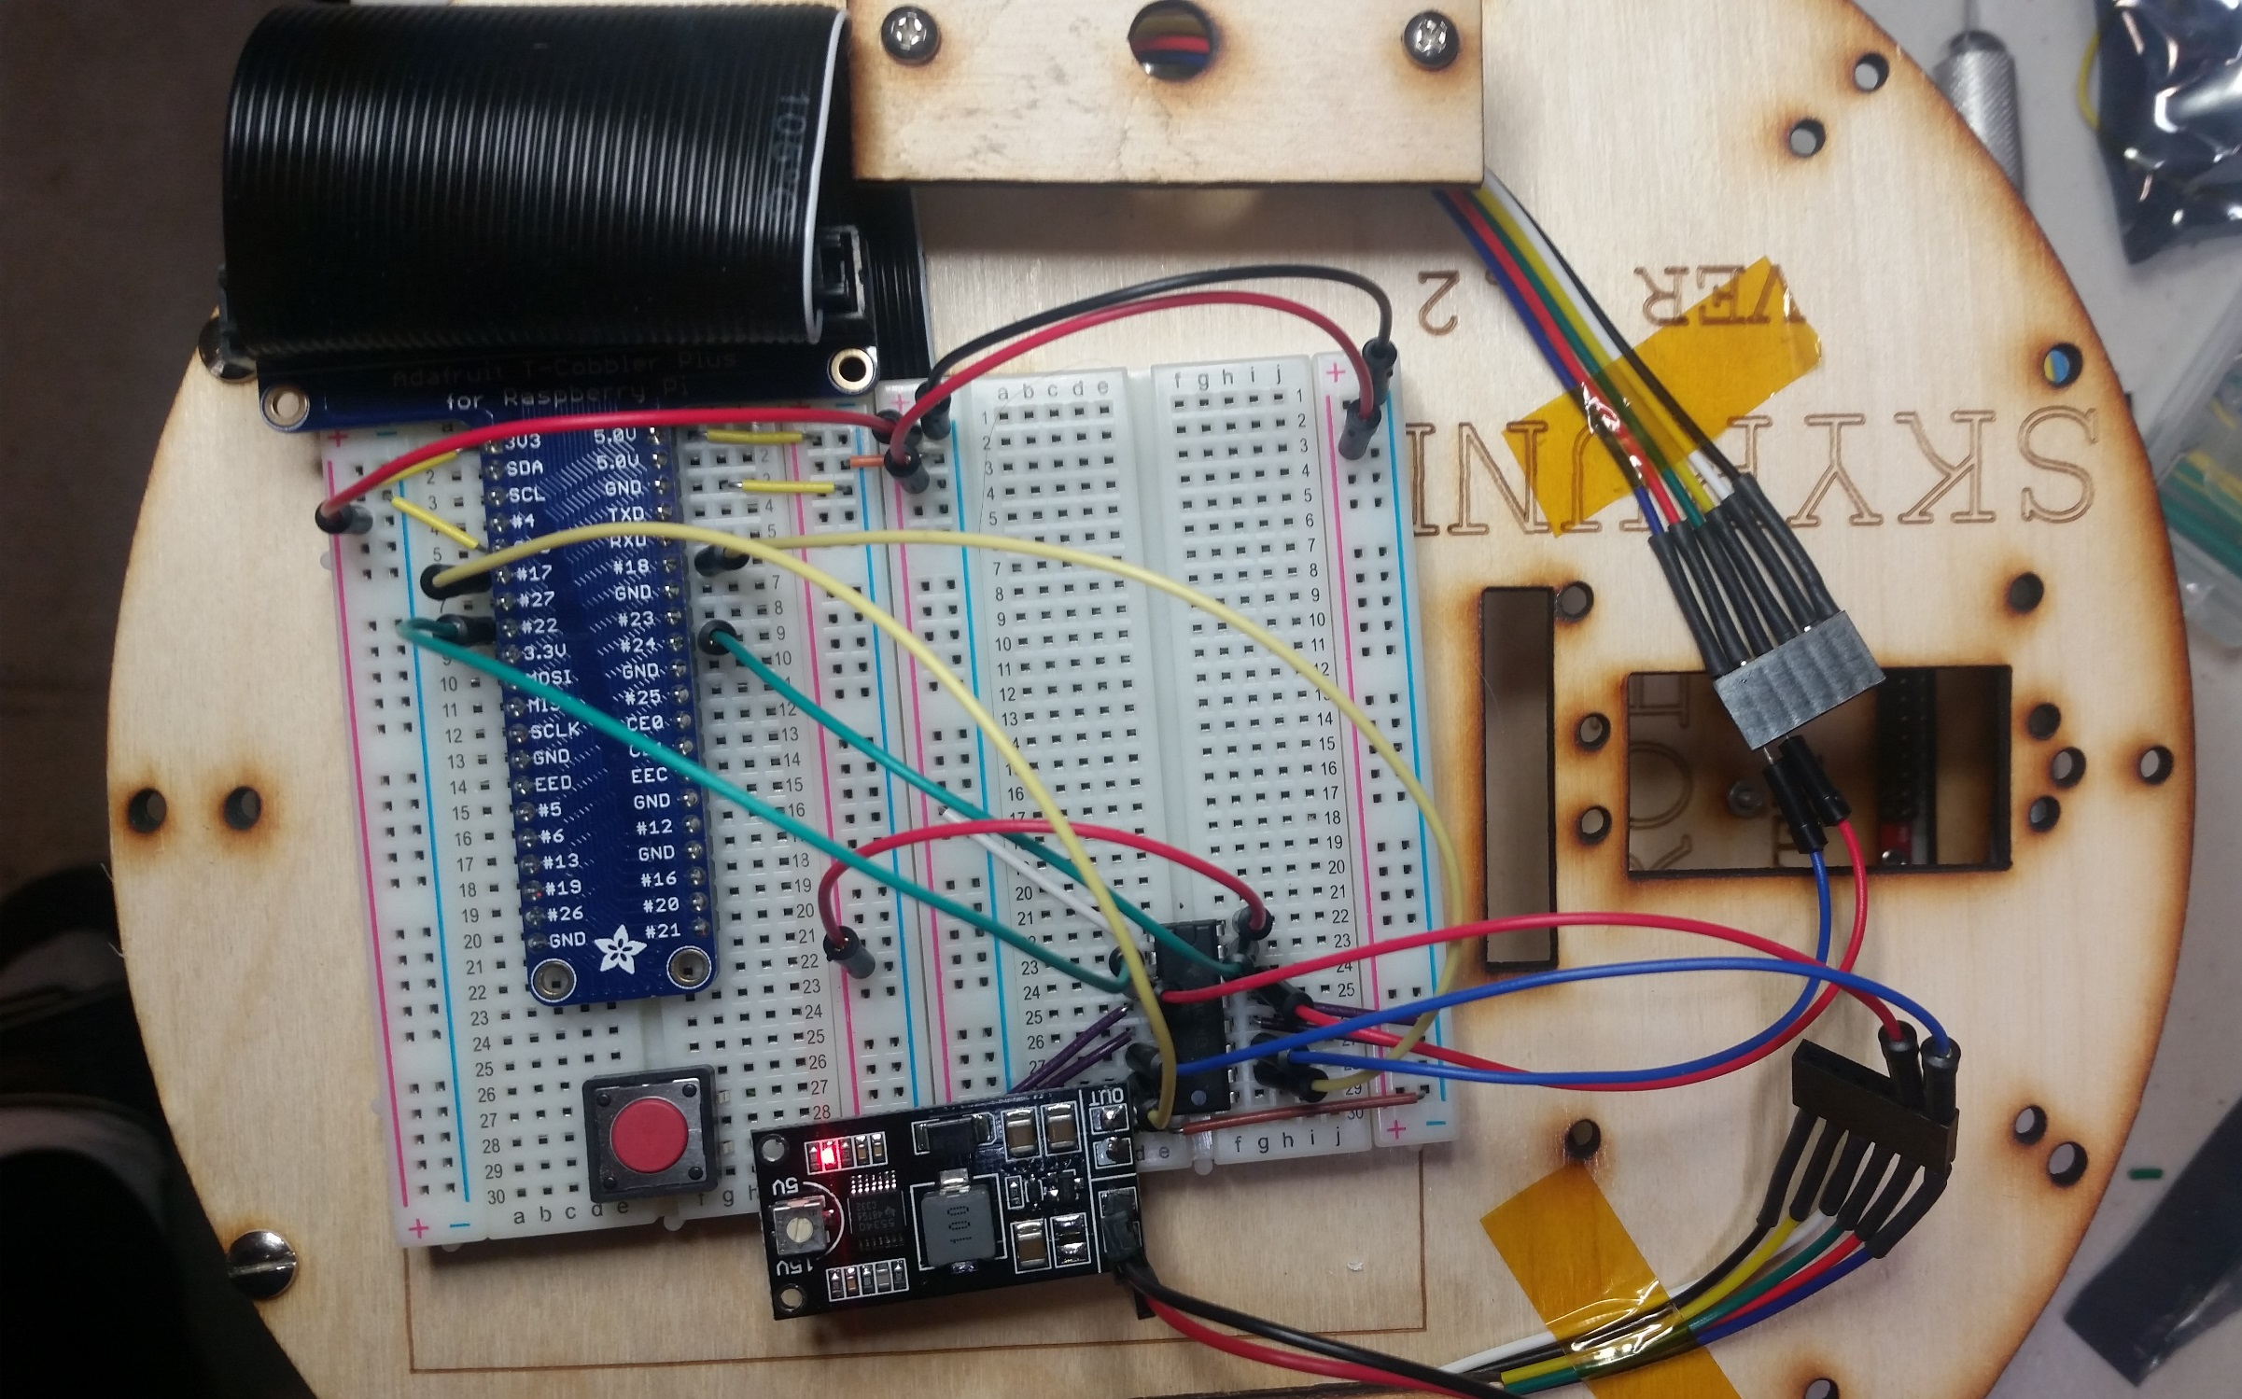
(NC)
PinRF = GPIO22
PinLF = GPIO18
40 pin parallel cable to raspberry pi
PinLB=GPIO24
PinRB = GPIO17
(NC)
Solder less breadboard
DC Motor wires
5V supply
L293 motor IC
PIN1
3.3V supply
DC Motor wires
Voltage Booster

Slide 3
MOTOR DRIVER AND VOLTAGE BOOSTER
GPIO pin is not able to supply high current to drive the motor (> 250mA)
Typical GPIO pin can supply 2-10mA at a max voltage of 3.3V
A motor driver and voltage booster are needed
To allow higher voltage (6V) and drive current (up to 1A) to drive the motor
To allow a low drive GPIO pin (voltage/current) to control the speed of motor using PWM
To allow directional control of the motor rotation

Slide 4
Motor control
GPIO Pin | FORWARD | BACKWARD | GO LEFT | GO RIGHT | STOP
PinLF(22) | High / 255 | Low | Low | High | LOW
PinLB(17) | Low / 0 | High | High | Low | LOW
PinRF(24) | High / 255 | Low | High | Low | LOW
PinRB(18) | Low / 0 | High | Low | High | LOW

Slide 5
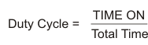
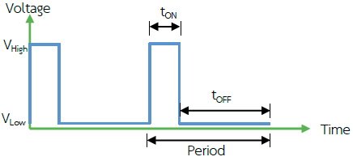
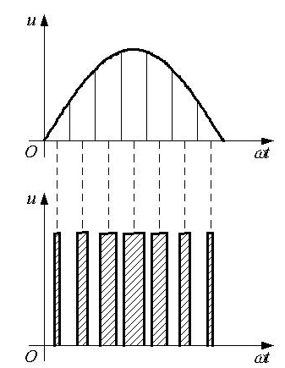
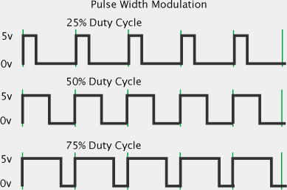



PWM Review

Slide 6
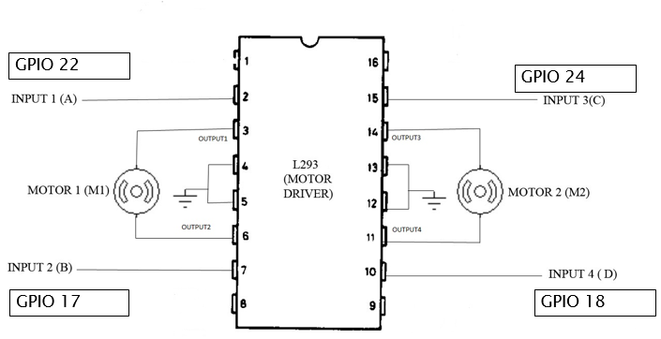

Slide 7
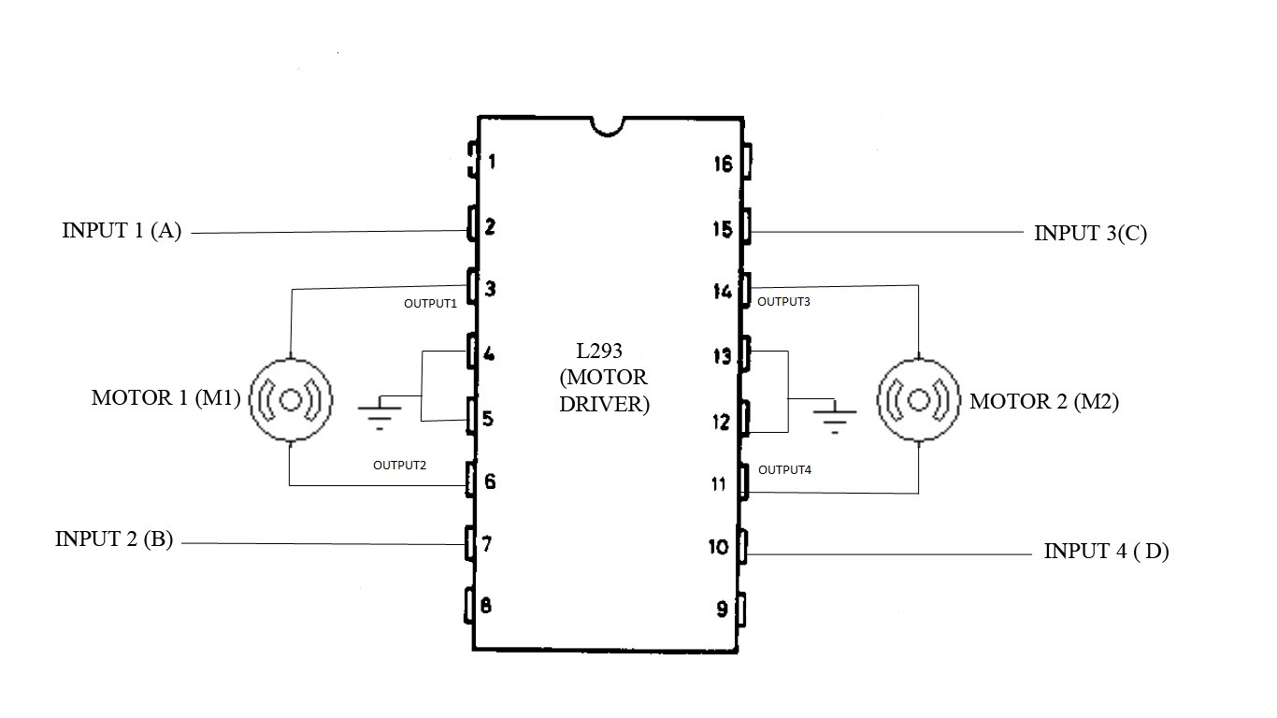
Motor Control / FORWARD
HIGH/255
HIGH/255
GPIO 22 / PinLF
GPIO 24/PinRF
HIGH
HIGH
GPIO 17 / PinLB
GPIO 18/PinRB
LOW / 0
LOW/0

Slide 8
Motor Control / BACKWARD
LOW/ 0
LOW/ 0
GPIO 22 / PinLF
GPIO 24/PinRF
HIGH
HIGH
GPIO 17 / PinLB
GPIO 18/PinRB
HIGH / 255
HIGH / 255

Slide 9
Motor Control / TURN LEFT
LOW/ 0
HIGH/ 255
GPIO 22 / PinLF
GPIO 24/PinRF
HIGH
HIGH
GPIO 17 / PinLB
GPIO 18/PinRB
HIGH / 255
LOW/ 0

Slide 10
Motor Control / TURN RIGHT
HIGH/255
LOW/0
GPIO 22 / PinLF
GPIO 24/PinRF
HIGH
HIGH
GPIO 17 / PinLB
GPIO 18/PinRB
LOW/0
HIGH/255

Slide 11
Motor Control / STOP
LOW/0
LOW/0
GPIO 22 / PinLF
GPIO 24/PinRF
HIGH
HIGH
GPIO 17 / PinLB
GPIO 18/PinRB
LOW/0
LOW/0

Slide 12
Motor Control / ??????
HIGH/255
HIGH/255
GPIO 22 / PinLF
GPIO 24/PinRF
HIGH
HIGH
GPIO 17 / PinLB
GPIO 18/PinRB
HIGH/255
HIGH/255

Slide 13
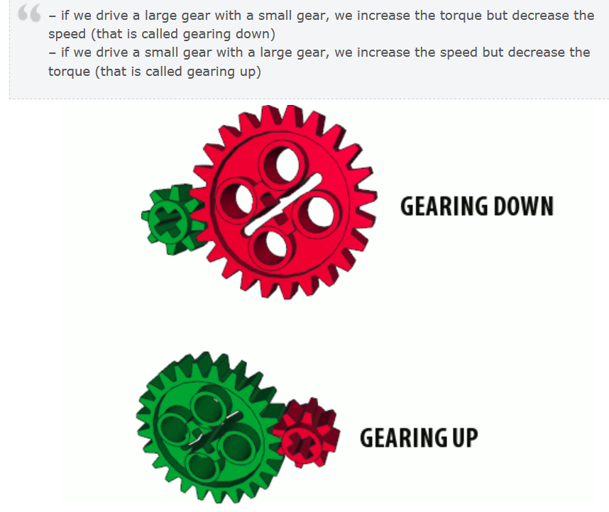
Gears & Torque

Slide 14
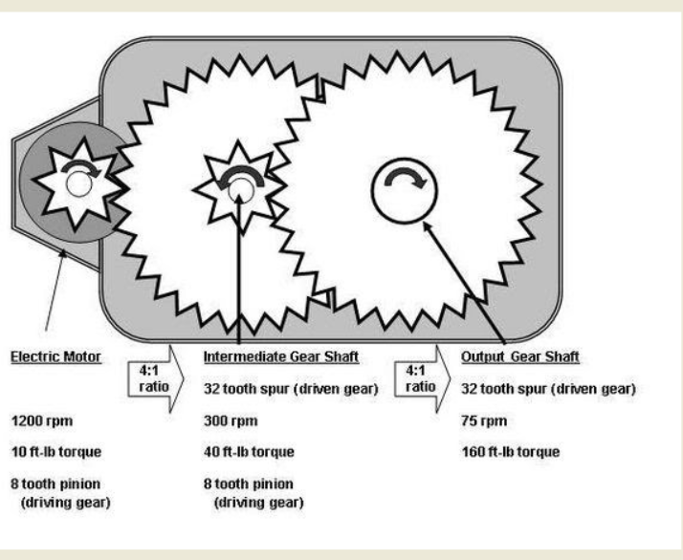
Gears & Torque

