Slide 1
Line Sensor (Feedback For Autonomous Operation)
Line sensor detects if there is a line on the floor
Consists of 2 elements
Line sensor
ADC which stands for Analog-to-digital converter ( 8channels)
Raspberry pi will talk to the ADC chip with SPI bus
SPI stands for Serial Peripheral Bus.
High speed serial bus
Motor
Motor IC
RPI
ADC IC
Line sensor
Chassis
Motor

Slide 2
Feedback Control, Autonomous mode
USER CONTROL
AUTONOMOUS
Sensor inputs
Read voltage of 8 sensors
Make a decision on where the line is relative to the 8 sensors
Generate Error signals: how much is the offset from center or going straight. Left and Right wheels have separate error signals
Use the error signals to decide how to drive the 2 PWM GPIO pins
Keyboard inputs
Feedback Control
PWM signal using GPIO pins
PWM signal using GPIO pins
Directional and Speed Control
Directional and Speed Control

Slide 3
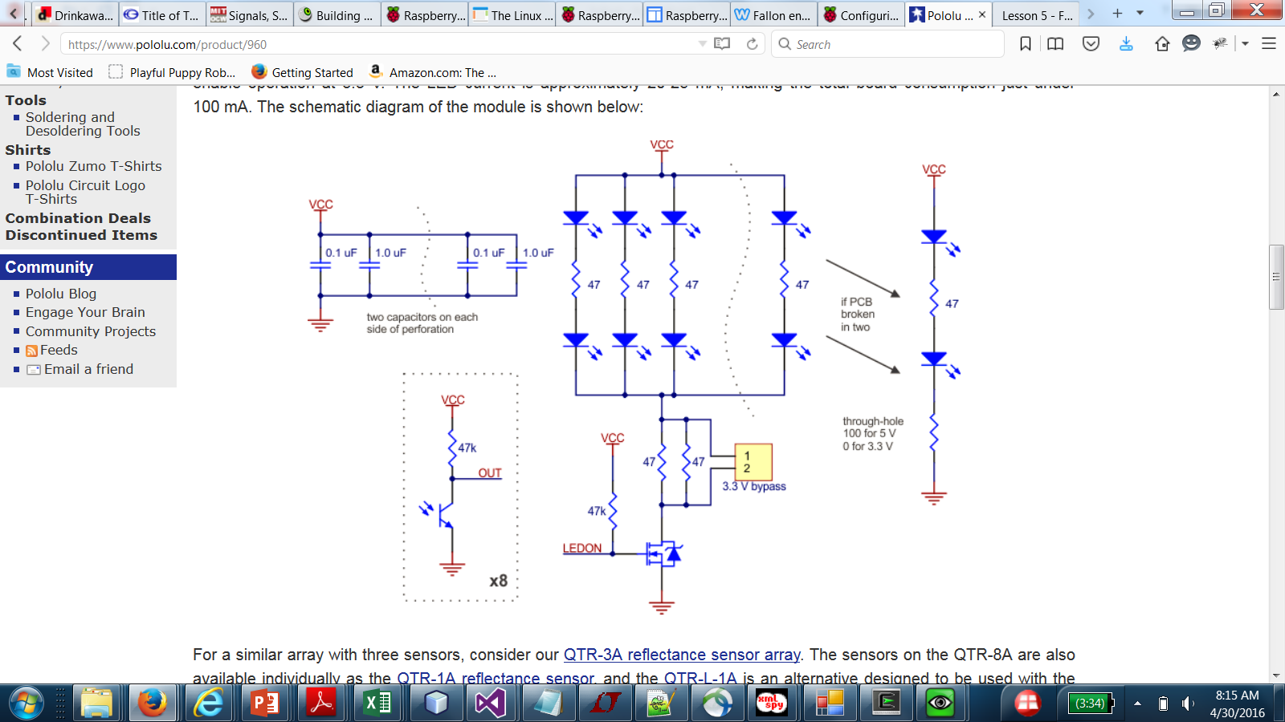
How Does The LineSensor Work
If there is reflection from the floor, then the light sensitive transistor will turn on the voltage will be low
If there is no reflection, ie a black surface where the light is absorbed, then the light sensitive transistor is off and voltage is high
Purpose of ADC
Measure the voltage
convert to 10 bits number
Python driver
Read the 10 bit number
Decide if a line is present by comparing it to a threshold voltage
ADC

Slide 4
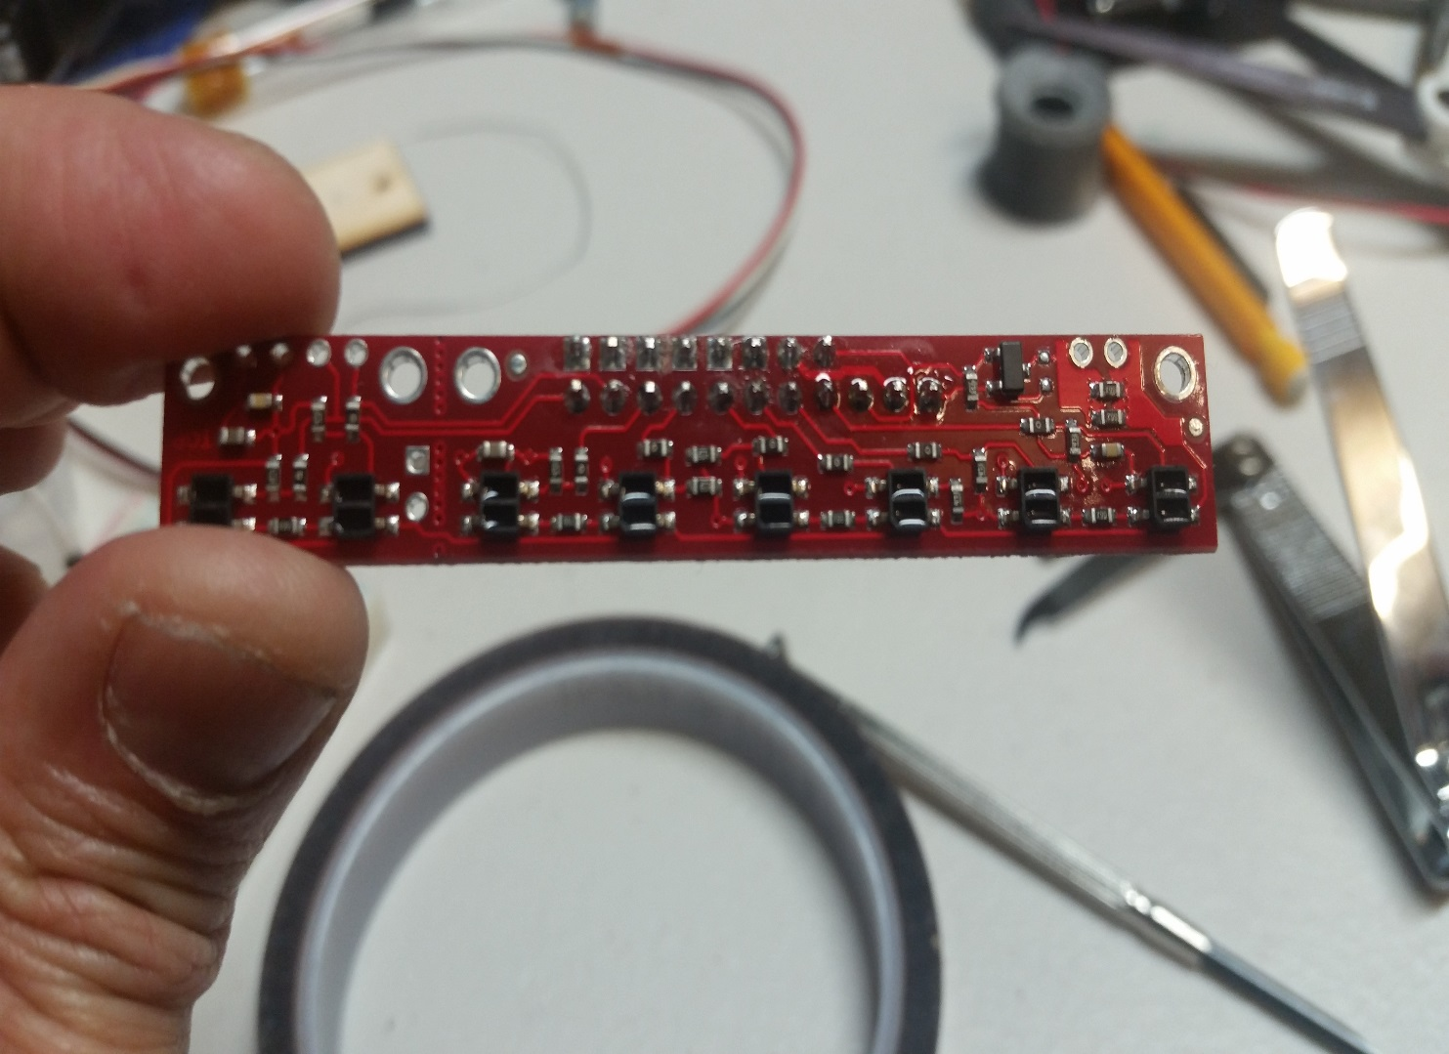
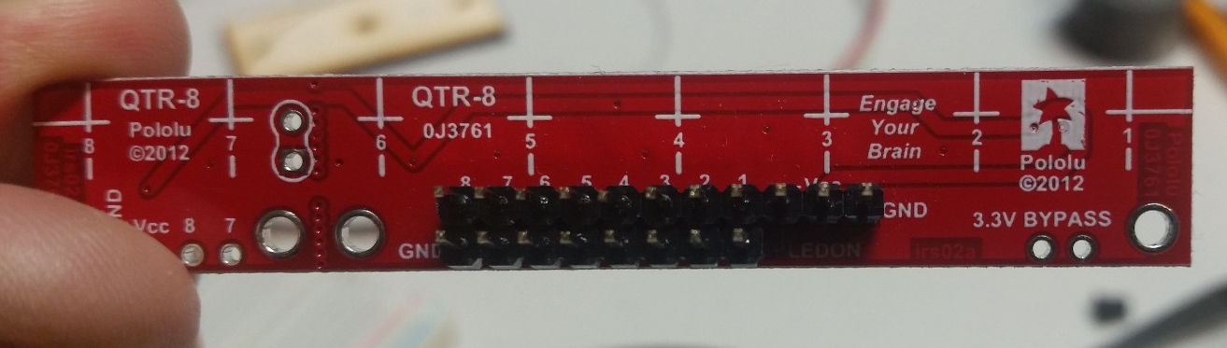
Line Sensor Top View
Infra-Red transmit LED
Light Sensitive transistor
Header pins for voltage sense
3.3V power and ground

Slide 5
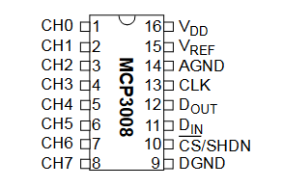
Wiring Line Sensors
Analog-to-digital Converter
3.3V
3.3V
GND
10 wires Ribbon cable
GPIO11 (SPI0_SCLK)
Line
GPIO09 (SPI0_MISO)
GPIO10 (SPI0_MOSI)
GPIO8 (SPI0_CS0)
GND
RPI GPIO Pin Connections

Slide 6
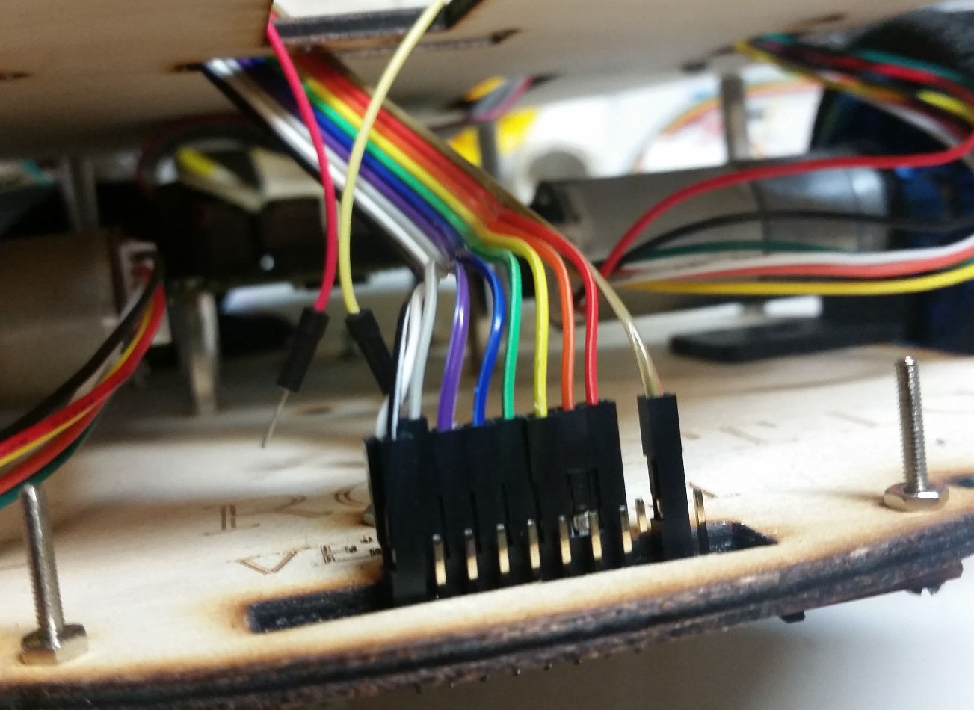
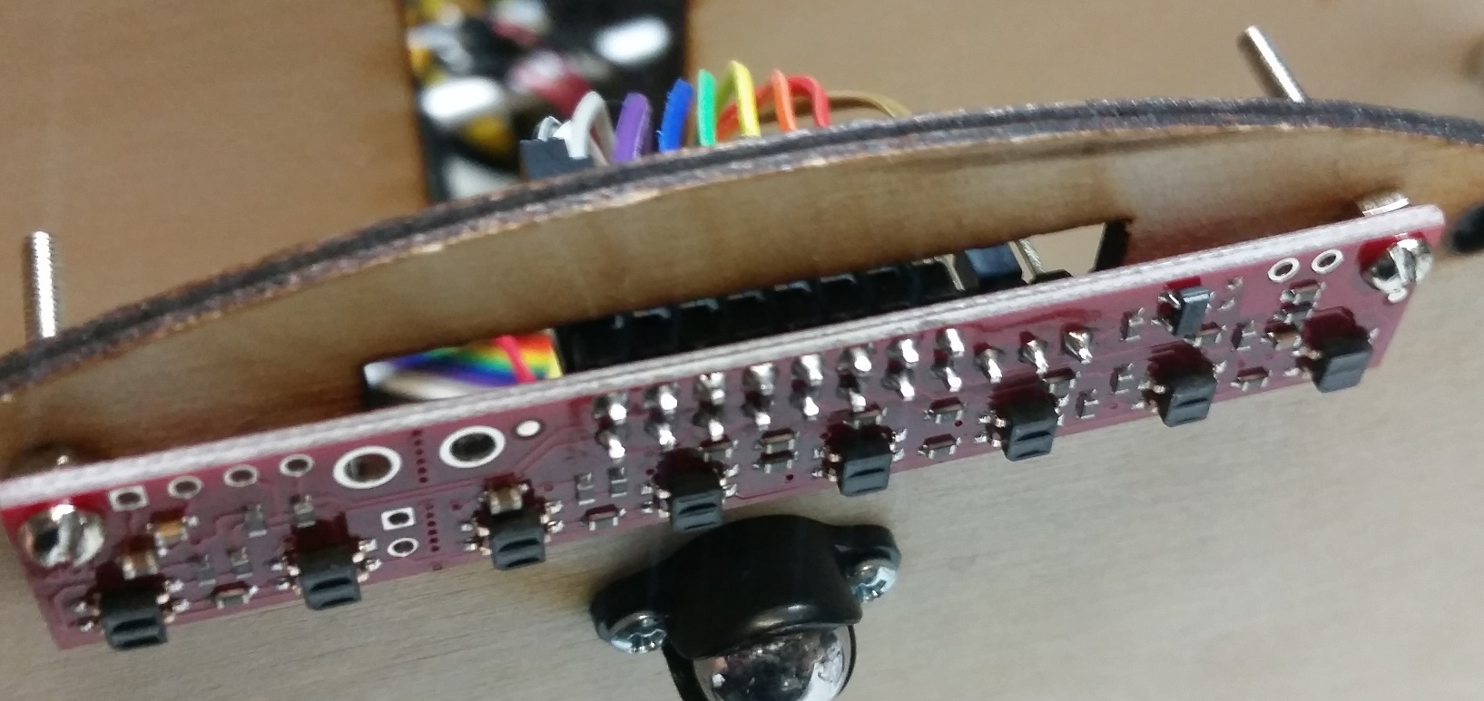
VCC
GND
Front row
Line sensors nearer to the caster wheels
asdfsf

Slide 7
Steering Control
Left Turn
Left Drift
Forward
Right Drift
Right Turn
Reverse
Steering is achieved by having a differential speed between the left wheels and right wheels
DiffSPD = abs(LeftWheelSpeed – RightWheelSpeed)

Slide 8
Error Signal Generations
Line
Line
Line
7
6
5
4
3
2
1
0
7
6
5
4
3
2
1
0
7
6
5
4
3
2
1
0
Error, steer left
RightError = LINE_DETECT[2] + (LINE_DETECT[1] * 4.) = 0
LeftError = LINE_DETECT[5] + (LINE_DETECT[6] * 4.) = 1
Steer Straight, no error
No differential speed
Error, steer right
RightError = LINE_DETECT[2] + (LINE_DETECT[1] * 4.) = 1
LeftError = LINE_DETECT[5] + (LINE_DETECT[6] * 4.) =0
Line
Line
7
6
5
4
3
2
1
0
7
6
5
4
3
2
1
0
Error, steer left
RightError = LINE_DETECT[2] + (LINE_DETECT[1] * 4.) = 0
LeftError = LINE_DETECT[5] + (LINE_DETECT[6] * 4.) =4
Error, steer right
RightError = LINE_DETECT[2] + (LINE_DETECT[1] * 4.) = 4
LeftError = LINE_DETECT[5] + (LINE_DETECT[6] * 4.) =0

Slide 9
Using Error Signal For Steering Control
Line
Line
Line
0
1
2
3
4
5
6
7
0
1
2
3
4
5
6
7
0
1
2
3
4
5
6
7
Error, steer left
RightError = LINE_DETECT[2] + (LINE_DETECT[1] * 4.) = 0
LeftError = LINE_DETECT[5] + (LINE_DETECT[6] * 4.) = 1
right = RightError
left = LeftError
# amplify error, assuming left > 0
DiffSPD = Kp * left
PIN_SPD = AvgVar + (DiffSPD/2) # left
PIN_SPD2 = AvgVar - (DiffSPD/2) #right
AvgVar is the average speed
pi.set_PWM_dutycycle(PIN_1, PIN_SPD) pi.set_PWM_dutycycle(PIN_3, PIN_SPD2)
Error, steer left
PIN_SPD = AvgVar + (DiffSPD/2) # left
PIN_SPD2 = AvgVar - (DiffSPD/2) #right
Steer Straight, no error
No differential speed
Line
0
1
2
3
4
5
6
7

