Slide 1
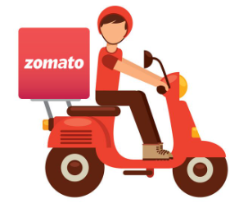
Exploratory Data Analysis on Zomato
An Insightful Analysis of Zomato Data

Slide 2
About the Project
This project is been made with the help of Google colaboratory notebook.
The dataset is been imported by google drive.
The link to the dataset is Indian_Restaurants.csv
In the project the dataset is been named df for the exploratory data analysis (EDA) and df.copy for visualization.
For the data cleaning purpose, I have used python library like numpy and pandas. For the data visualization I used matplotlib and seaborn.
The dataset comprises of 60417 rows and 26 columns.

Slide 3
About the Company
Zomato is an Indian multinational restaurant aggregator and food delivery company. It was founded by Deepinder Goyal and Pankaj Chaddah in 2008. Zomato provides information, menus and user-reviews of restaurants as well as food delivery options from partner restaurants in more than 1,000 Indian cities and towns.

Slide 4
Key facts about Zomato
Services Offered:
Restaurant Discovery: Helps users find and review restaurants based on cuisines, locations, and preferences.
Food Delivery: Partners with restaurants to deliver food directly to customers.
Table Booking: Allows users to reserve tables at partner restaurants.
Zomato Pro: A subscription-based service offering discounts on food delivery and dining out.
Grocery Delivery : Introduced during the COVID-19 pandemic as a response to changing customer needs.
Hyperpure : A platform for restaurants to source fresh and quality ingredients.

Slide 5
Global Presence: Initially started in India, Zomato now operates in multiple countries across Asia, the Middle East, Europe, and the Americas.
Acquisitions and Partnerships: Zomato has acquired several companies to expand its offerings, including Uber Eats India, Runnr, and TechEagle Innovations (for drone-based delivery research).
IPO: Zomato went public in July 2021, becoming one of the first Indian tech unicorns to list on the stock market.
Vision and Mission
Vision: To be the global leader in food and dining services by creating a seamless experience for both users and restaurant partners.
Mission: "Better food for more people" – promoting food safety, quality, and convenience.

Slide 6
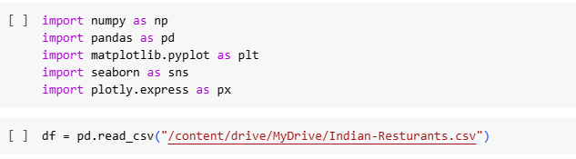

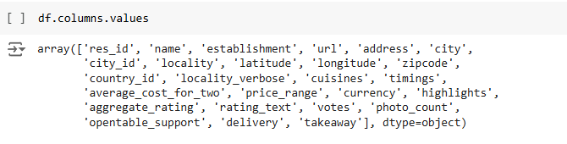
Imported Libraries and Column values and Shape of the Dataset

Slide 7

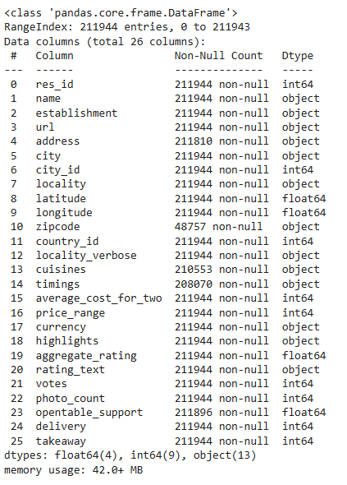
Column Information

Slide 8
Column Description
res_id : Unique identifier for the restaurant.
name: The name of the restaurant.
establishment: Type of the establishment (e.g., restaurant, café, bar).
url: Website or online link for the restaurant.
address: Physical location of the restaurant.
city: The city where the restaurant is located.
city_id: Unique identifier for the city.
locality: Specific area or neighborhood within the city.
latitude: Geographic latitude of the restaurant's location.
longitude: Geographic longitude of the restaurant's location.
zipcode: Postal code for the restaurant's address.
country_id: Unique identifier for the country where the restaurant is located.
locality_verbose: Detailed description of the locality.
cuisines: Types of cuisine offered (e.g., Italian, Chinese).
timings: Operating hours of the restaurant.
average_cost_for_two: Estimated average cost for two people to dine at the rest.

Slide 9
price_range: General price category (e.g., inexpensive, moderate, expensive).
currency: Currency used for pricing (e.g., USD, EUR).
highlights: Key features or attractions of the restaurant (e.g., outdoor seating,live music).
aggregate_rating: Overall rating based on customer reviews.
rating_text: Descriptive text related to the aggregate rating (e.g., "Excellent“,"Good").
votes: Number of votes or reviews the restaurant has received.
photo_count: Number of photos available for the restaurant.
opentable_support: Indicates if the restaurant supports OpenTable reservations.
delivery: Availability of food delivery services.
takeaway: Availability of takeaway food services.

Slide 10
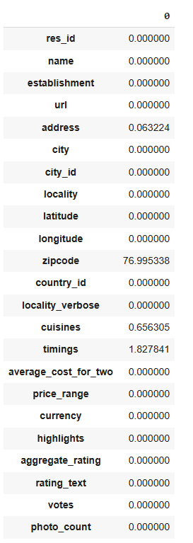


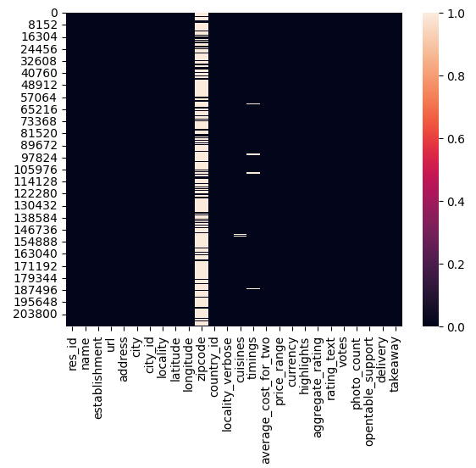

Slide 11

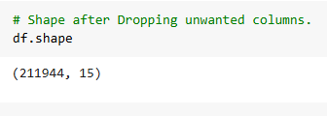
Data Cleaning and Preprocessing
In the initial step of data cleaning we have to make a copy of the data but here I have not made any copy.
First Step : we have to remove unwanted columns from the dataset like below shown.

Slide 12
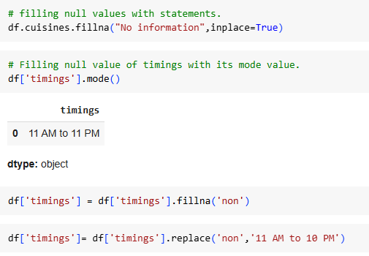
Second Step : Removing null values

Slide 13


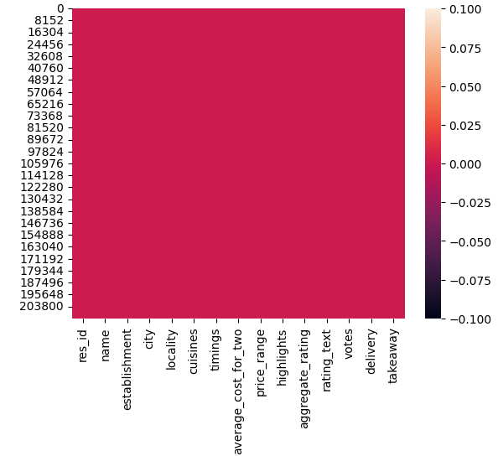
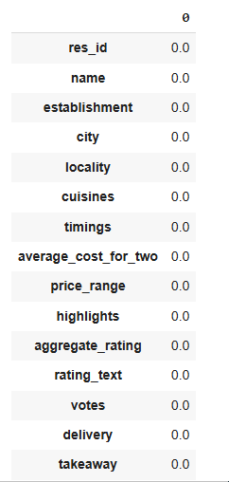
After data cleaning results

Slide 14
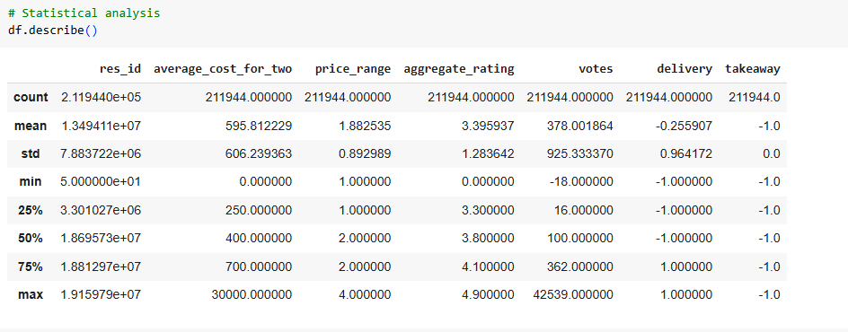

Exploratory Data Analysis

Slide 15
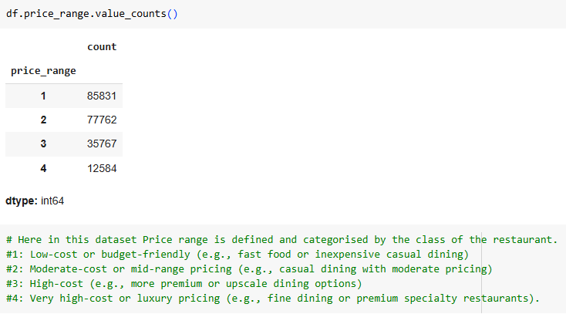

Slide 16
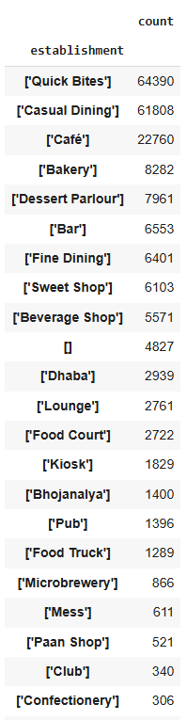

Here establishments defined by different types of place food ordered.
the one which shows [] are establishments which have not been defined.
It encompases 4827

Slide 17
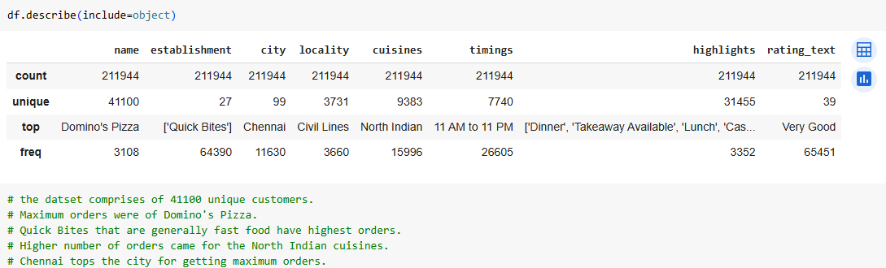

Slide 18
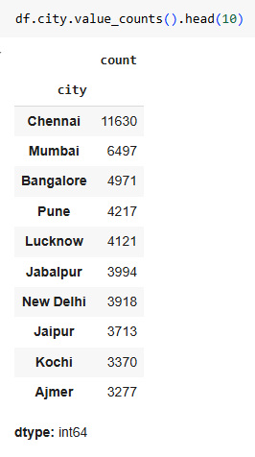

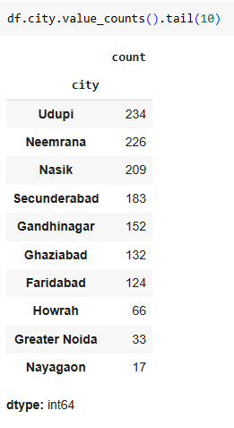

List of top 10
and
last 10 cities
Number of orders

Slide 19
DATA VISUALIZATION AND INSIGHTS

Slide 20
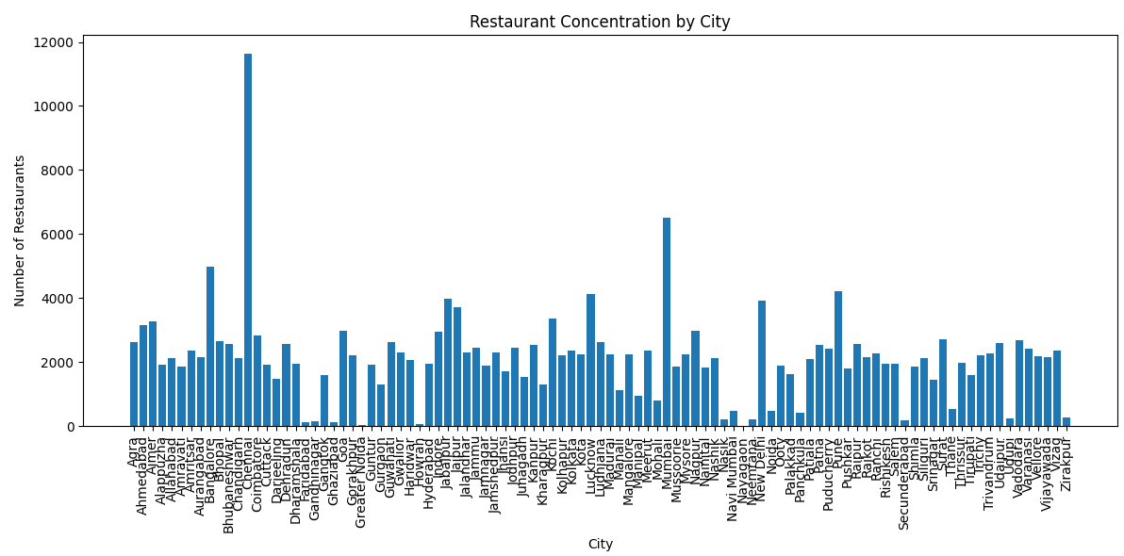
UNIVARIATE ANALYSIS - Analyze a single variable to understand its distribution or unique values.

Slide 21
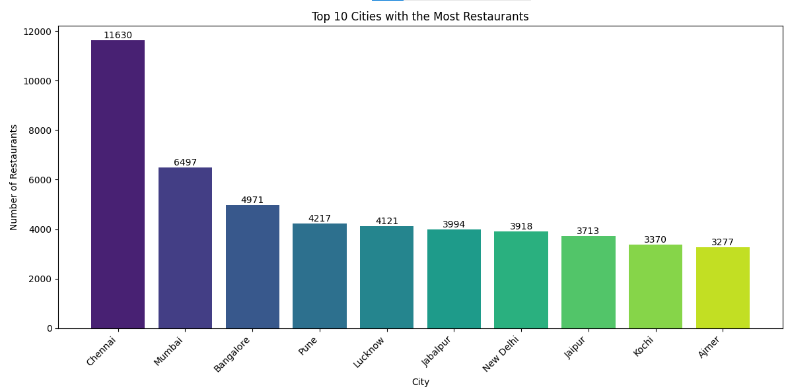

Slide 22
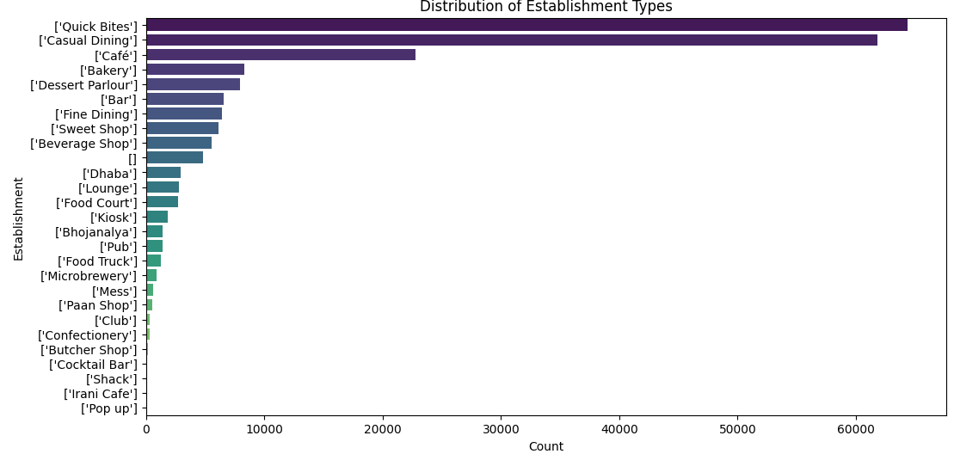

Slide 23
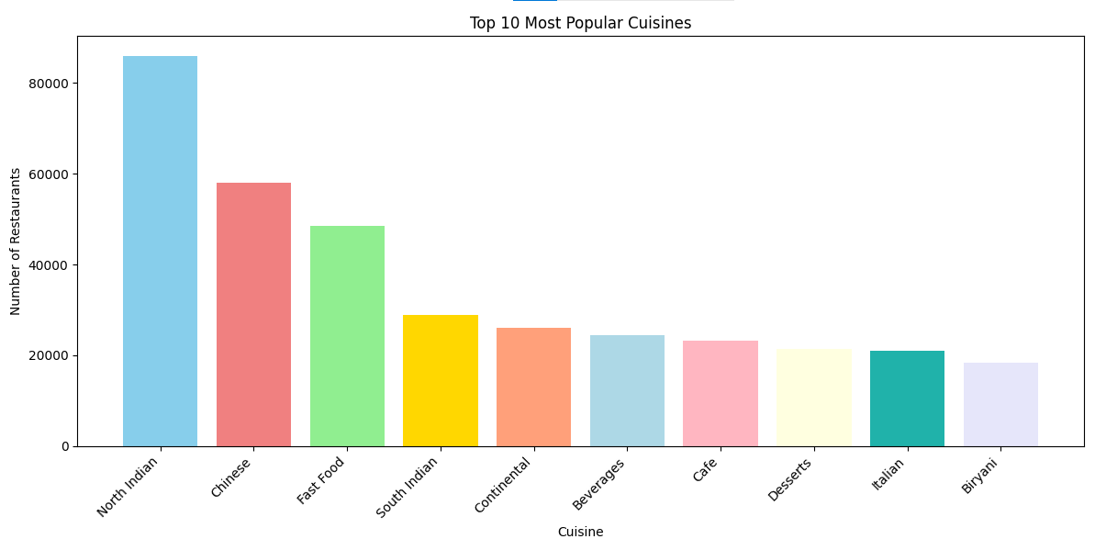

Slide 24
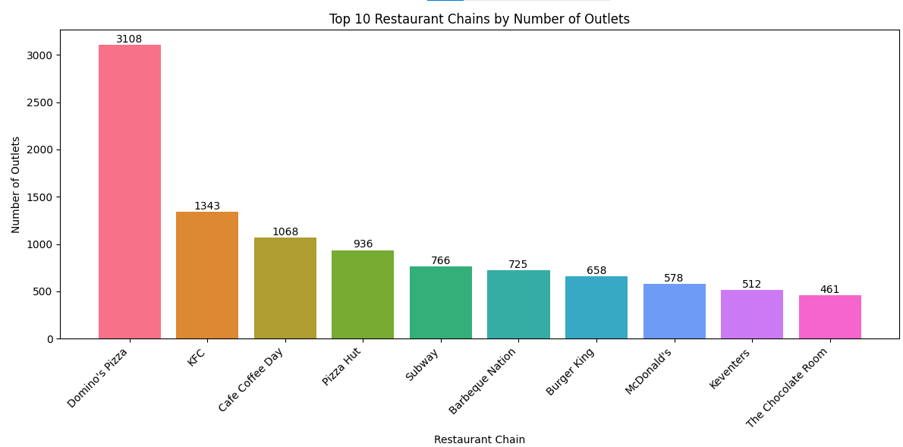

Slide 25
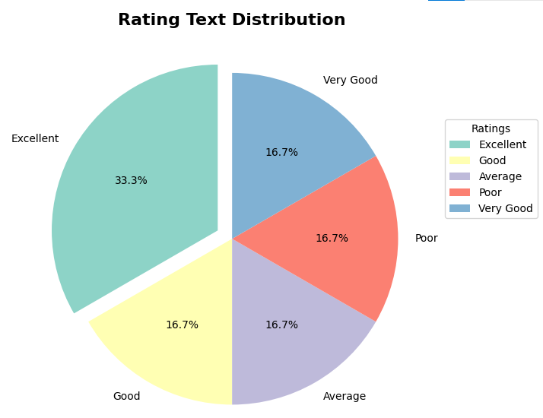

Slide 26
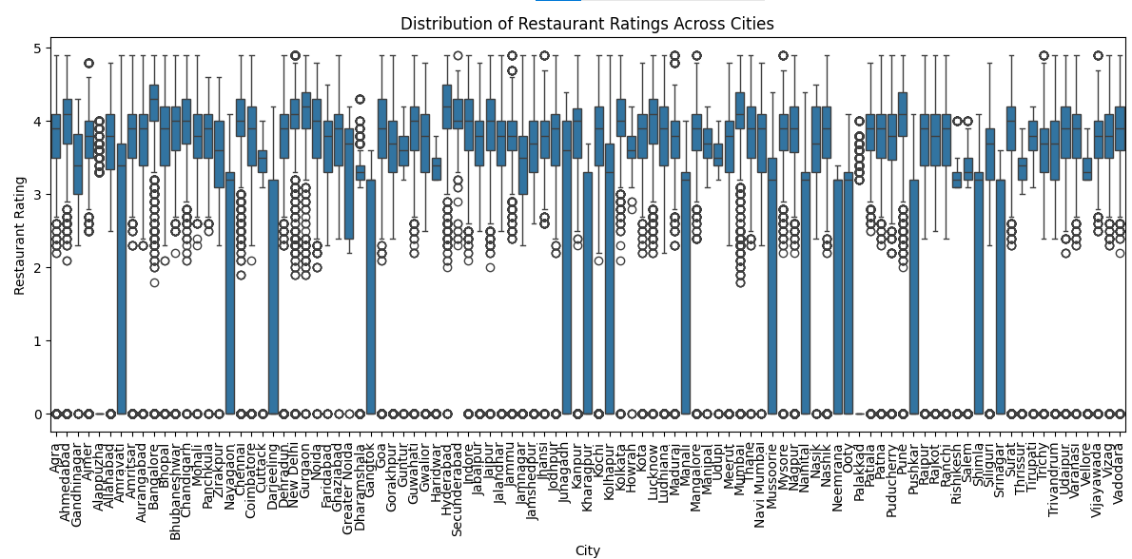

Slide 27
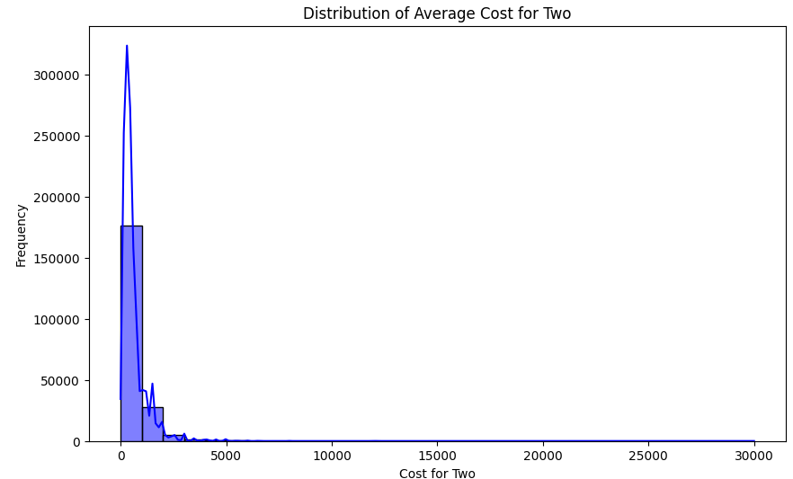
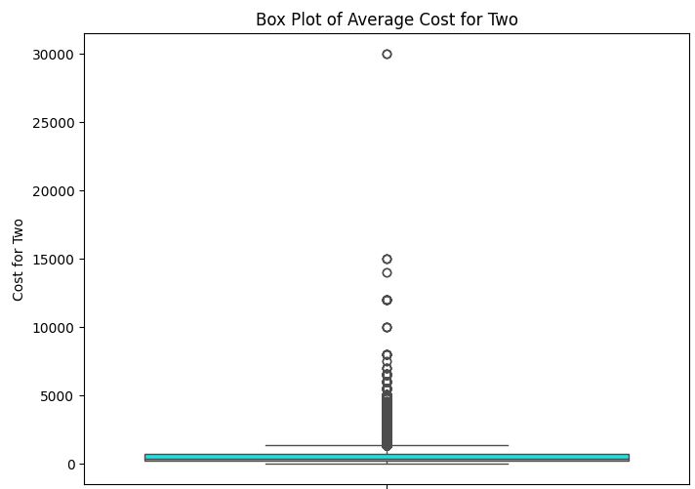

Slide 28
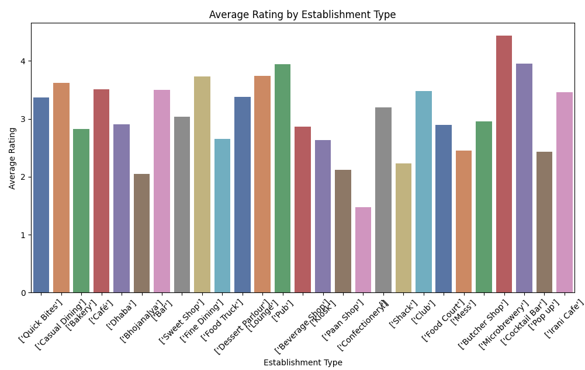
Bivariate Analysis - Analyze relationships between two variables.

Slide 29
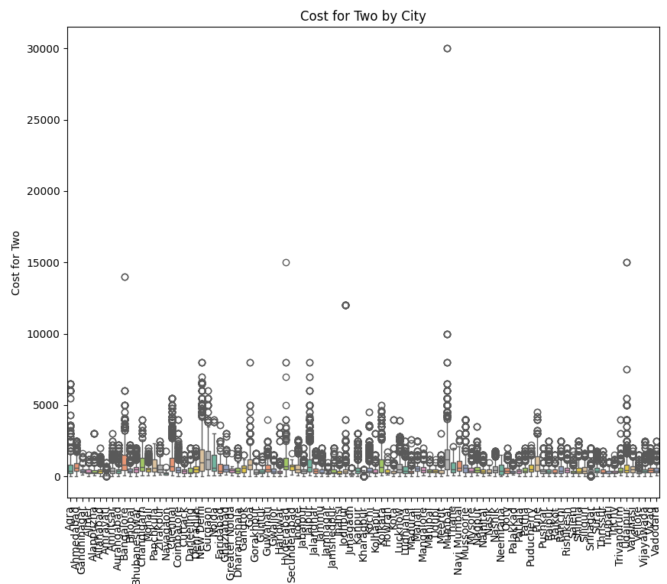

Slide 30
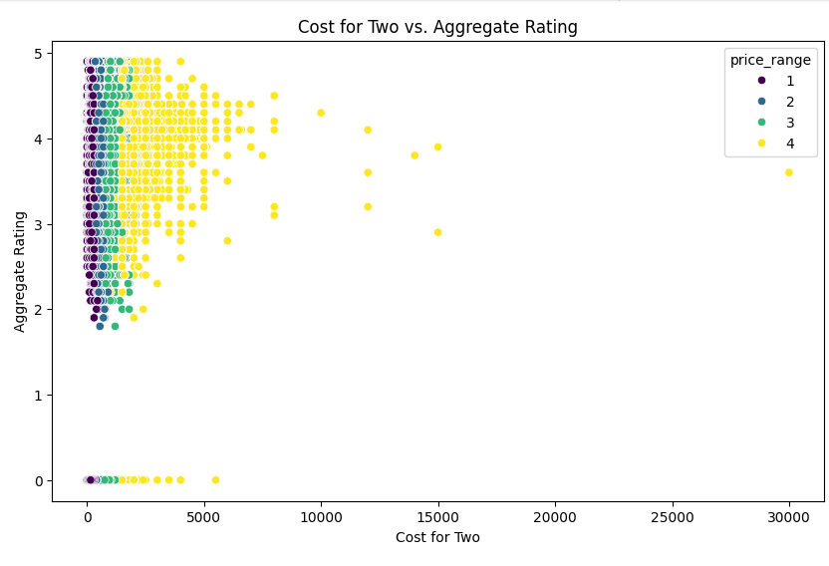

Slide 31
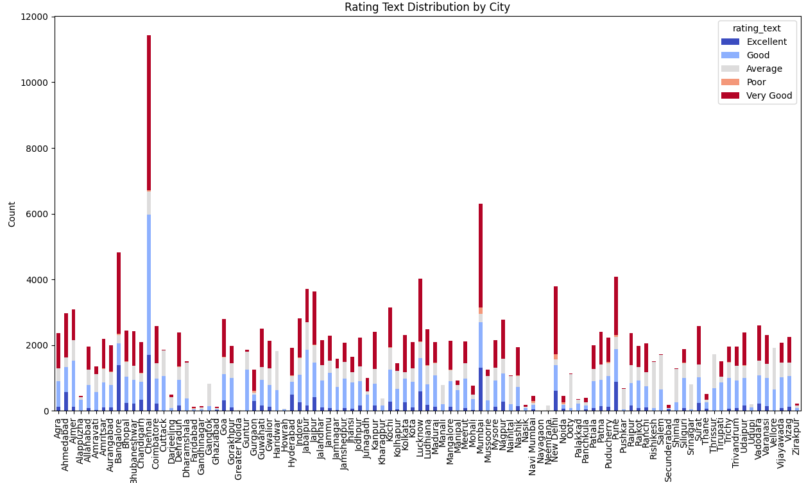
Multivariate Analysis - Analyze combinations of variables to uncover patterns.

Slide 32
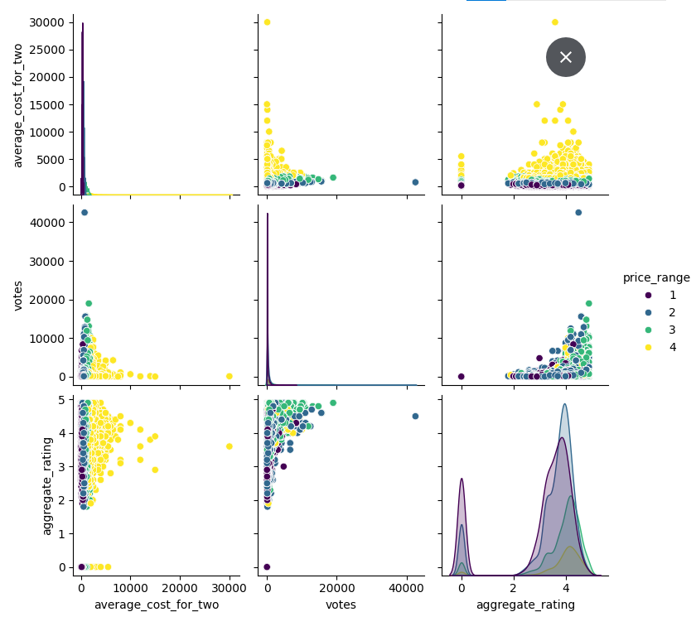

Slide 33
FINAL INSIGHTS
KEY FINDINGS :-
Restaurant Distribution: Chennai has the highest number of restaurants, followed by Mumbai, Bangalore, and Pune.
Cities like Nayagaon, Greater Noida, and Howrah have the least number of restaurants.
Popular Cuisines: North Indian, Chinese, and South Indian cuisines are the most popular among customers.
Restaurant Chains: Domino's Pizza, Cafe Coffee Day, and KFC are the top restaurant chains with the highest number of outlets.
Establishment Types: Quick Bites and Casual Dining are the most common establishment types.
Cost Variation: Average cost for two varies significantly across cities. Metro cities generally have higher average costs.
Rating Distribution: Most restaurants have ratings in the 'Good' and 'Very Good' categories.
Relationship Between Cost and Rating: There is a positive correlation between the average cost for two and the aggregate rating.
Restaurants with higher prices tend to have higher ratings.

Slide 34
CONCLUSION:-
Market Opportunities: There is potential for restaurant expansion in cities with fewer outlets, focusing on popular cuisines like North Indian, Chinese, and South Indian.
Competitive Landscape: The restaurant industry in India is competitive, with established chains like Domino's Pizza, Cafe Coffee Day, and KFC dominating the market.
Customer Preferences: Customers in India prefer Quick Bites and Casual Dining establishments with diverse cuisine options.
Pricing Strategy: Restaurants can consider a pricing strategy that aligns with the average cost for two in their respective cities.
Quality and Rating: Maintaining high food quality and service standards is crucial for attracting customers and achieving good ratings.

Slide 35
RECOMMENDATIONS :-
Expansion Strategy: Restaurants can focus on expanding their presence in cities with lower restaurant concentration.
# Menu Optimization: Include a variety of popular cuisines like North Indian, Chinese, and South Indian to cater to customer preferences.
# Competitive Differentiation: Restaurants can differentiate themselves by offering unique dining experiences, innovative menu items, or specialized services.
# Pricing Optimization: Set prices that are competitive and aligned with the average cost for two in the local market.
# Quality Control: Implement rigorous quality control measures to ensure consistent food quality and service standards.
# Customer Feedback: Actively collect customer feedback to identify areas for improvement and enhance customer satisfaction.
# Online Presence: Maintain a strong online presence with accurate information and customer reviews.
# Marketing and Promotions: Utilize effective marketing strategies to reach target customers and promote restaurant offerings.

Slide 36
The link to the dataset is Indian_resturants.csv. The Github link to see codes in google colab is https://github.com/jishnu1709/Zomato-eda
THANK YOU
By :- Jishnu Magoo
Email id :- jishnu17magoo@gmail.com

