Slide 1

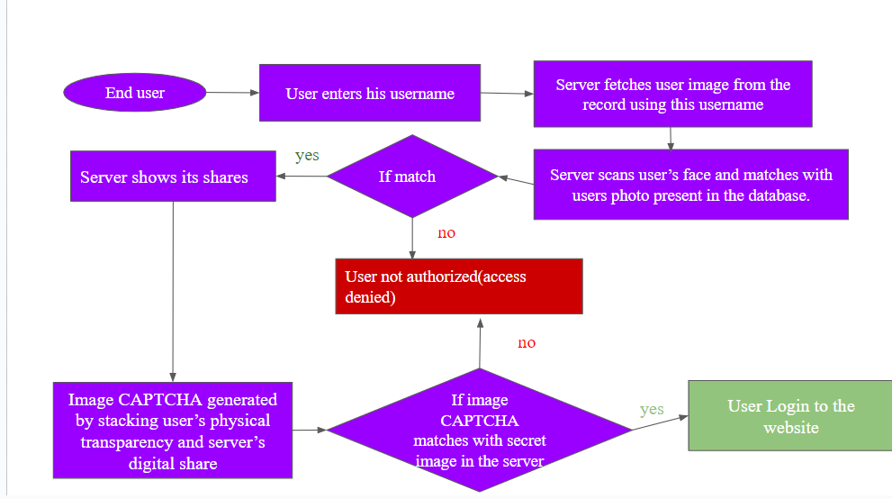
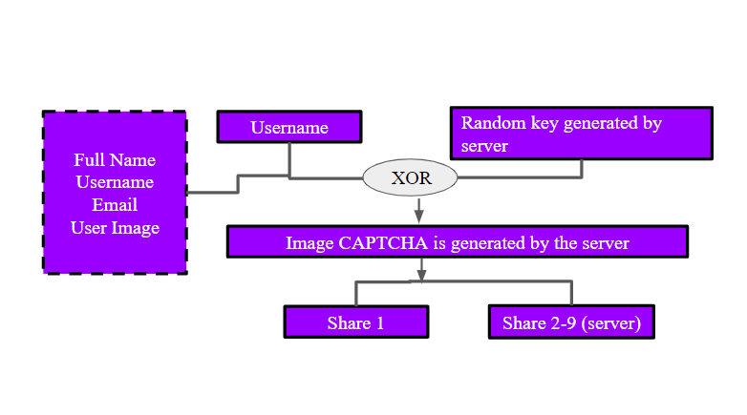
DEPARTMENT OF COMPUTER SCIENCE AND ENGINEERING
TKM COLLEGE OF ENGINEERING
ANTIPHISHING BASED ON VISUAL CRYPTOGRAPHY
PROJECT GUIDE: REENA MARY GEORGE
ANAGHA P SANTHOSH (TKM19CS015), EMIL JOJI (TKM19CS022), JISHNU M (TKM19CS030), PRANAV K (TKM19CS049)
ABSTRACT
LOGIN PHASE
Email is a global service used by over a billion people. Flexibility, reliability, and convenience make email a popular communication service. Despite its advantages, email can also serve as a vector for cyberattacks, phishing being only one of them. Phishing is an attack that attempts to steal money, or identity of people, by getting them to reveal personal information such as credit card numbers, bank information, or passwords on websites that pretend to be legitimate. As a security precaution against phishing an anti-phishing technique based on Completely Automated Public Turing Test to Tell Computers and Humans are Apart(CAPTCHA) employing multiple secret sharing has been developed. The suggested method provides multiple levels of security. The first layer determines whether or not the consumer is a certified customer. The website only allows signed-in users who have been authenticated. The second layer shields the client's system from potential keylogger and screen loggers. The third layer verifies if the client's information is related to the picture captcha. Human users alone can solve the image captcha. No machine-based client can therefore decipher the secret word or any other personal information of the client using captcha strategy. The picture captcha in the fourth layer is made by stacking the shares of the end user and the server and it cannot display the original image captcha for that specific user (who is attempting to log in to the site) if the website is phishing
FACE RECOGNITION
The user’s face is captured and if it matches the photo
uploaded during the registration it moves to next step else
login fails
CAPTCHA CONFIRMATION
The common share of user is stacked with one of 8 share of
server and if it matches one of the captchas generated during
registration phase then login succeeds
OBJECTIVES
To ensure the authenticity of the user with less information entered through
the console.
To ensure originality of the website to prevent phishing attacks.
Protection from keyloggers and screen loggers.
Improved security for financial transactions.
CONCLUSIONS
METHODOLOGY
The proposed approach gives multiple layers of safety:
The first layer determines if or not the customer is a registered customer.
A second layer shields the client's system from potential keylogger and screen logger's assaults.
The third layer verifies whether the client is associated to the image captcha.
The fourth layer confirms the website's originality.
The captcha once generated for one user is not used for other users
The facial recognition makes the model more secure
REGISTRATION PHASE
REFERENCES
Akanksha Arora, Hitendra Garg, Shivendra Shivani,Anti-phishing technique based on dynamic image captcha using multi secret sharing scheme,Journal of Visual Communication and Image Representation,Volume 88,2022.
Peng Li, Jianfeng Ma, Quan Ma,(t, k, n) XOR-based visual cryptography scheme with essential shadows,Journal of Visual Communication and Image Representation,Volume 72,2020.
R.G. Sharma, P. Dimri, H. Garg, Visual cryptographic techniques for secret image sharing: a review, Inf. Secur. J.: Glob. Perspect. 27 (2018) 241–259.
Zhengxin Fu, Liguo Fang, Hangying Huang, Bin Yu,Distributed three-level QR codes based on visual cryptography scheme,Journal of Visual Communication and Image Representation,Volume 87,2022,103567,ISSN 1047-3203.
SHARE GENERATION
Image captcha generated by performing XOR on the username and random key is splitted into 9 shares
One share for user
8 other shares for server

