Slide 1


Unraveling Telangana's Path to Inclusive Development
Final Report for: The BDM Capstone Project
Submitted by: Jishnu S G
Roll Number: 21f1006877
Institution: Indian Institute of Technology, Madras

Slide 2
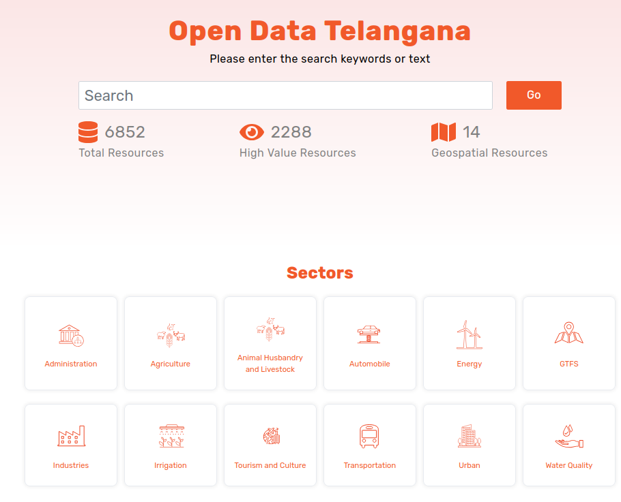
About the Organization & Data
Telangana is a south-central state in Indian subcontinent with rich history, diverse culture and rapid growth.
States Vision : A leader in data-driven governance, committed to balancing industrial growth and agrarian sustainability.
Open Data Telangana : An initiative from government to enhance transparency and data accessibility .
This analysis is based on data scraped from this public portal.
Key Datasets : We analyzed TS-iPASS, Vehicle Registrations, Land Registrations, and Weather data covering the period from 2019 to 2024.

Slide 3
Key Problems & Objectives
Key Problems
Problem 1 : Small investments face systemic approval delays : Smaller projects may experience disproportionately longer approval timelines compared to large-scale proposals, discouraging local entrepreneurship.
Problem 2 : e-Stamp adoption efficiency over document registration : Identify if digital transitions in registrations improved revenue collection efficiency for scalable governance and promoting digital inclusion.
Problem 3 : Rainfall-mechanization mismatch inflates farm costs : Uneven rainfall forces over/under investments in agri-vehicles without promising irrigation infrastructure might lead to unnecessary capital expenditure and subsidies.
Objective
To provide data-backed recommendations that ensure inclusive growth and climate resilience.
To bridge the urban-rural divide by aligning government policies with real-world data.

Slide 4
Data and Methodology
Data Sourcing
We used a web-scraping script to collect data from the data.telangana.gov.in portal in tabular format.
Data Cleaning
The raw data was meticulously cleaned and unified to handle inconsistencies in naming, dates, and categories.
Python and pandas module for the data cleaning and filtering data from 2019 to 2024 only.
Analysis
We mainly used time-series, statistical and comparative analytics to generate district-level insights from the data.
Visualizations
Key findings are presented using plots from Matplotlib, Seaborn, and Plotly.

Slide 5
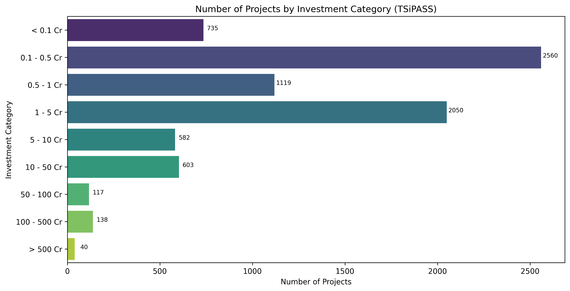
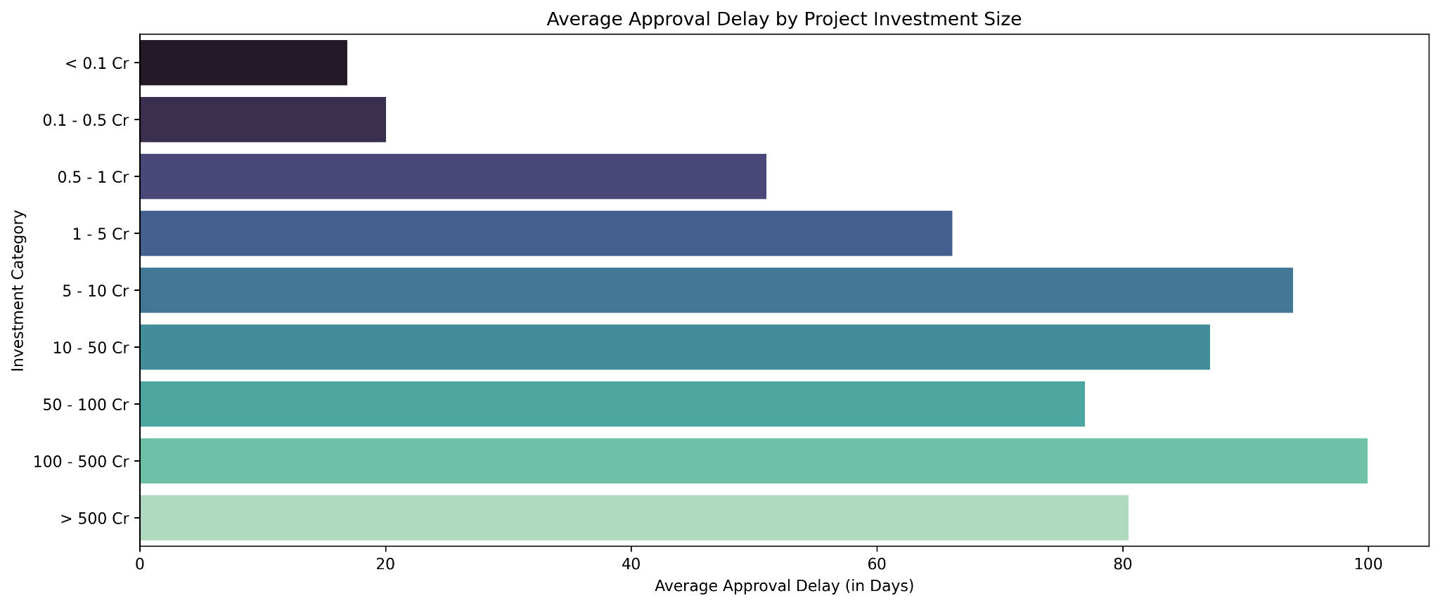
Key Findings: Problem 1
Small businesses face approval delays, which may limit entrepreneurship.
Initial Hypothesis
The portrayal of states growth was shown as the large scale investments.
This led us to assume MSMEs faces systemic delays.
Data-Driven Finding :
Most projects are of investments under 5 crores.
Job creation doesn’t directly scales with investment size.
Direct analysis of approval times revealed the opposite.
The longest approval delays are for the largest projects, not small businesses.
Approval timeline is correlated with type of sector.

Slide 6
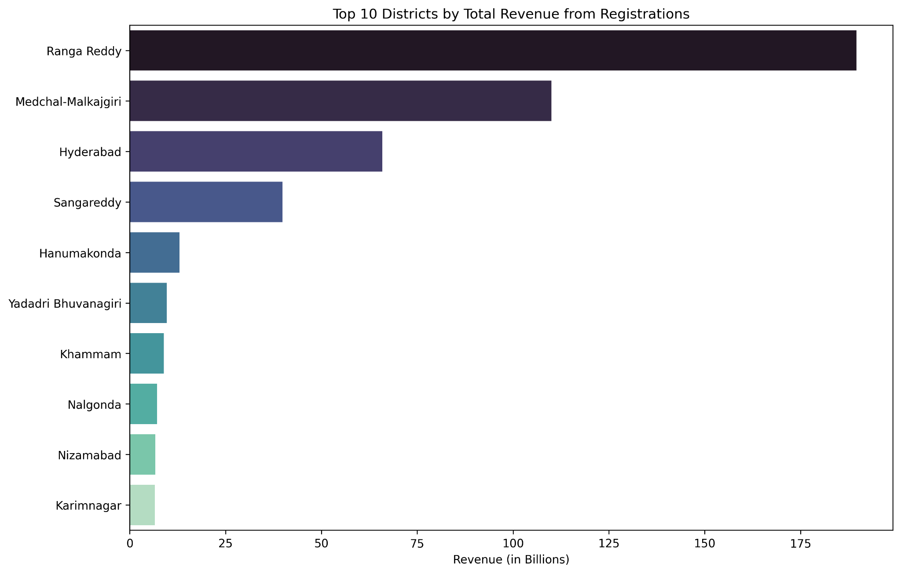
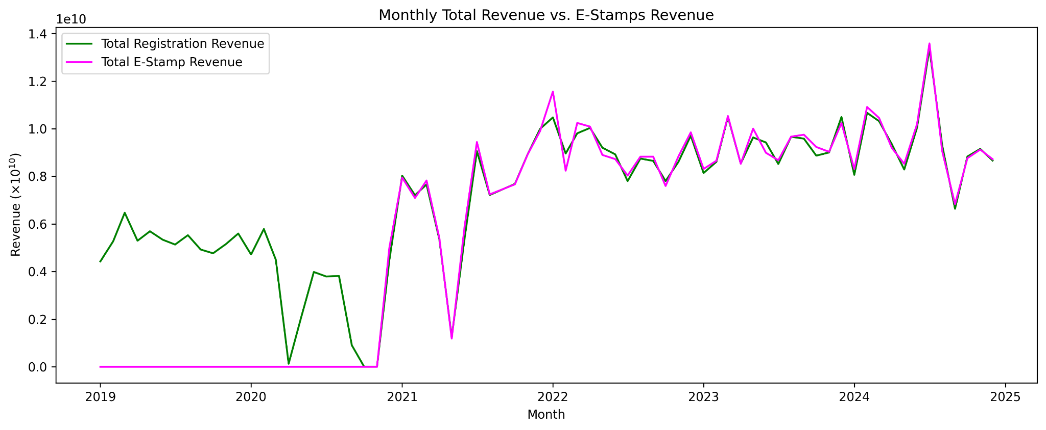
Key Findings: Problem 2
E-Stamp Digital Transformation
The Instantaneous Transition
E-stamp revenue was zero until late 2020, then suddenly took over as the dominant revenue source.
Districts generating most of the total registration revenue are major urban and peri-urban districts.
Districts that generate most revenue and districts with most investment are highly overlapped.
The fast e-stamp adoption shows scalable governance and digital inclusion, thus transforming document registration for the state ot fully digital.

Slide 7
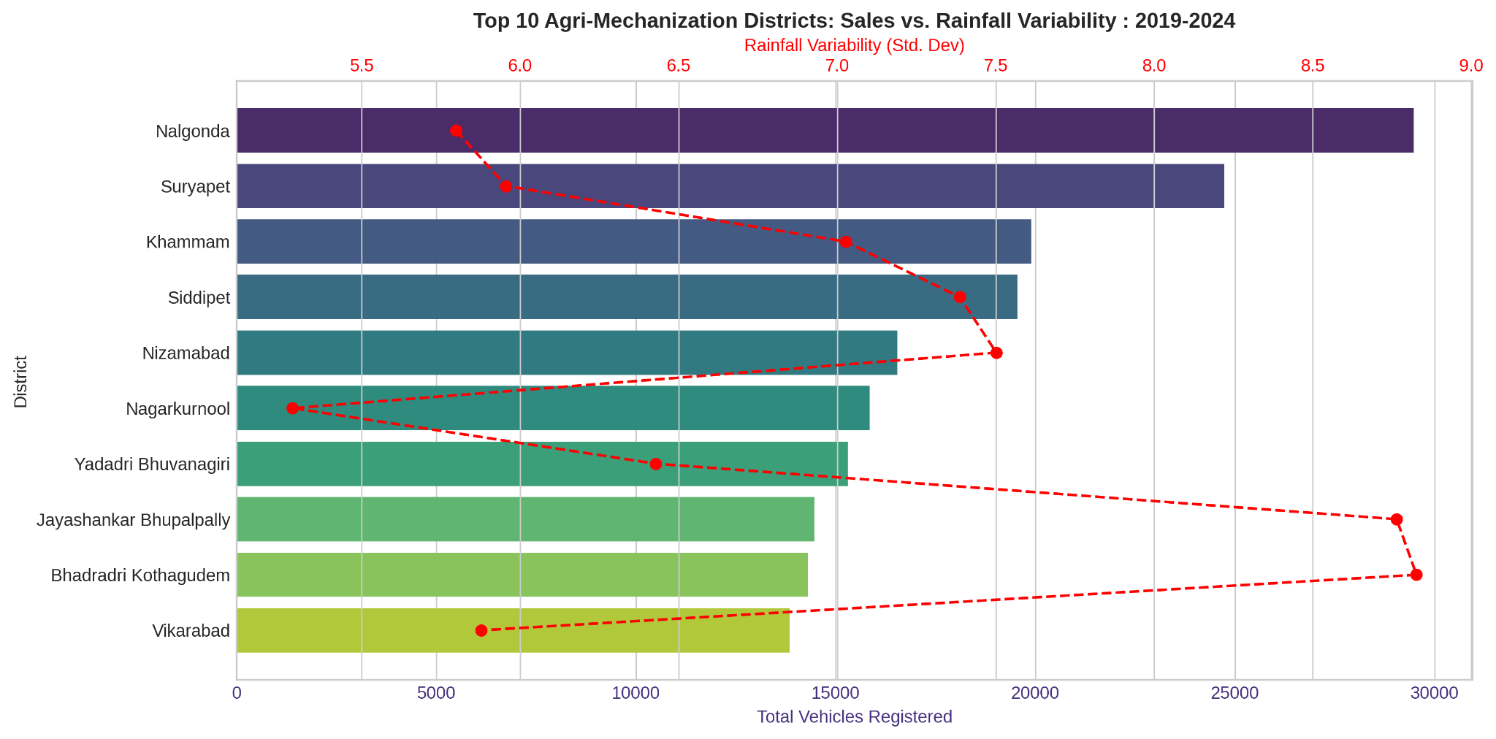
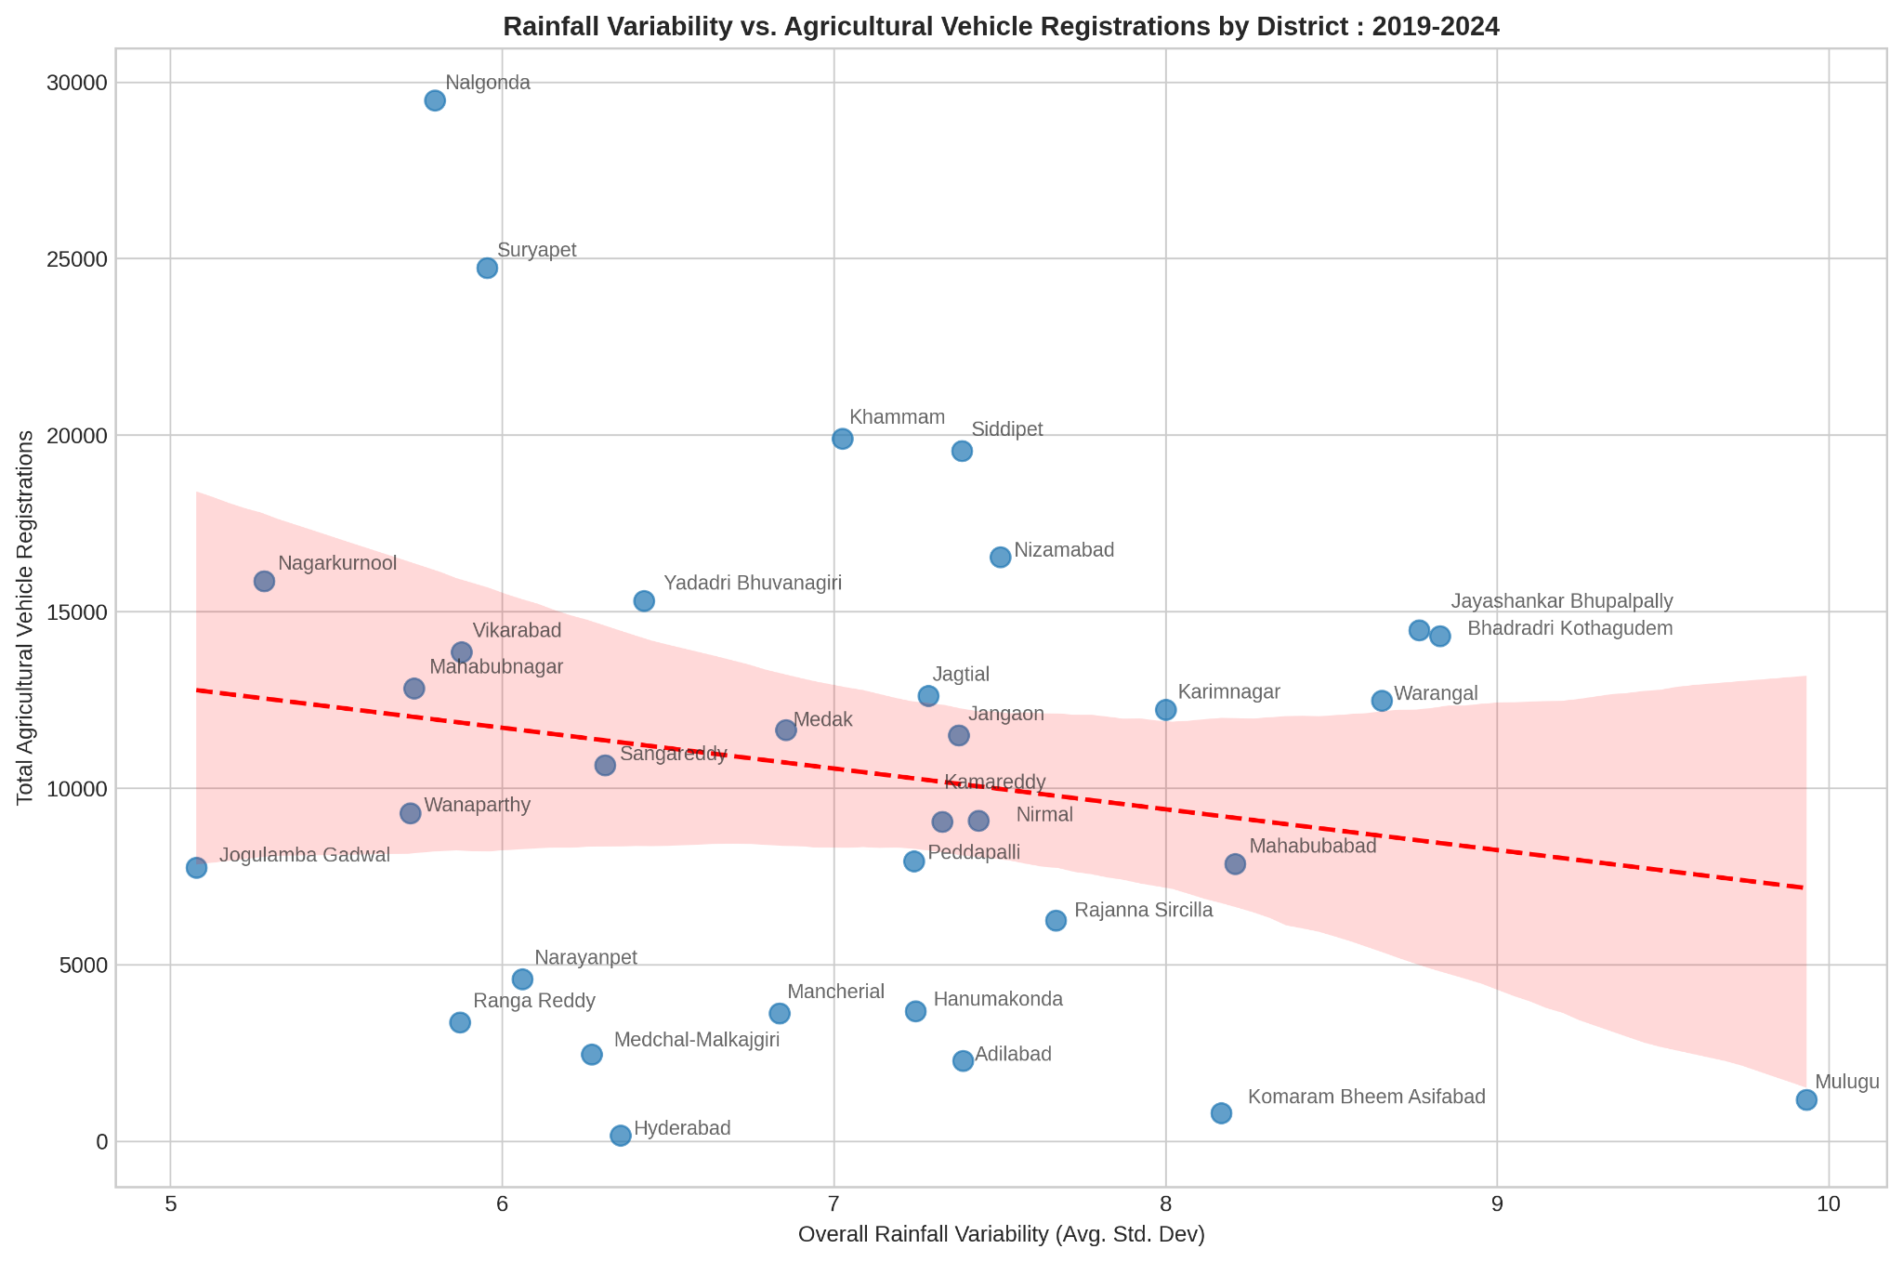
Key Findings: Problem 3
The Agri-Mechanization Mismatch
Districts with the highest agricultural vehicle sales shows moderate rainfall variability but not the highest.
Districts having rain variability range 5-7 shows the most vehicle sales, and are not urban districts.
Districts like Nalgonda and Suryapet were in the top 15 districts attracted highest investments.
Dual-axis plot shows, districts with the most agri-vehicle sales have moderate rainfall unpredictability, not the highest.
Scatter plot confirms, regions with the most unpredictable rainfall often have lower agri-vehicle sales.

Slide 8
Recommendations for Strategic Action
For Industrial Growth
Implement a focused digitalized single-window clearance system for large scale time consuming sectors like Real Estate, Infrastructure and Textiles.
Address the tangible needs of MSMEs and improvised mentorship programs like T-Hub.
For Digital Governance
Replicate the successful e-stamp model for other services including agricultural and non-commercial land registrations to improve efficiency and transparency.
Enhancement of digital infrastructure to ensure robust and secure data handling and protection for long term reliability and public trust.
For Agrarian Resilience
Prioritize climate-aligned irrigation infrastructure in high-variability districts and link agricultural subsidies to water availability.
Re-evaluate the subsidy programs to target clusters of farmers and not on the entire state to boost the agrarian activity.

Slide 9
Conclusion & Future Scope
Conclusion
Summary : Our data-driven analysis reframed key problems and provided clear, actionable recommendations.
Impact : This approach allows the government to make informed policy decisions that balance industrial efficiency with agrarian sustainability.
Future
Future analysis could include data on loan approvals, crop yields, and irrigation to further refine these insights.

Slide 10


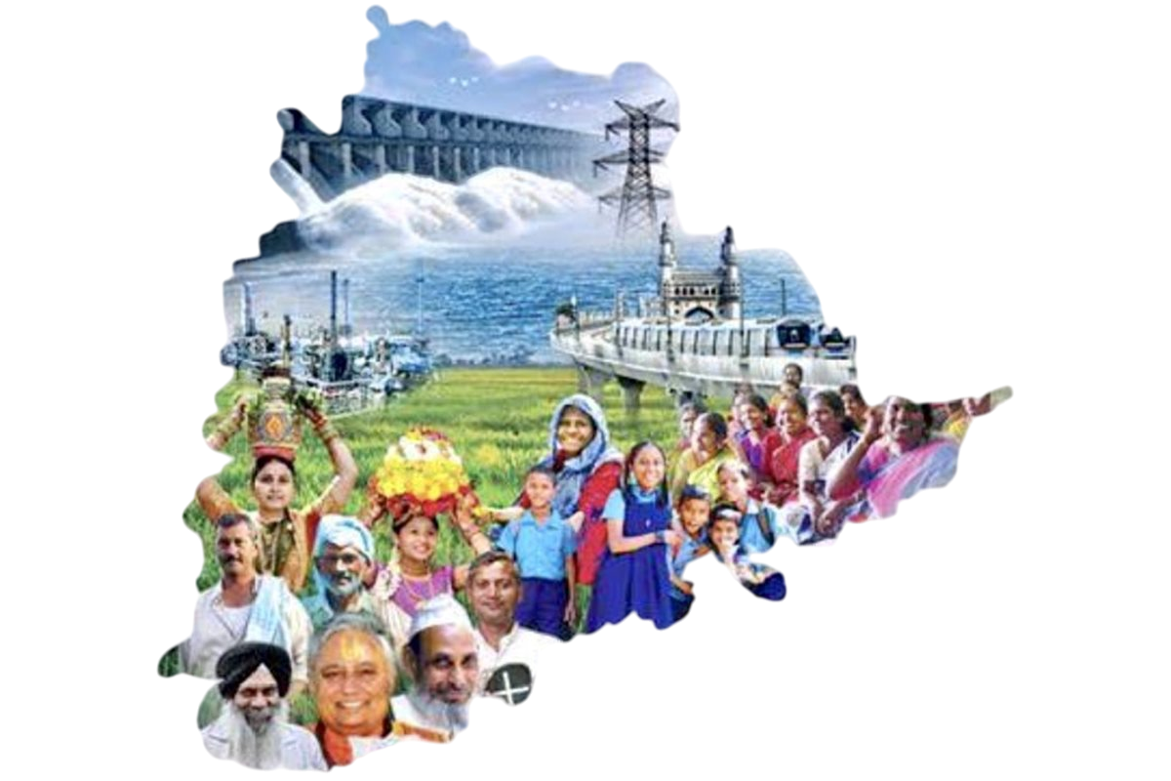

Resources & References
Dataset
Open Data Telangana
TS-iPASS Data
RTA Registration Data
Google Drive
Weather Data
TS-iPASS Data
RTA Registration Data
Web-scraping Script : Data Collection Notebook
Analysis Notebook : Analysis Notebook

