Slide 1
AUTOSHOP (ONLINE USED VEHICLE SALE SYSTEM)
GUIDE:- Mr. JINSON DEVIS JISHNUMON P B
DEPT OF COMPUTER APPLICATION MCA S6 Reg
No:29

Slide 2
1.ABSTRACT
The project entitled ‘Autoshop’ is an online Automobile shopping system that allows web users to purchase used vehicles online without visiting any physical location.
‘Autoshop’ allows the user to purchase Automobile online and Bid vehicles in Auction.
The Site Administrator updates the information about new Automobiles concurrently.
Only registered customers can purchase Automobiles bid from Autoshop.
The user must register in the site to access their accounts, after login they can buy used vehicles by bidding Automobiles which are available for auction.

Slide 3
The user can bid a vehicle with a high rate than the latest Bid Rate, before the date expires.
After date expires, the site sends the Confirmation letter to the user who bid the car with highest rate through email-id which they specified.
This system allows the users to search items category wise, then Brand wise and Model wise. Thus this system provides all the basic functionalities to a user who would like to purchase used cars in online.

Slide 4
The important modules of the project are:
User Module
Auction
Administrator Module
The project has been developed based on these modules.
1.User Module
The main processes in this module are given below:
Edit Details
Purchase
Bidding
Product Review
View Updations about new product

Slide 5
2.Auction
Select Vehicles
Add to Auction
Updating Details
Setting Initial Rate
Sending Confirmations
Administrator Module
Edit Profile
Confirm Employee account
Manage Customers
Checking Products
Add Vehicle to Auction

Slide 6
4. Purchasing
Selecting a Model
Displaying Details
Purchase

Slide 7
TABLE DESIGN
1.REGISTRATION
Table no : 1
Table name : tbl_registration
Primary key :user_id
FIELDS | DATA TYPE | CONSTRAINTS | DESCRIPTION
user_id | Int(10) | Primary Key | Unique User_identification
l_id | Int(10) | Foreign Key | Login_identification
f_name | Varchar(50) | Not null | First Name of the user
m_name | Varchar(50) | Not null | Middle Name of the user
l_name | Varchar(50) | Not null | Last Name of the user
addr | Varchar(50) | Not null | Address of the user
gender | Varchar(50) | Not null | Gender of the user
dob | Varchar(50) | Not null | Dob of the user
contact_no | Numeric(50) | Not null | Contact_nunmber
e-mail_id | Varchar(50) | Not null | Email_id of the user

Slide 8
2.LOGIN
Table no : 2
Table Name:-tbl_login_autoshop
Primary key :l_id
FIELDS | DATA TYPE | CONSTRAINTS | DESCRIPTION
l_id | Int(10) | Primary Key | Unique Login_identification
Username | Varchar(50) | Not null | Username
Pass | Varchar(50) | Not null | Password
Rol | Varchar(20) | Not null | Role
Status | Varchar(20) | Not null | Status

Slide 9
3.AUCTION
Table No:-3
Table Name:-tbl_auction
Primary Key:-auction_id
FILDS | DATA TYPE | CONSTRAINTS | DESCRIPTION
auction_id | Int(10) | Primary Key | Unique Auction_identification
user_id | Int(10) | Foreign_Key | User_identfiction
bid_amt | Numeric(50) | Not null | Auction Bid_amount
bid_date | Date | date | Auction Bid_date
vehicle_id | Int(10) | Foreign_Key | Car identification

Slide 10
4. ADD VEHICLES
Table No:-4
Table Name:-tbl_addvehicle
Primary Key:-vehicle_id
FIELDS | DATA TYPE | CONSTRAINTS | DESCRIPTION
vehicle_id | Int(10) | Primary Key | Unique Vehicle identification
vehicle_name | Varchar(50) | Not null | Name of the Vehicles
b_price | Numeric(50) | Not null | Basic price of the vehicles
description | Varchar(200) | Not null | Description of the vehicles
model | Varchar(50) | Not null | Model
color | Varchar(50) | Not null | Different Colors of vehicles
fueltype | Varchar(50) | Not null | Fueltype
year | Numeric(50) | Not null | Year
mileage | Numeric(50) | Not null | Mileage of the vehicles
transmission | Varchar(50) | Not null | Transmission of the vehicles
registered | Varchar(50) | Not null | Check for Registered vehicles
status | Varchar(50) | Not null | Status

Slide 11
5.ADD TO AUCTION
Table No:-5
Table Name:-tbl_addtoauction
Primary Key:-aid
FIELDS | DATA TYPE | CONSTRAINTS | DESCRIPTION
a_id | Int(20) | Primary Key | Auction_identification
adding_date | Date | Not null | Adding_date of auction
last_date | Date | Not null | Last_date of auction
v_id | Int(20) | Foregin Key | Unique Vehicle_identification

Slide 12
6.WORKSHOP
Table No:-6
Table Name:-tbl_workshop
Primary Key:-wid
FIELD | DATA TYPE | CONSTRAINTS | DESCRIPTION
w_id | Int(10) | Primary Key | Workshop_identification
cid | Int(10) | Foregin Key | Customer_idenntification
view_status | Varchar(50) | Not null | View live status of the work shop
delivery_details | Varchar(100) | Not null | Delivery details of the Vehicles
extra_fitting | Varchar(100) | Not null | Adding extra fittings to the Vehicles

Slide 13
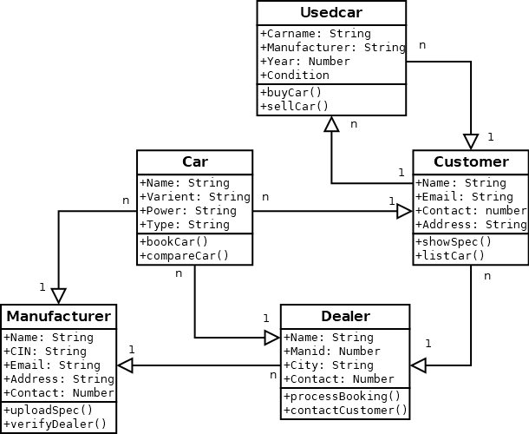
UML Diagrams – AUTOSHOP
Structural Diagrams
Class Diagram

Slide 14
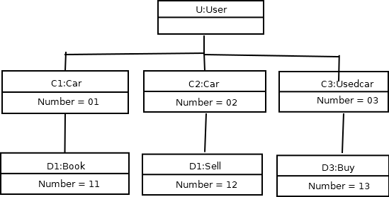
Object Diagram

Slide 15
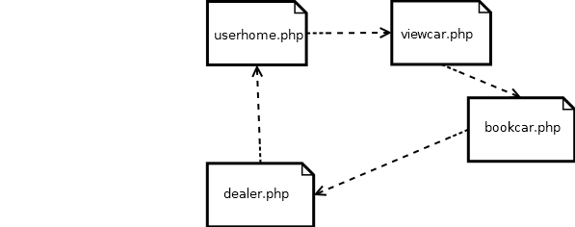
Component Diagram

Slide 16
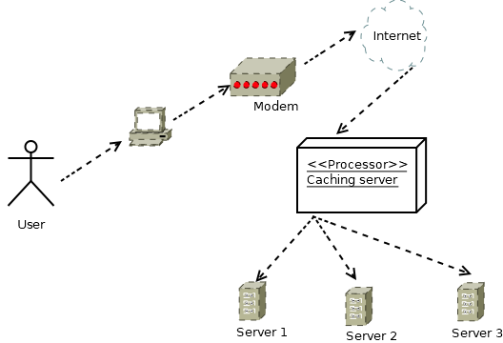
Deployment Diagram

Slide 17
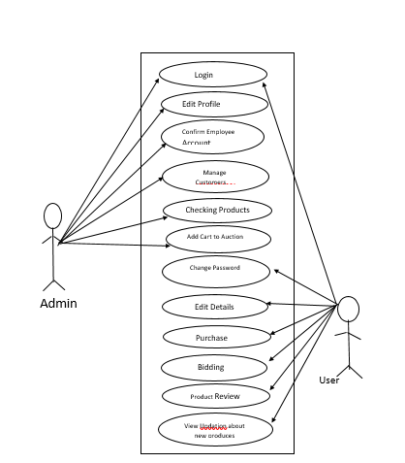
Behavioral Diagrams
Use case diagram

Slide 18
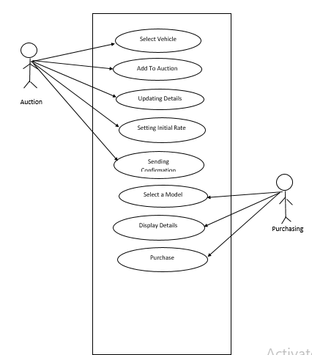

Slide 19
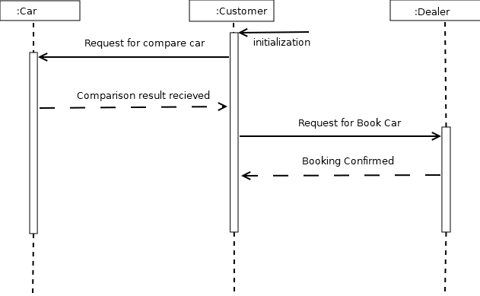
Sequence Diagram

Slide 20
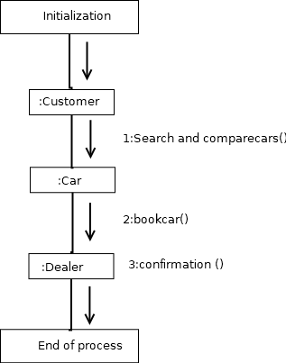
Collaboration Diagram

Slide 21
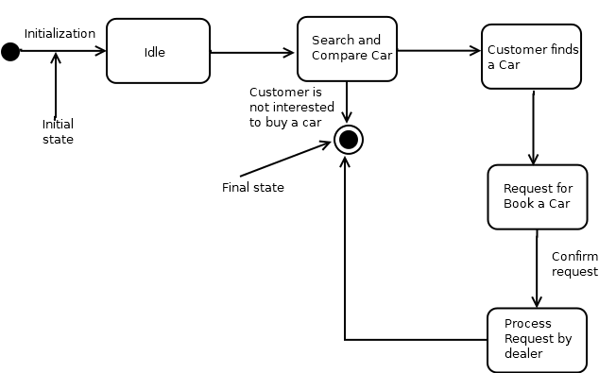
Statechart Diagram

Slide 22
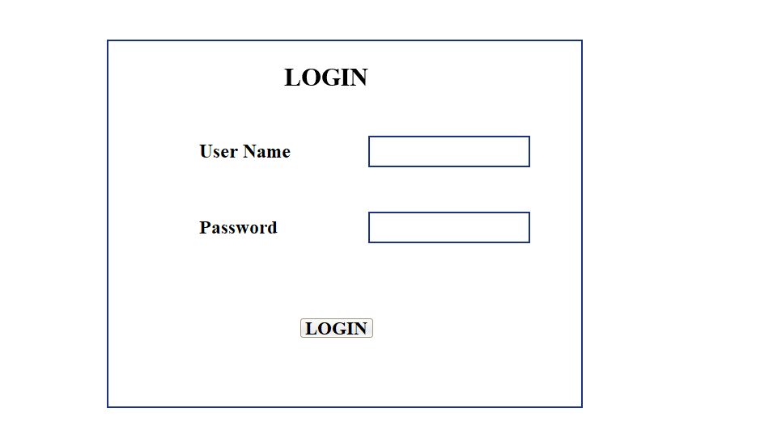
FORM DESIGN
1.LOGIN FORM

Slide 23
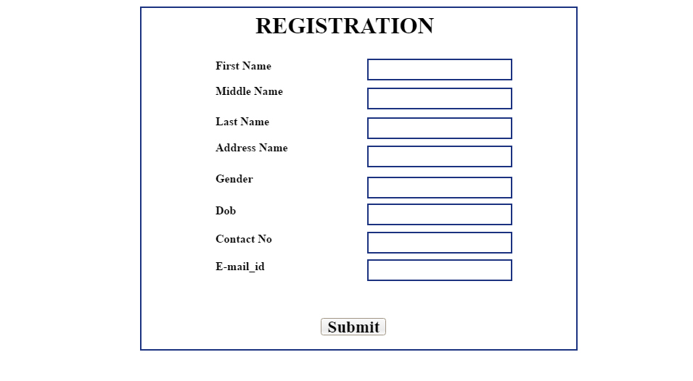
2. REGISTRATION FORM

Slide 24
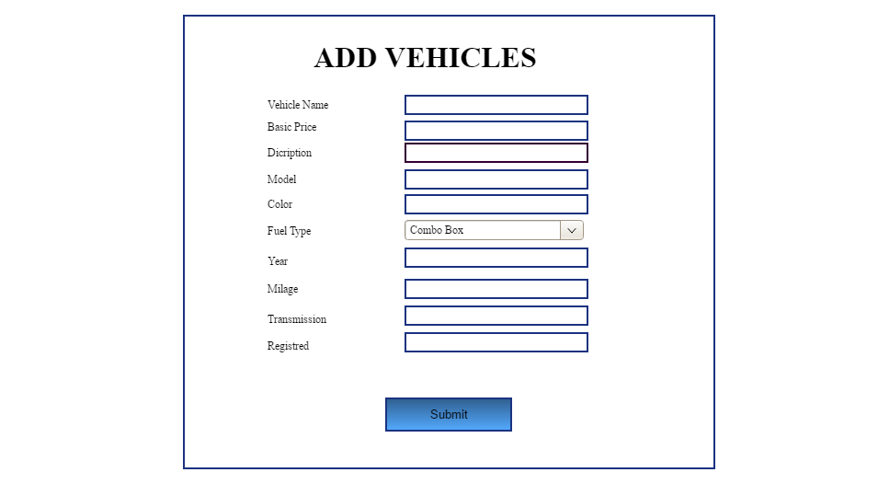
3. ADD VEHICLE FORM

Slide 25
THANK YOU…

