Slide 1
FASt Optimisation of CNN Architecture Using Genetic Algorithm
JISHNU P
CB.EN.P2AID19017

Slide 2
contents
Introduction
Objective
Flow diagram
Dataset
Module wise Algorithms
Outputs obtained
Result
Conclusion
References

Slide 3
introduction
Convolutional Neural Networks (CNNs) are the deep neural network models and have been used with great success for image classification.
The performance of CNNs depends on their architecture and hyperparameter settings.
The requirement of extensive domain knowledge and expertise in neural network design often makes it difficult for inexperienced researchers and application engineers to design successful CNN architectures for challenging applications.

Slide 4
OBJECTIVE
To efficiently explore a defined space of potentially suitable CNN architectures and tune their hyperparameters using Genetic Algorithm.
Hyperparameter | Values
Learning rate (LR) | 0.1,0.01,0.001,0.0001
Weight decay (WD) | 0.1,0.01,0.001,0.0001,0.00001
Momentum (M) | 0.5,0.55,0.6,0.65,0.7,0.75,0.8,0.85,09
No.of Layers (NL) | 8 - 20

Slide 5
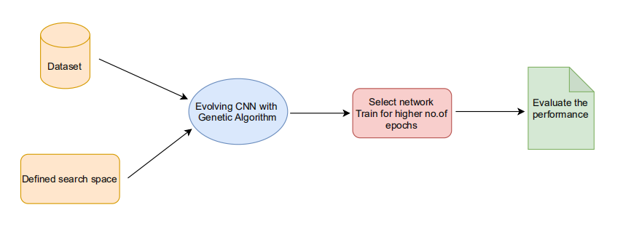
Flow diagram
figure : Flow diagram of the project

Slide 6
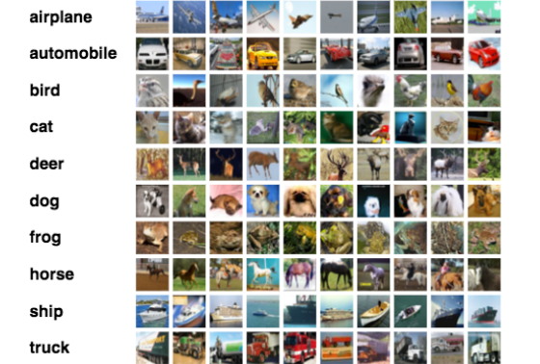
DAtaset
CIFAR - 10 dataset
contains 60,000 32x32 color images
10 different classes represent airplanes, cars, birds, cats, deer, dogs, frogs, horses, ships, and trucks.

Slide 7
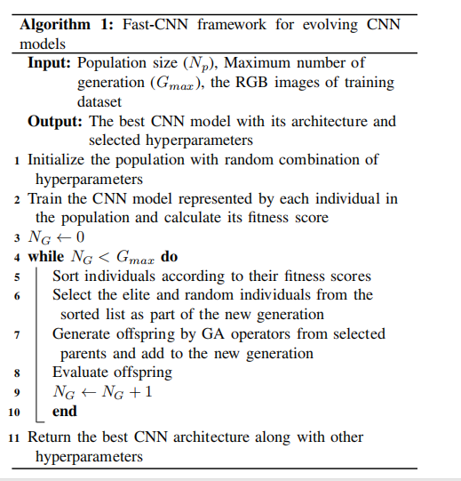
PROPOSED ALGORITHM

Slide 8

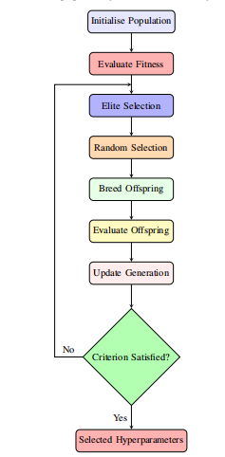
fLOWCHART
figure : Flow chart of the proposed algorithm

Slide 9
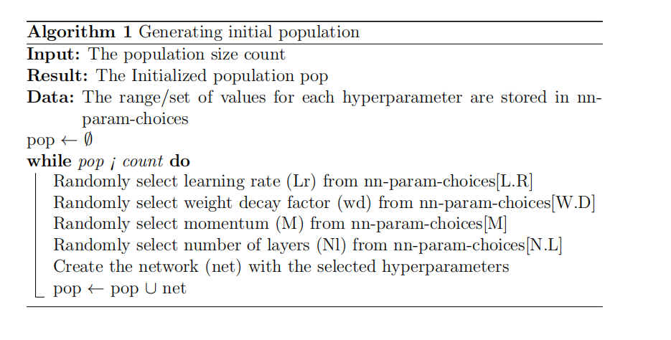
GENERATING initial population
≤

Slide 10
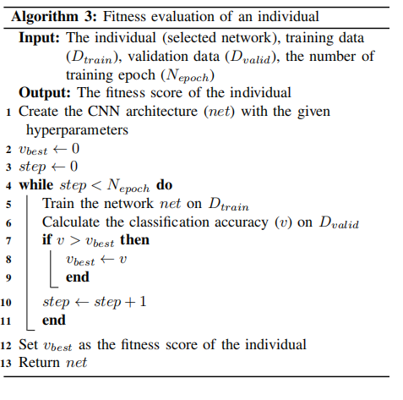
Algorithm for fitness evaluation

Slide 11
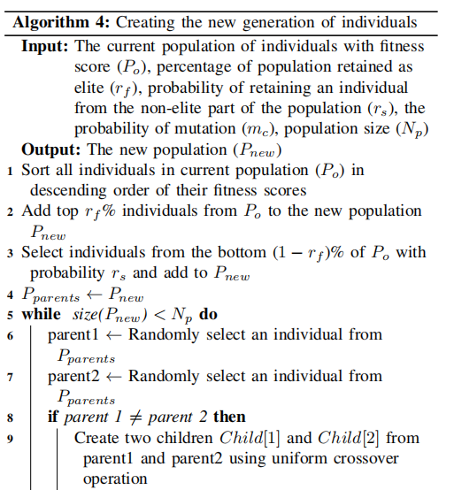
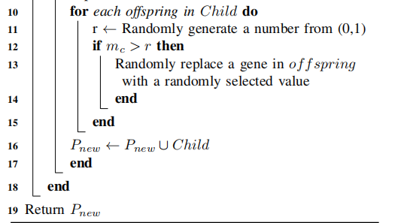
Creating new generation

Slide 12
design of experiment
Representation | Floating point
Fitness | Classification accuracy
Crossover | discrete recombination
Mutation | Uniform mutation
Parent selection | Random (2)
Survivor selection | (μ + λ) selection
Elitism | 4% of initial population
Termination condition | Number of generations

Slide 13
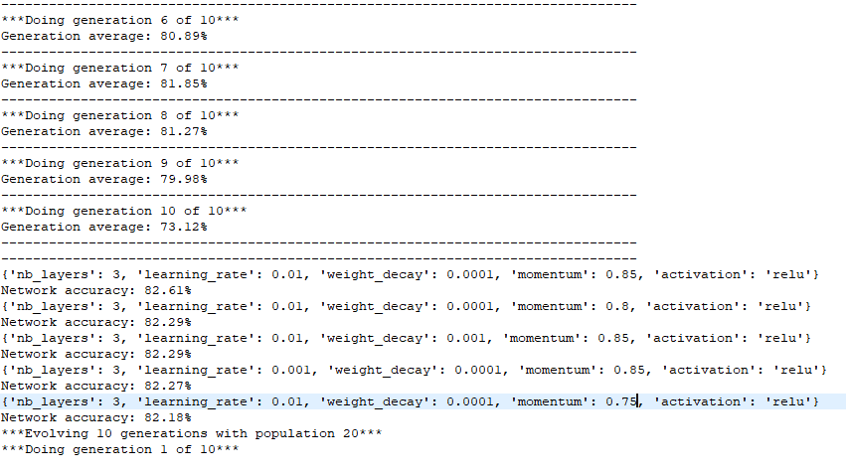
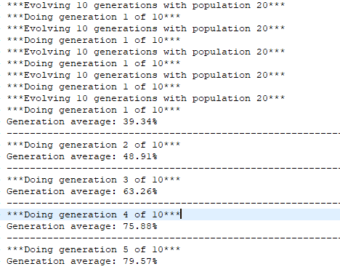
Output

Slide 14
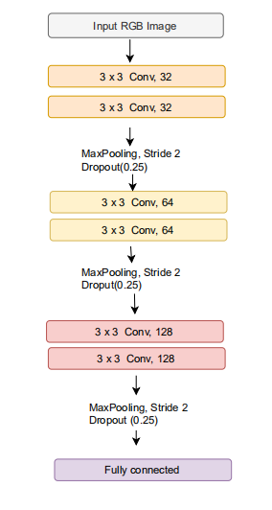
Architecture of evolved CNN
Figure : Architecture of top CNN model(s) evolved by fast CNN

Slide 15
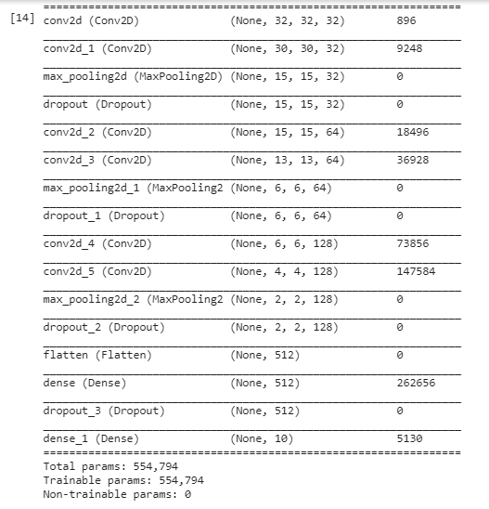
evolved cnn model

Slide 16
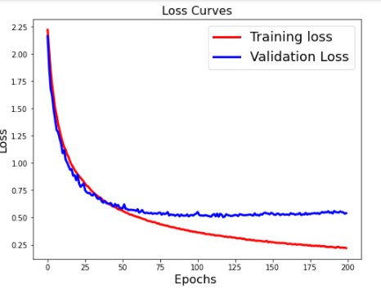
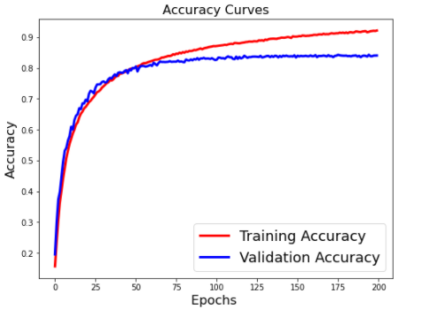
output(CIFar10) epoch 200

Slide 17
results
Hyper parameters |  |  | CIFAR10
Learning Rate | Weight decay | Momentum | Accuracy (Train) | Accuracy (validation)
0.01 | 0.0001 | 0.85 | 92.14% | 84.02%
0.01 | 0.0001 | 0.8 | 89.19% | 83.62%

Slide 18
conclusion
Proposed approach evolved the CNN model by tuning the hyper parameters for the given search space.
The time consumed by the model to evolve the CNN is directly proportional to the search space of hyper parameters.
GPU capacity is very important because runtime is very high when we set large values for population, generations, epochs.

Slide 19
references
A. Bakhshi, N. Noman, Z. Chen, M. Zamani and S. Chalup, "Fast Automatic Optimisation of CNN Architectures for Image Classification Using Genetic Algorithm," 2019 IEEE Congress on Evolutionary Computation (CEC).
Parsa Esfahanian, Mohammad Akhavan, “ GACNN: Training Deep Convolutional Neural Networks with Genetic Algorithm”, 2019
https://www.analyticsvidhya.com/blog/2017/06/architecture-of-convolutional-neural-networks-simplified-demystified/

Slide 20
THANK YOU

Slide 21
Steps INvolved
step1 : Collecting the Dataset - CIFAR10
step 2 : Define the search space
step 3 :Evolve CNN model using GA
step 4: Analyse the performance of the evolved CNN model

