Slide 1
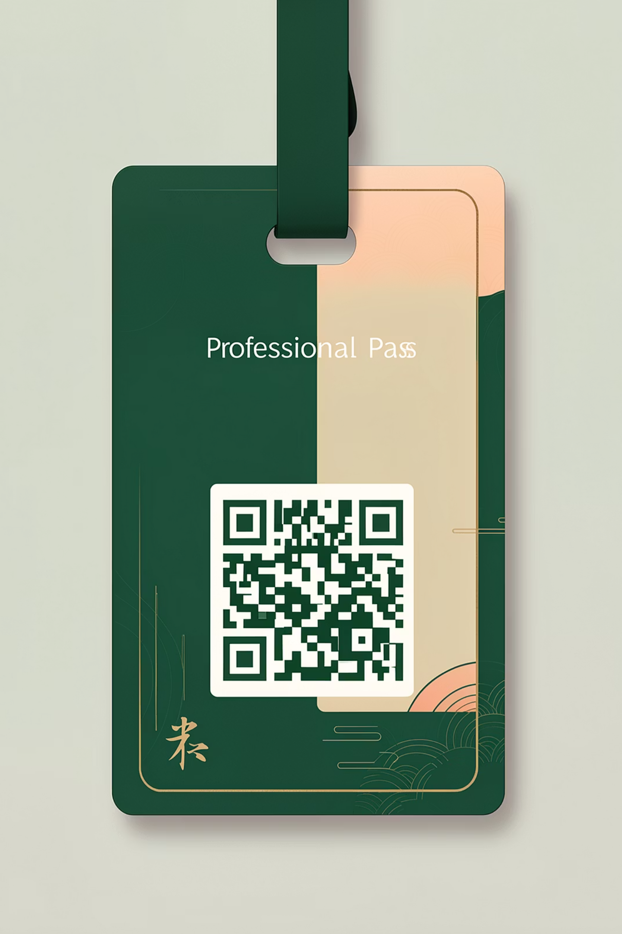
Visitor Gate Pass Generator
A digital solution for managing visitor entry using HTML, CSS, and JavaScript
Team Members
R. Jishnu Tej • A. Nivvi • B. Prasanna Satvika • T. Manojna
College
Pragati Engineering College

Slide 2
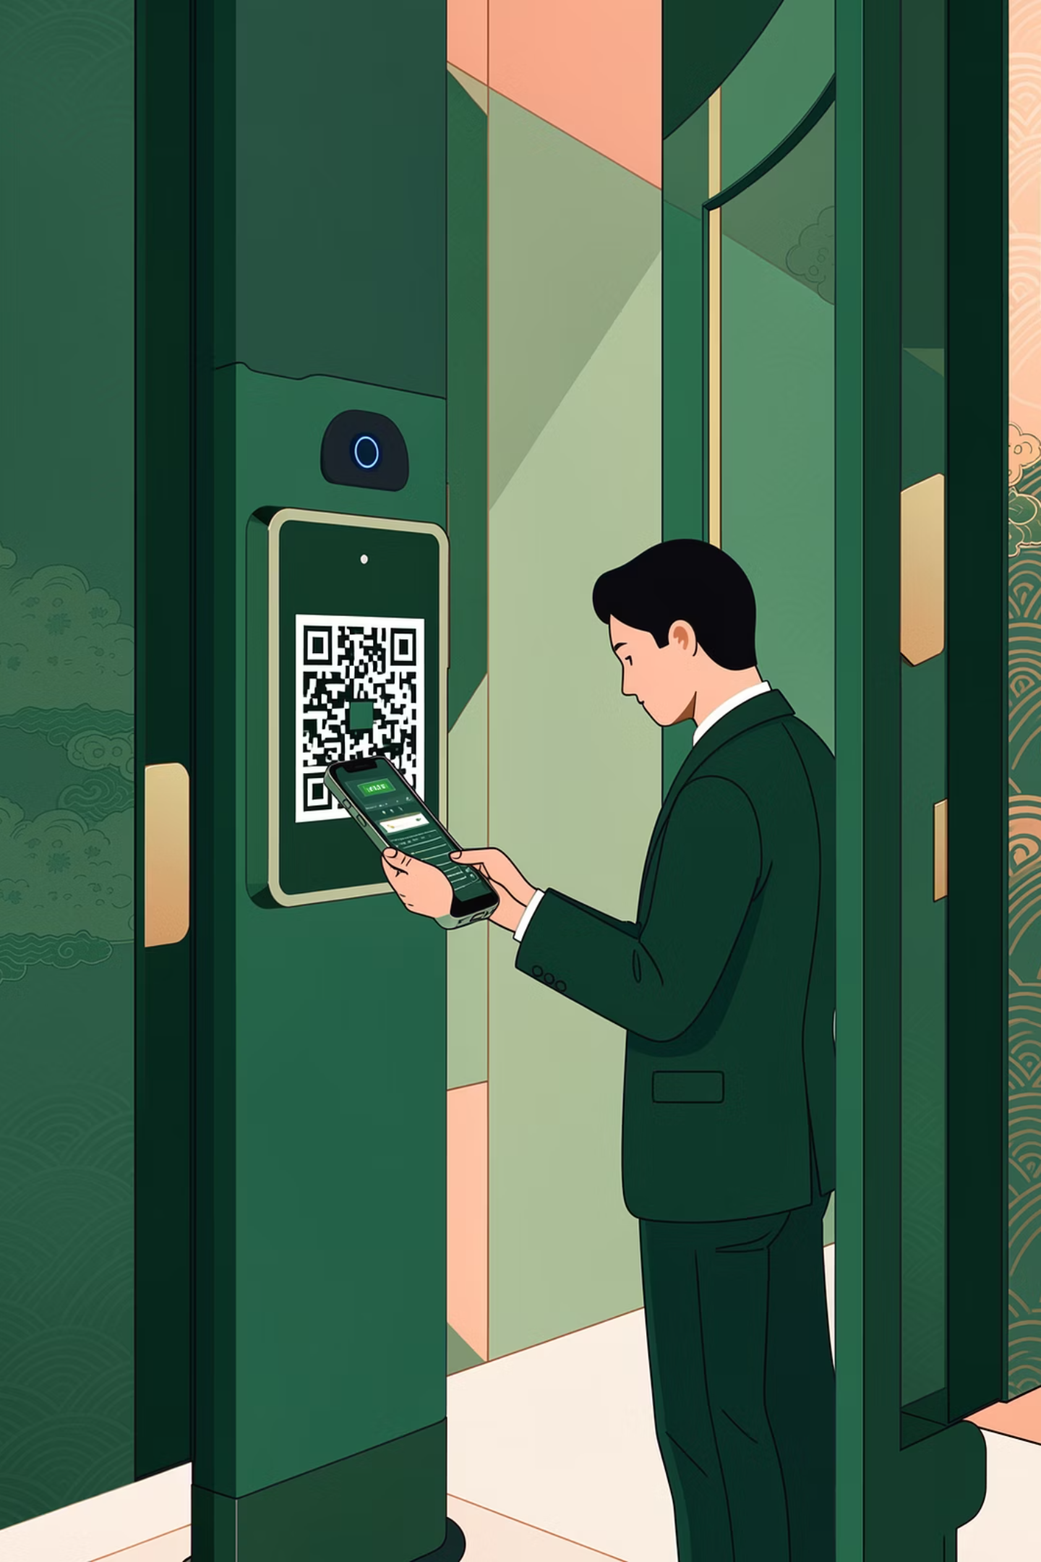
Introduction
The Problem
Our Solution
Manual visitor entry systems are time-consuming, prone to errors, and difficult to track. Paper-based logs make it challenging to search for past visitors or generate reports efficiently.
A digital gate pass generator that automates visitor registration, creates scannable QR codes, and maintains searchable visitor logs for improved security and efficiency.

Slide 3
Project Objectives
01
02
Generate Visitor Passes
Store Visitor Data
Create professional, printable visitor passes with unique identification
Maintain comprehensive records of all visitor entries and exits
03
04
Reduce Manual Work
Improve Efficiency
Eliminate paper-based processes and handwritten logs
Streamline visitor management with quick data entry and retrieval

Slide 4
Technologies Used
HTML
CSS
Structure and content organization for the web application
Styling and responsive design for an attractive user interface
JavaScript
QR Code Library
Core logic for form validation, ID generation, and QR code creation
Generate scannable QR codes for visitor authentication

Slide 5





System Overview
The Visitor Gate Pass Generator follows a straightforward workflow to manage visitor entries efficiently.
Data Entry
Visitor information captured through web form
Validation
Input verification and unique ID generation
QR Creation
Generate scannable QR code for the pass
Storage
Data saved to browser's LocalStorage
Retrieval
Search and display visitor logs instantly

Slide 6
System Modules
1
2
3
Visitor Entry Page
Visitor Log Page
Processing Module
HTML form for capturing visitor details including name, contact, purpose of visit, and time of entry. Includes input validation and error handling.
Display table showing all visitor records with search functionality to quickly find specific entries. Data presented in organized, readable format.
JavaScript logic that handles form validation, generates unique visitor IDs, creates QR codes, stores data in LocalStorage, and manages the visitor log display.

Slide 7
Working Process
The system follows a sequential flow from data input to storage and retrieval.
Input Collection
Visitor details entered via web form
Validation
Data verified and unique ID generated
Pass Generation
Professional visitor pass created with details
QR Code
Scannable QR code embedded in pass
Storage
Data saved to browser LocalStorage
Log Display
Complete visitor log available for search

Slide 8
Key Features
Unique ID Generation
QR Code Generation
LocalStorage Storage
Automatic creation of unique visitor identification numbers
Scannable QR codes for quick visitor authentication
Persistent data storage within the user's browser
Search Functionality
Print Option
Quick search through visitor logs to find specific entries
Print visitor passes directly from the application

Slide 9
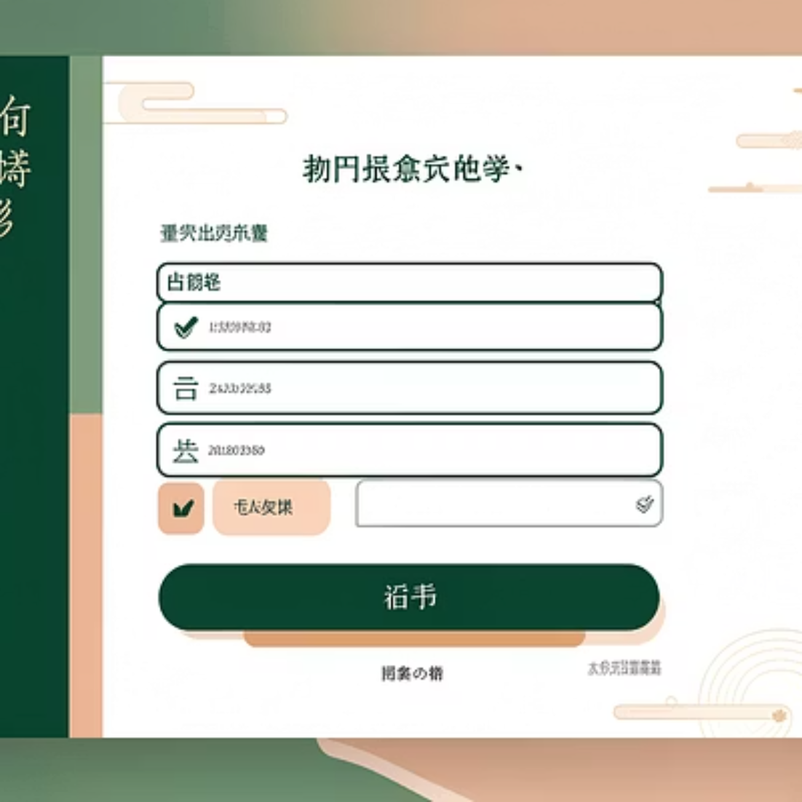
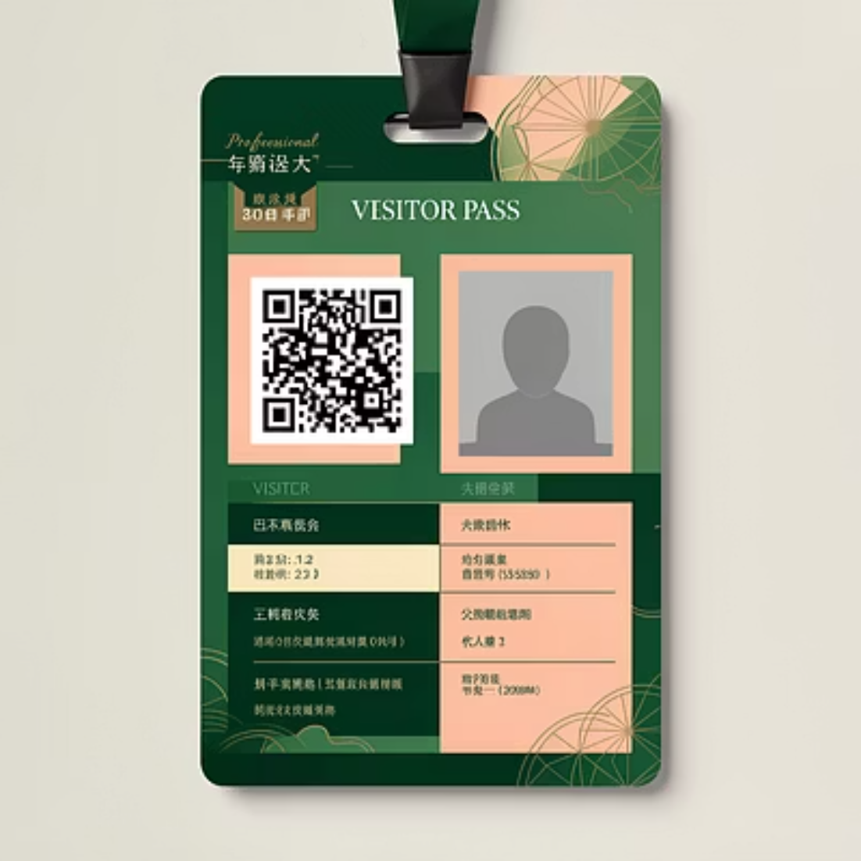
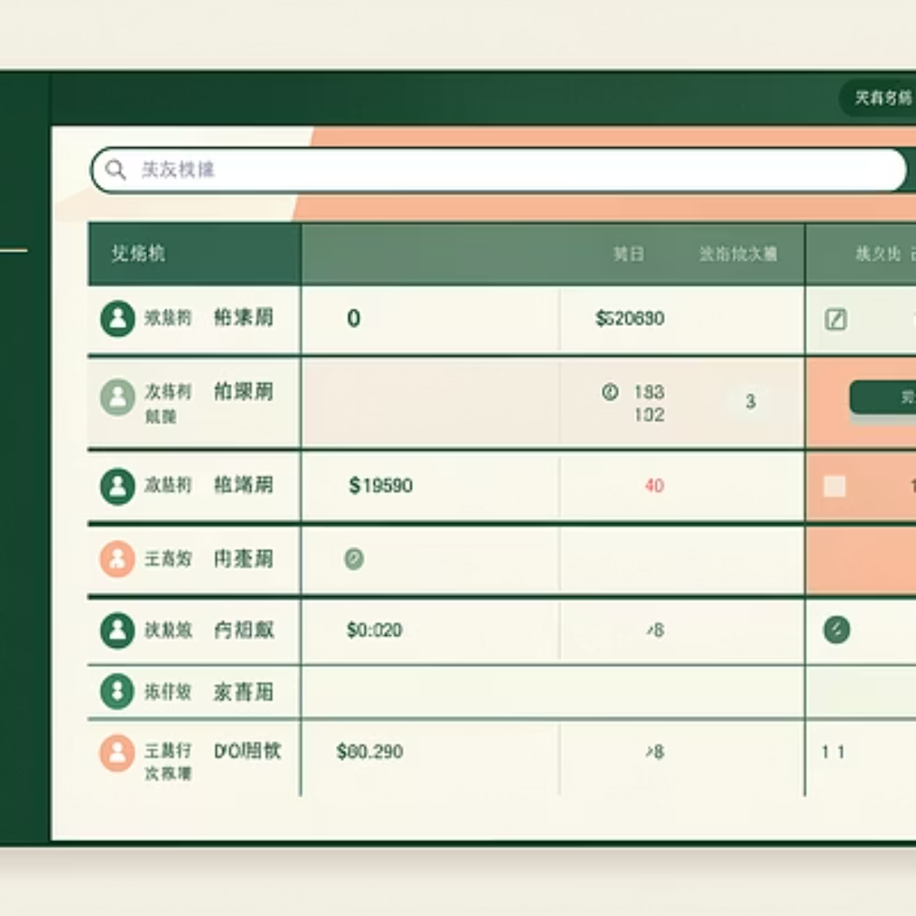
Output Screens
The system generates three main interface screens for visitor management.

Slide 10
Limitations & Future Scope
Current Limitations
Future Enhancements
No permanent database storage
Data stored only in browser LocalStorage
No user authentication system
Single-user implementation
Implement database integration
Add user login and authentication
Enhance security features
Multi-user support with roles
Conclusion
The Visitor Gate Pass Generator successfully addresses manual visitor entry challenges through digital automation. The system reduces paperwork, improves data accuracy, and provides efficient visitor tracking with QR code authentication.

