Slide 1

Flight Fare Prediction
Welcome to our presentation on flight fare prediction. Flight ticket prices often change due to various factors like demand, season, and airline policies, making it hard for travelers to know the best time to book. This is where machine learning comes in. By analyzing past data such as routes, dates, airlines, and booking patterns, Data Science models can predict future prices with good accuracy. This helps travelers save money and make smarter booking decisions. It also benefits airlines by helping them optimize pricing and manage seat availability. In this presentation, we’ll explore how this technology works and why it matters.

Slide 2




Domain and Context of Flight Fare Prediction
Airline Industry / Travel Tech
The prediction of flight ticket prices is a critical application within the
airline industry and the broader travel technology sector. It supports strategic planning and operational
efficiency for all participants.
Dynamic Pricing Planning
Flight fares are influenced by a multitude of factors including airline, origin, destination, journey date, duration, and number of stops. Accurate predictions empower customers to plan purchases effectively and allow companies to offer competitive, dynamic pricing strategies.
Beneficiaries of Accurate Prediction
Travelers: Identify optimal booking times for cost savings.
Travel Agencies: Implement sophisticated dynamic pricing models.
Airlines: Enhance demand forecasting and revenue management.

Slide 3
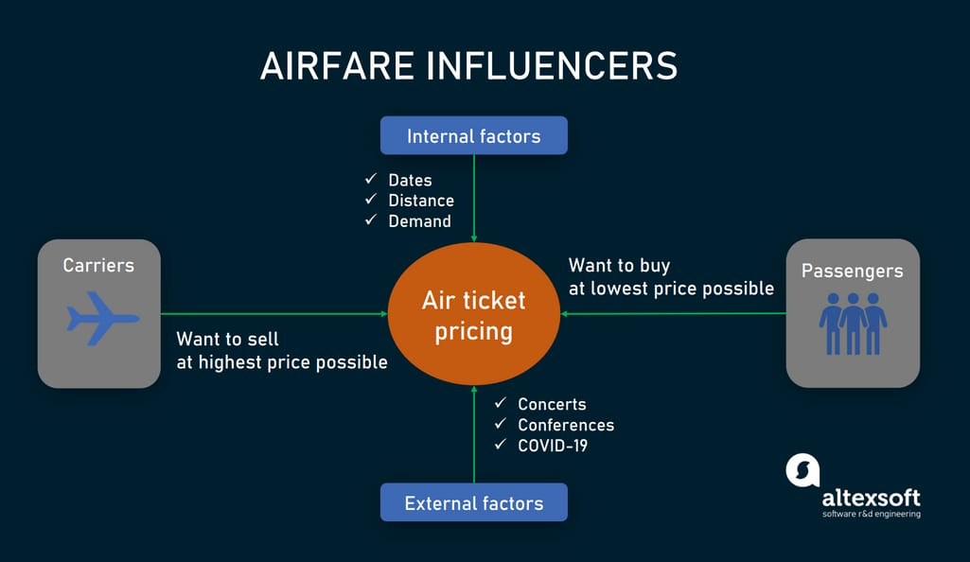
Dataset Overview: Features and Categorization
The dataset used for this case study, often sourced from platforms like Kaggle, comprises
various features crucial for fare prediction.
Airline | Categorical: Carrier of the flight.
Source, Destination | Categorical: Departure and arrival cities.
Date_of_Journey | Date/Time: Specific date of travel.
Duration | Textual/Mixed: Total travel time.
Total_Stops | Categorical: Number of layovers.
Additional_Info | Categorical: Miscellaneous flight details.
Price | Numerical: Target variable (flight fare).
Understanding these features and their types is fundamental for effective data preprocessing and model building.

Slide 4
Problem Statement & Workflow for Flight Fare Prediction
Problem Statement:
Airline ticket prices fluctuate based on various factors such as airline, source and destination cities, date of journey, duration, number of stops, and seasonality. The goal of this project is to predict flight fares accurately so that:
Travelers can make cost-effective booking decisions.
Travel agencies/airlines can optimize their pricing strategies.
Work Done:
Collected the flight fare dataset from Kaggle
Filled missing values using median/mode as required
Removed unnecessary columns from the dataset
Converted columns to correct data types
Scaled the numerical features for uniformity
Visualized relationships between key columns and flight fare

Slide 5
Summary of Preprocessing Steps
Handling Missing Values
Missing entries were imputed using appropriate statistical methods (e.g., mean, median, mode) to maintain data integrity.
Duration Transformation
The 'Duration' feature, originally a string, was meticulously converted into minutes to allow for numerical analysis and model consumption.
Date/Time Transformation
Granular features like day, month, and hour were extracted from 'Date_of_Journey', 'Dep_Time', and 'Arrival_Time' to capture temporal patterns.
Categorical Data Encoding
Categorical features were transformed into numerical formats using Label Encoding or One-Hot Encoding, depending on their cardinality and potential ordinality.
Outlier Removal
Outliers, particularly in the 'Price' distribution, were identified and removed to prevent undue influence on model training and improve prediction accuracy.
Data Readiness
These comprehensive steps collectively ensured a final cleaned dataset, optimally prepared and ready for subsequent modelling phases.

Slide 6
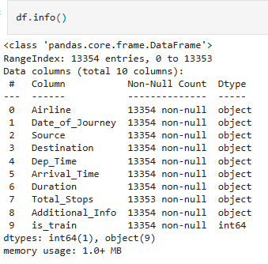
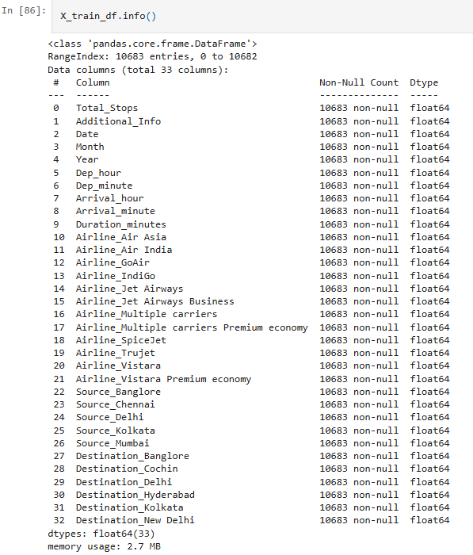
Preprocessed Dataset with
Encoded & Scaled Features
Raw Flight Dataset

Slide 7
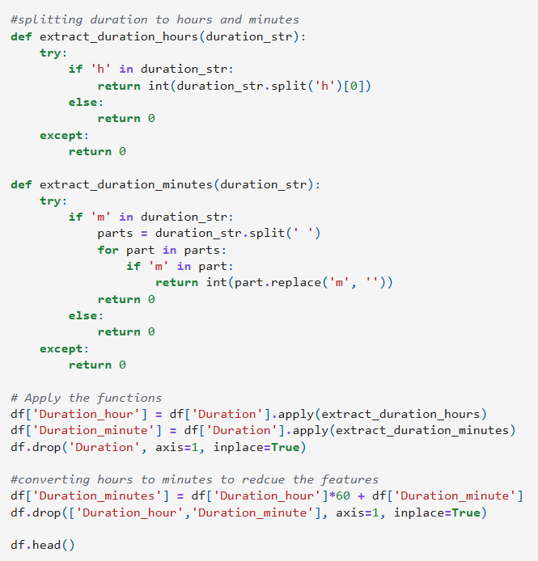
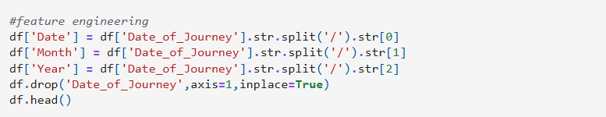
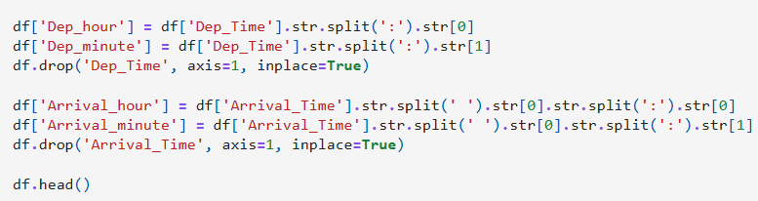
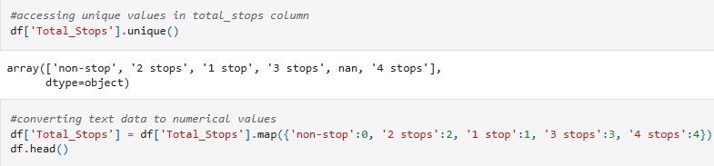
Feature Engineering

Slide 8
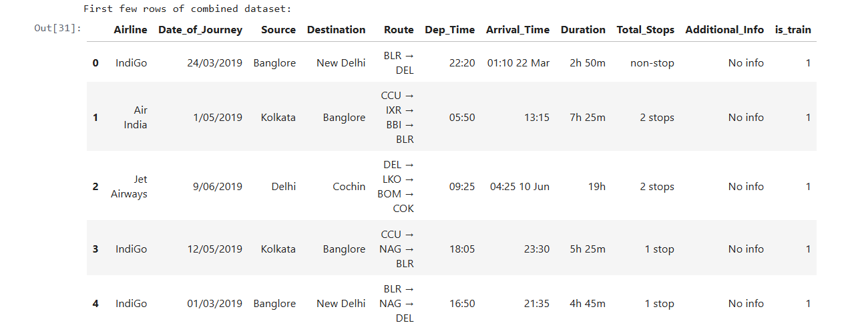
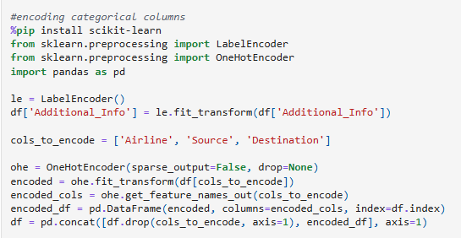
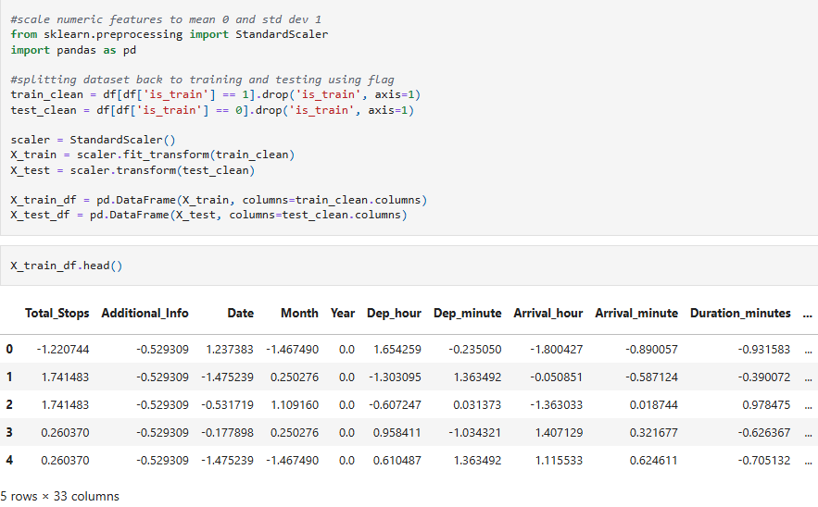
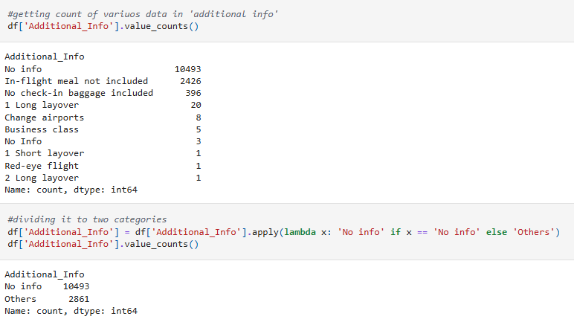
Original Dataset
Encoding & Scaling

Slide 9
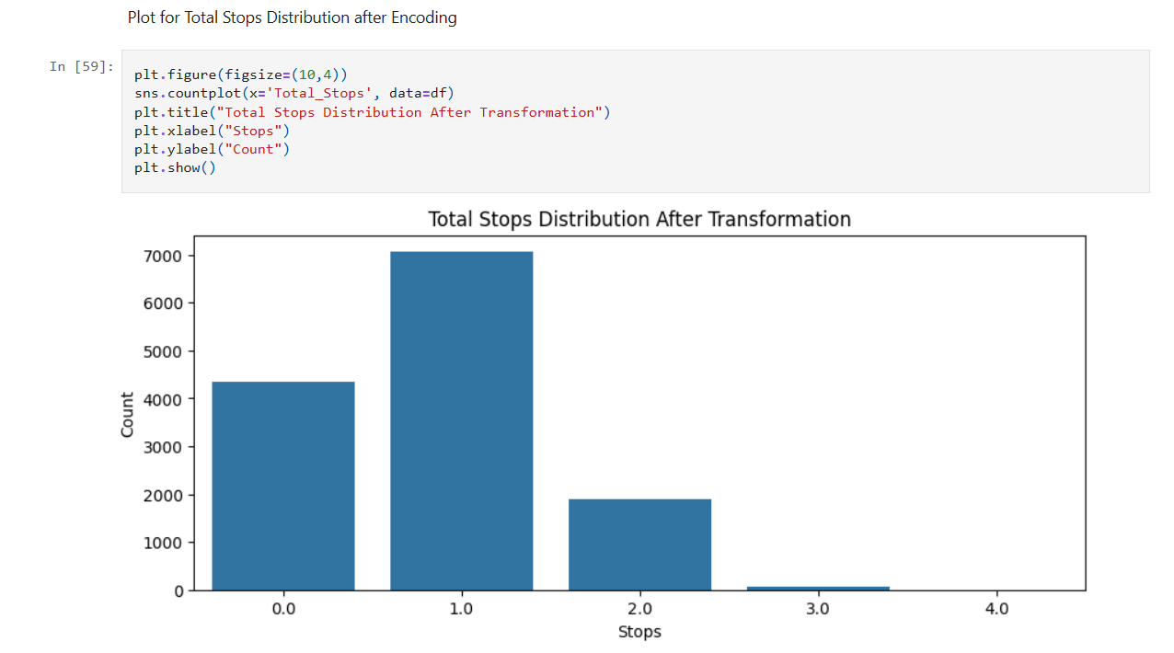
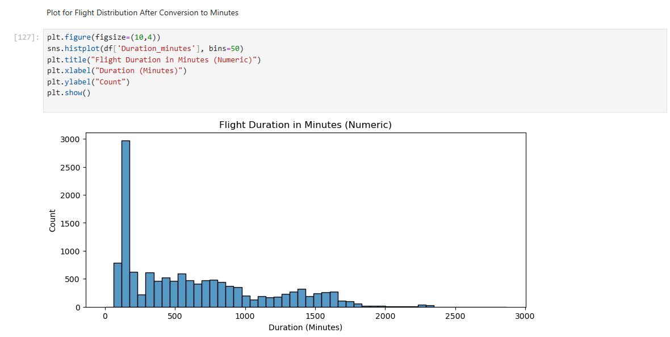
Visualization of Applied Transformation

Slide 10
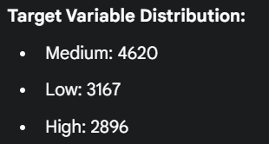
Model Implementation: K-Nearest Neighbours (KNN) Classifier
Objective: To classify flight fares into three categories: 'Low', 'Medium', and 'High’.
# Convert the target variable 'Price' into classes
price_bins = [0, 6000, 12000, float('inf’)]
price_labels = ['Low', 'Medium', 'High’]
y_class = pd.cut(y, bins=price_bins, labels=price_labels, right=False)
# Import the classifier and split the data for validation
from sklearn.neighbors import KNeighborsClassifier
from sklearn.model_selection import train_test_split
# Split the preprocessed training data for training and validation
X_train, X_val, y_train_class, y_val_class = train_test_split(
X_train_df, y_class, test_size=0.2, random_state=42, stratify=y_class)
# Initialize and train the KNN Classifier with K=5
knn_classifier = KNeighborsClassifier(n_neighbors=5)
knn_classifier.fit(X_train, y_train_class)

Slide 11
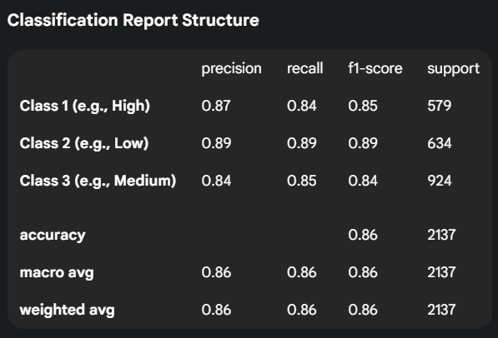
1. The trained KNN model was evaluated on the validation set to assess its performance.
2. Accuracy Score: The model achieved an accuracy of 86% on the validation data.
3. Confusion Matrix:
[ [485 7 87]
[ 2 564 68]
[ 71 66 787] ]
Model Evaluation

Slide 12
Conclusion & Insights
Summary:
This project successfully developed a machine learning model to predict flight fare categories with a high degree of accuracy.
Extensive data preprocessing and feature engineering were performed to prepare the dataset for modeling. This included handling missing values, converting data types, and encoding categorical variables.
A K-Nearest Neighbors (KNN) classification model was implemented and trained on the cleaned dataset.
Key Insights:
The model achieved an accuracy of 86%, demonstrating its effectiveness in classifying flight prices.
The classification report shows strong precision and recall across all price categories, indicating a well-balanced model.
Hyperparameter tuning helped in identifying the optimal K value, which is crucial for the performance of the KNN algorithm.

