Slide 1
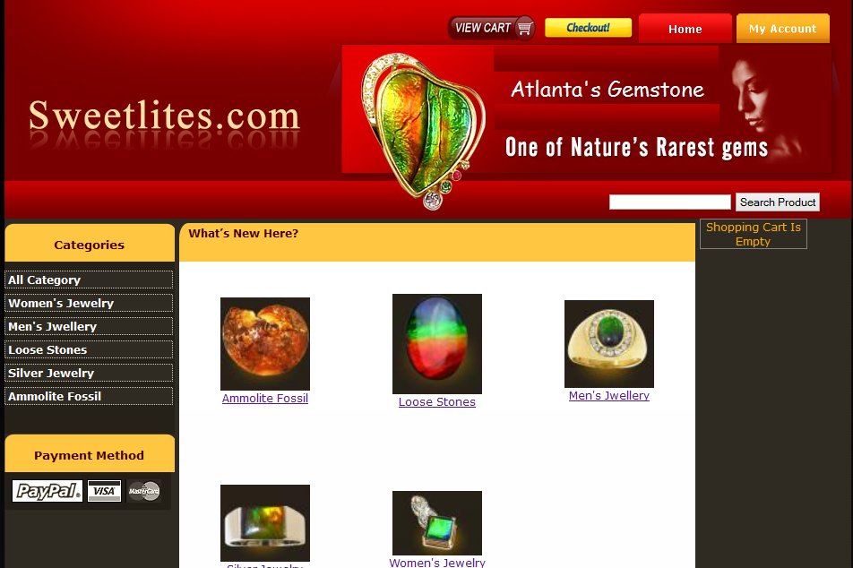
E-COMMERCE USING PHP-MVC
Jyoti Islam
Shrada Pradhan

Slide 2
User
Anyone who wants to buy Jewelry.

Slide 3
Design
A core layout/template for the whole website.
A front-end for user to buy Jewelry.
A back-end for site admin to maintain website.

Slide 4
Key Features- Front End
Different Category of Jewelry
Different Products of Each Category.
Product Details
Add to Cart
View Cart
Checkout Cart
Payment Information Verification
Search Product
Pagination
User Registration/Log In

Slide 5
Key Features- Back End
Manage Different Category & Sub-Category of Jewelry
ADD
EDIT
DELETE
Manage Different Products of Each Category.
ADD
EDIT
DELETE

Slide 6
Key Features- Back End
Manage Orders
ADD
EDIT
DELETE
Manage Users
ADD
EDIT
DELETE
Change Password

Slide 7
Key Features- Back End
User Log IN/Log Out
User Session
Pagination

Slide 8
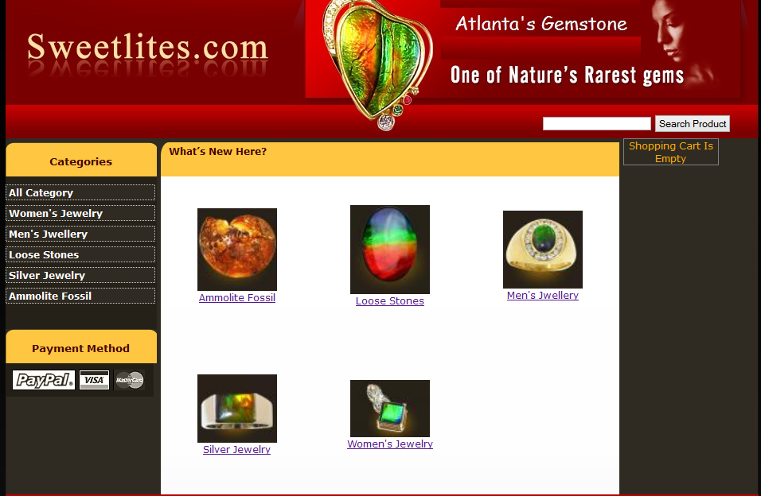
Different Category

Slide 9
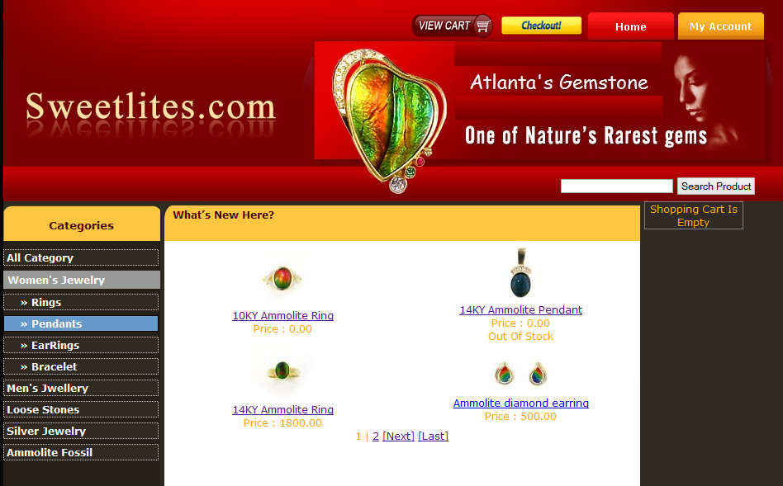
Different Sub-Category

Slide 10
Different Sub-Category

Slide 11
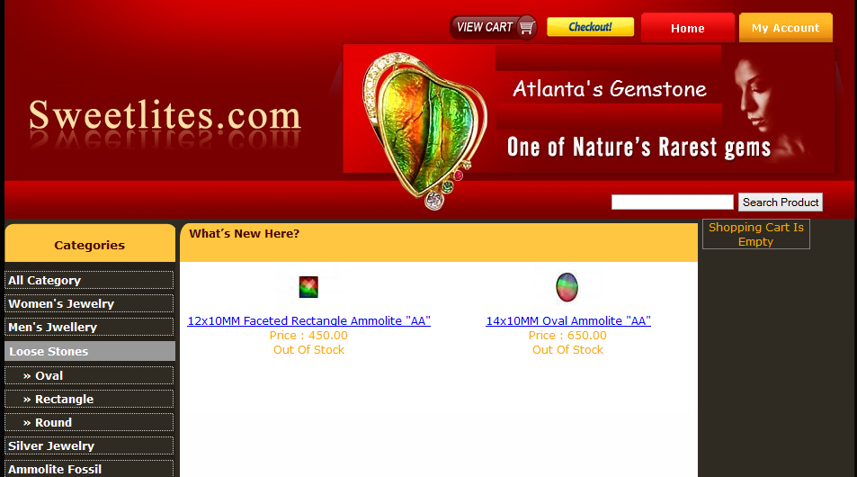
Different Products

Slide 12
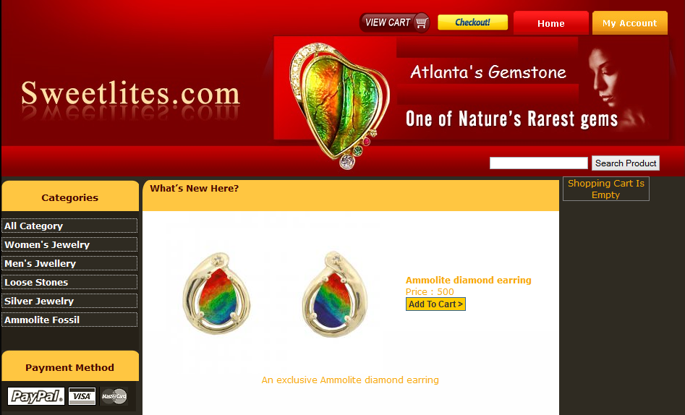
Product Details

Slide 13
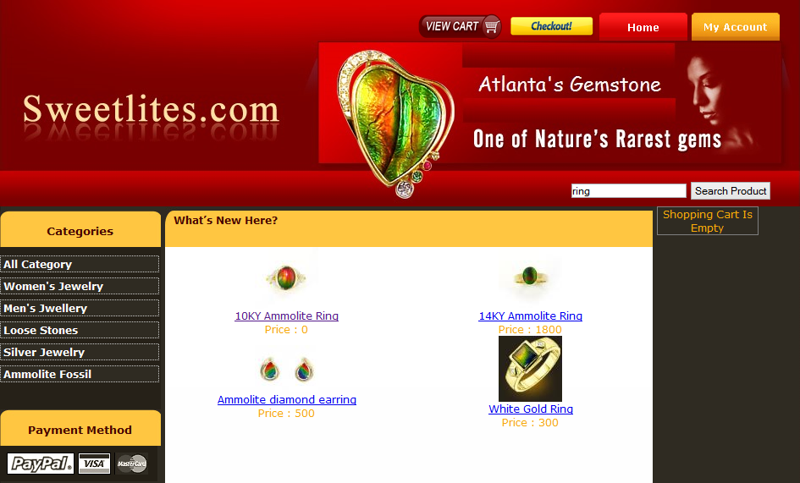
Search Product

Slide 14
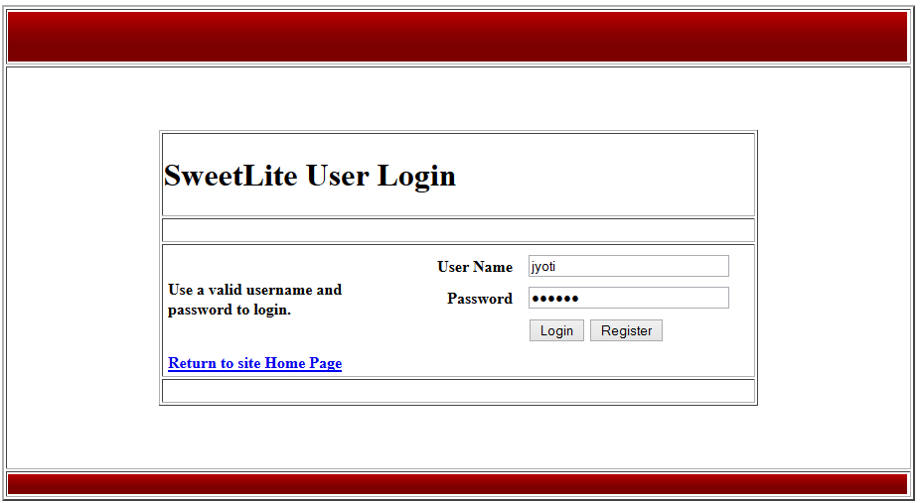
User Log In/Registration

Slide 15
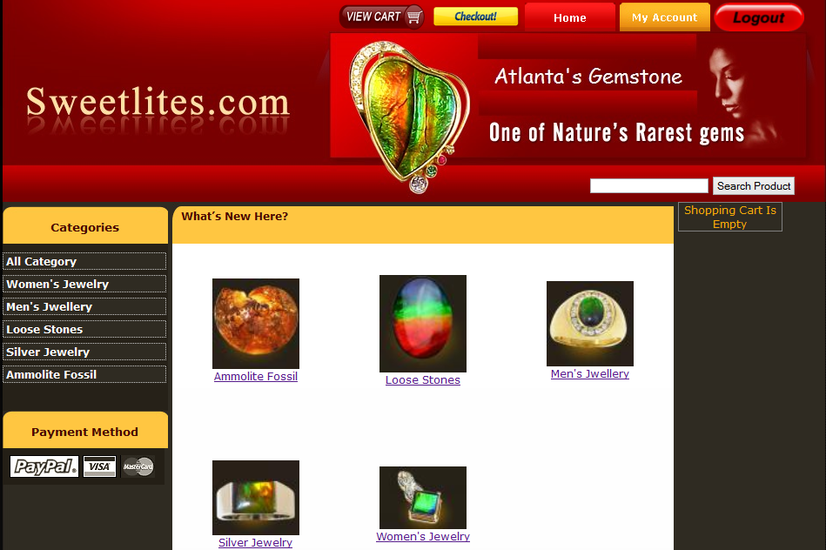
User Home Screen

Slide 16
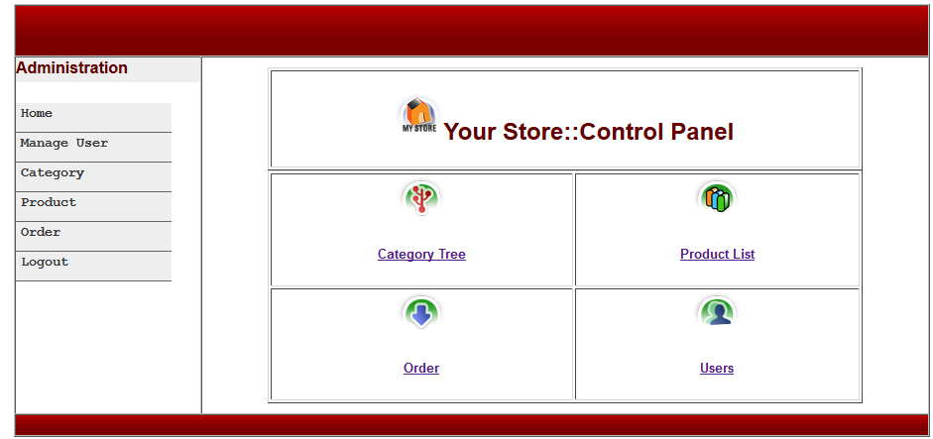
Admin Home Screen

Slide 17
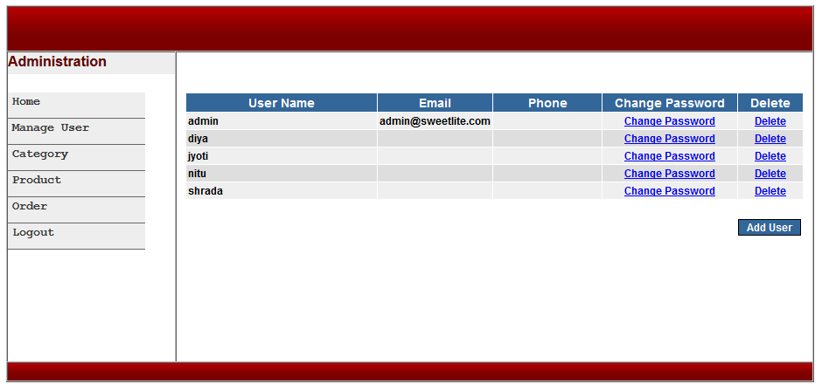
Manage User

Slide 18
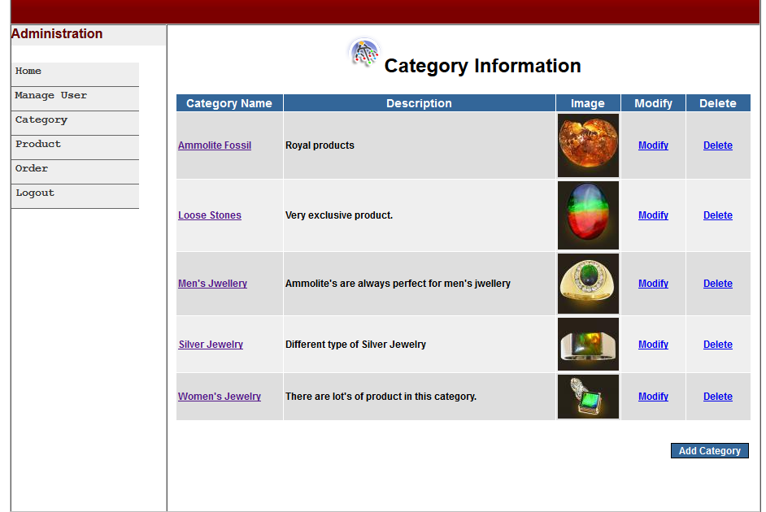
Manage Category

Slide 19
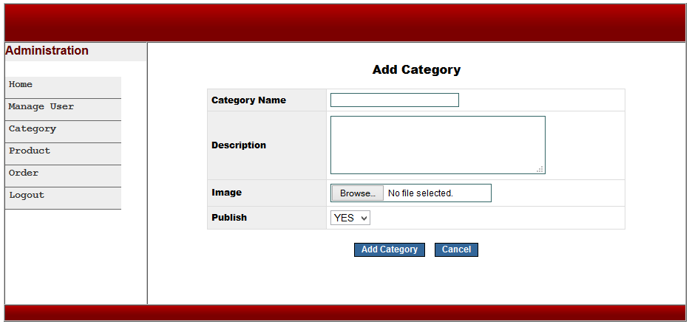
Add Category

Slide 20
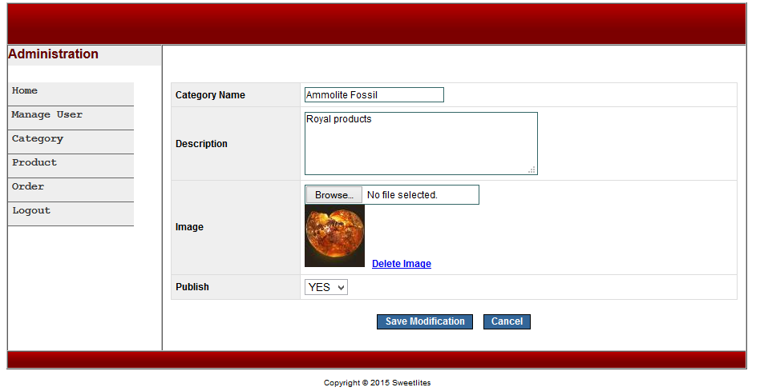
Modify Category

Slide 21
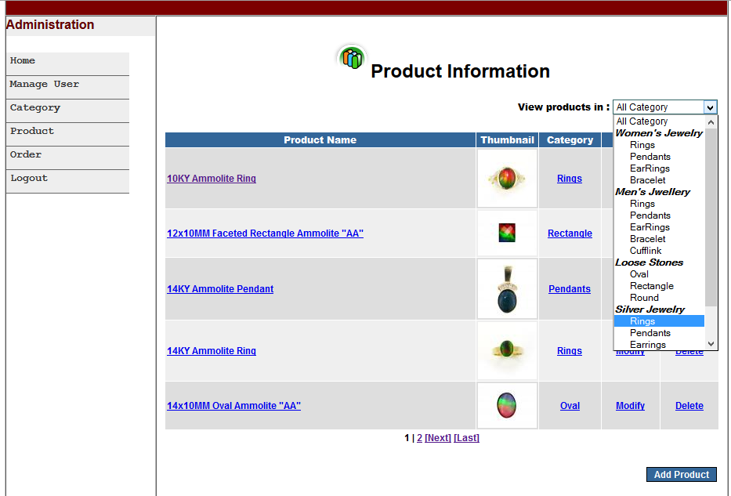
Manage Product

Slide 22
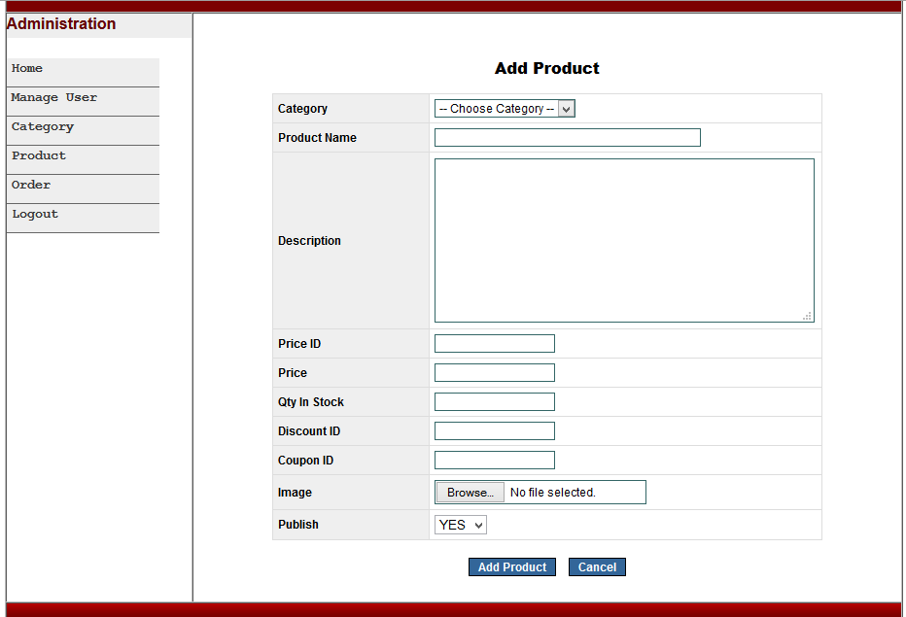
Add Product

Slide 23
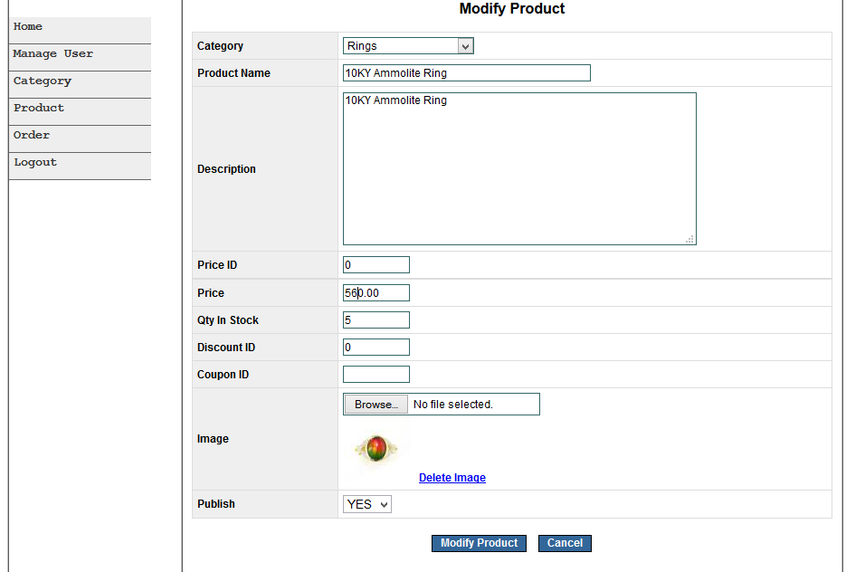
Modify Product

Slide 24
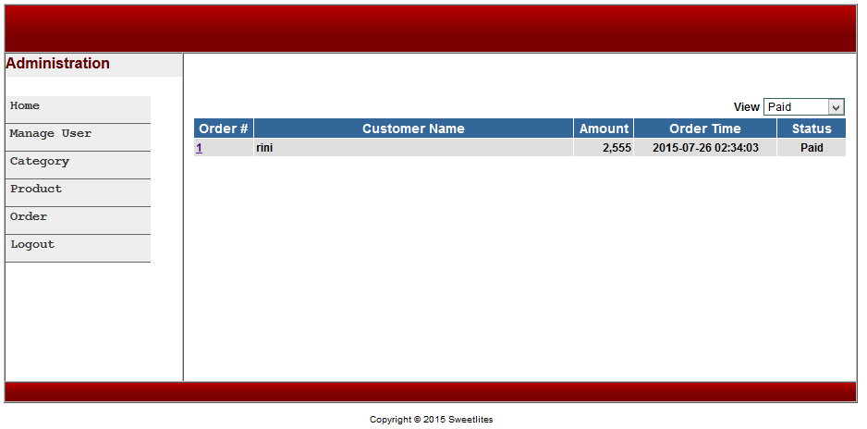
Manage Order

Slide 25
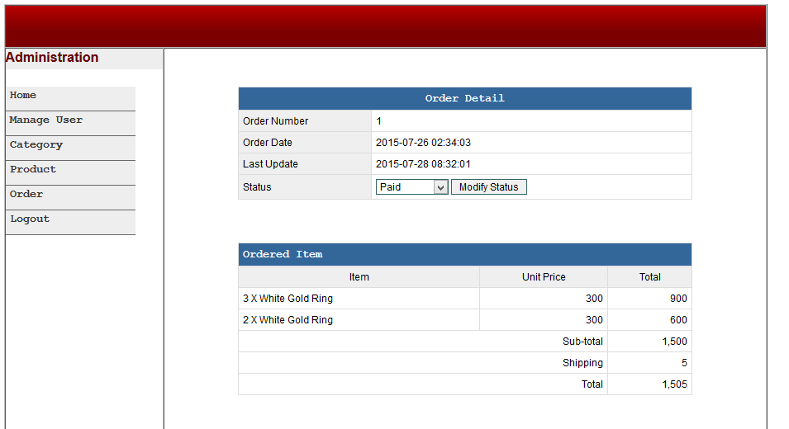
Order Details

Slide 26
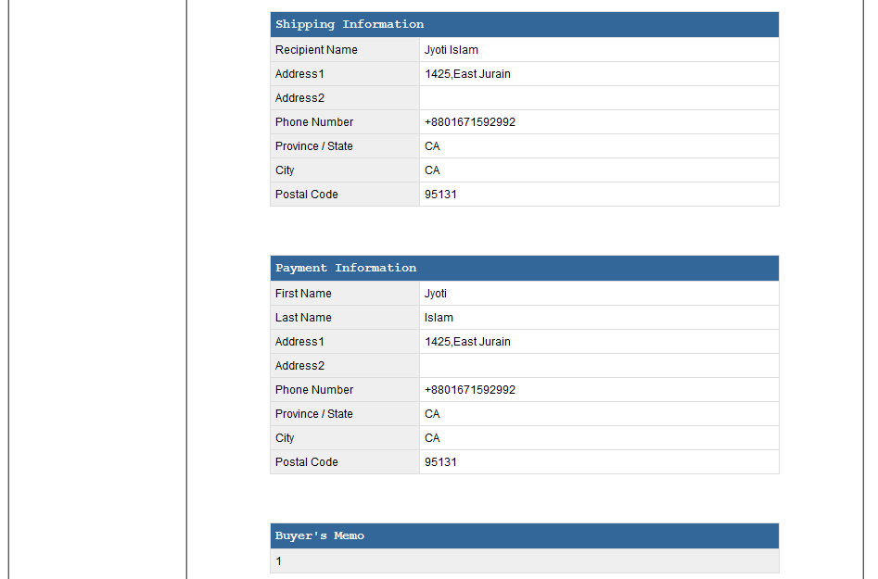
Order Details (cont…)

Slide 27
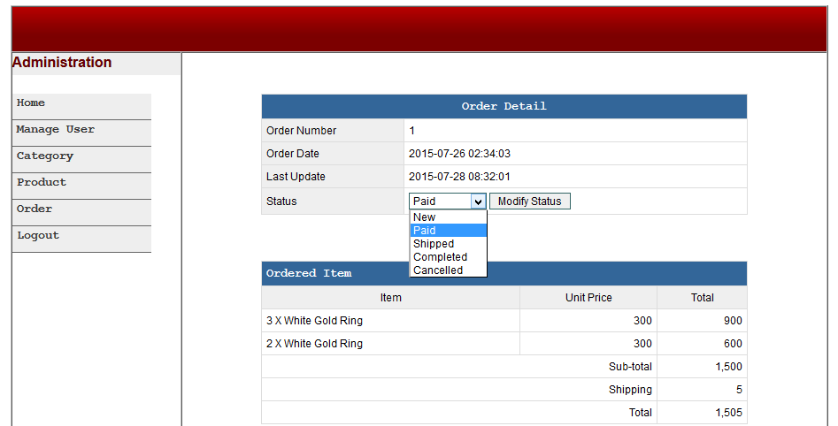
Modify Order

Slide 28
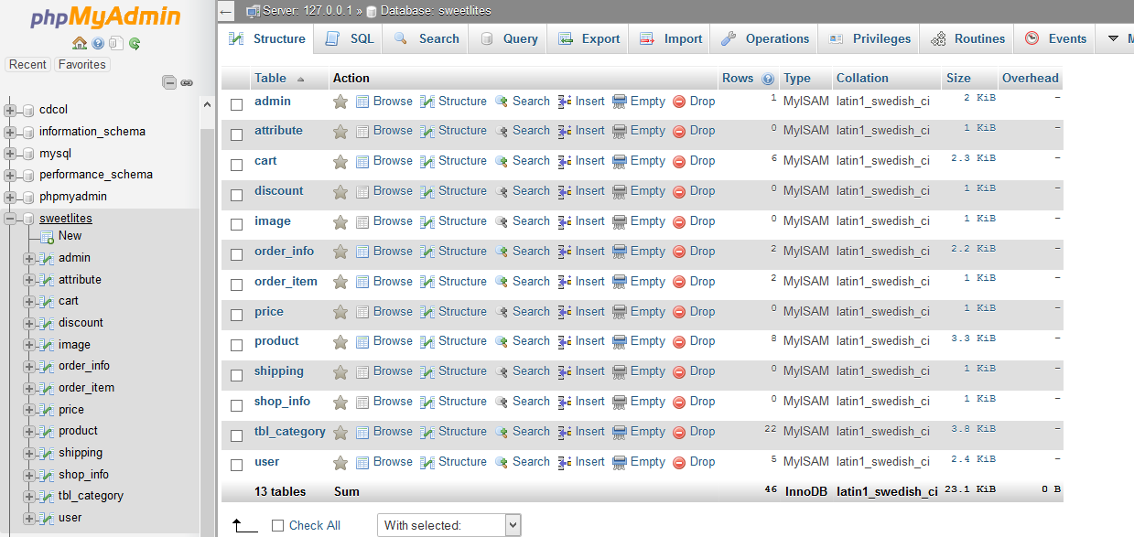
Database

Slide 29
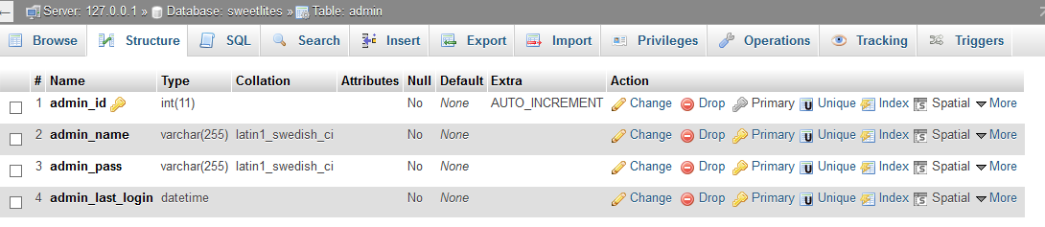
Admin table

Slide 30
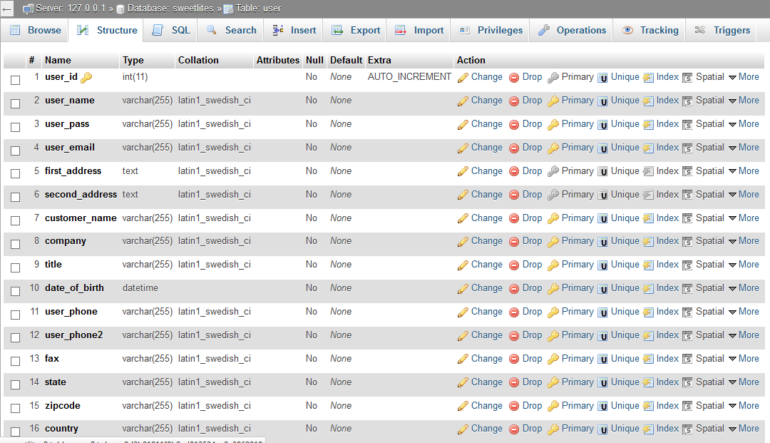
User table

Slide 31
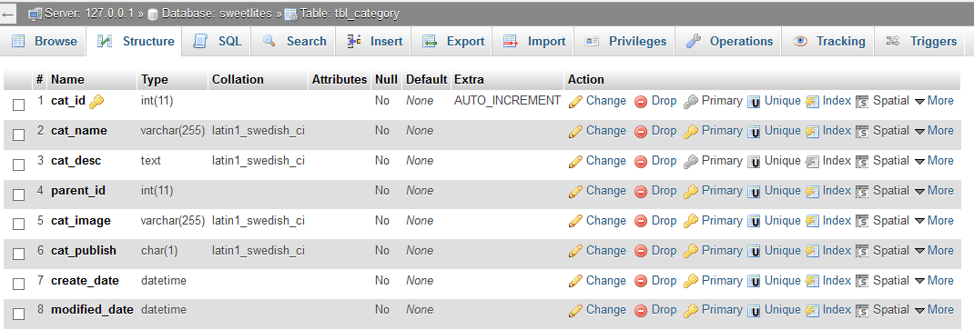
Category table

Slide 32
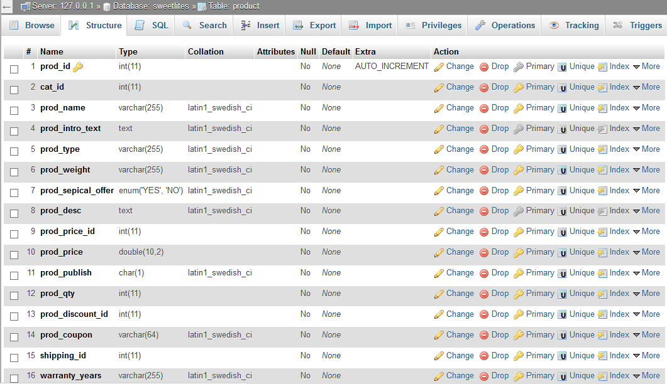
Product table

Slide 33
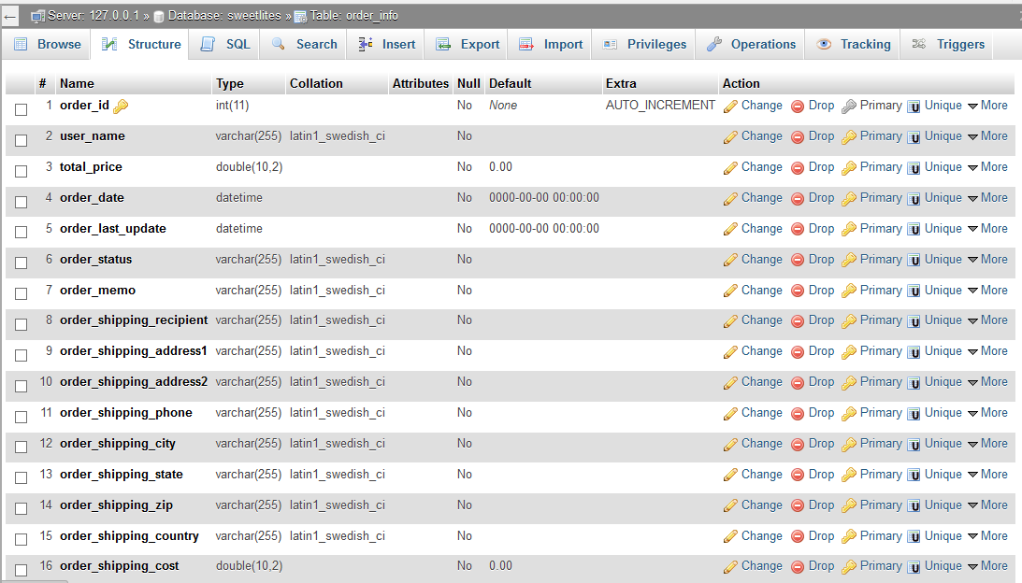
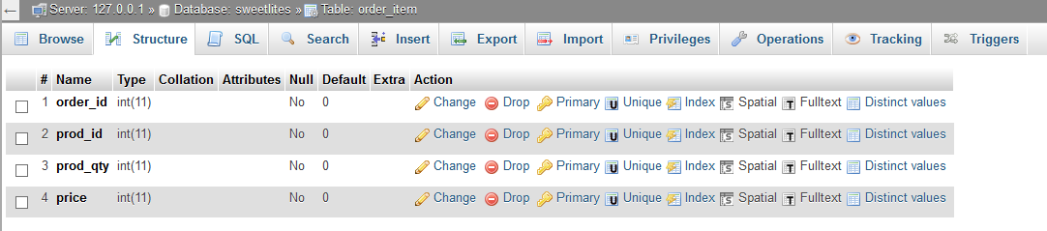
Order_info and Order_item table

Slide 34
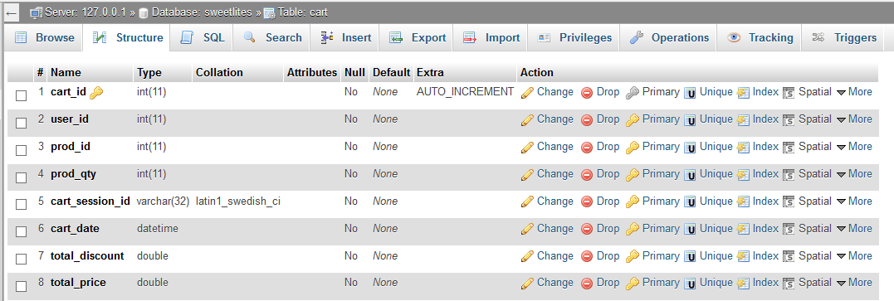
Cart table

Slide 35
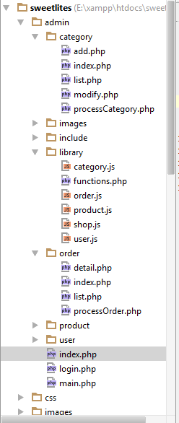
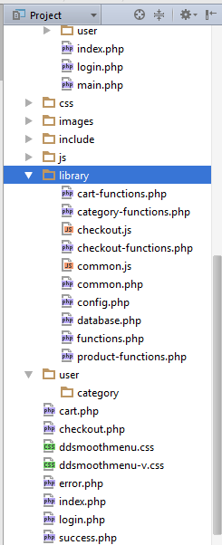
Project Structure

Slide 36
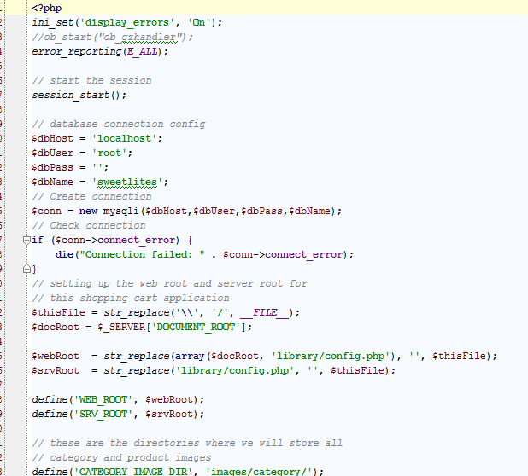
Database Connection

Slide 37
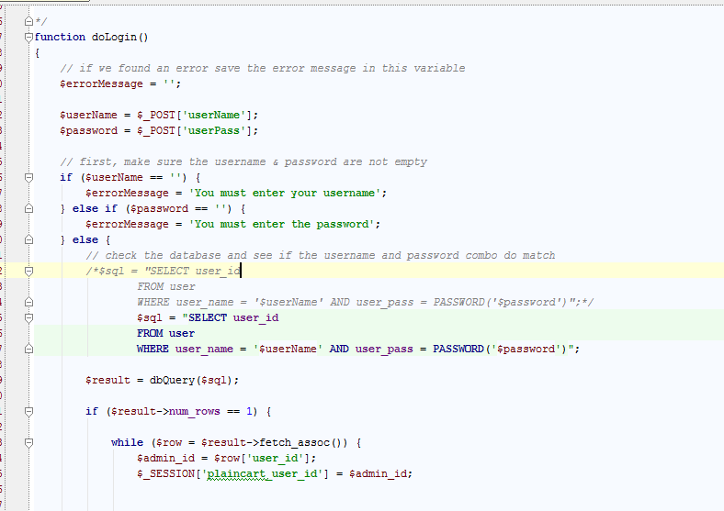
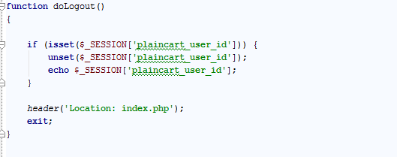
User Log In & Log Out

Slide 38
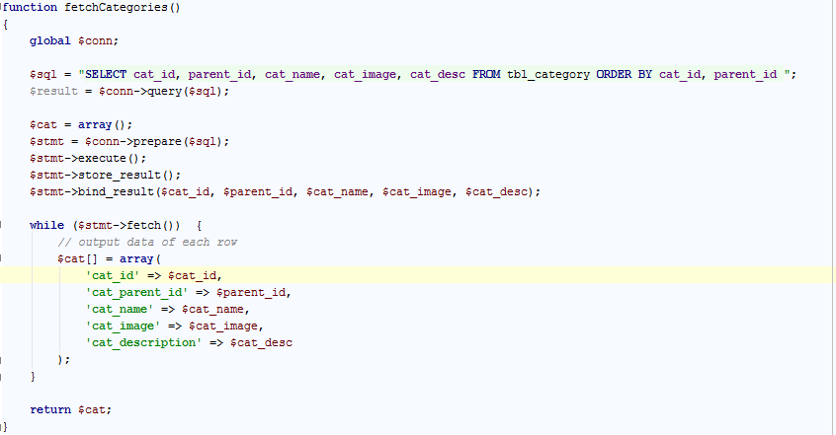
Fetch Category List

Slide 39
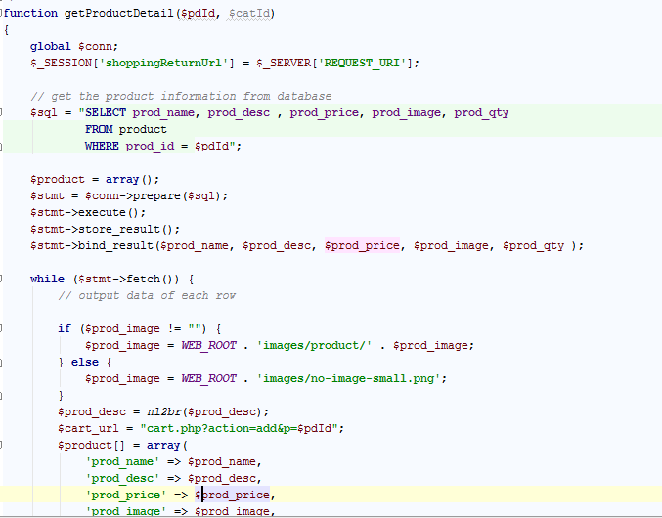
Fetch Product Detail

Slide 40
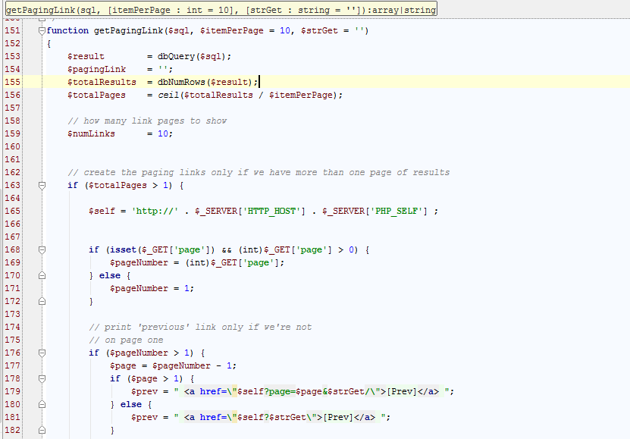
Pagination

Slide 41
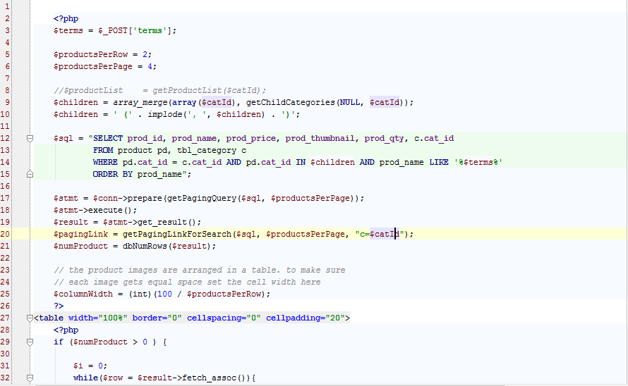
Search Product

Slide 42
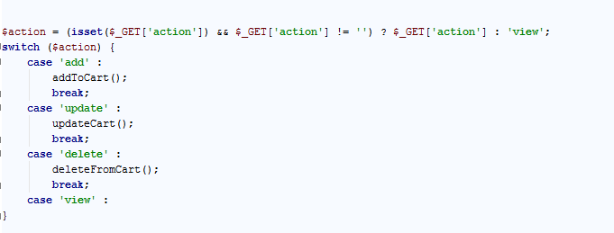
Cart functionality

Slide 43
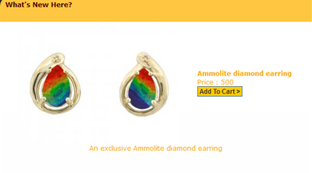
Add to Cart

Slide 44
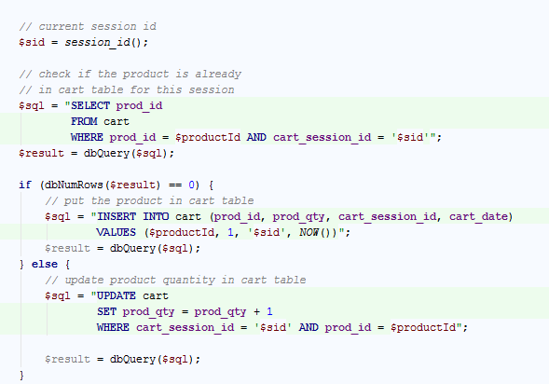
Add to Cart

Slide 45
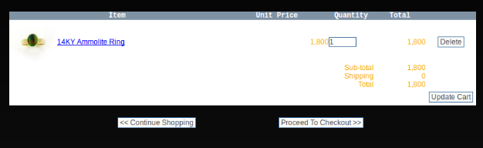
View Cart

Slide 46
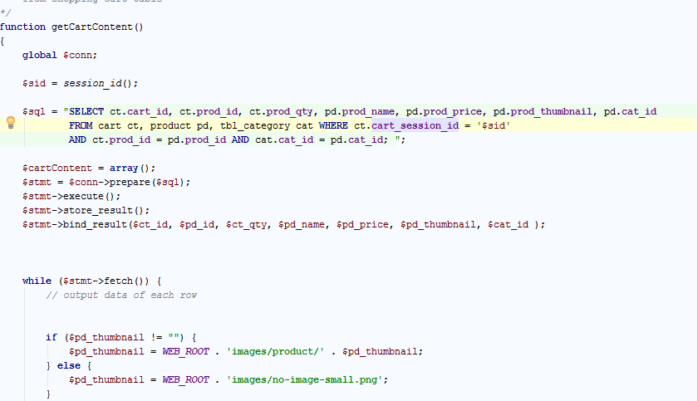
View Cart

Slide 47
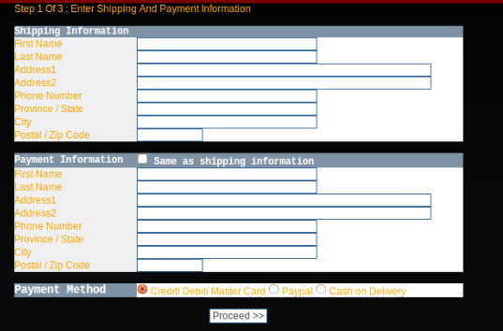
Check-out

Slide 48
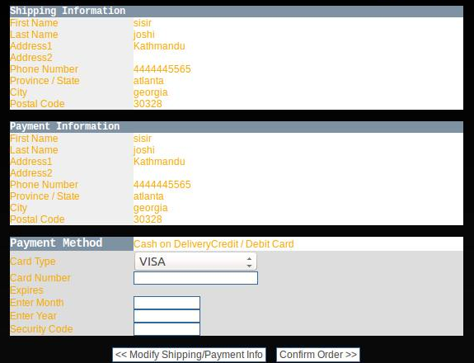
Payment Verification

Slide 49
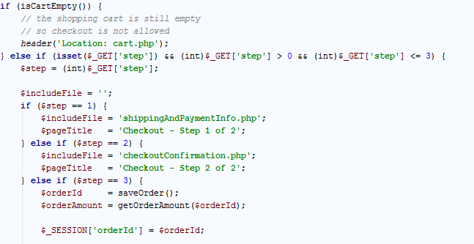
Check-out

Slide 50
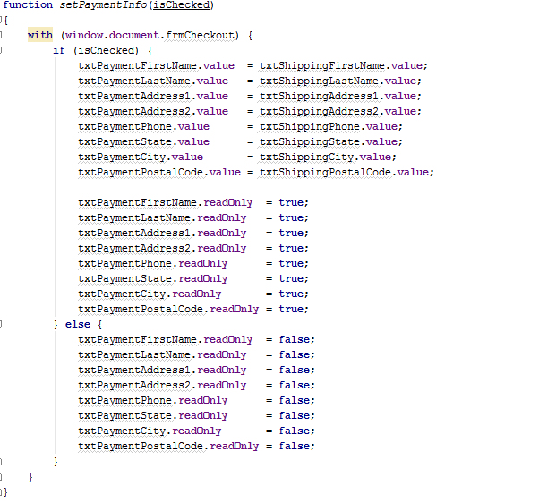
Check-out

Slide 51
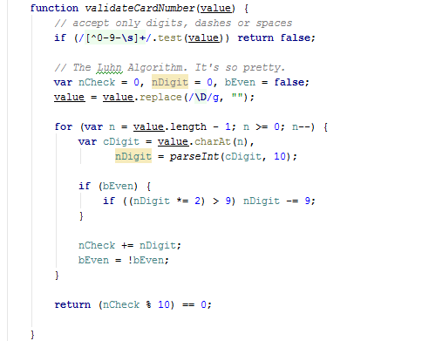
Payment Verification

Slide 52
Testing
Test each features.
Test website from different browser.
Test website from different location.

Slide 53
Demo

