Slide 1

Express, React, RTK Query-part3
자동차 데이터, 이미지를 RTK, RTK Query로 처리

Slide 2
code
https://github.com/jisooyu/yu-mern-rtk-query-car-3.git

Slide 3
강의 주요 목적
user의 data, authentication을 포함한 application 설명
지난 번 비디오 참조
관광공사 고캠핑 데이터를 RTK Query에서 불러오기 - PART 1 (youtube.com)
관광공사 고캠핑 데이터를 RTK Query와 RTK에서 처리하기 - PART 2 (youtube.com)

Slide 4
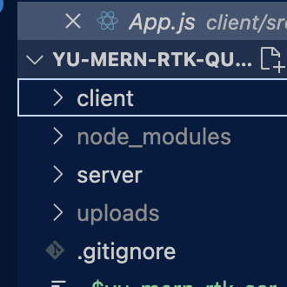
프로젝트 구조 및 생성
project name
|
---- client
|
---- server

Slide 5
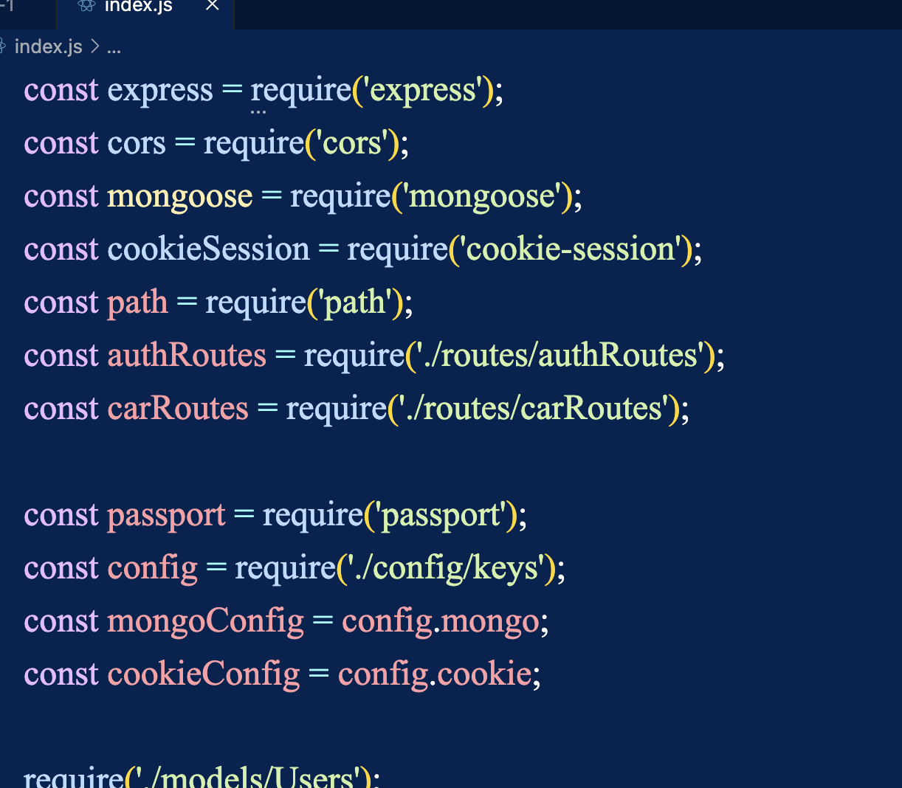
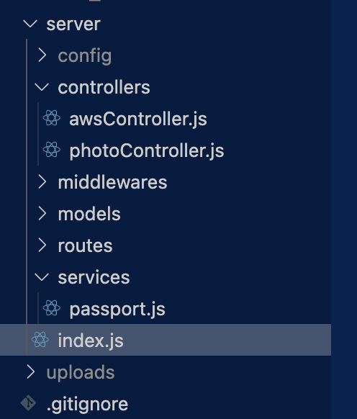
server – part 3; INDEX.JS

Slide 6
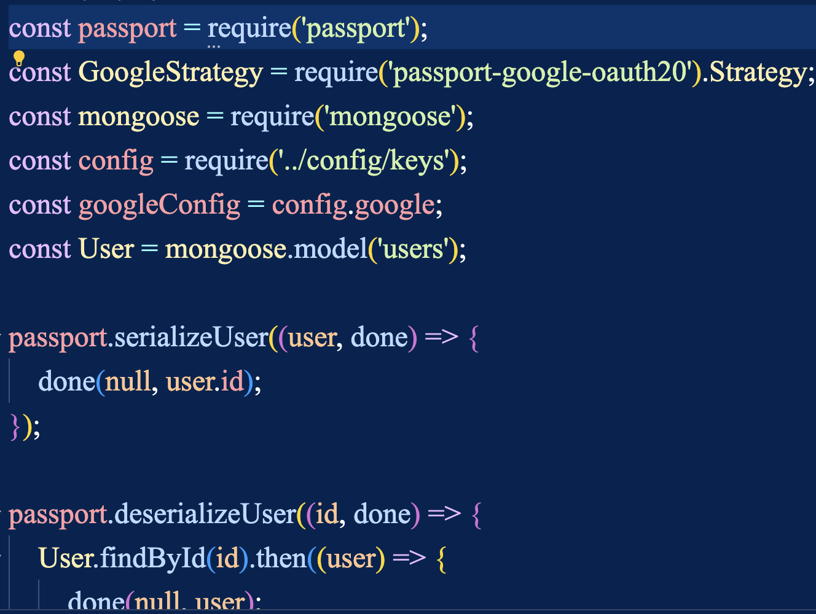
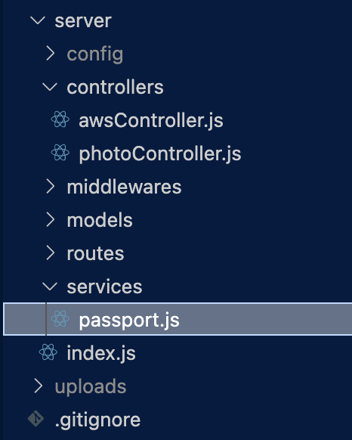
server – part 3: PASSPORT.JS

Slide 7
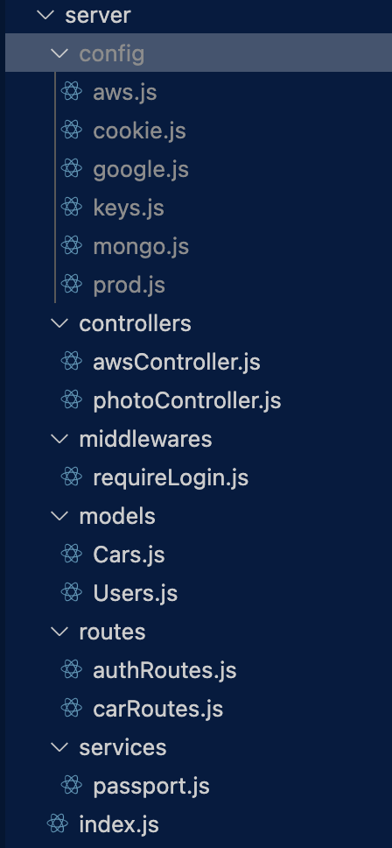
server – part 3:others

Slide 8
transformResponse function in Redux Toolkit Query
Custom Data Transformation:
You can use transformResponse to modify the data received from the API before it’s stored in the cache.
For normalization, you can extract relevant parts of the response (e.g., the "data" array) and normalize them using tools like createEntityAdapter.
In your example, you’re using createEntityAdapter to normalize user data by passing only the "data" array to it².
To include "meta" and "links" keys, you can handle them separately within transformResponse.
Handling Metadata and Pagination:
When dealing with paginated responses, like the one you described, you can extract pagination-related information (such as "meta" and "links") from the original response.
Store this metadata separately (e.g., in a separate slice) to keep track of pagination details.
Your current approach of creating a separate “usersSlice” to store metadata works, but there might be more elegant solutions.
Better Approach:
Instead of storing metadata in a separate slice, consider enhancing your transformResponse logic.
Extract the "meta" and "links" keys from the original response and dispatch actions to update your state accordingly.
This way, you can keep all related data (including metadata) within the same slice, avoiding unnecessary complexity.
source: COPILOT

