Slide 1
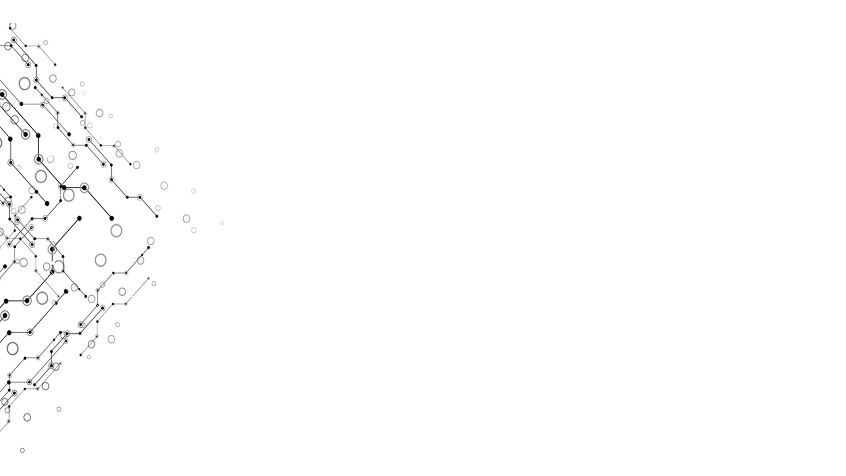

Presentation of GOBOARD
Computational Thinking and System Design
TgopKnight from Group 3
Week 10

Slide 2

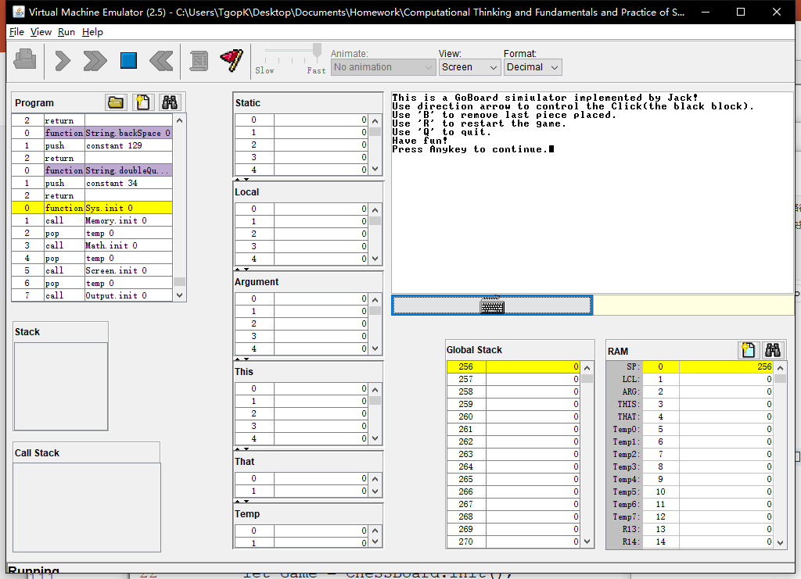
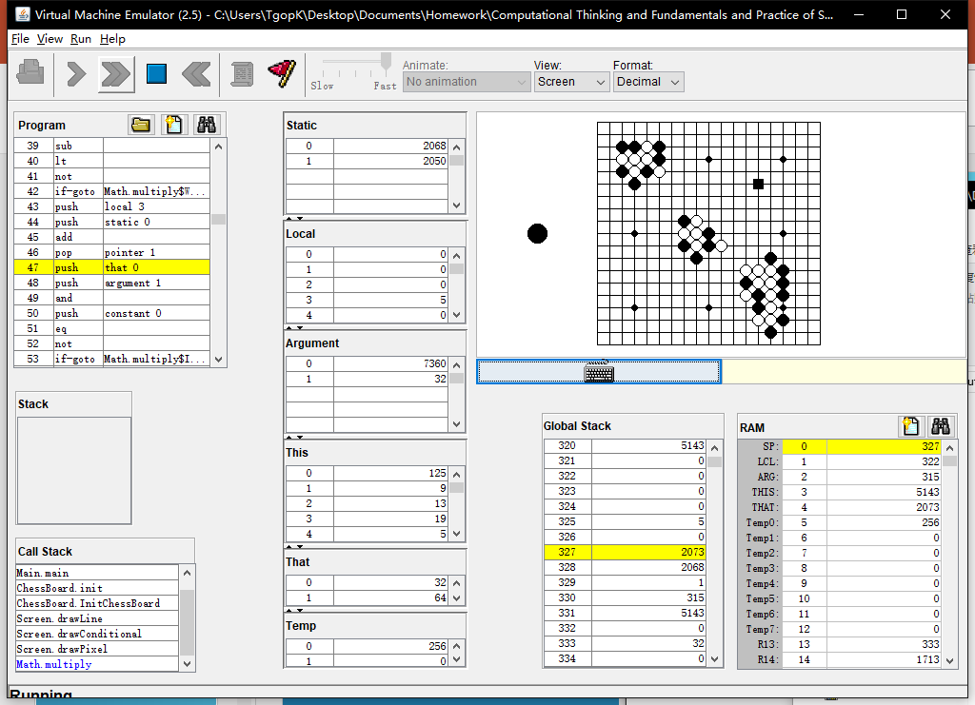
EFFECTION
Week 10
Simulated on
VMEmulator!
Computational Thinking and System Design

Slide 3
Logic model
Week 10
Inputs:
Jack OS API.pdf + Lecture 09 High-level language.pdf
Resource codes from Project 9
Activities:
Editor(Vim) + Programming
Partly adapted from the SquareGame provided in Project 9
Outputs:
A board supports basic placing pieces operation
Outcomes/Impacts:
As a basic of GO game(using Jack language!)
Computational Thinking and System Design

Slide 4
What do we ACHIEVE
Week 10
Simulator of a Goboard
Able to place Black and White Go piece
Able to judge placed point, but unable to reflact
Able to ‘Withdraw’
Able to ‘Clear’ the ‘Board’
Computational Thinking and System Design

Slide 5
How do we achieve
Week 10
Jack language
Vim
Computational Thinking and System Design

Slide 6
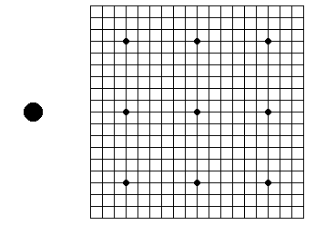
BUILD a board without chess pieces
Week 10
Line 19 * 19
Top left corner: (125, 9)
Interval between lines: 12
9 Black circles
Radius = 3
1 Hint Go piece
Which color next
Radius = 10
Computational Thinking and System Design

Slide 7
PLACE a Chess piece
Week 10
Jack
Array: Grid[19 * 19]
-1: empty 0: black 1: white
Int: NextPiece = 0/1 (decide which Go piece next)
Computational Thinking and System Design

Slide 8
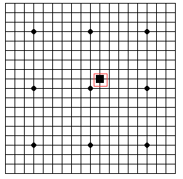
PLACE a Chess piece
Week 10
However, Jack language can not provide mouse click.
I didn’t find it from Jack OS API.pdf
A Black Block to substitute mouse!
Int: ClickX, ClickY
Length of Block side: 11
Press “Enter” to place a Go piece
Using direction arrows to move the Block
This idea is adapted from the SquareGame
Computational Thinking and System Design

Slide 9
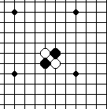
PLACE a Chess piece
Week 10
With Array Grid, we can simply finish judging if a location was already place with a Go piece.
However we can’t provide an alert window…
For Go piece
Black: radius = 6
White: A Black one + radius = 5
Computational Thinking and System Design

Slide 10
WITHDRAW
Week 10
Jack
Data Structure: Stack
Needn’t record placed color
Keyboard.keyPressed() = ‘B’
Computational Thinking and System Design

Slide 11
CLEAR
Week 10
Jack
InitChessBoard()
Keyboard.keyPressed() = ‘R’
Computational Thinking and System Design

Slide 12
QUIT
Week 10
Jack
Return ;
Keyboard.keyPressed() = ‘Q’
Computational Thinking and System Design

Slide 13
HINT
Week 10
The Screen is very small (256 * 512)
System: ERROR 8
Reason: output beyond the Screen
Better not using vim as the editor
Its syntax coded with the format of xml (*.xml)
Vim use its own format (*.vim)
Jack expression does not follow the usual priority
A + B * C = (A + B) * C
Computational Thinking and System Design

Slide 14
HINT
Week 10
VMEmulator: Animate: No animation
Sorry for blaming Jack as a very slow language
Computational Thinking and System Design

Slide 15

Our Problems
Week 10
In fact, the Click was static initially.
But that was too inconspicuous(ugly)…
Sol: Make it blink!
Computational Thinking and System Design

Slide 16
Our Problems
Week 10
Code:
method void Display() {
let cnt = cnt + 1;
if (cnt > 599) {
if (cnt = 600) { do DisplayPiece(ClickX * Size + ClickY); }
if (cnt > 19999) { let cnt = 0; }
}
else { do DisplayClick(); }
return ;
}
Computational Thinking and System Design

Slide 17
HOWEVER
Week 10
When the click displayed on a black Go piece, it is still not very conspicuous……
Primary reason: the Screen is a little bit small…
Computational Thinking and System Design

Slide 18
Our Problems
Week 10
When display the Block, sometimes the part it locate will refresh to white
This problem become evident when the Block displayed on a Black Go piece
Sol:?
Computational Thinking and System Design

Slide 19
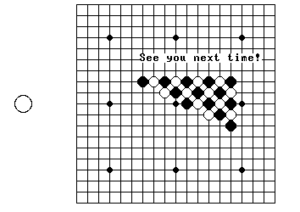
Thanks for listening!
Week 10
Computational Thinking and System Design

