Slide 1
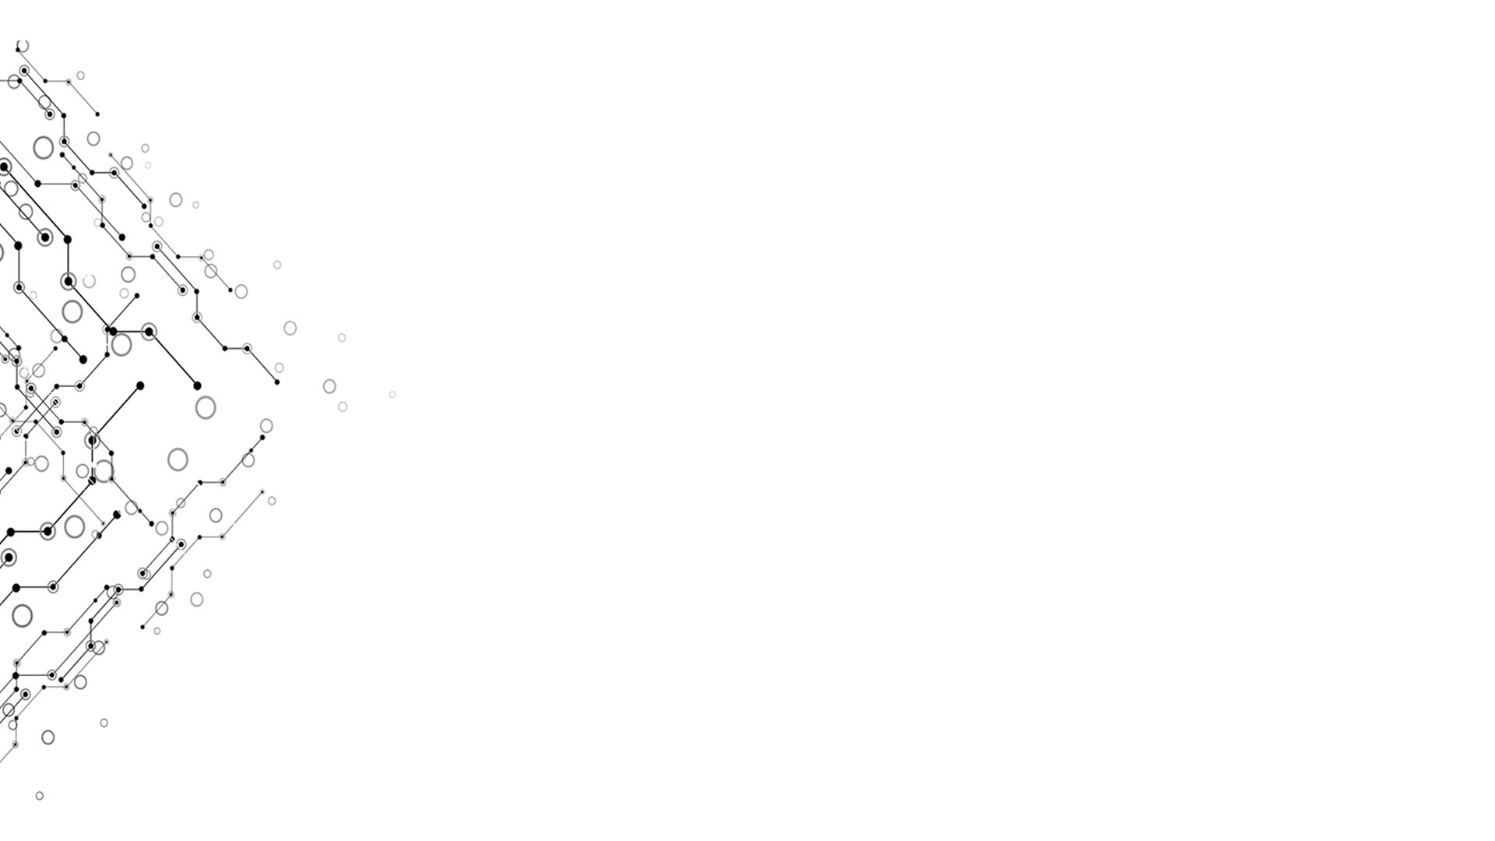

Presentation of GOBOARD
Computational Thinking and System Design
TgopKnight from Group 3
Week 10

Slide 2
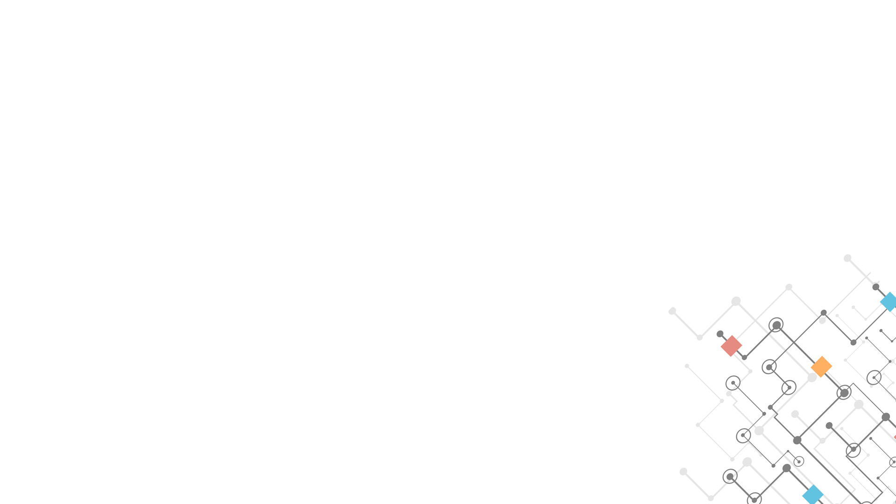
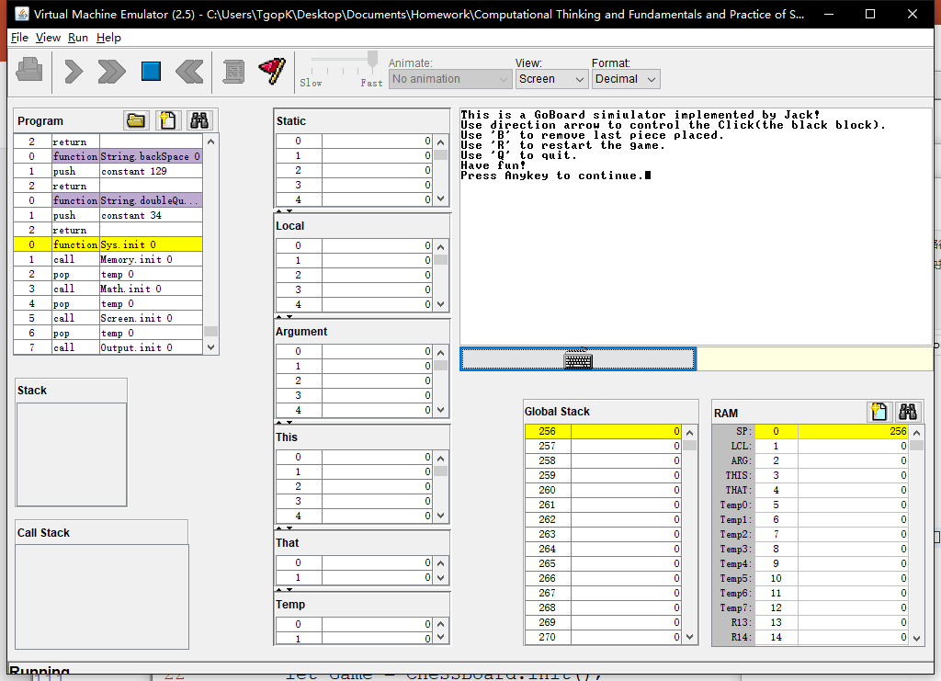
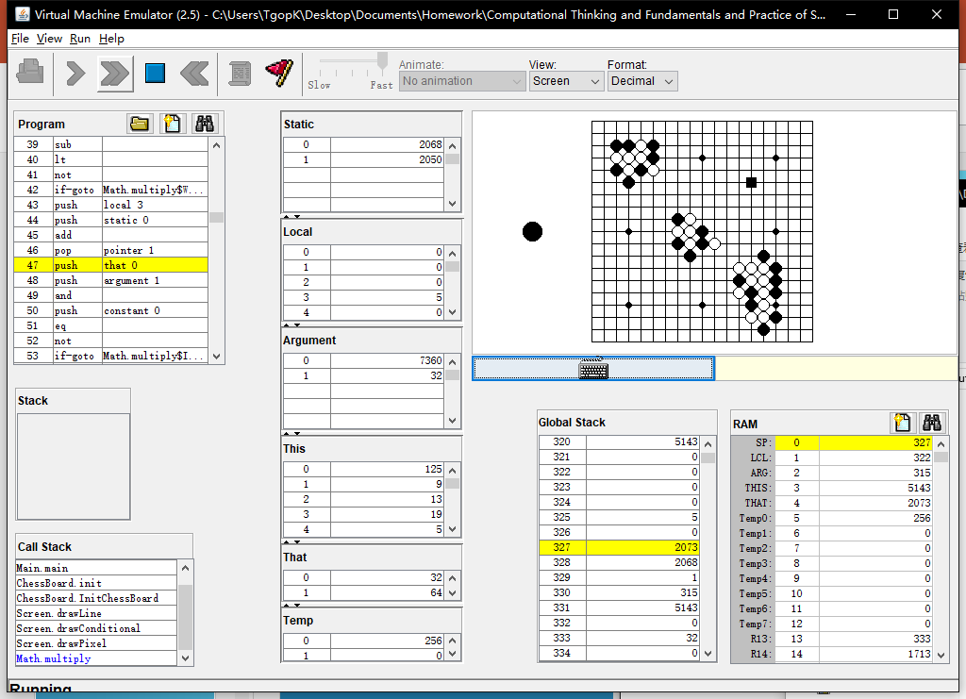
EFFECTION
Week 10
Simulated on
VMEmulator!
Computational Thinking and System Design

Slide 3
Logic model
Week 10
Inputs:
Jack OS API.pdf + Lecture 09 High-level language.pdf
Resource codes from Project 9
Game from 4399.com
Activities:
Editor(Vim) + Programming
Partly adapted from the SquareGame provided in Project 9
Outputs:
A board supports basic placing pieces operation
Outcomes/Impacts:
As a basic of GO game(using Jack language!)
Computational Thinking and System Design

Slide 4
What do we ACHIEVE
Week 10
Simulator of a Goboard
Able to place Black and White stone
Able to judge placed point, but unable to reflact
Able to ‘Withdraw’
Able to ‘Clear’ the ‘Board’
Able to adapt to Rule 1: The rule of Liberty
Computational Thinking and System Design

Slide 5
How do we achieve
Week 10
Jack language
Vim
Computational Thinking and System Design

Slide 6
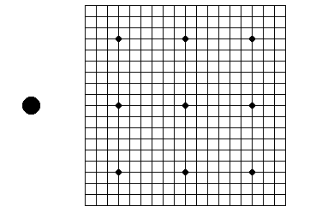
BUILD a board without chess pieces
Week 10
Line 19 * 19
Top left corner: (125, 9)
Interval between lines: 12
9 Star points
Radius = 3
1 Hint Stone
Which color next
Radius = 10
Computational Thinking and System Design

Slide 7
PLACE a Chess piece
Week 10
Jack
Array: Grid[19 * 19]
-1: empty 0: black 1: white
Int: NextPiece = 0/1 (decide which Stone next)
Computational Thinking and System Design

Slide 8
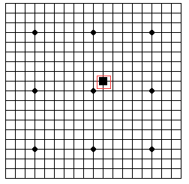
PLACE a Chess piece
Week 10
However, Jack language can not provide mouse click.
I didn’t find it from Jack OS API.pdf
A Black Block to substitute mouse!
Int: ClickX, ClickY
Length of Block side: 11
Press “Enter” to place a Stone
Using direction arrows to move the Block
This idea is adapted from the SquareGame
Computational Thinking and System Design

Slide 9
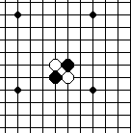
PLACE a Chess piece
Week 10
With Array Grid, we can simply finish judging if a location was already place with a Stone.
However we can’t provide an alert window…
For Stone
Black: radius = 6
White: A Black one + radius = 5
Computational Thinking and System Design

Slide 10
WITHDRAW
Week 10
Jack
Data Structure: Stack
Needn’t record placed color
Keyboard.keyPressed() = ‘B’
Computational Thinking and System Design

Slide 11
CLEAR
Week 10
Jack
InitChessBoard()
Keyboard.keyPressed() = ‘R’
Computational Thinking and System Design

Slide 12
QUIT
Week 10
Jack
Return ;
Keyboard.keyPressed() = ‘Q’
Computational Thinking and System Design

Slide 13
HINT
Week 10
The Screen is very small (256 * 512)
System: ERROR 8
Reason: output beyond the Screen
Better not using vim as the editor
Its syntax coded with the format of xml (*.xml)
Vim use its own format (*.vim)
Jack expression does not follow the usual priority
A + B * C = (A + B) * C
Computational Thinking and System Design

Slide 14
HINT
Week 10
VMEmulator: Animate: No animation
Sorry for blaming Jack as a very slow language
Computational Thinking and System Design

Slide 15

Our Problems
Week 10
In fact, the Click was static initially.
But that was too inconspicuous(ugly)…
Sol: Make it blink!
Computational Thinking and System Design

Slide 16
Our Problems
Week 10
Code:
method void Display() {
let cnt = cnt + 1;
if (cnt > 599) {
if (cnt = 600) { do DisplayPiece(ClickX * Size + ClickY); }
if (cnt > 19999) { let cnt = 0; }
}
else { do DisplayClick(); }
return ;
}
Computational Thinking and System Design

Slide 17
HOWEVER
Week 10
When the click displayed on a black Stone, it is still not very conspicuous……
Primary reason: the Screen is a little bit small…
Computational Thinking and System Design

Slide 18
Our Problems
Week 10
When display the Block, sometimes the part it locate will refresh to white
This problem become evident when the Block displayed on a Black Stone
Sol:?
Computational Thinking and System Design

Slide 19
Rule 1: the rule of liberty
Week 10
Liberty: empty points directly orthogonally adjacent to the Stone
For Stones with the same color and connected with each other in the way above, we consider these Stones as a whole
If a connected Stone block has No liberty, it should be removed from board
If the connected Stone block with the Stone placed just now has No liberty, we should consider other connected block first
Computational Thinking and System Design

Slide 20
Rule 1: the rule of liberty
Week 10
For easier implementation, we consider the connected Stone block with the Stone placed just now is unremoveable
After every placing step, we scan the whole board by the Breadth First Search method to find every connected Stone block that has no liberty(Suffocated connected block)
Then we just remove all Stones in the Suffocated connected block
This idea was adapted from 4399.com-_-||
Computational Thinking and System Design

Slide 21
Rule 1: the rule of liberty
Week 10
Noticing that when placing a Black stone, there will be no Suffocated connected Black block appearing except the connected block itself located
So when scan the board, we only have to focus on the connected White block
Computational Thinking and System Design

Slide 22
Rule 1: the rule of liberty
Week 10
With Rule 1, we should modify our Withdraw method a little
Jack
Data Structure: 2 Stack
One Stack recorded all changes that happened on every points
Another Stack recorded how many changes occurred of every placing operation
Needn’t record placed color, either
Keyboard.keyPressed() = ‘B’
Computational Thinking and System Design

Slide 23
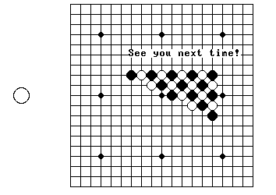
Thanks for listening!
Week 10
Computational Thinking and System Design

