Slide 1
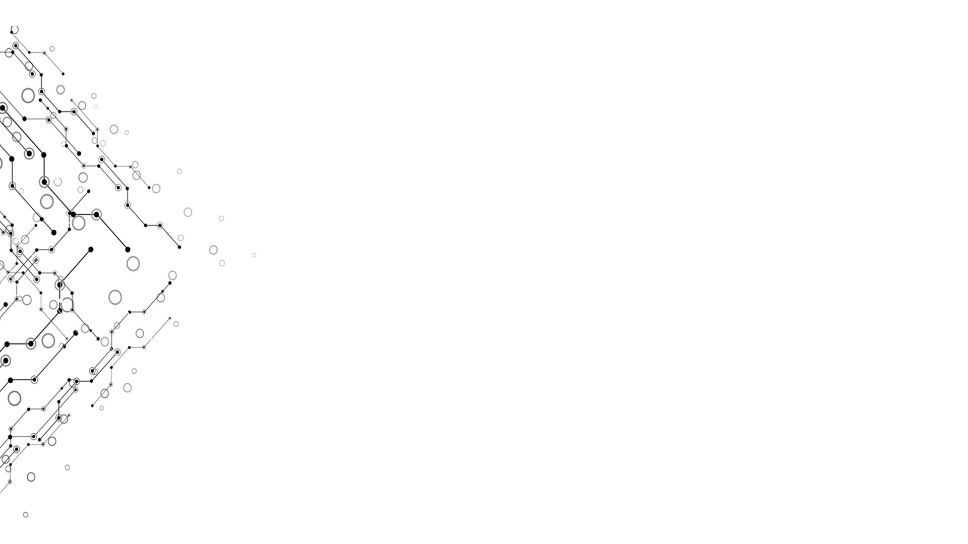

Presentation of GOBOARD
Computational Thinking and System Design
TgopKnight from Group 3
Week 13

Slide 2
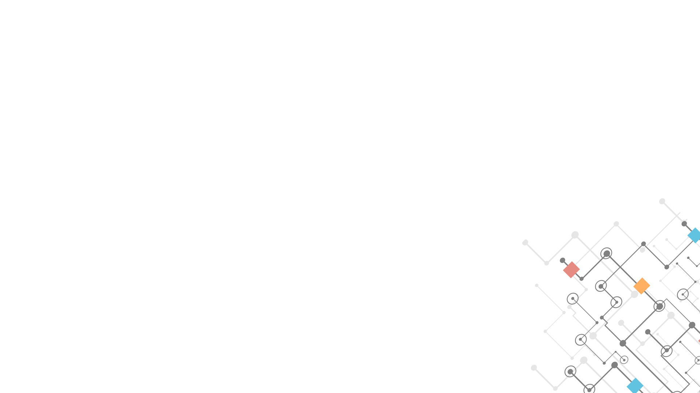
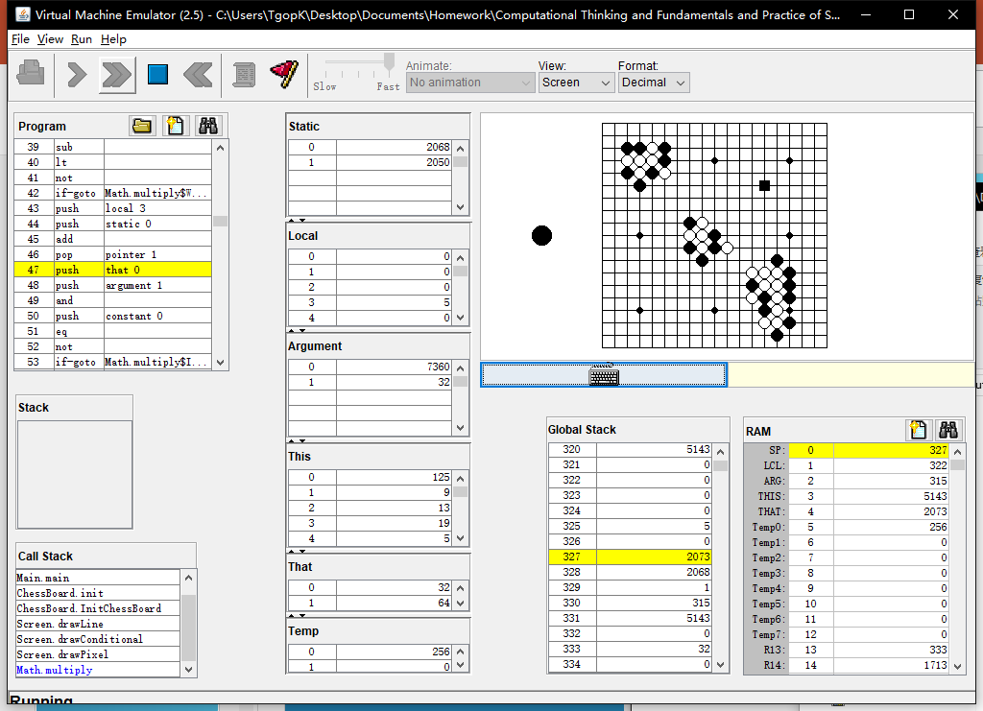
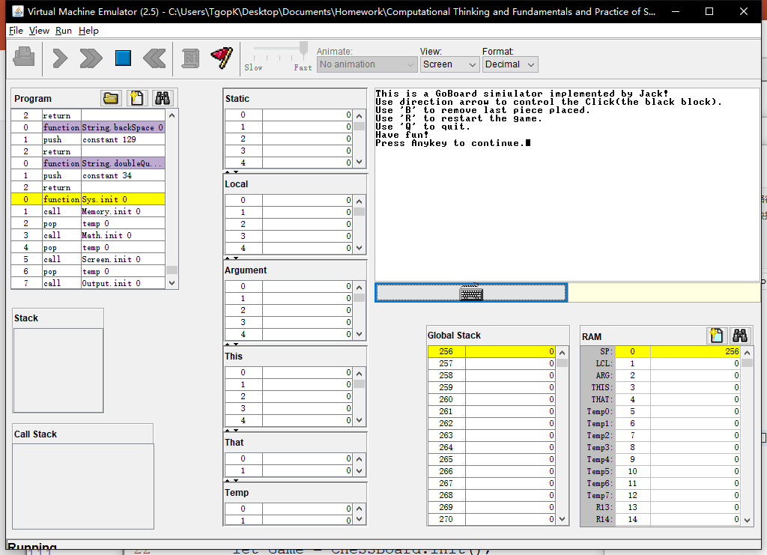
EFFECTION
Week 13
Simulated on
VMEmulator!
Computational Thinking and System Design

Slide 3
Logic model
Week 13
Inputs:
Jack OS API.pdf + Lecture 09 High-level language.pdf
Resource codes from Project 9
Game from 4399.com
Activities:
Editor(Vim) + Programming
Partly adapted from the SquareGame provided in Project 9
Outputs:
A board supports basic placing pieces operation
Outcomes/Impacts:
As a basic of GO game(using Jack language!)
Computational Thinking and System Design

Slide 4
What do we ACHIEVE
Week 13
Simulator of a Goboard
Able to place Black and White stone
Able to judge placed point, but unable to reflact
Able to ‘Withdraw’
Able to ‘Clear’ the ‘Board’
Able to adapt to Rule 1: The rule of Liberty
Able to adapt to Rule 2: No Circle
Able to judge winner
Computational Thinking and System Design

Slide 5
How do we achieve
Week 13
Jack language
Vim
Computational Thinking and System Design

Slide 6
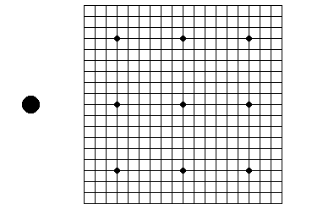
BUILD a board without chess pieces
Week 13
Line 19 * 19
Top left corner: (125, 9)
Interval between lines: 12
9 Star points
Radius = 3
1 Hint Stone
Which color next
Radius = 10
Computational Thinking and System Design

Slide 7
PLACE a Chess piece
Week 13
Jack
Array: Grid[19 * 19]
-1: empty 0: black 1: white
Int: NextPiece = 0/1 (decide which Stone next)
Computational Thinking and System Design

Slide 8
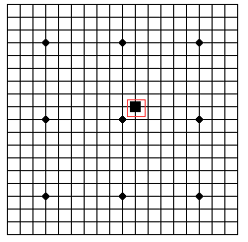
PLACE a Chess piece
Week 13
However, Jack language can not provide mouse click.
I didn’t find it from Jack OS API.pdf
A Black Block to substitute mouse!
Int: ClickX, ClickY
Length of Block side: 11
Press “Enter” to place a Stone
Using direction arrows to move the Block
This idea is adapted from the SquareGame
Computational Thinking and System Design

Slide 9
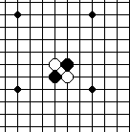
PLACE a Chess piece
Week 13
With Array Grid, we can simply finish judging if a location was already place with a Stone.
However we can’t provide an alert window…
For Stone
Black: radius = 6
White: A Black one + radius = 5
Computational Thinking and System Design

Slide 10
WITHDRAW
Week 13
Jack
Data Structure: Stack
Needn’t record placed color
Keyboard.keyPressed() = ‘B’
Computational Thinking and System Design

Slide 11
CLEAR
Week 13
Jack
InitChessBoard()
Keyboard.keyPressed() = ‘R’
Computational Thinking and System Design

Slide 12
QUIT
Week 13
Jack
Return ;
Keyboard.keyPressed() = ‘Q’
Computational Thinking and System Design

Slide 13
HINT
Week 13
The Screen is very small (256 * 512)
System: ERROR 8
Reason: output beyond the Screen
Better not using vim as the editor
Its syntax coded with the format of xml (*.xml)
Vim use its own format (*.vim)
Jack expression does not follow the usual priority
A + B * C = (A + B) * C
Computational Thinking and System Design

Slide 14
HINT
Week 13
VMEmulator: Animate: No animation
Sorry for blaming Jack as a very slow language
Computational Thinking and System Design

Slide 15

Our Problems
Week 13
In fact, the Click was static initially.
But that was too inconspicuous(ugly)…
Sol: Make it blink!
Computational Thinking and System Design

Slide 16
Our Problems
Week 13
Code:
method void Display() {
let cnt = cnt + 1;
if (cnt > 599) {
if (cnt = 600) { do DisplayPiece(ClickX * Size + ClickY); }
if (cnt > 19999) { let cnt = 0; }
}
else { do DisplayClick(); }
return ;
}
Computational Thinking and System Design

Slide 17
HOWEVER
Week 13
When the click displayed on a black Stone, it is still not very conspicuous……
Primary reason: the Screen is a little bit small…
Computational Thinking and System Design

Slide 18
Our Problems
Week 13
When display the Block, sometimes the part it locate will refresh to white
This problem become evident when the Block displayed on a Black Stone
Sol:?
Computational Thinking and System Design

Slide 19
Rule 1: the rule of liberty
Week 13
Description
Liberty: empty points directly orthogonally adjacent to the Stone
For Stones with the same color and connected with each other in the way above, we consider these Stones as a whole
If a connected Stone block has No liberty, it should be removed from board
If the connected Stone block with the Stone placed just now has No liberty, we should consider other connected block first
Computational Thinking and System Design

Slide 20
Breadth First Search
Week 13
A method to scan the whole board
Be able to separately all connected blocks along with their border states
Time complexity: O(N)
N is the scale of the board
Computational Thinking and System Design

Slide 21
Breadth First Search
Week 13
Implementation
Data Structure: queue
For every point that is not scanned yet, we add it to the tail of the queue, and then start search
During the search, each time we pop the head of the queue, and judge 4 points that are orthogonally adjacent to the head one
If they are in the same states, we add the neighbor point to the tail of the queue
If they are not in the same states or the point is not exist (such as the up direction of the top line of the board), we found the border of this block
Computational Thinking and System Design

Slide 22
Rule 1: the rule of liberty
Week 13
For easier implementation, we consider the connected Stone block with the Stone placed just now is unremoveable
After every placing step, we scan the whole board by the Breadth First Search method to find every connected Stone block that has no liberty(Suffocated connected block)
Then we just remove all Stones in the Suffocated connected block
This idea was adapted from 4399.com-_-||
Computational Thinking and System Design

Slide 23
Rule 1: the rule of liberty
Week 13
Noticing that when placing a Black stone, there will be no Suffocated connected Black block appearing except the connected block itself located
So when scan the board, we only have to focus on the connected White block
Computational Thinking and System Design

Slide 24
Rule 1: the rule of liberty
Week 13
With Rule 1, we should modify our Withdraw method a little
Jack
Data Structure: 2 Stack
One Stack recorded all changes that happened on every points
Another Stack recorded how many changes occurred of every placing operation
Needn’t record placed color, either
Keyboard.keyPressed() = ‘B’
Computational Thinking and System Design

Slide 25
Rule 2: no circle
Week 13
Description
The state of the whole board can’t repeat
If that happened, we should stop the game and judge the result
Such as double ko circle
How to judge there is a circle?
Computational Thinking and System Design

Slide 26
Method 1: the state of whole board
Week 13
Implementation
Record all board states
Each time we place a Stone, judge if the board has appeared yet
Problem: The state is too large: O(3 ^ 361)
Solution: hash algorithm
Computational Thinking and System Design

Slide 27
Hash algorithm
Week 13
1 Implementation
Consider the state of every point: empty – 0; black – 1; white – 2;
Consider the whole board as a p system number with 361 bits (p > 2)
We store the remainder of this number divided by a prime number q
Select several pairs of (p, q), we can get a vector that on behalf of the state
Obviously the scale of vector is much smaller and can be stored
Computational Thinking and System Design

Slide 28
Hash algorithm
Week 13
Conclusion
If 2 boards have the same states, their corresponding vectors will be the same
If 2 boards have different states, their corresponding vectors will be the same in a small probability
We define this small probability as conflict
So how to avoid conflicts?
Computational Thinking and System Design

Slide 29
How to avoid conflicts
Week 13
Theoretically, if the number of different states which the vector can represent is larger than the number of all states of the board, we can separate all board states by judging their vectors
However, we can’t promise that there are no conflicts
Don’t forget our withdraw operations
Computational Thinking and System Design

Slide 30
How to avoid conflicts
Week 13
If 2 vectors are different, they must represent different board states
If 2 vectors are the same, we can use withdraw operation to restore the board states
Then we can judge whether the state now appeared or not
Computational Thinking and System Design

Slide 31
Method 2: the state of operation
Week 13
Implementation
Record all operations
Each time we place a Stone, judge if there is a suffix operations with a formal like ‘SS’(S is a suffix operations)
Algorithm 1: Brute-Force scanning
Algorithm 2: Knuth-Morris-Pratt Algorithm
Computational Thinking and System Design

Slide 32
Knuth-Morris-Pratt Algorithm
Week 13
A String S & An array fail
Fail[i] means the last location of the longest prefix that is a suffix of S[0..i]
Computation: ordered
Computational Thinking and System Design

Slide 33
Judge winner
Week 13
Pick out the dead stones (by human)
Consider every connected empty block
If the border is constructed all by black stone, consider these points belongs to black one
If the border is constructed all by white stone, consider these points belongs to white one
Otherwise divided these points into 2 parts
Black one komi 7.5 points (3.75 stones)
Computational Thinking and System Design

Slide 34
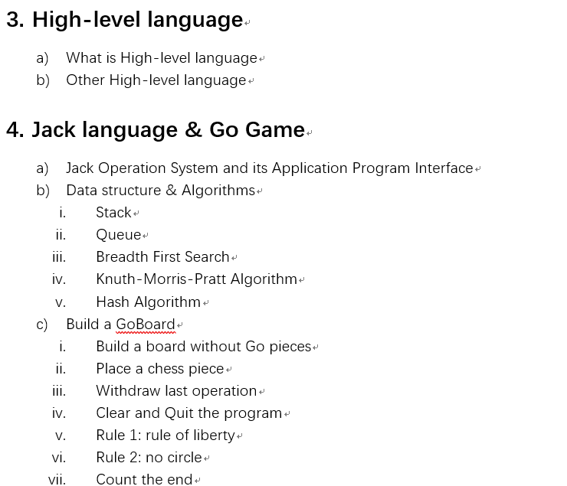
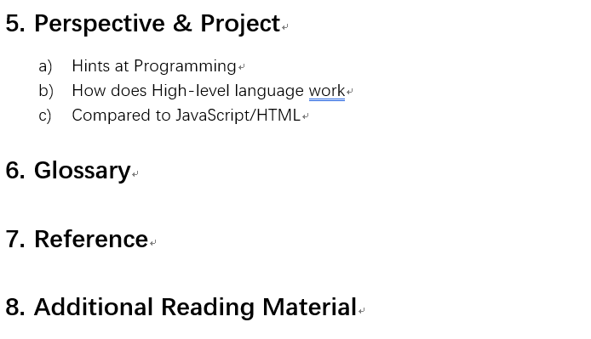
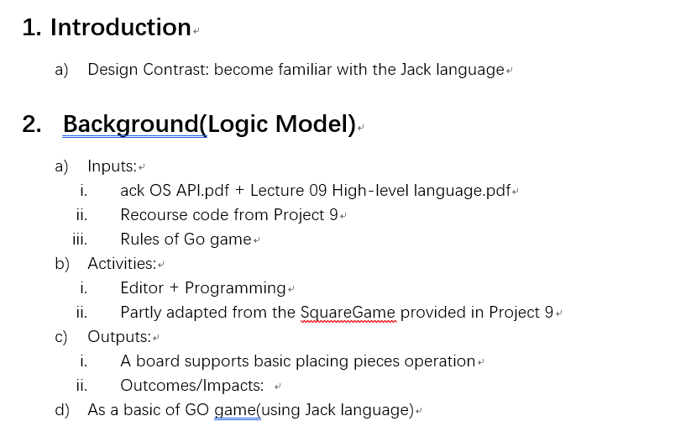
Publish flow outline
Week 13
Computational Thinking and System Design

Slide 35
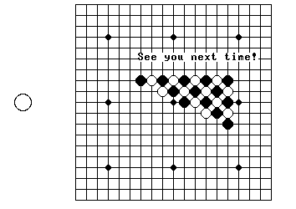
Thanks for listening!
Week 10
Computational Thinking and System Design

