Slide 1
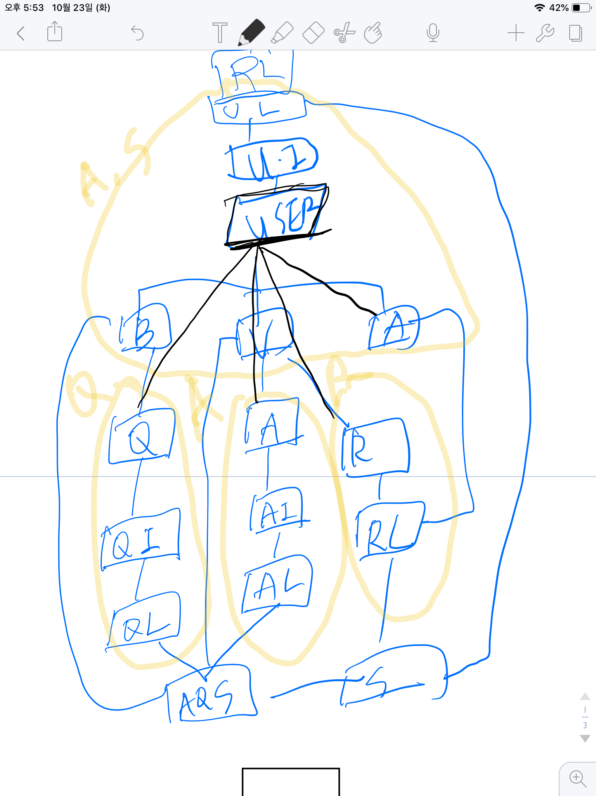
UserList
UserInfo
User
Question
Answer
Report
QuestionInfo
AnswerInfo
ReportList
QuestionList
QuestionList
Storage
Database

