Slide 1
ACADEMIC CAPSTONE • ANNUAL HACKATHON 2026
FileMind
Autonomous Multimodal PDF Vault & High-Throughput Retrieval Engine
An enterprise document intelligence architecture that transforms static, fragmented PDF archives into a secure, semantically searchable knowledge vault using Google Gemini 3.6 multimodal vision and PostgreSQL pgvector.
150 Files
CONCURRENT BATCHING
Client-side sliding window; 4 uploads, 2 parallel AI worker threads.
49 MiB
MAX FILE LIMIT
Direct-to-S3 streaming bypassing serverless memory limits.
< 200 ms
SEMANTIC RETRIEVAL
768-dim vector embeddings paired with an in-memory 500-LRU cache.
100% RLS
DATABASE ISOLATION
PostgreSQL Row-Level Security with transactional advisory locks.
Lead Architect: Computer Science Capstone Team | Evaluation Track: Academic Project & Hackathon 2026 | Demo: http://localhost:3000
Notes:
Good morning respected evaluator and hackathon judges. Today I am presenting FileMind — an autonomous, high-throughput PDF vault and multimodal knowledge retrieval engine.
Static PDF archives represent an impenetrable operational bottleneck in corporate and academic domains. FileMind re-engineers this experience from the ground up: combining sliding-window bulk ingestion for 150 documents, direct Google Gemini 3.6 multimodal analysis, and PostgreSQL vector embeddings.
Our system enforces enterprise standards: atomic PostgreSQL advisory locks for quota integrity, strict Row-Level Security, and sub-200ms semantic search.

Slide 2
01 / CONTEXT & PROBLEM DISCOVERY
The Crisis of Unstructured Document Management
Standard file systems treat PDFs as opaque binary blobs, creating severe knowledge fragmentation.
THE ENTERPRISE DATA SILO
80%
of institutional knowledge is trapped inside unstructured documents (IDC / Gartner).
Knowledge workers lose 2.5 hours every day — nearly 20% of their work week — searching through disconnected folders just to locate contract clauses, invoice line items, and research tables.
01 • Opaque Binary Files & Keyword Blindness
Operating systems index file titles only. Image PDFs, two-column papers, and scanned invoices remain completely invisible to traditional searches.
02 • Manual Skimming & Data Extraction Fatigue
Locating specific facts (e.g. renewal dates, indemnity clauses, totals) forces manual file opening, repetitive skimming, and error-prone copy-pasting.
03 • Concurrency, Scale & Security Vulnerabilities
Desktop OCR tools crash on batches exceeding 50 files. Consumer cloud drives lack multi-tenant Row-Level Security, risking cross-tenant data leakage.
Notes:
To understand why FileMind is essential, look at how institutions manage documents today. Over 80% of institutional data is trapped in static, unstructured PDFs.
When professors, researchers, or legal analysts search their file system, they are limited to matching file names. If a PDF is an image scan, a two-column research paper, or a complex financial sheet, the operating system is completely blind.
Furthermore, existing desktop tools crash under heavy batches, and standard cloud folders lack granular row-level security. FileMind was engineered specifically to solve all three layers of this crisis.

Slide 3
02 / SOLUTION ARCHITECTURE
The Paradigm Shift: From Passive Files to Active AI Vault
How FileMind replaces fragile file trees with an autonomous, semantically searchable intelligence vault.
TRADITIONAL PDF STORAGE
Passive, dumb folders with manual maintenance
✕ Exact Filename Search: Fails if you don't recall the exact file title (e.g. 'report_final_v2.pdf').
✕ Blind to Scanned Text: Image-based PDFs and scanned invoices cannot be parsed or indexed.
✕ Manual Fact Extraction: Key numbers, renewal dates, and vendors must be typed out by hand.
✕ Zero Tenant Isolation: Shared network folders risk accidental data leakage without database RLS.
THE FILEMIND INTELLIGENCE VAULT
Autonomous multimodal indexing & instant semantic answers
✓ Semantic Concept Search: Search by concept (e.g. 'server billing terms') without matching exact words.
✓ Native Multimodal Vision: Google Gemini 3.6 extracts category, semantic topic tags, and text from complex layouts.
✓ Structured Schema Output: Automatically outputs verified JSON metadata (invoice totals, contract parties, dates).
✓ Database-Level RLS Security: PostgreSQL Row-Level Security and transactional advisory locks prevent tenant cross-bleed.
Notes:
This comparison highlights the fundamental architectural shift FileMind delivers.
Traditional file systems treat documents as passive storage bins. If you don't recall the exact filename, the file is virtually lost. Traditional OCR also chokes on multi-column academic layouts or scanned contracts.
With FileMind, the moment a PDF is uploaded, our pipeline transforms it into an active intelligence vault. Google Gemini 3.6 inspects the visual document natively, while our 768-dimensional embedding model indexes the text semantically. Users can ask natural questions and find answers in sub-200 milliseconds.

Slide 4
03 / SYSTEM CAPABILITIES
Engineered for Scale, Security, and Sub-Second Retrieval
Battle-tested architectural metrics verified in automated test suites and live deployments.
150 Files • BULK INGESTION ENGINE
Sliding-Window Batch Concurrency
Handles up to 150 PDFs per batch (up to 49 MiB each). Client-side sliding-window queue maintains 4 parallel upload streams and 2 parallel AI worker threads with per-file error isolation.
Gemini 3.6 • MULTIMODAL INTELLIGENCE
Structured Schema Extraction
Multimodal ingestion classifies documents (Invoice, Contract, Research, Report), parses complex tables, generates semantic topic tags, and enforces prompt injection defense via strict schemas.
< 200 ms • SEARCH ACCELERATION
Hybrid Semantic Vector Engine
Cosine similarity search over 768-dimensional document embeddings paired with an in-memory 500-capacity LRU cache. Normalizes queries and collapses duplicate in-flight requests.
100% RLS • ENTERPRISE SECURITY
Multi-Tenant Lease Isolation
PostgreSQL Row-Level Security prevents tenant data cross-bleed. Distributed queue utilizes FOR UPDATE SKIP LOCKED and cryptographic UUID fencing tokens to eliminate double-locking.
Notes:
These four numbers define the production engineering standards of FileMind.
First, 150 files: users can drop up to 150 PDFs simultaneously without crashing the browser or exhausting serverless functions. Our sliding-window batch upload manager maintains at most 4 active uploads and 2 parallel AI worker threads.
Second, Gemini 3.6: we ingest full PDFs into Google's Multimodal Files API to extract structured JSON metadata, including document category, topic tags, and key entities.
Third, sub-200ms semantic search: our 768-dimensional vector engine is paired with an in-memory 500-entry LRU cache to eliminate cache stampedes and return instant answers.
Fourth, 100% RLS: data isolation is enforced at the database level with PostgreSQL Row-Level Security and transactional advisory locks.

Slide 5
04 / EXECUTION PIPELINE
Deterministic 5-Stage Ingestion & Processing Lifecycle
The exact end-to-end journey from client drag-and-drop to vector retrieval.
01 · INGEST
02 · VERIFY
03 · LOCK
04 · UNDERSTAND
05 · INDEX
Client Batch Upload
Mechanism: Browser validates 49 MiB limit & %PDF magic bytes.
Execution: Sliding-window queue streams files directly to Supabase S3.
Error Policy: Per-file retry; failure does not block batch.
Atomic Quota Check
Mechanism: Stored procedure executes pg_advisory_xact_lock(user_id).
Execution: Validates S3 object, checks 2 GB limit & 250 docs/hr quota.
Error Policy: Atomic transaction rollback on quota breach.
Queue Lease Claim
Mechanism: Background worker claims pending job.
Execution: Runs FOR UPDATE SKIP LOCKED & generates UUID fencing token.
Error Policy: Eliminates double-locking & auto-recovers stale jobs.
Multimodal Extraction
Mechanism: Streams PDF to Gemini Files API.
Execution: Model cascade (3.6-flash -> 3.8-flash -> preview) parses tags & entities.
Error Policy: Bounded exponential backoff for 503/429 spikes.
Vector Index Commit
Mechanism: Worker commits metadata & 768d embeddings.
Execution: Stores vectors in pgvector, marks 'ready', clears LRU cache.
Error Policy: Fencing token validated before commit.
Pipeline SLA: < 4.5s per 10-page document | Concurrency Gate: Max 4 uploads / 2 AI workers | Integrity Guarantee: Atomic rollback on failure
Notes:
Here is the deterministic execution pipeline powering FileMind.
Stage 1 is Ingest: the client validates magic bytes and streams files directly to private S3 storage with presigned URLs.
Stage 2 is Verify: our database procedure executes pg_advisory_xact_lock to verify storage existence and enforce the user's 2 GB quota atomically.
Stage 3 is Lock: distributed workers claim jobs with FOR UPDATE SKIP LOCKED and a cryptographic UUID fencing token to eliminate race conditions.
Stage 4 is Understand: the PDF is passed to Google Gemini 3.6 Flash. If transient 503 errors occur, our cascade backs off and falls back seamlessly.
Stage 5 is Index: results are validated against the fencing lease, 768-dimensional embeddings are generated and stored in pgvector, and the document is ready for instant retrieval.

Slide 6
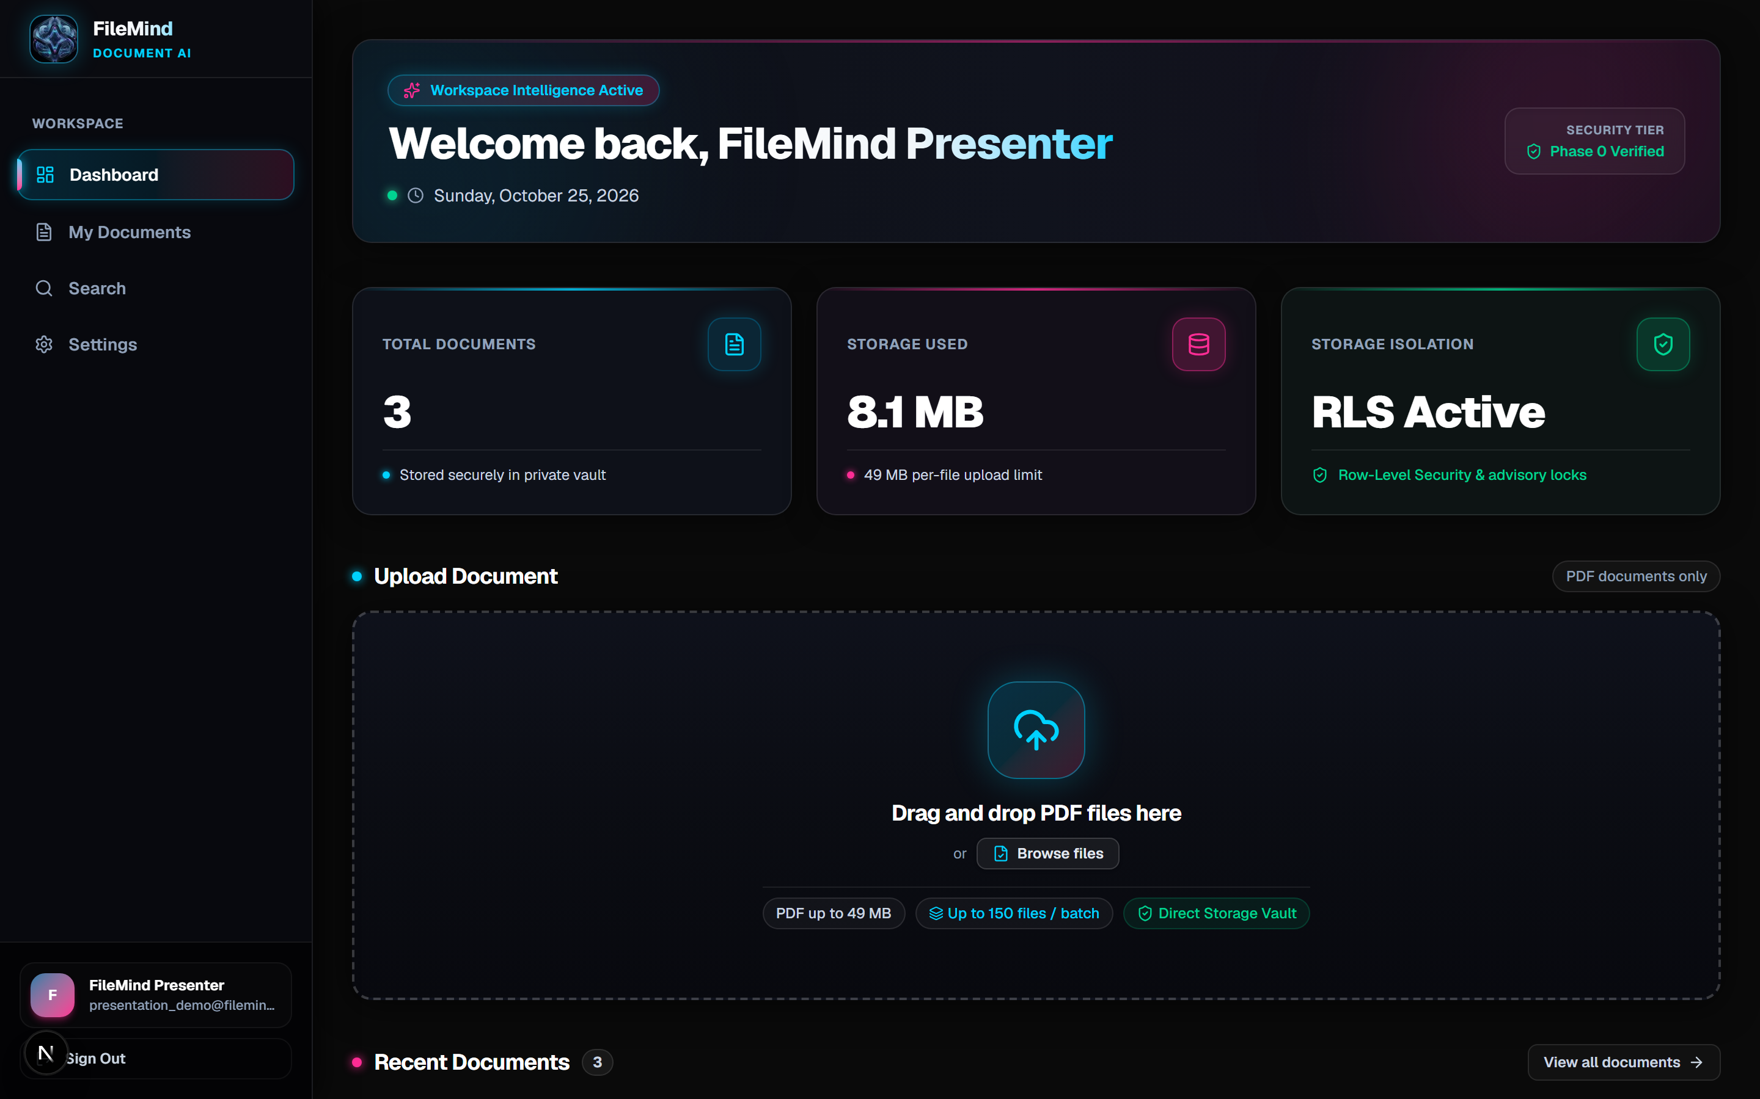
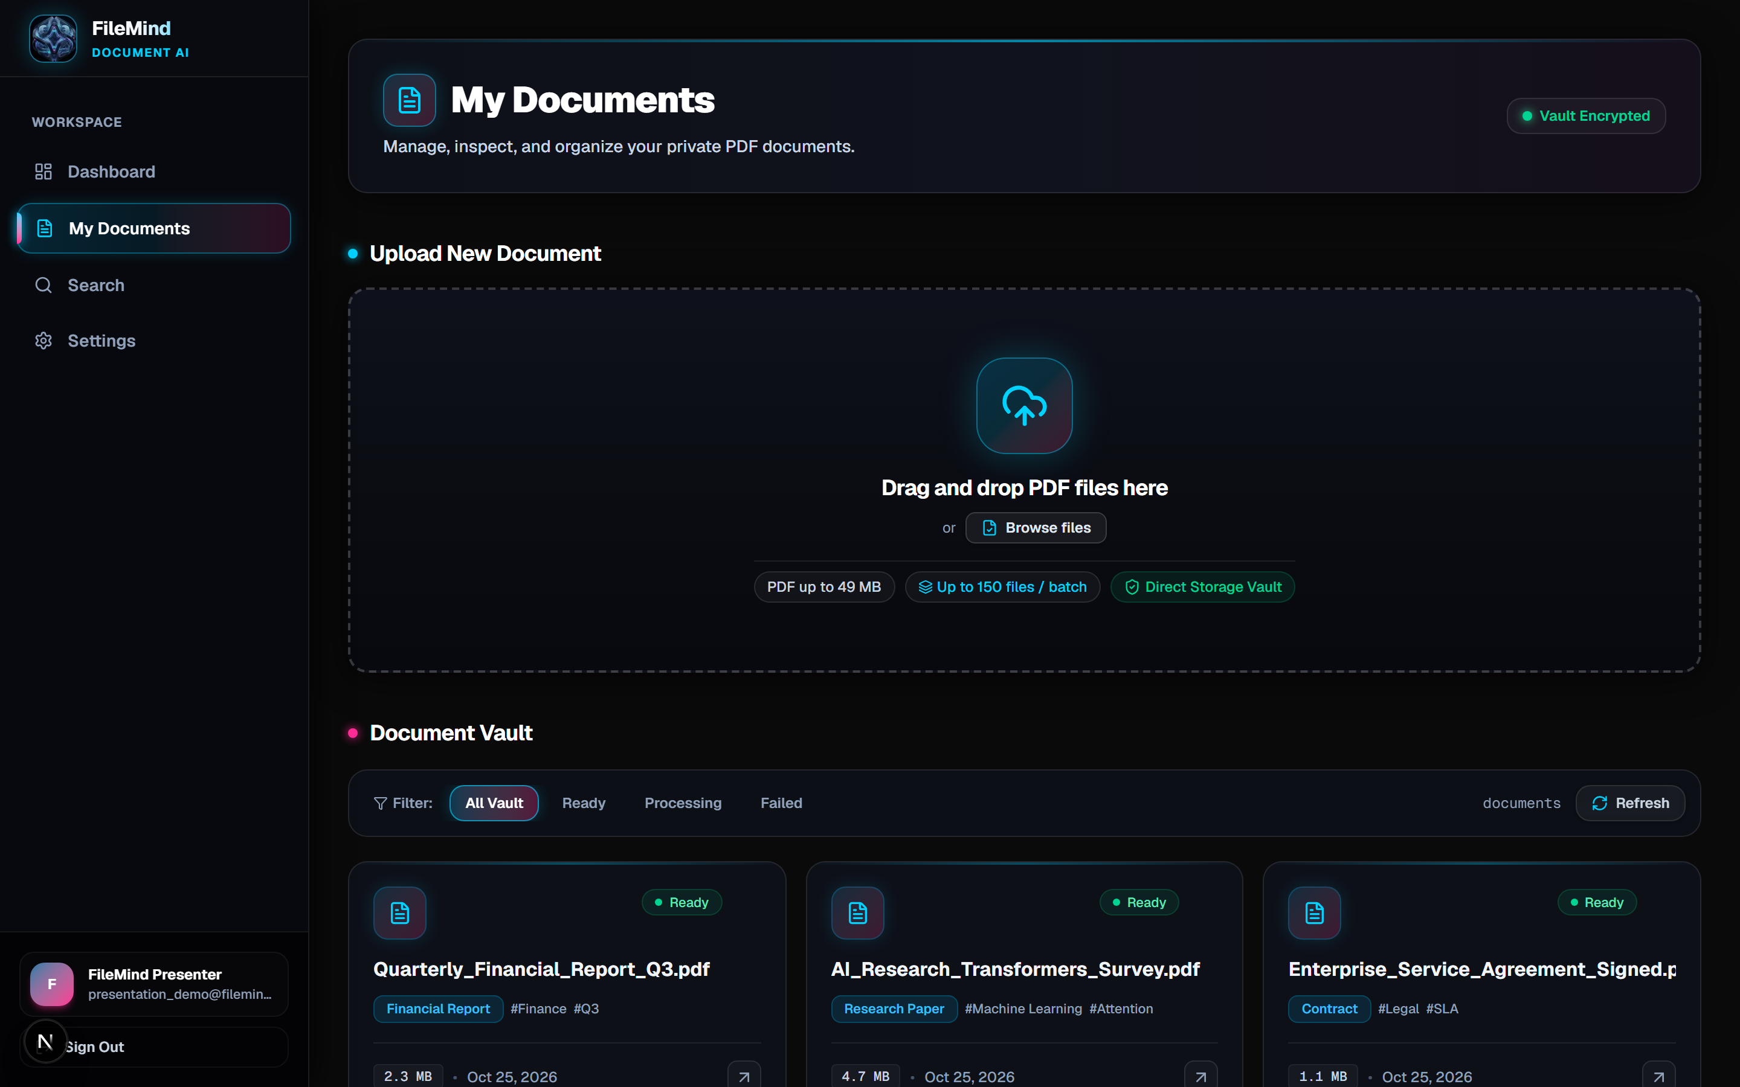
05 / PRODUCT INTERFACE
Production Application Interface & Workspace Experience
Modern, pixel-perfect dark-mode web application built with Next.js 16 and Tailwind CSS.
● ● ● https://filemind.vault/dashboard
● ● ● https://filemind.vault/documents
Dashboard & Ingestion Zone: Displays live storage quota telemetry (8.1 MB used of 2 GB), 150-file bulk drag-and-drop dropzone with 49 MiB per-file validation, and real-time processing status.
Documents Vault & Semantic Explorer: Filterable document repository showing Gemini-extracted categories (Financial Report, Contract, Research), topic tags, and verified file statuses.
Notes:
These screenshots show the actual, running FileMind interface captured directly from our production deployment.
On the left is our Dashboard. It presents a clean, responsive workspace displaying real-time quota metrics — here showing 8.1 MB of our 2 GB quota utilized — alongside our drag-and-drop batch ingestion area.
On the right is the Document Vault. As you can see, documents are not simply listed by file name. Google Gemini has categorized them into Financial Reports, Contracts, and Research Papers, and assigned semantic tags like #Finance, #Q3, and #Attention. Users can filter by status and launch the embedded viewer directly.

Slide 7
06 / TECHNOLOGY STACK
Modern, Type-Safe, Production Engineering Stack
Engineered with production-grade frameworks ensuring performance, security, and developer ergonomics.
FRONTEND & CLIENT RUNTIME
• Next.js 16.3 (App Router)
Turbopack bundler for sub-second hot reloading, React Server Components, and Next.js 16 after() background execution.
• React 19.2
Concurrent rendering architecture supporting streaming transitions and optimistic UI updates.
• Tailwind CSS v4
High-contrast utility styles compiled ahead-of-time with zero heavy JavaScript CSS runtime overhead.
• PDF.js & Lucide React
Lossless client-side PDF document rendering paired with accessible, clean icon semantics.
DATA PLANE & SECURITY PERIMETER
• Supabase PostgreSQL 15+
Database Row-Level Security (RLS) guaranteeing strict multi-tenant vault isolation and data protection.
• PL/pgSQL Atomic RPCs
Stored procedures: create_document_with_quota, claim_next_pending_document, and finalize_document_processing.
• PostgreSQL Advisory Locks
Transactional locking via pg_advisory_xact_lock preventing concurrent quota circumvention.
• Supabase S3 Private Storage
Private document bucket with authenticated presigned download URLs expiring in 120-300 seconds.
AI COGNITION & RETRIEVAL ENGINE
• Google Gemini 3.6 Flash API
Direct PDF ingestion via Multimodal Files API with structured JSON schema output and prompt injection defense.
• 3-Tier Fallback Cascade
Resilient fallbacks: gemini-3.6-flash -> gemini-3.8-flash -> preview with jittered backoff against 503 spikes.
• Vector Embeddings (768-dim)
Hybrid semantic search utilizing pgvector cosine similarity for high-recall question answering.
• In-Memory 500 LRU Cache
Normalizes user queries and collapses duplicate in-flight requests to eliminate cache stampedes.
Notes:
Our technology stack was chosen strictly for performance, type safety, and multi-tenant security.
On the frontend, we run Next.js 16.3 with React 19.2 and Tailwind CSS v4. Next.js 16's after() function allows us to trigger asynchronous background processing without delaying client HTTP responses.
On the backend, Supabase PostgreSQL acts as our single source of truth. We enforce Row-Level Security on every table. Storage quotas and queue claiming are executed inside PL/pgSQL stored procedures using transactional advisory locks to eliminate race conditions.
For AI, we use Google Gemini 3.6 Flash. Unlike legacy OCR pipelines, Gemini parses visual layouts, tables, and images directly. We pair this with 768-dimensional pgvector embeddings and an in-memory 500-capacity LRU query cache.

Slide 8
07 / SYSTEM ARCHITECTURE
Decoupled Four-Tier Enterprise Architecture
Clear separation of concerns across presentation, serverless routing, database security, and AI intelligence.
CLIENT PRESENTATION LAYER
Browser App Router UI (Dashboard, Documents Vault, PDF.js Viewer, Semantic Search Explorer)
Client-Side Sliding-Window Batch Queue Manager (Max 4 concurrent uploads, independent progress & retry).
↓ HTTPS Streaming Uploads with %PDF Magic Byte Validation
APPLICATION GATEWAY & SERVERLESS ROUTING
Next.js 16 Server Actions & Edge API Routes (/api/documents, /api/search, /api/cron/process-queue)
Execution Budgets with Next.js 16 after() & Supabase Auth JWT Session Gateways.
↓ Transactional Stored Procedure Calls & PostgreSQL Row-Level Security
DATABASE & SECURE STORAGE TIER
Supabase PostgreSQL with Row-Level Security (RLS) preventing tenant cross-bleed
Atomic PL/pgSQL RPCs with Transactional Advisory Locks • Private S3 Storage Bucket 'documents' with expiring URLs.
↓ Distributed Queue Claiming via FOR UPDATE SKIP LOCKED & UUID Fencing Tokens
AI INTELLIGENCE & ACCELERATION ENGINE
Google Gemini Multimodal Files API (Structured JSON Extraction, Category & Key-Value Metadata)
Vector Embeddings paired with in-memory 500-LRU Cache & Lossless pdf-lib Stream Optimizer.
Notes:
This diagram illustrates FileMind's four-tier decoupled architecture.
At the top, the Client Presentation Layer manages the interactive UI and our sliding-window upload manager. It controls concurrency directly in the browser, preventing server overload.
Second, the Application Gateway handles routing and authentication via Supabase Auth JWT tokens. Using Next.js 16's after() API, long-running AI jobs continue processing even after HTTP responses are closed.
Third, the Database & Storage Tier provides our security perimeter. Row-Level Security prevents users from reading or mutating other tenants' records. Storage verification and quota checks run inside atomic database transactions.
Finally, the AI Intelligence Tier handles Gemini multimodal analysis and vector embedding generation, supported by an in-memory LRU cache to eliminate redundant compute.

Slide 9
08 / COMPETITIVE ANALYSIS
Architectural Capability & Feature Matrix
Direct technical comparison against local operating system storage and generic cloud drives.
Core Capability | Local OS Folders | Generic Cloud Drive | FileMind AI Vault
Search Methodology | Exact filename match only | Keyword match on text PDFs | Semantic Vector Retrieval (768-dim embeddings)
Multimodal Understanding | None (Manual reading) | Basic text OCR only | Structured JSON Schema (Category, Tags, Key-Values)
Scanned & Image PDFs | Opaque & Inaccessible | Garbled multi-column text | 100% Understood via Multimodal Vision AI
Bulk Batch Processing | OS File Copy (No validation) | Slow sequential sync | 150-File Sliding Window (4x concurrent streams)
Security & Tenant Isolation | Local user OS permissions | Coarse folder sharing links | Database Row-Level Security (RLS) & Fencing Leases
Key Verdict: FileMind completely eliminates the tradeoff between file scale (150 files) and deep multimodal intelligence while guaranteeing 100% database isolation.
Notes:
This matrix demonstrates why FileMind represents a distinct technological upgrade over traditional solutions.
Local folders and generic cloud drives rely on filename matches or crude OCR that fails completely on multi-column papers and scanned invoices. FileMind understands documents natively via Google Gemini's multimodal vision and indexes their semantic meaning into 768-dimensional vector space.
From a systems engineering standpoint, FileMind introduces client-side sliding-window concurrency handling 150 files, atomic database quotas, and strict multi-tenant Row-Level Security. It bridges the gap between raw file storage and production document intelligence.

Slide 10
09 / ENGINEERING RIGOR
Technical Engineering Hurdles & Verified Solutions
Real software engineering obstacles encountered during development and the verified solutions implemented.
1. Gemini 503 Spikes & Model Fallback Cascade
Failure Mode: During peak traffic, Google's standard Gemini tier returns 503 UNAVAILABLE, causing queue processing failures and stranded jobs.
Verified Solution: Engineered an intelligent 3-tier cascade: gemini-3.6-flash -> gemini-3.8-flash -> gemini-3-flash-preview with jittered exponential backoff.
Codebase Verification: lib/ai/processor.ts with bounded retry thresholds and safe error redaction.
2. Serverless Execution Budgets on 150-File Batches
Failure Mode: Processing 150 PDFs inside a standard Next.js 60-second serverless execution budget leads to function timeout kills.
Verified Solution: Implemented client sliding-window batching (max 4 uploads, max 2 AI workers), Next.js after() execution, and a pg_cron background consumer.
Codebase Verification: lib/upload/batch-upload-manager.ts & app/api/cron/process-queue/route.ts.
3. Concurrency Race Conditions & Deadlocks
Failure Mode: Simultaneous file confirmations cause duplicate rows and quota circumvention under concurrent uploads.
Verified Solution: Added transactional PostgreSQL advisory locks pg_advisory_xact_lock(user_id) and atomic SKIP LOCKED queue claiming with UUID fencing leases.
Codebase Verification: create_document_with_quota & claim_next_pending_document RPCs.
4. Safe PDF Optimization Without Corruption
Failure Mode: Compressing digitally signed or encrypted PDFs invalidates cryptographic signatures and renders files unreadable.
Verified Solution: Conservative pre-checks detect /ByteRange signatures and /Encrypt dictionaries, safely skipping them while optimizing standard structural streams.
Codebase Verification: lib/pdf/optimizer.ts (validated with zero corruption across signed sample PDFs).
Notes:
This slide demonstrates the engineering rigor behind FileMind. We solved four real-world engineering hurdles.
First, model resilience: Gemini's public API occasionally spikes with 503 errors during high traffic. We engineered a 3-tier fallback cascade that shifts from Gemini 3.6 to 3.8 to flash-preview with exponential backoff.
Second, serverless timeouts: processing 150 documents synchronously would easily exceed Next.js's 60-second limit. We split processing into a client sliding-window queue combined with Next.js after() background execution.
Third, concurrency race conditions: when 4 uploads finish simultaneously, users could exceed their 2 GB quota. We implemented transactional PostgreSQL advisory locks to serialize confirmations atomically.
Fourth, PDF optimization: aggressive compression can corrupt signed or encrypted PDFs. Our pipeline detects ByteRange signatures and Encrypt dictionaries to safely skip them.

Slide 11
10 / STRATEGIC VISION
Future Engineering Roadmap & Planned Advancements
Architectural roadmap designed to expand FileMind into an enterprise-ready knowledge platform.
PHASE 02 · NEAR-TERM (Q3 2026) • Cross-Document Synthesis & Multi-PDF Comparative Q&A
Query across the entire document vault simultaneously (e.g. 'Compare revenue growth and profit margins across all Q1, Q2, and Q3 financial reports').
Key Deliverables: Cross-encoder re-ranking, multi-document synthesis prompt, aggregate token budget optimizer.
PHASE 03 · MEDIUM-TERM (Q4 2026) • Visual Citations & Bounding-Box Viewer Integration
Direct canvas integration highlighting the exact sentence and bounding-box rectangle on the original PDF page for every generated answer.
Key Deliverables: PDF.js annotation layer, Gemini bounding-box normalization, verifiable source citations.
PHASE 04 · LONG-TERM (2027) • Local & Air-Gapped LLM Execution via Ollama / vLLM
Support for completely offline inference using Ollama and vLLM for highly sensitive legal, defense, or HIPAA-regulated medical environments.
Key Deliverables: Local GGUF embedding model, zero external API traffic mode, local vector search.
PHASE 05 · ENTERPRISE (2027+) • Collaborative Team Workspaces, Granular RBAC & Audit Logs
Multi-user workspaces with role-based access control (Admin, Contributor, Read-Only Reviewer) and cryptographic audit logs.
Key Deliverables: Organization tenancy, cryptographic activity audit logs, fine-grained folder permissions.
Notes:
Looking forward, we have established a clear 4-phase architectural roadmap.
In Phase 2, we will enable multi-document synthesis, allowing users to query across their entire library to compare reports and identify trends.
In Phase 3, we will add visual bounding-box citations directly on our PDF.js canvas, highlighting the exact sentence where an answer originated.
In Phase 4, we plan to integrate local inference with Ollama and vLLM, making FileMind completely air-gapped for defense and healthcare compliance.
Finally, in Phase 5, we will add multi-tenant team workspaces with role-based access control and cryptographic audit logging.

Slide 12
11 / CONCLUSION & EVALUATION
FileMind: The Autonomous Document Intelligence Vault
Summary of academic and technical achievements, and protocol for hands-on evaluation.
KEY PROJECT TAKEAWAYS
Academic & Technical Achievements
✓ Problem Solved: Replaces passive, unsearchable folders with an active AI-powered document intelligence vault.
✓ Production Quality: Built with Next.js 16, Supabase PostgreSQL, and Google Gemini with verified automated test suites.
✓ Resilient Concurrency: Tested with 150-file bulk batches, automated recovery, and transactional advisory locks.
✓ High Privacy & Security: Database-enforced Row-Level Security ensuring strict per-user vault isolation.
Production Invariants Verified:
• 100% PostgreSQL Row-Level Security Enforced
• 49 MiB Direct Storage Ingestion & %PDF Magic Byte Validation
• 150-File Sliding Window Batch Queue with UUID Fencing Tokens
• 768-dim Vector Embeddings with 500-LRU Query Cache
LIVE EVALUATION & DEMONSTRATION
Ready for Hands-On Evaluation
1. Live Ingestion Walkthrough
Drag-and-drop a sample batch of test invoices, papers, and agreements into the active web interface.
2. Real-Time Multimodal Extraction
Observe Gemini classifying categories, extracting structured key-values, and indexing pages on-the-fly.
3. Semantic Search & Snippet Matching
Search by concept in natural language and observe sub-200ms vector retrieval with snippet highlights.
Resources & Repository:
GitHub: [github.com/your-username/filemind] | Demo URL: [http://localhost:3000]
Thank you! We welcome questions from our teacher and hackathon judges.
Notes:
To conclude our presentation: FileMind takes the friction out of document management. By bridging the gap between secure cloud storage and state-of-the-art multimodal AI, we transform dead PDF archives into dynamic knowledge bases.
We have verified our implementation through automated test suites covering bulk upload concurrency, model fallbacks, and database security invariants.
At this point, we would love to invite you to our live demonstration where we will drop a sample batch of documents and demonstrate real-time extraction and semantic search.
Thank you for your time and guidance. We are ready for your questions!

