Slide 1
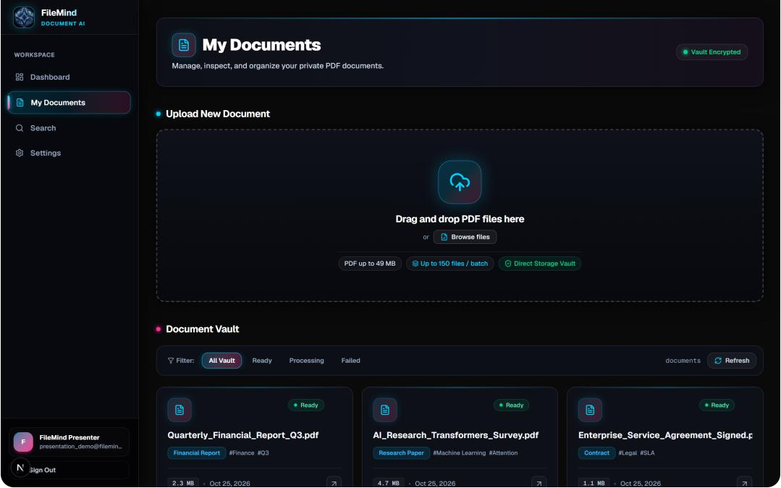
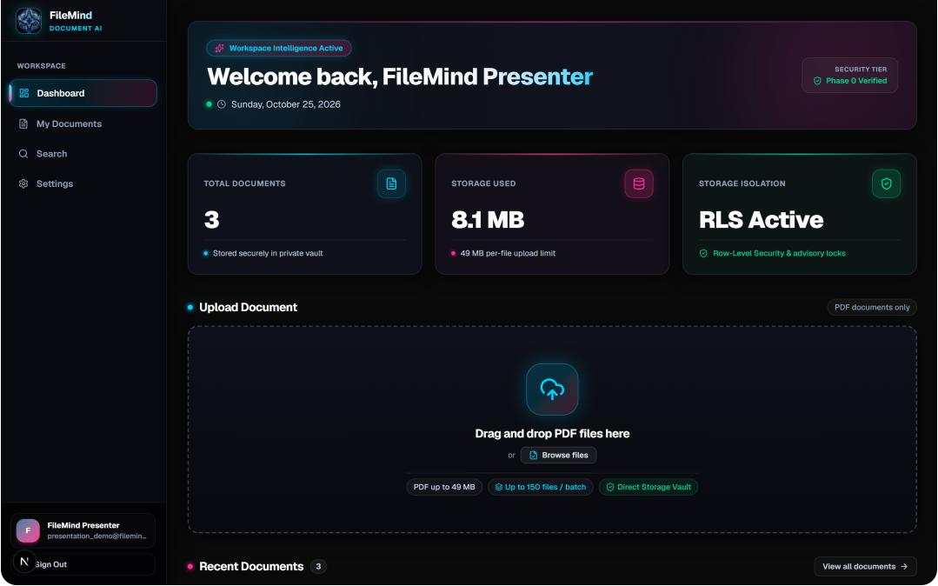
FileMind
filemind.vault/documents
An AI-powered PDF vault that
finds answers, not just files.
filemind.vault/dashboard
Upload a batch of PDFs: invoices, research papers, contracts, even scans. FileMind reads every page with multimodal AI, pulls out structured data and makes the whole vault searchable by meaning, with each user's files isolated at the database level.
150
49 MiB
< 200 ms
PDFs per batch
max file size
vector retrieval
Jitendar (Team Lead) · Kaushal Verma · Vishal
Roll: 25001011024 (IT) · 25001011027 (IT) · 25001015070 (ENC)
J.C. Bose University of Science and Technology, YMCA
Notes:
Open with the one-line pitch: FileMind is a PDF vault that finds answers, not just files. Mention the three numbers on screen: 150 PDFs per batch, 49 MiB per file and sub-200 ms retrieval. Introduce the team.

Slide 2



Search can’t see inside your PDFs
File systems treat PDFs as opaque blobs, so the knowledge inside them is fragmented and hard to reach.
80%
Keyword-blind storage
OS and cloud search only index file names. Scanned invoices, image-based PDFs and multi-column papers stay invisible to every query.
of enterprise and academic knowledge is trapped in unstructured documents.
Manual fact extraction
Source: IDC / Gartner
Finding an invoice total, a renewal date or an indemnification clause means opening the file, skimming it and copy-pasting by hand.
2.5 hrs
Tools that break at scale
a day spent hunting for buried information: nearly 20% of the working week.
Desktop OCR tools crash on batches of 50+ files, and consumer cloud drives lack row-level access control, so private files can leak.
Notes:
Frame the pain: most knowledge lives in documents, but search only sees file names. Walk the three failures: keyword-blind storage, manual fact extraction, and tools that break at scale or leak data.

Slide 3



From passive folders to a searchable vault
FileMind replaces manual upkeep with document understanding and instant retrieval.
TRADITIONAL PDF STORAGE
FILEMIND AI VAULT
Passive folders, manual upkeep
Reads documents, finds answers
Exact filename search
Semantic concept search
Fails unless you recall ‘report_v2_final.pdf’.
Ask for ‘cloud server bill’, no keyword needed.
Blind to scanned text
Multimodal understanding
Image PDFs and scans can’t be indexed.
Gemini extracts category, tags and page text.
Manual data entry
Structured JSON output
Totals, vendors and dates typed by hand.
Invoice totals, dates and parties as clean JSON.
No tenant isolation
Database-enforced isolation
Shared folders with no row-level security.
PostgreSQL RLS plus advisory locks.
Notes:
Contrast row by row: filename search becomes concept search, scans become readable, manual entry becomes structured JSON, and shared folders become database-enforced isolation.

Slide 4




Four capabilities, verified by tests
Every feature below runs in the codebase today and is covered by an automated test suite.
BULK INGESTION
MULTIMODAL INTELLIGENCE
150 files
Gemini 3.6
Sliding-window batch concurrency
Structured schema extraction
Up to 150 PDFs per batch, 49 MiB each. Client-side windowing keeps at most 4 uploads and 2 background AI workers active, with per-file error isolation.
Classifies each file (invoice, contract, report), extracts topic tags and key-value fields, and blocks prompt injection with strict system instructions.
SEARCH & RETRIEVAL
ENTERPRISE SECURITY
< 200 ms
100% RLS
Hybrid semantic vector search
Multi-tenant lease isolation
Cosine similarity over 768-dim embeddings plus a 500-entry in-memory LRU cache. Queries are normalised and duplicate in-flight requests collapsed.
Row-Level Security blocks cross-tenant reads. Workers claim jobs with SKIP LOCKED and UUID fencing tokens: no double-processing, no stale writes.
Notes:
Four capabilities, each backed by tests: batch ingestion of 150 files, Gemini structured extraction, sub-200 ms vector search with an LRU cache, and multi-tenant isolation with RLS and fencing tokens.

Slide 5


From drag-and-drop to searchable in five steps
The lifecycle of every file, from browser upload to an indexed, searchable document.
1
2
3
4
5
INGEST
VERIFY
LOCK
UNDERSTAND
INDEX
Client batch upload
Atomic quota check
Queue lease claim
Multimodal extraction
Vector index commit
The browser checks the 49 MiB limit, then a sliding-window queue streams files straight to the private bucket, with no server bottleneck.
A stored procedure confirms the object exists and takes pg_advisory_xact_lock to enforce the 2 GB per-user quota.
A worker claims the next job with FOR UPDATE SKIP LOCKED and gets a UUID fencing token, so no file is processed twice.
The PDF goes to the Gemini Files API. A model cascade (3.6-flash → 3.8-flash → preview) with backoff extracts category, tags and pages.
The finalize RPC validates the lease token, commits metadata atomically and schedules 768-dim embeddings.
BUILT TO FAIL SAFELY
Per-file error isolation
Exponential backoff with jitter
Background jobs via pg_cron
Notes:
Follow one file: browser upload, atomic quota check with an advisory lock, a worker claims it with SKIP LOCKED and a fencing token, Gemini extracts structure through a model cascade, then the finalize RPC commits and schedules embeddings.

Slide 6
Built and running today
The working app: a dark-mode interface built with Next.js 16, Tailwind CSS v4 and Lucide icons.
filemind.vault/dashboard
filemind.vault/documents
1
2
3
4
1
Live storage quota metrics
2
150-file batch drop zone
3
Ready / processing / failed
4
Gemini categories & tags
Notes:
This is the real application. Left: the dashboard with live storage quota (1) and the 150-file batch drop zone (2). Right: the document vault with status filters (3) and the categories and tags Gemini extracted automatically (4).

Slide 7









A modern, type-safe stack
Production-grade frameworks across the interface, the data layer and the AI pipeline.
FRONTEND & APPLICATION
BACKEND, DATA & SECURITY
MULTIMODAL AI & ACCELERATION
Server-rendered, streaming UI
Isolation and atomic locking
Vision AI and vector caching
Next.js 16.3 (App Router)
Supabase PostgreSQL 15+
Gemini API (@google/genai)
Turbopack, Server Components and after() for background work.
Row-Level Security for strict multi-tenant vault isolation.
Direct PDF ingestion via the Files API, JSON-schema output and prompt-injection defence.
React 19.2
PL/pgSQL stored procedures
Vector embeddings (768-dim)
Streaming transitions and optimistic UI updates.
Atomic RPCs:
create_document_with_quota
claim_next_pending_document
finalize_document_processing
Hybrid semantic search with a 500-entry LRU query-embedding cache.
Tailwind CSS v4
Supabase Storage (S3)
pdf-lib
High-contrast dark theme with no CSS-in-JS runtime.
Private bucket with authenticated, presigned download URLs.
Lossless stream compression that safely skips signed or encrypted PDFs.
Notes:
Three layers of the stack. Frontend: Next.js 16 App Router, React 19 and Tailwind v4. Data: Supabase Postgres with RLS and atomic PL/pgSQL RPCs. AI: Gemini Files API, 768-dim embeddings with an LRU cache, and pdf-lib for safe compression.

Slide 8

Four layers, with security in the database
Clear separation between the UI, the serverless gateway, the data tier and the AI engine.
01 BROWSER
App Router UI
Dashboard
Documents vault
PDF.js viewer
Semantic search explorer
Client presentation
Batch queue: 4 concurrent uploads, per-file retry
02 NEXT.JS 16
Server Actions
/api/documents
/api/search
/api/cron/process-queue
Gateway & serverless
after() execution budgets
Supabase Auth JWT sessions
03 SUPABASE
PostgreSQL + Row-Level Security
Atomic PL/pgSQL RPCs
Transactional advisory locks
Database & storage
private bucket: documents
04 GEMINI
Gemini Files API
Structured JSON extraction
Category & key-value metadata
768-dim embeddings
AI & acceleration
500-entry LRU cache
pdf-lib stream optimiser
Notes:
Four layers. The key design choice is layer three: isolation and locking are enforced inside Postgres with RLS, atomic RPCs and advisory locks, so a bug in the app layer cannot leak another user's documents.

Slide 9
How FileMind compares
Against local OS folders, generic cloud drives and OCR utilities.
Capability | Local OS folders | Generic cloud drive | FileMind AI vault
Search method | Exact filename match only | Keyword match on text-based PDFs | Semantic vector retrieval (768-dim embeddings)
Document understanding | None; manual reading | Basic text OCR | Structured JSON: category, tags, key-values
Scanned & image PDFs | Opaque and unsearchable | Garbled multi-column text | Read page by page with multimodal vision AI
Bulk processing | OS file copy, no validation | Slow sequential sync | 150-file sliding window, 4 concurrent streams
Security & isolation | Local OS user permissions | Coarse folder sharing links | Row-Level Security and fencing leases
Notes:
The comparison people usually ask about first. Folders and cloud drives search names or raw text; FileMind searches meaning, reads scans, processes 150-file batches concurrently and isolates tenants in the database.

Slide 10



Hard problems we solved along the way
Real failures we hit during development, and what we built to fix each one.
CHALLENGE
WHAT WENT WRONG
WHAT WE BUILT
Gemini 503 spikes at peak hours
Google’s standard tier returned 503 UNAVAILABLE at peak times, failing queue jobs and stranding files.
3-tier fallback with backoff and jitter:
gemini-3.6-flash → gemini-3.8-flash →
gemini-3-flash-preview
Serverless limits on 150-file batches
Processing 150 PDFs inside a 60-second serverless budget got functions killed mid-batch.
Sliding-window batching (max 4 uploads, 2 AI workers), Next.js after() execution and a pg_cron background consumer.
Race conditions under concurrent uploads
Simultaneous confirmations created duplicate rows and let users slip past their storage quota.
Transactional pg_advisory_xact_lock(user_id) plus atomic SKIP LOCKED queue claims with UUID fencing leases.
Optimising PDFs without corrupting them
Compressing signed or encrypted PDFs breaks their signatures and can leave files unreadable.
Pre-checks detect /ByteRange signatures and /Encrypt dictionaries and skip those files; everything else is optimised.
Notes:
Pick one or two of these to tell as a story, depending on time. The 503 cascade and the advisory-lock race fix usually land best with technical audiences.

Slide 11
Roadmap: from vault to knowledge platform
What we plan to build next to make FileMind enterprise-ready.
PHASE 01 · LIVE
AI document vault
Batch ingestion, Gemini extraction, semantic search and RLS isolation: everything shown in this deck.
PHASE 02
Cross-document synthesis & multi-PDF Q&A
Ask one question across the whole vault, e.g. ‘Compare revenue growth and profit margins across the Q1, Q2 and Q3 reports’, and get a comparative summary.
PHASE 03
Visual citations & bounding-box viewer
Highlight the exact sentence and bounding box on the original PDF page for every generated answer, so each citation can be verified.
PHASE 04
Local & air-gapped LLM execution
Ollama and vLLM integration for fully offline inference in sensitive legal, defence and HIPAA-regulated medical environments.
PHASE 05
Team workspaces & role-based access
Admin, Contributor and Read-only Reviewer roles, with cryptographic audit logs of document access and metadata changes.
Notes:
Phase one is what you have seen. Next: ask questions across many PDFs at once, verifiable visual citations, offline LLMs for sensitive sectors, and team workspaces with role-based access.

Slide 12


Live demo: what you’ll see
We’ll run the app live with a real batch of invoices, research papers and legal agreements.
1
Live ingestion walkthrough
Drag a mixed batch of test invoices, papers and contracts into the running web app and watch per-file progress.
TRY IT YOURSELF
Resources
Source code
2
Real-time multimodal extraction
github.com/jitendarswami63-ai/file-mind
See Gemini classify each document, extract structured key-values and index pages on the fly.
Live demo
filemind.vercel.app
3
Semantic search & snippet matching
Test documents
Search by concept in plain language and get sub-200 ms vector results with highlighted snippets.
Invoices, research papers and legal agreements
Notes:
Switch to the live app. Drop a mixed batch, point out per-file progress, open one extracted document to show category and key-values, then run a concept search such as 'cloud server bill'.

Slide 13


Stop searching for documents.
Start finding answers.
Problem solved
Production quality
Resilient at scale
Privacy by design
Passive, unsearchable folders become an active AI document vault.
Next.js 16, Supabase PostgreSQL and Gemini, backed by test suites.
Tested on 150-file batches with automated recovery and advisory locks.
Row-Level Security keeps every user’s vault strictly isolated.
Thank you. Questions welcome.
Jitendar (Team Lead) · Kaushal Verma · Vishal
Roll: 25001011024 (IT) · 25001011027 (IT) · 25001015070 (ENC)
J.C. Bose University of Science and Technology, YMCA
Notes:
Close on the line: stop searching for documents, start finding answers. Recap the four takeaways in one breath, thank the audience and invite questions.

