Slide 1
Denuvakonda Bhanu Jitendhar
Final Project
3/21/2024 Annual Review

Slide 2
Building a Basic Key Logger in Python
3/21/2024 Annual Review

Slide 3


AGENDA
Research keylogger ethics and Python libraries for keyboard events.
Build a basic keylogger program using Python libraries.
Implement core functionalities and thoroughly test on a controlled environment.
3/21/2024 Annual Review

Slide 4

PROBLEM STATEMENT
Develop a Python program that simulates a basic keylogger to understand how user input is captured and processed by the system. This program will focus on educational purposes, allowing users to explore the functionality of keyboard events and data recording in Python.
3/21/2024 Annual Review

Slide 5

PROJECT OVERVIEW
This project aims to develop a basic keylogger program using Python. The primary focus is on learning and understanding how user input is captured and processed by the system.
3/21/2024 Annual Review

Slide 6

WHO ARE THE END USERS?
Programmers interested in learning Python:
Keyboard Event Handling Libraries
Data Recording Techniques
Ethical Considerations in Programming
Individuals curious about computer systems
User Input Tracking
Python as a Programming Tool
3/21/2024 Annual Review

Slide 7
SOLUTION AND ITS VALUE PROPOSITION
This project proposes an "Interactive Input Recorder" program built with Python. It allows users to explore how user input, specifically keystrokes, are captured and processed within a computer system.
Value Proposition:
1. Learn by Doing: Users gain practical experience with Python by building a program that interacts with the system.
2. Demystify User Input: The program helps users understand how computers record keystrokes, providing insights into system functionality.
3. Safe and Ethical Learning: The project prioritizes ethical use, focusing on capturing anonymized data in a controlled environment.
4. Foundation for Further Exploration: The program serves as a springboard for learning more advanced Python concepts related to user interaction and data processing.
3/21/2024 Annual Review

Slide 8

THE WOW IN YOUR SOLUTION
1. Interactive Visualizations:
Heatmap
Character Breakdown
2. Engaging User Interface:
Customization Options
Live Recording Feedback
3. Educational Applications:
Touch Typing Practice
Accessibility Tool Exploration
Understanding User Behaviour.
3/21/2024 Annual Review
8

Slide 9
MODELLING
The program starts and initializes the event listener and data recorder components.
The user interacts with the program (optional UI) to initiate recording.
The event listener captures keystrokes and sends the data to the data recorder.
The data recorder stores the captured keystrokes in the chosen format.
(Optional) The data visualization component can process and display the recorded data.
The user interacts with the program again (optional UI) to stop recording, clear data, or exit the program.
3/21/2024 Annual Review
9

Slide 10
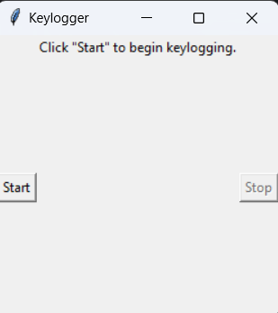
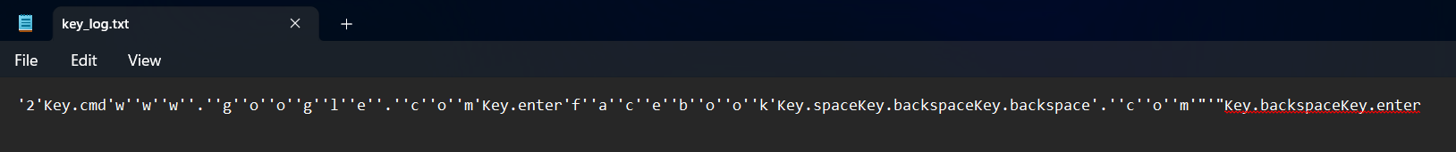
RESULTS
3/21/2024 Annual Review
10

