Slide 1

PRESENTATION ON
GOLF PLAY PREDICTION
By:-
Jitendra Shah - 201500035
DEPARTMENT OF COMPUTER SCIENCE AND ENGINEERING
SIKKIM MANIPAL INSTITUTE OF TECHNOLOGY
MAJITAR, RANGPO, EAST SIKKIM - 737136

Slide 2
TABLE OF CONTENTS
S.NO. | CONTENT | SLIDE NO.
1. | Introduction | 4
2. | Scope | 5
3. | Objective | 6
4. | Problem Statement | 7
5. | Goals | 8
6. | Application | 9
7. | Limitation | 10
8. | Information Retrieval | 11
9. | Methodology | 12

Slide 3
S.NO. | CONTENT | SLIDE NO.
10. | Analysis | 13
11. | Advantages | 14
12. | System Used | 15
13. | Basic Definition | 16
14. | Design | 17
15. | Coding | 19
16. | Query Representation Through Graph | 23
17. | Outcomes | 24
18. | Drawbacks | 25
19. | Conclusion | 26

Slide 4
INTRODUCTION
It is a difficult task to decide whether the conditions are favourable to play on a particular day as the factors which decide the whether can be overwhelming.
The project aims at solving this particular problem by considering two factors - temperature(°F) and humidity.
Decision tree induction classification algorithm has been used to analyze and predict favourable conditions.

Slide 5
SCOPE
It will replace data analytics and prediction tasks carried out by human.
Machine Learning algorithms will act as a major differentiator in business.
Most businesses will tap into algorithmic models for their operational and customer-facing functions.

Slide 6
To Improve the
Accuracy
Precision
and profitability of decision-making.
To help the user to determine whether or not to play the game on a given day based on the current temperature and humidity.
OBJECTIVE

Slide 7
PROBLEM STATEMENT
To Analyze the dataset and to predict whether playing golf is possible.
The factors involved are
temperature
humidity

Slide 8
GOALS
Having good and meaningful data
Get accurate annotations
Removal of redundancies :- Eliminate irrelevant or redundant features
Dimensionality reduction :- Simpler, faster, more interpretable models

Slide 9
APPLICATION
Predicting of unforeseen scenarios.

Slide 10
LIMITATION
Small dataset.
High performance and computing machine need when prediction is based on more than two factors.
Drawback with decision tree learners is that they can generate incomprehensibly large trees.

Slide 11
INFORMATION RETRIEVAL
Watching players.
Collecting weather data.
Consulting the website:
http://www2.cs.uregina.ca/~dbd/cs831/notes/ml/dtrees/c4.5/c4.5_prob1.html

Slide 12
METHODOLOGY
Classification: Decision Tree Induction Algorithm.
Regression: root mean squared error, variance score.

Slide 13
ANALYSIS
Factors required for analysing
Temperature
Humidity
Evaluate how the model will perform on unseen data i.e. model generalization capability

Slide 14
ADVANTAGES
Generation of favourable conditions for players.
Predicting various unforeseen scenarios.
Highly accurate outcomes with an accuracy of 89%.

Slide 15
SYSTEM USED
Operating System : Windows 10.
Processor : Intel Core i5.

Slide 16
BASIC DEFINITION
Training set
Set of examples used to learn the model, i.e., to train the classifier, regressor, etc.
Test set
Independent, unseen, examples used to evaluate the learnt model.
Variance score
Explained variance regression score function : Best possible score is 1.0, lower values are worse.
Mean squared error
Mean squared error regression loss

Slide 17
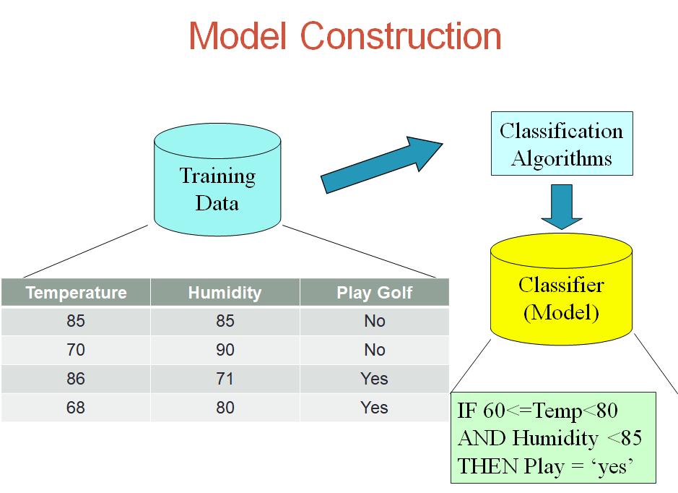
DESIGN

Slide 18
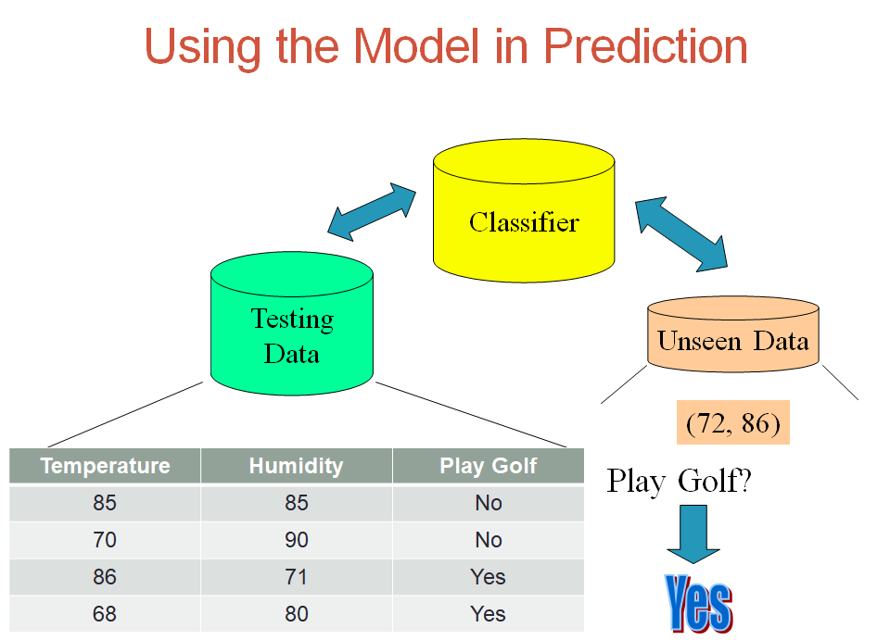

Slide 19
CODING
import numpy as np
import matplotlib.pyplot as plt
import pandas as pd
from sklearn.metrics import mean_squared_error, r2_score
dataset = pd.read_csv('playgolf.csv')
dataset.PlayGolf.replace(('Yes', 'No'), (1, 0), inplace=True)
X = dataset.iloc[:,2:-2].values
y = dataset.iloc[:, 5].values
from sklearn.cross_validation import train_test_split
X_train, X_test, y_train, y_test = train_test_split(X, y, test_size = 0.20 , random_state = 0)
from sklearn.tree import DecisionTreeClassifier
classifier = DecisionTreeClassifier(criterion = 'entropy', random_state = 0)
classifier.fit(X_train, y_train)
y_pred = classifier.predict(X_test)

Slide 20
from matplotlib.colors import ListedColormap
X_set, y_set = X_train, y_train
aranged_temp=np.arange(start = X_set[:, 0].min() - 1, stop = X_set[:, 0].max() + 1, step = 0.01)
aranged_hum=np.arange(start = X_set[:, 1].min() - 1, stop = X_set[:, 1].max() + 1, step = 0.01)
X2, X3 = np.meshgrid(aranged_temp,aranged_hum)
plt.contourf(X2, X3, classifier.predict(np.array([X2.ravel(), X3.ravel()]).T).reshape(X2.shape),
alpha = 0.75, cmap = ListedColormap(('red', 'green')))
plt.xlim(X2.min(), X2.max())
plt.ylim(X3.min(), X3.max())
for i, j in enumerate(np.unique(y_set)):
plt.scatter(X_set[y_set == j, 0], X_set[y_set == j, 1],
c = ListedColormap(('red', 'green'))(i), label = j)
plt.title('Decision Tree Classification (Training set)')
plt.xlabel('Temperature')
plt.ylabel('Humidity')
plt.legend()
plt.show()

Slide 21
from matplotlib.colors import ListedColormap
X_set, y_set = X_test, y_test
aranged_temp=np.arange(start = X_set[:, 0].min() - 1, stop = X_set[:, 0].max() + 1, step = 0.01)
aranged_hum=np.arange(start = X_set[:, 1].min() - 1, stop = X_set[:, 1].max() + 1, step = 0.01)
X2, X3 = np.meshgrid(aranged_temp,aranged_hum)
plt.contourf(X2, X3, classifier.predict(np.array([X2.ravel(), X3.ravel()]).T).reshape(X2.shape),
alpha = 0.75, cmap = ListedColormap(('red', 'green')))
plt.xlim(X2.min(), X2.max())
plt.xlim(X2.min(), X2.max())
plt.ylim(X3.min(), X3.max())
for i, j in enumerate(np.unique(y_set)):
plt.scatter(X_set[y_set == j, 0], X_set[y_set == j, 1],
c = ListedColormap(('red', 'green'))(i), label = j)

Slide 22
plt.title('Decision Tree Classification (Testing set)')
plt.xlabel('Temperature')
plt.ylabel('Humidity')
plt.legend()
plt.show()
print("Mean squared error: %.2f"% mean_squared_error(y_test, y_pred))
print('Variance score: %.2f'% r2_score(y_test,y_pred))
t=int(input("Enter the current temperature:"))
h=int(input("Enter the current humidity:"))
arr=np.array([t,h]).reshape(1,2)
arr_pred = classifier.predict(arr)
if arr_pred == 1:
print ("Play Golf = Yes\n")
else:
print ("Play Golf = No\n")

Slide 23
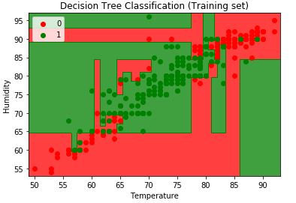
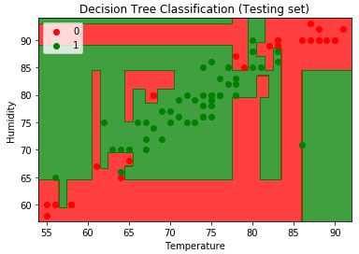
QUERY REPRESENTATION THROUGH GRAPH
Fig. 1
Fig. 2

Slide 24
OUTCOMES
Mean squared error: 0.03
Variance score: 0.89
Enter the current temperature:72
Enter the current humidity:86
Play Golf = Yes

Slide 25
DRAWBACKS
Analysis and prediction is strictly done on the basis of two factors.
Better results can be obtained if implemented using IOT.

Slide 26
CONCLUSION
This project has outlined the concepts, designs and methodologies to be used for the experiments to be implemented in this project. It has introduced the dual methodologies of using collective training data and testing data, outlining the nuances of each approach. The experiments to be performed for predictive modelling have been detailed with the differences between each of them discussed along with their expected outcomes.

