Slide 1

UI-UX Design In JavaFX
Jitendra Sharma
Section - H
Roll No - 161500251(16)

Slide 2
Content
What is JavaFX?
Why we require JavaFX?
History
What is FXML?
Deployments
BrowserFX

Slide 3
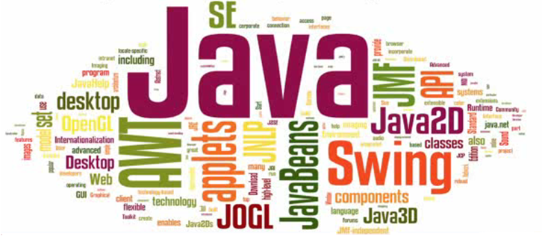
What is JavaFX? (I)
Notes:
3
Next step in the evolution of Java as a rich client platform.
Designed to provide a lightweight, hardware-accelerated Java UI platform
http://docs.oracle.com/javafx/2.0/overview/jfxpub-overview.htm
http://docs.oracle.com/javafx/
http://javafx.com/
http://en.wikipedia.org/wiki/JavaFX
http://www.oracle.com/technetwork/java/javafx/overview/faq-1446554.html
http://www.svjugfx.org/
http://www.slideshare.net/JAX_London/java-core-javafx-20-great-user-interfaces-in-java-simon-ritter

Slide 4



What is JavaFX? (II)
Rich sets of graphics and media API
Cross-Platform
Deploy on the Desktop or in the browser
Notes:
4
Windows – Supported
Mac OS – First half of 2012 (SDK available)
Linux – Second half of 2012 (Dev Preview available)
http://docs.oracle.com/javafx/2.0/overview/jfxpub-overview.htm
http://docs.oracle.com/javafx/
http://javafx.com/
http://en.wikipedia.org/wiki/JavaFX
http://www.oracle.com/technetwork/java/javafx/overview/faq-1446554.html
http://www.svjugfx.org/
http://www.slideshare.net/JAX_London/java-core-javafx-20-great-user-interfaces-in-java-simon-ritter

Slide 5
Why we require JavaFX? (II)
Better GUI than swing
Can be deployed in the browser
Follow MVC architecture

Slide 6
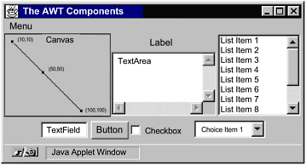
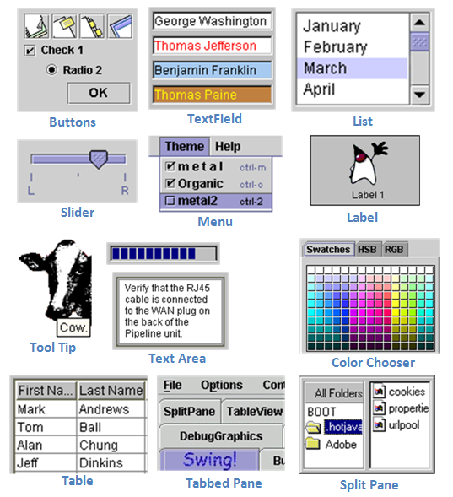
Why we require JavaFX? (II)
1. Awt Components
2. Swing Components

Slide 7
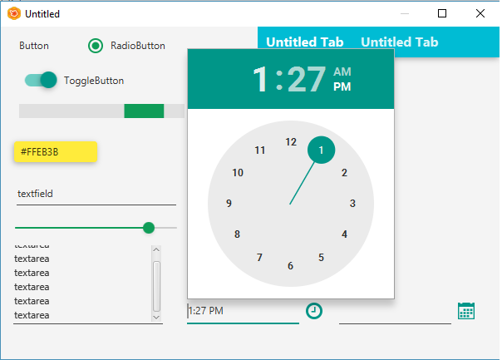
Why we require JavaFX? (II)
JavaFX Components

Slide 8
History (III)
Started as a project by Chris Oliver called F3
Sun Microsystems first announced JavaFX in 4 Dec , 2008
In 2010 , Oracle accquired Sun Microsystems and released JavaFX 2.0

Slide 9
What is FXML? (IV)
Scriptable, XML-based markup language for defining user interfaces
Alternative to developing UI programmatically
Easy and intuitive for web developers
Allows embedding any JVM scripting language
JavaScript
Groovy
Clojure
…
Notes:
http://docs.oracle.com/javafx/2.0/api/javafx/fxml/doc-files/introduction_to_fxml.html
• Scriptable, XML-based markup language for defining user interfaces
• Convenient alternative to developing UI programmatically in Java
• Easy to learn and intuitive for developers familiar with web technologies or other markup based UI technologies
• Powerful scripting feature allows embedding scripts within a FXML file. Any JVM scripting language can be used, including JavaScript, Groovy, and Clojure, among others

Slide 10
Deployments (V)
Ideal for offline applications
Embedded in a web page
Can interact with the web page through JavaScript
Deploy Jar file, JNLP and HTML

Slide 11
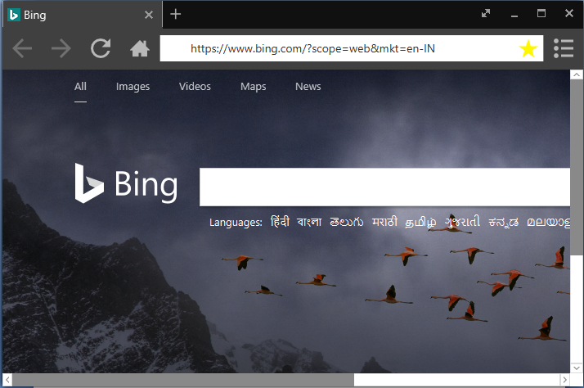
BrowserFX

Slide 12
BrowserFX
Simple Web-Browser
With few functionalities like save Bookmarks and History
Build in Java8
Use Edited Modules TabpaneFX and StageFX

Slide 13
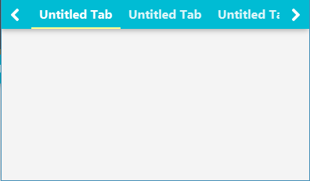
BrowserFX
JFXTabpane -
Material Design TabPane , Created By jfoenix
Problem – No close Button UI

Slide 14
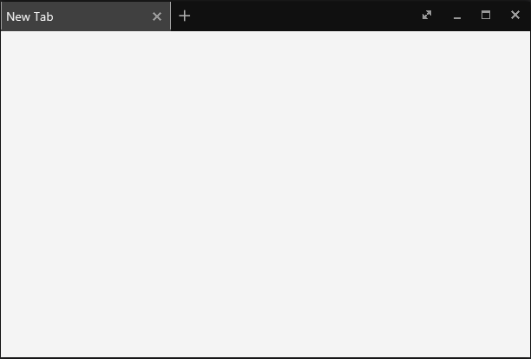
StageFX with TabpaneFX

Slide 15
StageFX
Undecorated Stage
Have fullscreen, maximize, minimize and close buttons
Box-shadow effects
Smooth closing and start

Slide 16
BrowserFX
Future Works –
Class for Save Html page as Html file
Class for Downloading Files
Create Popup Menu

Slide 17
Thank you

