Slide 1

GRE-SYNS

Slide 2
DESCRIPTION
GRE Syns is the perfect application to build your vocabulary for GRE.
The first of its kind, GRE Syns stands out from other apps by grouping the words you find similar in meaning so that you can study these words together.
With more than 900 groups, the user has to learn only half the meanings! It also gives user the ability to create new groups and add words to these groups as well as the existing groups. This helps in learning the words quickly and you have to memorize lesser meanings.

Slide 3
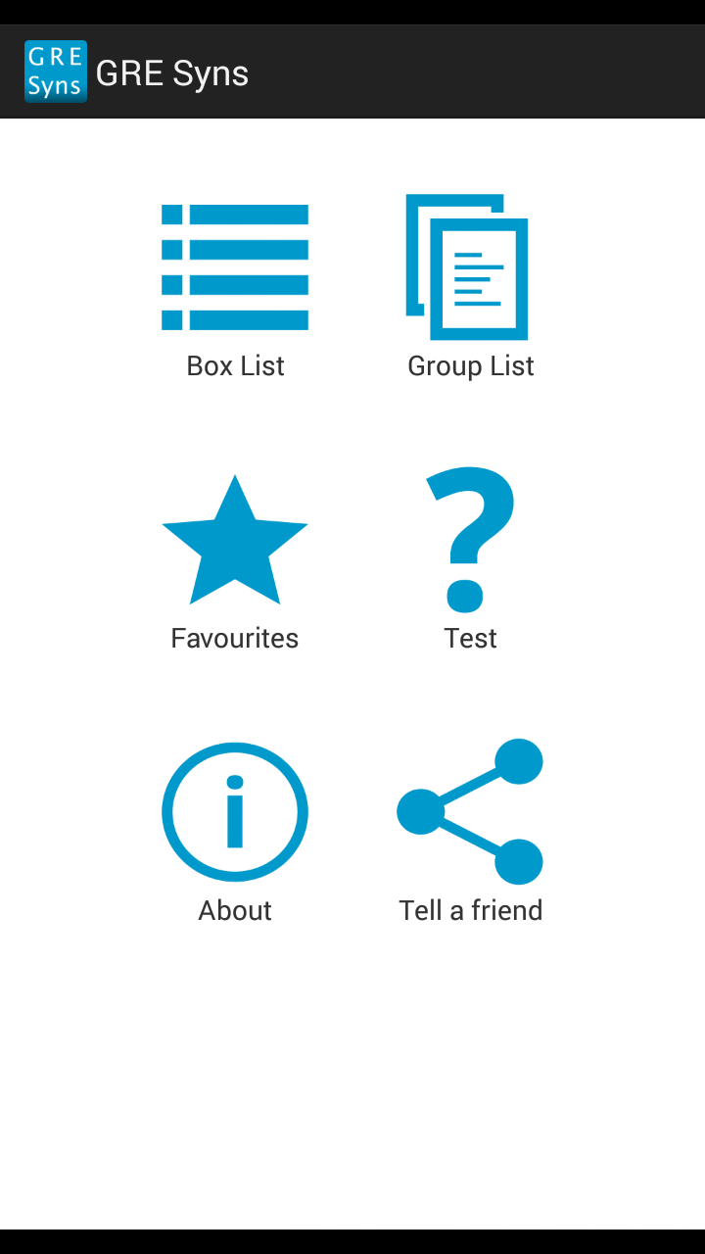
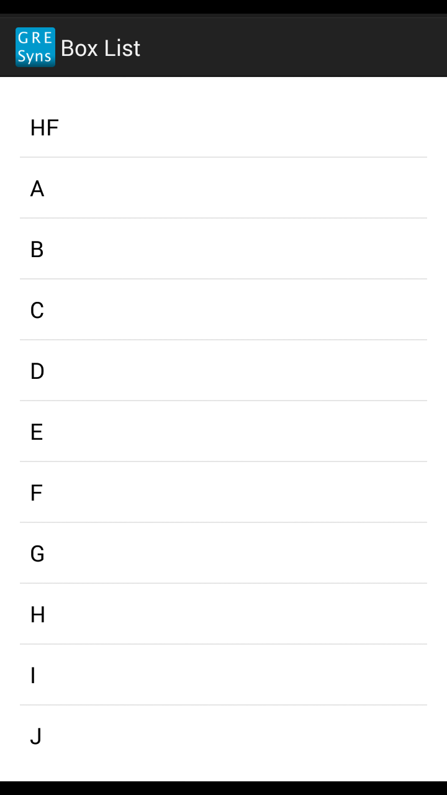
SCREENSHOTS

Slide 4
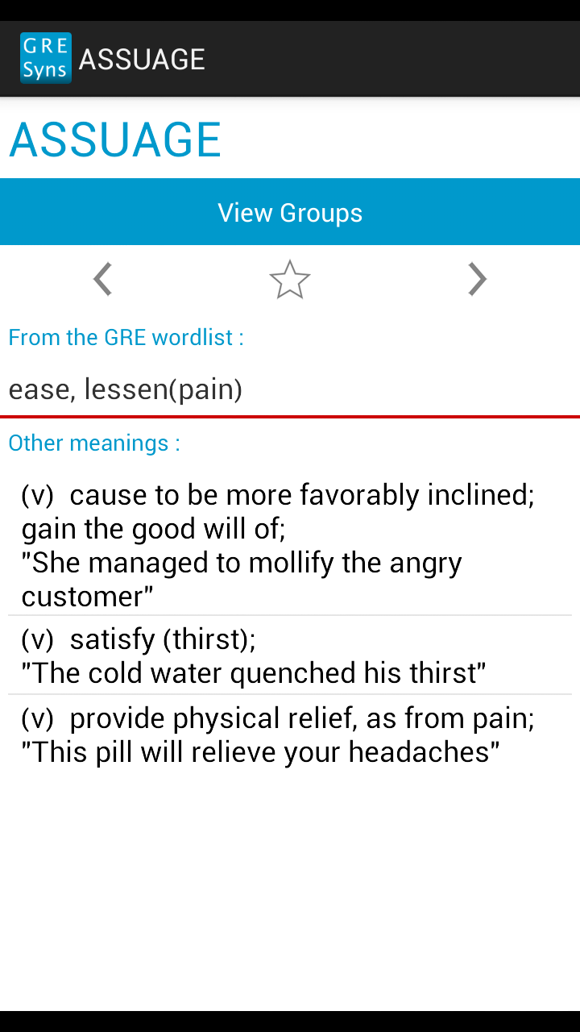
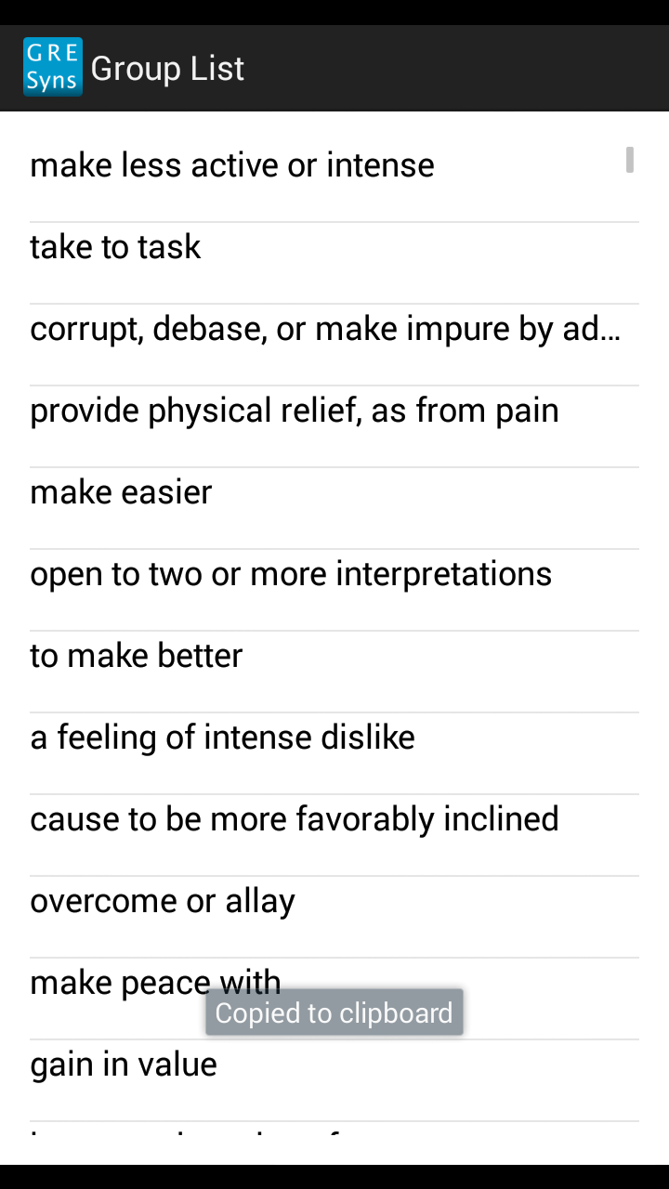
SCREENSHOTS

Slide 5
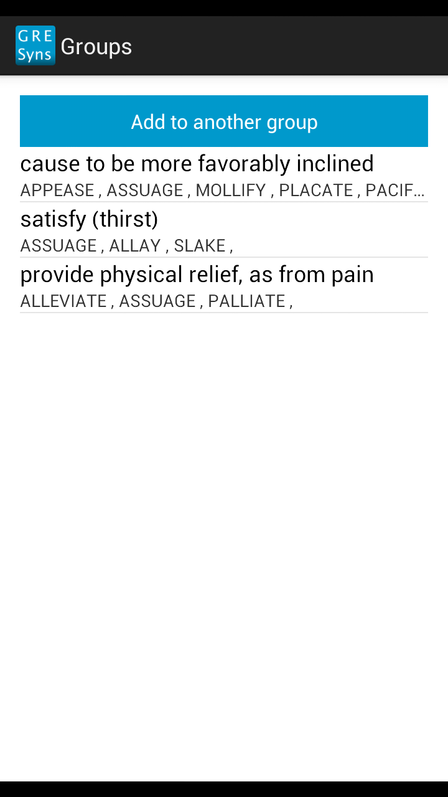
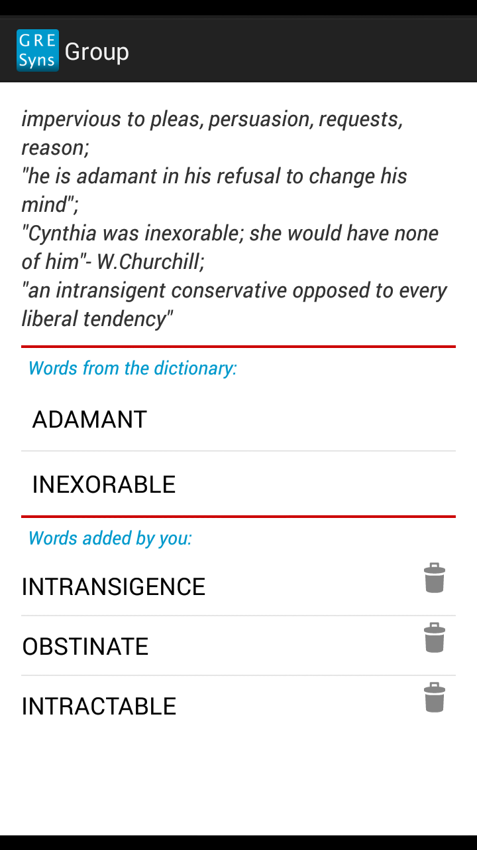
SCREENSHOTS

Slide 6
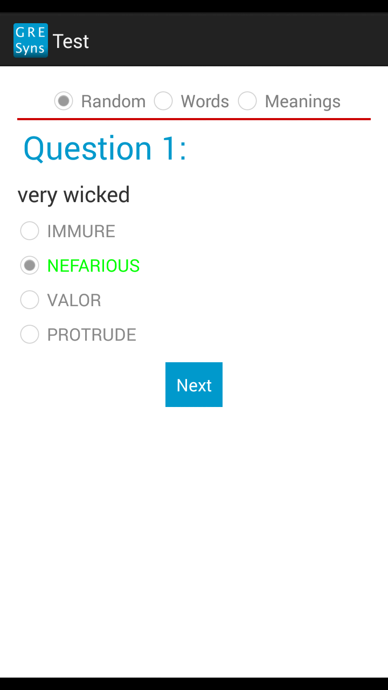
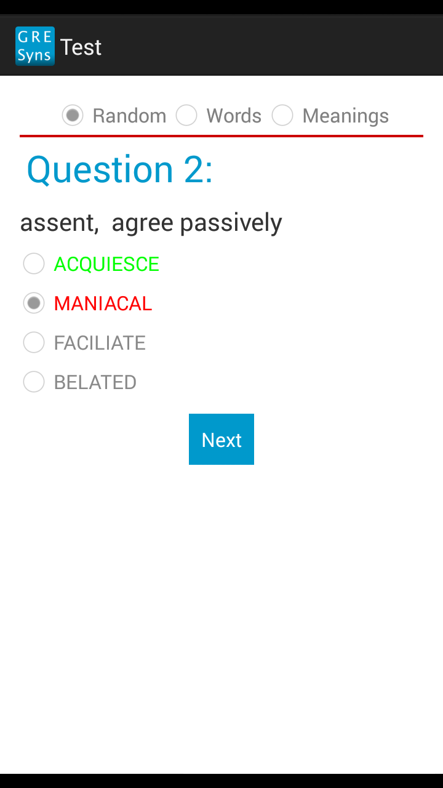
SCREENSHOTS

Slide 7
Developers
JITENDRA JAIN (jitendra.jain@live.com)
DEEP SHAH (deepshah.91@gmail.com)
DHARMENDRA HINGU (dharmendra.hingu@gmail.com)

Slide 8
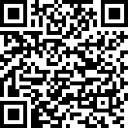
GRE-SYNS on PLAY STORE
DO TRY GRE-SYNS AVAILABLE ON PLAYSTORE ON THIS LINK

Slide 9
Thank You

