Slide 1

Cloudsim: simulator for cloud computing infrastructure and modeling
Presented By:
SHILPA V PIUS

Slide 2

Content
What is Cloud Computing?
What is CloudSim?
CloudSim Architecture.
CloudSim Installation & Working.
Versions in Market (CloudSim).
References.

Slide 3

What is Cloud Computing?
A type of parallel and distributed system consisting of a collection of interconnected and virtualized computers that are dynamically provisioned and presented as one or more unified computing resources based on service-level agreements established through negotiation between the service provider and consumers.
According to the National Institute of Standards and Technology (NIST) [4]: “a pay-per-use model for enabling available, convenient, on-demand network access to a shared pool of configurable computing resources that can be rapidly provisioned and released with minimal management effort or service provider interaction.”

Slide 4
What is CloudSim?
CloudSim is an open Source product coded & designed in JAVA language, which is used in the field of cloud computing for simulation.
Basically CloudSim is a simulator.
It is easy to use.
Compile the CloudSim Example Codes simply through Command prompt or you may also Add CloudSim with Eclipse, Netbeans etc. for making work easy.

Slide 5

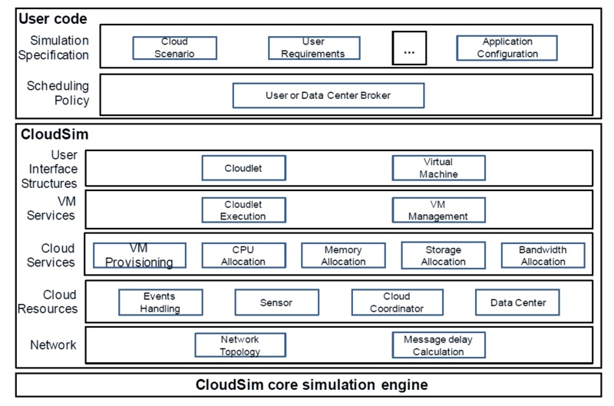
CloudSim Architecture
User code.
CloudSim.
GridSim.
SimJava.

Slide 6
CloudSim Architecture
CloudSim core simulation engine:
  SimJava+GridSim.
CloudSim:
  Provides Support for modeling and simulation
  Manages the instantiation and execution of core entities (VMs, hosts, data centers, applications).
User Code:
  Exposes configuration related functionalities for hosts, applications, VMs, number of users and their application types, and broker scheduling policies.
A Cloud application developer can generate:
A mix of user request distributions, application configurations.
Cloud availability scenarios at this layer and perform robust tests based on the custom configurations already supported within the CloudSim.

Slide 7
CloudSim Installation & Working
Download the Zipped CloudSim 3.0 package from the GRIDS Laboratory web portal on CloudSim. (Windows & Linux).
Install the JAVA 6.0 Version or Higher.
Paste the downloaded version of CloudSim in Drive C.
UnZip the CloudSim Package.
Try to execute all ready given examples first.
For Windows:
Start the Command Prompt (cmd).
Provide the path upto the given example.
For Ubuntu:
First Install the ANT package.
Then work on ANT as similar to windows

Slide 8
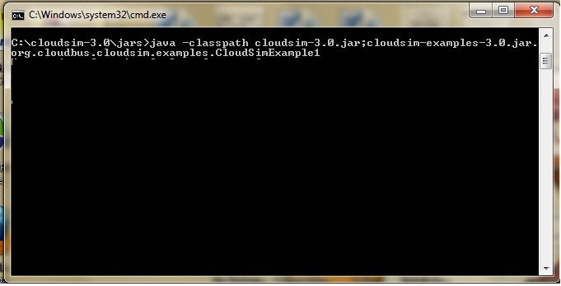
CloudSim Installation & Working

Slide 9
Versions
Version 1.0
This was the first version of the Cloudsim it was released on the April 7, 2009 [10]. This version of Cloudsim support for modeling and simulation of large scale cloud computing infrastructure, including data centers on a single physical computing node, a self-contained platform for modeling data
centers, service brokers, scheduling, and allocations policies.
Version 2.0
This version was released on May 27, 2010 [11]. Major improvements in simulation core allowed enhanced scalability and performance of simulations and insertion and removal of simulation entities during simulation execution. It increases considerably scenarios that may be addressed in simulations.

Slide 10
Versions
Version 2.1
This version was released on July 27, 2010 [12]. This version has been migrated to using Apache Maven. Maven simplifies project by providing various tools and plugins. Some bug fixes, refactoring and removal of obsolete code.
Version 2.1.1
This version of cloudsim was released on Feb 10, 2011 [13]. This version of cloudsim consists of some bug fixes which come in the version 2.1.

Slide 11
Versions
Version 3.0
This version of cloudsim was released on Jan 11, 2012 [14]. This is the latest version of cloudsim with all the latest updates bug fixes. The updates in this version are new vm scheduler, new datacenter network model, new vm allocation and selection polices, new power models, new workload tracks, support for external workloads and support for user defined end of simulation.
Removal of some classes have been done like CloudCoordinator, Sensor, PowerPe and Power.PeList. Some API changes and some bug fixes in this version.

Slide 12
References
[1] R. Buyya, C. S. Yeo, S. Venugopal, J. Briberg, and I. Brandic. Cloud computing and emerging IT platforms: vision, hype, and reality for delivering computing as the 5th utility, Future generation computer systems, 25: 599-616,2009.
[2] R. Buyya, R. N. Calheiros, A. Beloglazov, and S. Garg. Clousim: A Framework for modeling and simulation of cloud computing infrastructures and services, the cloud computing and distributed systems laboratory, University of Melbourne, www.cloudbus.org.
[3] R. Buyya, R. Ranjan, and R. N. Calheiros. Modeling and simulation of scalable cloud computing environment and the cloudsim toolkit: challenges and opportunities, 2009.
[4] P. Mell and T. Grance. The NIST Definition of cloud computing, National Institute of Standards and Technology, Information Technology Laboratory, Technical Report Version 15, 2009.
[5] M. Armbrust, A. Fox, R. Griffith, A. Josoph, R. Kath, A. Konwinski, G. Lee, D. Patterson, A. Rabkin, I. Stoica, M. Zaharia,.Above the clouds: A Berkely view of cloud computing. Technical Report No. UCB/EECS-2009-28, University of California at Berkely, USA, Feb. 10, 2009.
[6] A. Legrand, L. Marchal, and H. Casanova. Scheduling distributed applications: the SimGrid simulation framework. In Proceedings of the 3rd IEEE/ACM International Symposium on Cluster Computing and the Grid, 2003.

Slide 13
References
[7] J. E. Smith and R. Nair. Virtual Machines: Versatile platformsfor systems and processes. Morgan Kauffmann, 2005.
[8] S. Nixon. Software as a Service and cloud computing using a theoretical model or testbed, http://saas-cloud-simulation.wikispaces.asu.edu, CSE564.
[9] K. Das. Extension of cloudsim: cloud computing simulator, 14-15, 2009.
[10] R. Buyya. Cloud Simulator cloudsim 1.0 software release, CLOUDS Lab, http://buyya.wordpress.com, April 07, 2009.
[11] R. Buyya. The cloudbus project release cloudsim toolkit 2.0, CLOUDS Lab, http://buyya.wordpress.com, May 27, 2010.
[12] R. Buyya. Cloud Simulator cloudsim version 2.1, GRIDS Lab, http://code.google.com/p/cloudsim, July 27, 2010.
[13] R. Buyya. Cloud Simulator updated bug fixes cloudsim version 2.1.1, GRIDS Lab, http://code.google.com/p/cloudsim, Feb 10, 2011.
[14] R. Buyya, R. N. Calheiros, A. Beloglazov, and S. Garg. GRIDS Lab, cloudsim 3.0 package download, updates from version 2.0 to version 3.0, Jan 11, 2012.

Slide 14


