Slide 1

Transformer-based Predictive Maintenance of Degrading Turbofan Engines
Jitendra Tiwari,
jitendra.tiwari@tum.de
Supervised by Daniel Koutas
Engineering Risk Analysis Group
Technische Universität München
München - Oct 2nd, 2024

Slide 2
Outline
Background and motivation
Literature Review
Methodologies
Results
Conclusion
References
Notes:
Literature review:
PDM Policies details
Model Architecture
Methodologies:
Data description
Code preparation
Hyper parameter tuning

Slide 3
Introduction
Prognostic health management predict the remaining useful life(RUL).
Prognostics is concerned with the prediction of time when components fail.
It ultimately helps us to figure out the tentative time frame, when one can replace the components before it fails.
Stochastic approach has been adopted in my work to estimate RUL due to multiple sources of uncertainty.

Slide 4
Introduction
Lei Y et. al. (2018) classified the Prognostic approach into four categories.
Physics model-based approaches.
Data-driven AI approaches are good at capturing uncertainty.
The aim of this thesis is Predictive Maintenance of Degrading Turbofan Engines using Transformer architectures.
Data-driven AI approaches.
Hybrid Approaches.
Statistical model-based approaches.

Slide 5
Literature Review
A decision-oriented metric $\hat{M }$ has been used for prognostic performance evaluation within any given decision setting.
A decision-oriented metric (𝑀 ) ̂ has been used for prognostic performance evaluation within any given decision setting.
PDM Decision settings:
Consider the decision of when to replace a component.
Consider a decision on ordering and keeping a replacement component in the inventory

Slide 6
Characteristics of Decision settings
Single Component problem is studied.
Component is monitored continuously.
Probabilistic RUL has been derived from monitored data.
Inspections are not considered.
Maintenance decision action has been made at discrete time steps defined by t_{k}
Notes:
∆T = 10 flight cycles have been chosen based on the authors‘s expertise.

Slide 7
Characteristics of Decision settings
Discrete-time steps t_{k}, where t_{k} = k•∆T and integer k = 1,2, …N and ∆T = 10 flight cycles.
Two types of replacement action are considered:
Preventive replacement with cost C_{p}
Corrective replacement with cost C_{c} which occurs upon component failure. Corrective replacement causes a higher cost than preventive replacement.
C_{c} > C_{p}
Replacement is assumed to be a perfect replacement.
Maintenance is a viable decision i.e. necessary repairs can be taken to address issues before they escalate.
Notes:
Perfect replacement means bringing the component back to its original state.

Slide 8
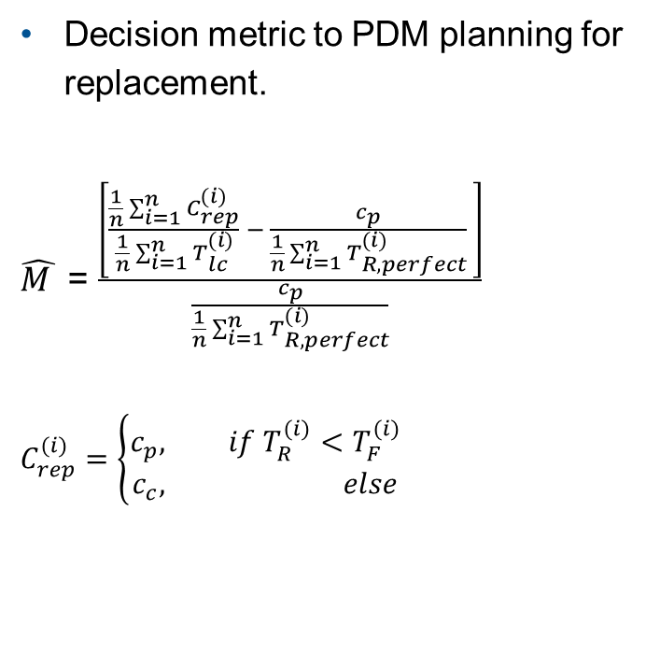
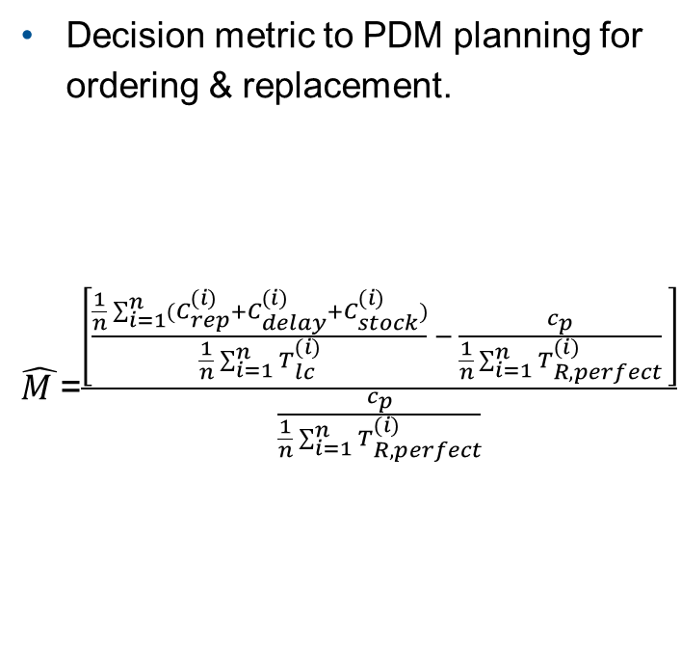
Decision Metric for Prognostic Performance Evaluation (Antonis et.al.2024)
Decision metric to PDM planning for replacement.
$\hat{M }$ = $\frac{\left[\frac{\frac{1}{n}\sum_{i=1}^{n}{C_{rep}^{(i)}}}{\frac{1}{n}\sum_{i=1}^{n}{T_{lc}^{(i)}}} − \frac{c_{p}}{\frac{1}{n}\sum_{i=1}^{n}{T_{R,perfect}^{(i)}}} \right]}{\frac{c_{p}}{\frac{1}{n}\sum_{i=1}^{n}{T_{R,perfect}^{(i)}}}}$
$$C_{rep}^{(i)}=\left\{\begin{aligned}c_{p}, if{ T}_{R}^{(i)}<T_{F}^{(i)} \\ c_{c}, else\end{aligned}\right.$$
Decision metric to PDM planning for ordering & replacement.
$\hat{M }$=$\frac{\left[\frac{\frac{1}{n}\sum_{i=1}^{n}{{(C}_{rep}^{(i)}+C_{delay}^{(i)}+C_{stock}^{(i)})}}{\frac{1}{n}\sum_{i=1}^{n}{T_{lc}^{(i)}}} − \frac{c_{p}}{\frac{1}{n}\sum_{i=1}^{n}{T_{R,perfect}^{(i)}}} \right]}{\frac{c_{p}}{\frac{1}{n}\sum_{i=1}^{n}{T_{R,perfect}^{(i)}}}}$
Notes:
$T_{R}^{(i)}$= Time steps when preventive replacement happens to i^{th} component.
$T_{R}^{(i)}$ lies in the set {t_{k} = k•∆T, k= 1,2,3, …}
$T_{F}^{(i)}$= Time steps when corrective replacement happens to i^{th} component in case of component failure.
$T_{lc}^{(i)}$ = min[$T_{R}^{(i)}$ , $T_{F}^{(i)}$]
$T_{R,perfect}^{(i)}$ = is the time step k•∆T, directly before $T_{F}^{(i)}$
L is a deterministic lead time. Which is the time from component ordering to delivery.
$C_{delay}^{(i)}$is the cost related to a late ordering of a component for replacement.
$C_{stock}^{(i)}$ is the cost related to an early ordering of a component i.e. the holding inventory cost.
# Assumptions for the costs, taken by the 2019 RESS paper
C_p = 100, C_c = 1000, C_unav = 10, C_inv = 1, DT = 10 # Decisions can be taken every DT=10, L = 20 # lead time
inventory holding is cheap, unavailability cost are much more expensive, preventive ist more expensive than that, and corrective replacement is the most expensive.

Slide 9
Metric for Prognostic performance Evaluation
$C_{delay}^{(i)}$= max($T_{order}^{(i)}$+ L - $T_{lc}^{(i)}$ ,0)•c_{unav}
𝐶_𝑑𝑒𝑙𝑎𝑦^((𝑖))= max(𝑇_𝑜𝑟𝑑𝑒𝑟^((𝑖))+ L - 𝑇_𝑙𝑐^((𝑖)) ,0)•c_{unav}
$C_{stock}^{(i)}$= max($T_{lc}^{(i)}$ -($T_{order}^{(i)}$ + L) ,0)•c_{inv} , L = 2•∆T=20 cycles
𝐶_𝑠𝑡𝑜𝑐𝑘^((𝑖))= max(𝑇_𝑙𝑐^((𝑖)) -(𝑇_𝑜𝑟𝑑𝑒𝑟^((𝑖)) + L) ,0)•c_{inv} , L = 2•∆T=20 cycles
$C_{rep}^{(i)}$= The (undiscounted) cost of the replacement action for the i^{th} component.
𝐶_𝑟𝑒𝑝^((𝑖))= The (undiscounted) cost of the replacement action for the i^{th} component.
C_{unav} = is the system unavailability cost per unit of time.
(Unavailability cost)
C_{inv} = is the holding inventory cost per unit time for a component. (Inventory cost)
$T_{order}^{(i)}$ = is explained in PDM policy for component ordering and preventive replacement.
𝑇_𝑜𝑟𝑑𝑒𝑟^((𝑖)) = is explained in PDM policy for component ordering and preventive replacement.

Slide 10

PdM policy for Component Ordering and Preventive Replacement
$a_{order,k}$=$\left\{\begin{aligned}O, if \text{Pr}\text{(}\text{RU} \text{Lpred}\text{,}\text{k} ≤ \text{w}\text{+∆}\text{T}≥p_{thres}^{order} \\ NO, else\end{aligned}\right.$
The policy first determines based on prognostics input whether a component should be ordered or not.
$p_{thres}^{order}$ = 0.11 (Optimized threshold values).
𝑝_𝑡ℎ𝑟𝑒𝑠^𝑜𝑟𝑑𝑒𝑟 = 0.11 (Optimized threshold values).
Pr(RU L_{pred,k} $≤$ w+∆T) is sum of class1 and class2 probabilities.
Pr(RU L_{pred,k} ≤ w+∆T) is sum of class1 and class2 probabilities.
W = $\left\lceil \frac{L}{\text{∆}\text{T}}\right\rceil$• ∆T is a ordering lead time.
W = ⌈𝐿/"∆T" ⌉• ∆T is a ordering lead time.
A lead time L is required for the component to become available upon ordering it.
If a compont is ordered at time step t_{k} the $T_{order}^{(i)}$ = t_{k} + w
If a compont is ordered at time step t_{k} the 𝑇_𝑜𝑟𝑑𝑒𝑟^((𝑖)) = t_{k} + w

Slide 11

PDM Policy1 for Preventive Replacement
$a_{rep,k}$=$\left\{\begin{aligned}DN, if\text{Pr}\text{(}\text{RU} \text{Lpred}\text{,}\text{k} ≤ Δ T\text{)}<\text{p}\text{thres} \\ PR , else\end{aligned}\right.$
The policy determines the action a_{rep,k} at each discrete time step t_{k} = k•∆T
Where DN denotes do nothing.
And PR denotes the preventive replacement.
p_{thres} = 0.5 has been taken for all the preventive replacement policies.
Pr(RU L_{pred,k} $≤ Δ T$) is the class 2 probability.
Pr(RU L_{pred,k} ≤ Δ 𝑇) is the class 2 probability.
After replacement one has a component with lower maintenance cost.

Slide 12

The objective function for PdM Policy 2
$a_{rep,k}$=$\left\{\begin{aligned}PR,ift_{k}+∆T ≥ T_{R,k}^{∗} \\ DN , else\end{aligned}\right.$
$\left(T_{R,k}\right)$ = $\frac{E\left[C_{rep}\left(T_{R,k}\right)\right]}{E\left[T_{lc}\left(T_{R, k}\right)\right]}$ = $\frac{P_{PR} •c_{p}+\left(1−P_{PR}\right)•c_{c}}{P_{PR} •\left(T_{R, k}\right)+\int_{t}^{T_{R, k}}{\text{t}\text{•} f_{RU L_{pred,k}} (\text{t}\text{ − }t_{k}) \text{dt}} }$ ,
Where:
$P_{PR}$= $\int_{T_{R, k}}^{∞}{f_{RU L_{pred,k}} (\text{t}\text{ − }t_{k}) \text{dt}}$
$T_{R,k}^{∗}$= is the optimal time to replacement, and one has to solve the objective function to find $T_{R,k}^{∗}$
𝑇_(𝑅,𝑘)^∗= is the optimal time to replacement, and one has to solve the objective function to find 𝑇_(𝑅,𝑘)^∗
P_{PR} denotes the probability that the component will be replaced preventively at $T_{R,k}^{∗}$
P_{PR} denotes the probability that the component will be replaced preventively at 𝑇_(𝑅,𝑘)^∗
(1- P_{PR}) is the probability that the component will fail before $T_{R,k}^{∗}$ and induce cost C_{c}
(1- P_{PR}) is the probability that the component will fail before 𝑇_(𝑅,𝑘)^∗ and induce cost C_{c}
The distribution of the predicted time to failure $f_{T_{F_{pred,k}}}\left(t\right)=$ $f_{RU L_{pred,k}} ($t - $t_{k})$
The distribution of the predicted time to failure 𝑓_(𝑇_(𝐹_(𝑝𝑟𝑒𝑑,𝑘) ) ) (t)= 𝑓_(𝑅𝑈 𝐿_(𝑝𝑟𝑒𝑑,𝑘) ) (t - 𝑡_𝑘)

Slide 13
PDM Policy for PR based on full RUL distribution
$T_{R,k}^{∗}$ = Is an optimal time of replacement found through solving an optimization problem at each discrete time step.
𝑇_(𝑅,𝑘)^∗ = Is an optimal time of replacement found through solving an optimization problem at each discrete time step.
A Preventive replacement is decided, when t_{k} + ∆T $≥$ $T_{R,k}^{∗}$ otherwise do nothing.
A Preventive replacement is decided, when t_{k} + ∆T ≥ 𝑇_(𝑅,𝑘)^∗ otherwise do nothing.
RUL-based PdM is the objective function to find the $T_{R,k}^{∗}$
RUL-based PdM is the objective function to find the 𝑇_(𝑅,𝑘)^∗
Full distribution of the RUL prediction at each time step t_{k} is known.

Slide 14
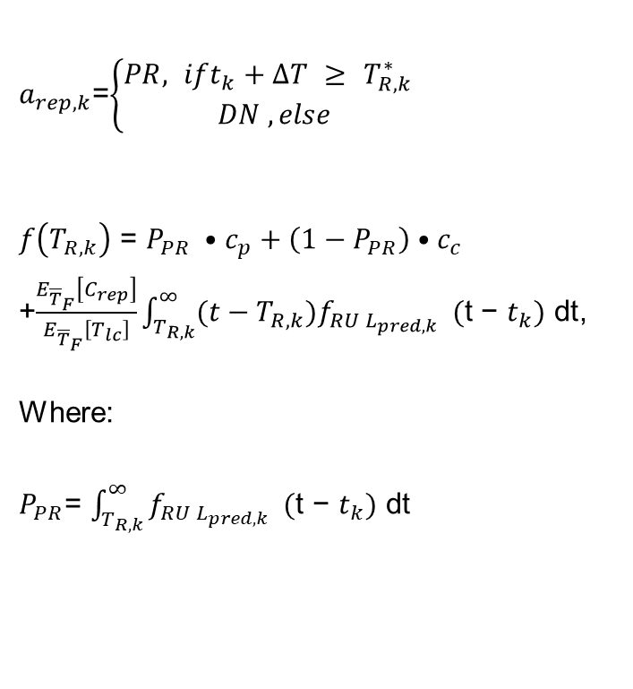
The objective function for PdM Policy 3
$a_{rep,k}$=$\left\{\begin{aligned}PR, ift_{k}+∆T ≥ T_{R,k}^{∗} \\ DN , else\end{aligned}\right.$
$f\left(T_{R,k}\right)$ = $P_{PR} •c_{p}+\left(1−P_{PR}\right)•c_{c}$ +$\frac{E_{{\overline{T}}_{F}}\left[C_{rep}\right]}{E_{{\overline{T}}_{F}}\left[T_{lc}\right]}\int_{T_{R, k}}^{∞}{{(t−T_{R,k})f}_{RU L_{pred,k}} (\text{t}\text{ − }t_{k}) \text{dt}}$,
Where:
$P_{PR}$= $\int_{T_{R, k}}^{∞}{f_{RU L_{pred,k}} (\text{t}\text{ − }t_{k}) \text{dt}}$
$T_{R,k}^{∗}$= is the optimal time to replacement, and one has to solve the objective function to find $T_{R,k}^{∗}$
𝑇_(𝑅,𝑘)^∗= is the optimal time to replacement, and one has to solve the objective function to find 𝑇_(𝑅,𝑘)^∗
P_{PR} denotes the probability that the component will be replaced preventively at $T_{R,k}^{∗}$
P_{PR} denotes the probability that the component will be replaced preventively at 𝑇_(𝑅,𝑘)^∗
Assumed “perfect“ monitoring case
$\frac{E_{{\overline{T}}_{F}}\left[C_{rep}\right]}{E_{{\overline{T}}_{F}}\left[T_{lc}\right]}$ = $\frac{c_{p}}{µ_{{\overline{T}}_{F}}}$
Assumed “perfect“ monitoring case
(𝐸_(¯𝑇_𝐹 ) [𝐶_𝑟𝑒𝑝 ])/(𝐸_(¯𝑇_𝐹 ) [𝑇_𝑙𝑐 ] ) = 𝑐_𝑝/µ_(¯𝑇_𝐹 )
The distribution of the predicted time to failure $f_{T_{F_{pred,k}}}\left(t\right)=$ $f_{RU L_{pred,k}} ($t - $t_{k})$
The distribution of the predicted time to failure 𝑓_(𝑇_(𝐹_(𝑝𝑟𝑒𝑑,𝑘) ) ) (t)= 𝑓_(𝑅𝑈 𝐿_(𝑝𝑟𝑒𝑑,𝑘) ) (t - 𝑡_𝑘)
Notes:
For a perfect monitoring case, every component will be preventive one(c_{p}), and the expected life cycle length of component will be equal to mean of distribution $f_{T_{F_{pred,k}}}\left(t\right)$

Slide 15
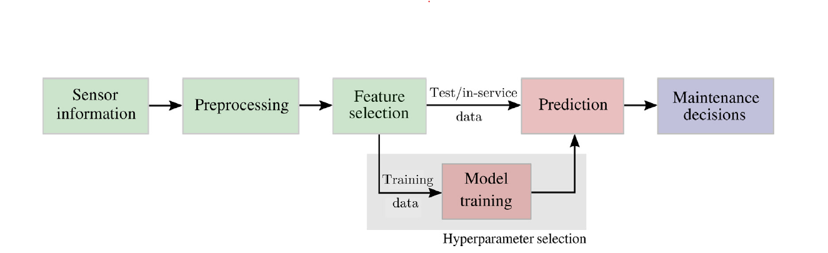
Flow Chart of Adopted data-driven PdM decision process
Notes:
If a component is ordered at t_{k} the earliest future decision time at which the component will be available for replacement is t_{k} + w

Slide 16
Model Parameters
Input dim | 25
Model_dim | 32
Num_heads | 4
Num_layers | 4
Seq_length | 50
Num_classes | 3
Dropout rate | 0.3107758
Learning rate | 0.0006020
Batch size | 4
Num_epochs | 15
Weight decay | 0.00003344
Patience | 5
Grad_acc_steps | 12
Transformer model architecture has been adopted to train the available time series CMAPSS dataset.
Transformer is an encoder-decoder type architecture
The encoder part extracts the features from our time series datasets.
The Decoder gives us the class probabilities. Since we have three classes to predict.
Notes:
model_dim: It determines the size of the attention heads and the feed-forward layers. Think of it as the "width" of your neural network.
Sequence length (50): represents nr of tokens in each sequence. each sequence contains 50 data points or tokens. While the input shape be (4,50,25) most of the internal computations in the transformer will be working with tensors of shape (4, 50, 32).
batch_size(4): This is the number of sequences processed together in a single forward/backward pass.
We are processing 4 sequences i.e. processing 50*4 =200 data points(tokens)
num_heads(4): The number of attention heads in each multi-head attention layer.
With patience = 5: If the model doesn't show improvement for 5 consecutive epochs, training will stop.
gradient_accumulation_steps (12) is useful when you're working with models that are too large to fit a big batch into memory.
Here's how it works step-by-step:
Process a batch of 4 samples.
Calculate the gradients, but don't update the model yet.
Repeat steps 2-3 for a total of 12 times.
After the 12th batch, sum up all the gradients from the 12 batches.
Update the model parameters using these accumulated gradients.
Reset the gradients and start over.

Slide 17
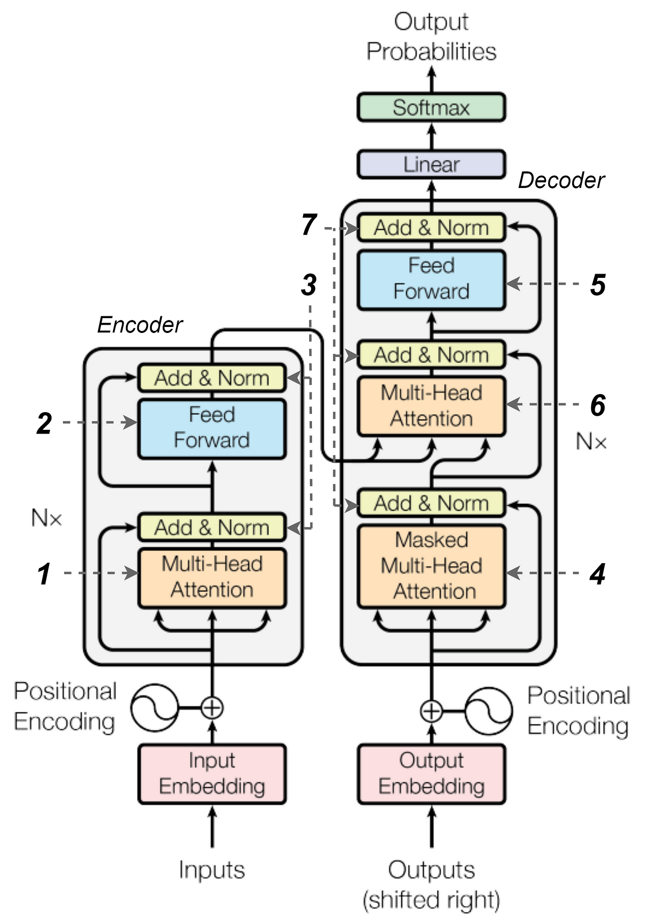
Model Architectures
Input Embedding: First layer of the transformer projects the size of input from (4,50,25) to (4,50,32).
Transformer Layers: All attention mechanisms and feed-forward networks operate on tensor with shape (batch_size, seq_length, model_dim)
Output layer: the final layer project from model_dim back to the desired output
Here N_{x} = 4 is the number of encode- decoder layers.

Slide 18
Data Description
The engine is operating normally at the start of each time series, and a fault develops at some point during the series.
In the training set, the fault grows in magnitude until system failure.
C-MAPSS (Commercial Modular Aero-Propulsion System Simulation) is a tool for simulating a realistic large commercial turbofan engine.
Dataset comprises of 26 attributes: out of which first and second are the unit number(id) and time in cycles, 3 operational settings, 21 sensor measurements.

Slide 19
Data Wrangling
Three operational settings have a substantial effect on engine performance.
The dataset has been divided into a train-validation-test set with a ratio of 80:10:10
The unique engine ID varies from 1 to 100.
Out of the available 100 engines id first 80 IDs have been chosen for training.
Calculate RUL for each engine’s: maximum cycle number- current cycle
Assign labels to each data point for classification:
Label2 ('label2') as 1 if RUL is less than or equal to 'w1', 2 if RUL is less than or equal to 'w0', and 0 otherwise.
W1=30 and W0=10 have been opted.
Create a copy of attribute ‚‘cycle‘ and perform min-max normalization to all attributes except ['id', 'cycle’, ‘RUL’, 'label2']
Notes:
Class 0: RUL>w1(high RUL)
Class 1: w0<RUL<=w1(Medium RUL)
Class 2: RUL <= w0 (Low RUL)

Slide 20
Data Wrangling
Generate a sequence for each engine to reshape features into
(12138, 50, 25)
Remove the columns that are not adding values to feature extraction such as ['id', 'cycle’, ‘RUL’,'label1’,'label2’]
train_df.shape = (16138, 30) & seq_array.shape = (12138, 50, 25)
generate labels for training and validation and test set by applying one hot encoding to column ‘label2’
The generate train_dataset, using seq_array and dummy label array.
generate a train loader using train_dataset and batch size and repeat this for the validation set.
use train_loader for training Transformer model and val_loader for hyperparameter tuning.
Notes:
# we always take the measurements of the last 50 cycles as input!
# Every sequence is reduced by a length of 50 (=sequence_length). We have 80 training sets, 80*50 = 4000 "less" inputs
# train_df.shape = (16138, 30)
# seq_array.shape = (12138, 50, 25)

Slide 21
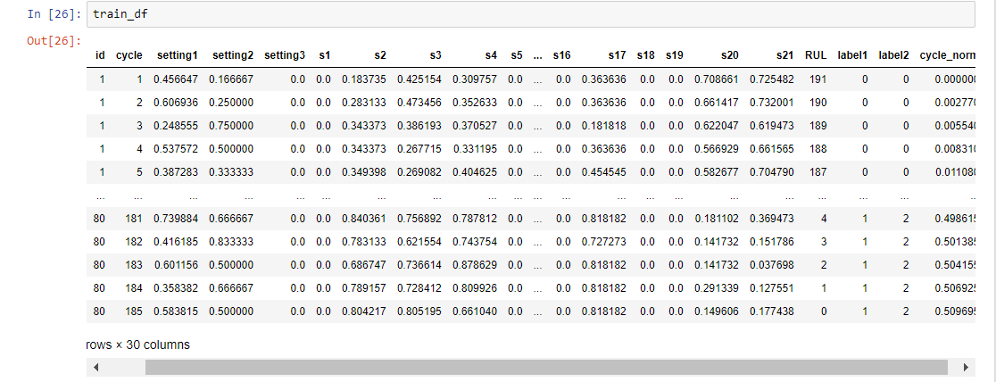
Train Dataset

Slide 22
Hyperparameter Tuning
Bayesian optimization has been used to find the best parameters of the transformer model.
P(accuracy | hyperparameter combination) = $\frac{P\left(\text{hyperparameter} \text{combination} | metric\right)P(accuracy)}{P(\text{hyperparameter} \text{combination})}$
P(accuracy | hyperparameter combination) = (𝑃("hyperparameter combination" │𝑚𝑒𝑡𝑟𝑖𝑐)𝑃(𝑎𝑐𝑐𝑢𝑟𝑎𝑐𝑦))/(𝑃("hyperparameter combination" ))
P(accuracy | hyperparameter combination) gives the probability of a given accuracy being maximized given the combination of hyperparameter values.
P(hyperparameter combination | accuracy) is the probability of a certain parameter combination if the given accuracy is maximized.
P(accuracy) is the initial accuracy quantity in the scalar.
P(hyperparameter combination) is the probability of getting that particular hyperparameter combination.
The algorithm iteratively explores hyperparameter configurations, learning from past trials to improve model performance with each iteration.

Slide 23
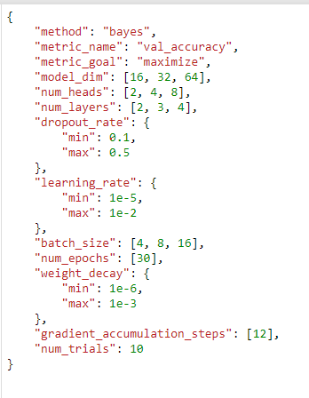
Hyperparameter Combination
Notes:
The Bayesian optimization method will intelligently select these 10 configurations, learning from the performance of previous trials to inform subsequent choices.
num_trials refers to the number of different hyperparameter configurations.

Slide 24
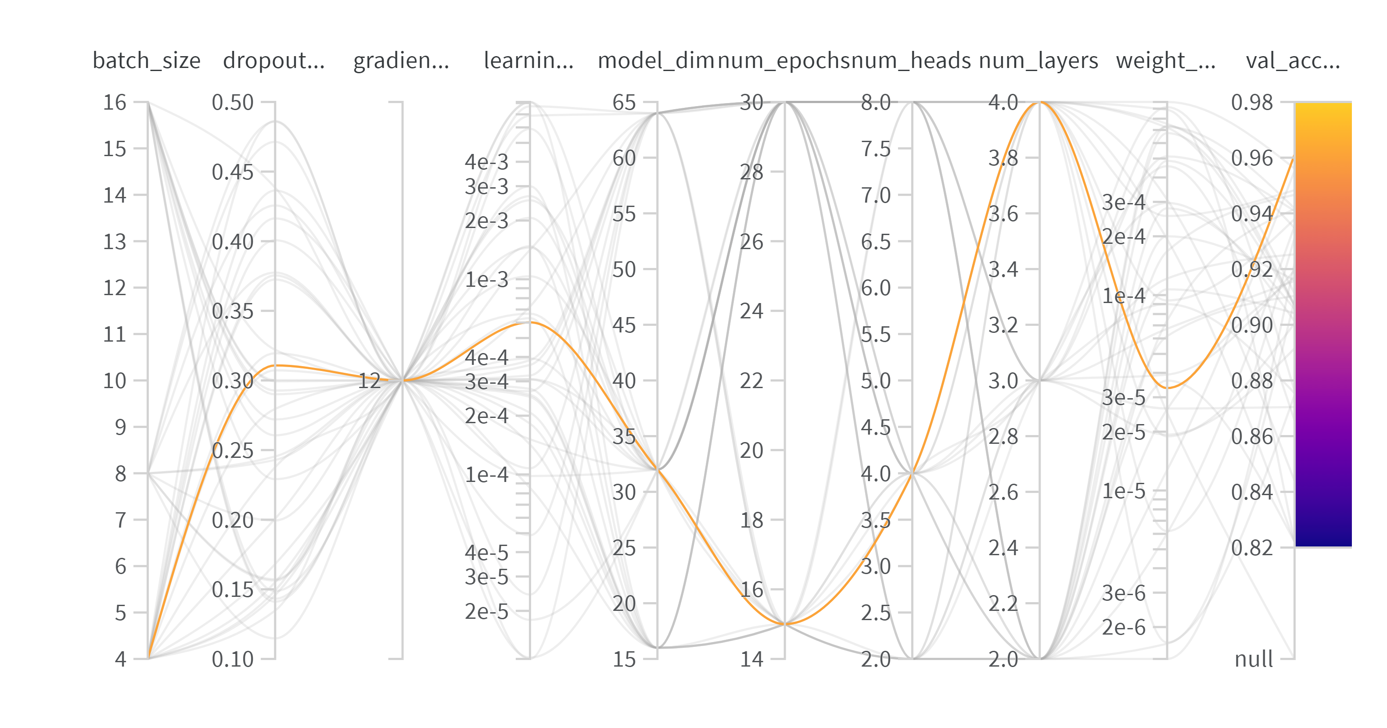
Tuned Hyper Parameter

Slide 25
Results
Score | LSTM |  |  | Transformer
 | Class 0 | Class 1 | Class 2 | Class 0 | Class 1 | Class 2
F1-score | 0.9864 | 0.8686 | 0.9246 | 0.9796 | 0.7773 | 0.8957
F2-score | 0.9887 | 0.8442 | 0.9470 | 0.9913 | 0.7323 | 0.8429
Precision | 0.9826 | 0.9125 | 0.8897 | 0.9606 | 0.8662 | 1.00
Recall | 0.9902 | 0.8287 | 0.9625 | 0.9993 | 0.7050 | 0.8111
Notes:
F1-score: LSTM outperforms Transformer in all three classes.
F2-score: LSTM performs better in two classes, while Transformer is slightly better in one class.
Precision: LSTM is better for two classes, but Transformer achieves perfect precision for the third class.
Recall: LSTM performs better in two classes, while Transformer has slightly higher recall in one class.
F1 score, which is a harmonic mean of precision and recall, This indicates a better balance between precision and recall.
Precision = True Positives / (True Positives + False Positives)
Recall = True Positives / (True Positives + False Negatives)

Slide 26
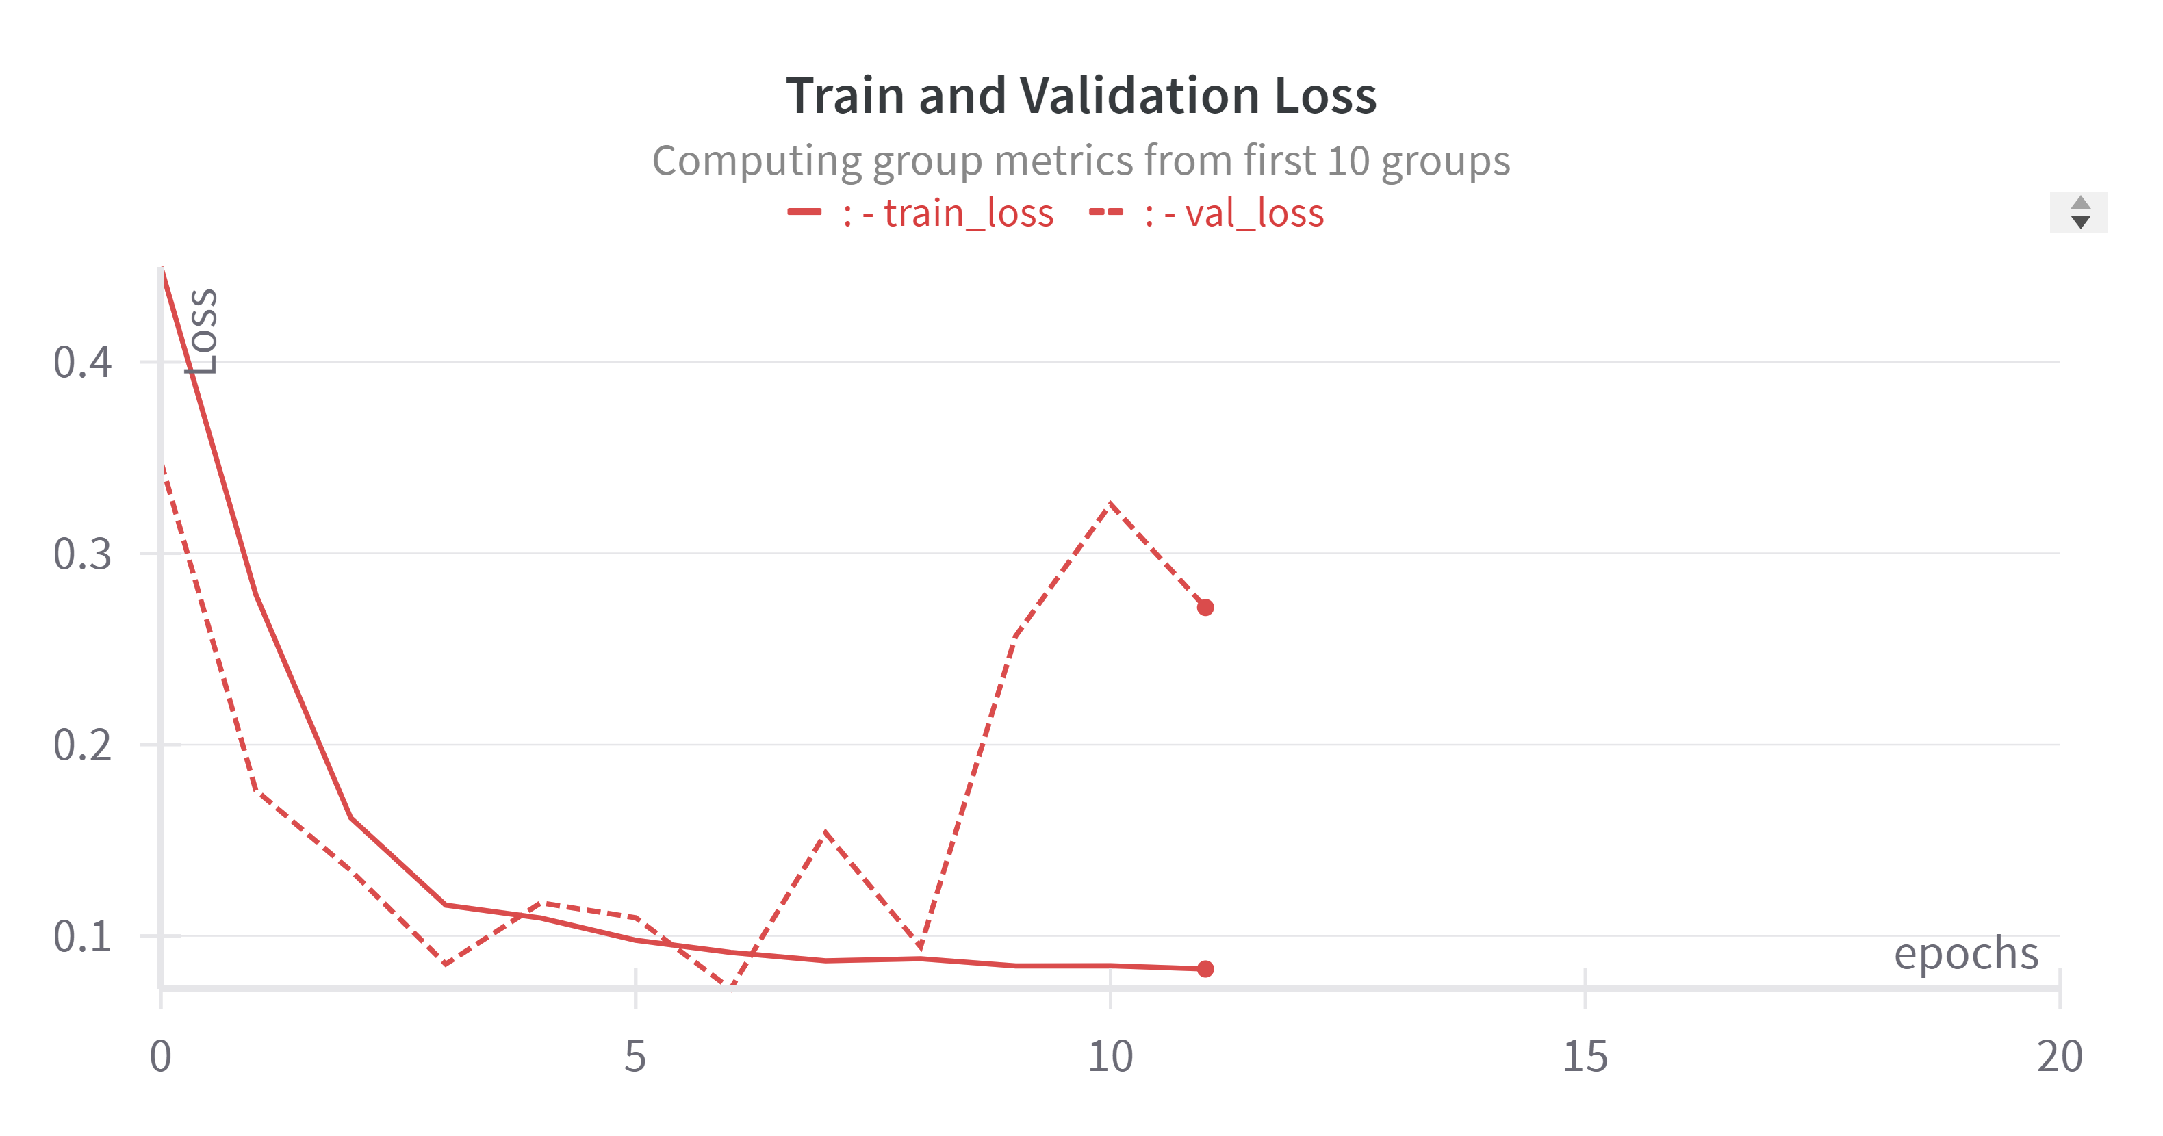
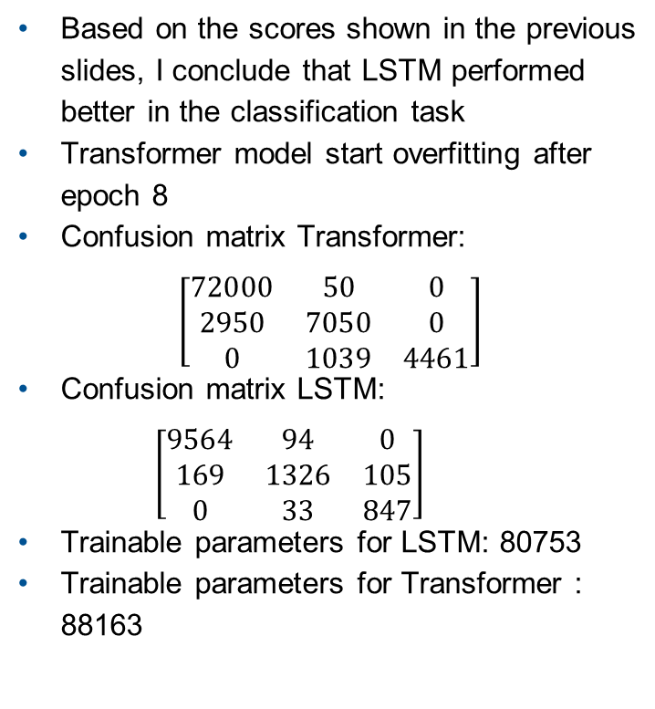
Train-Validation curve
Based on the scores shown in the previous slides, I conclude that LSTM performed better in the classification task
Transformer model start overfitting after epoch 8
Confusion matrix Transformer:
$$\left[\begin{matrix}72000 & 50 & 0 \\ 2950 & 7050 & 0 \\ 0 & 1039 & 4461\end{matrix}\right]$$
Confusion matrix LSTM: $\left[\begin{matrix}9564 & 94 & 0 \\ 169 & 1326 & 105 \\ 0 & 33 & 847\end{matrix}\right]$
Trainable parameters for LSTM: 80753
Trainable parameters for Transformer : 88163

Slide 27
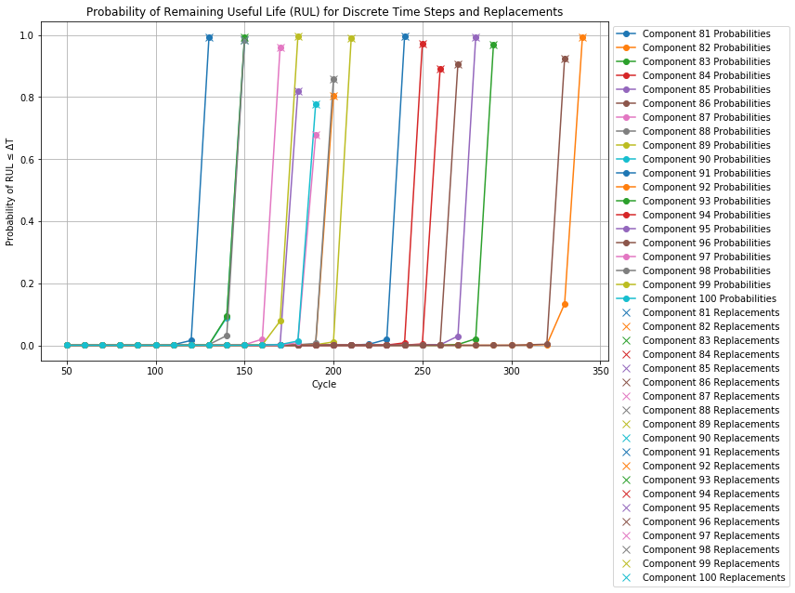
Plot of Both Overall and Replacement Probabilities, for Policy 1
Notes:
Plot both overall and replacement Probabilities to track the Replacement of components.
$a_{rep,k}$=$\left\{\begin{aligned}DN, if \text{Pr}\text{(}\text{RU} \text{Lpred}\text{,}\text{k} ≤\text{∆}\text{T}\text{)} <P\text{thres}\text{=0.5} \\ PR , else\end{aligned}\right.$

Slide 28
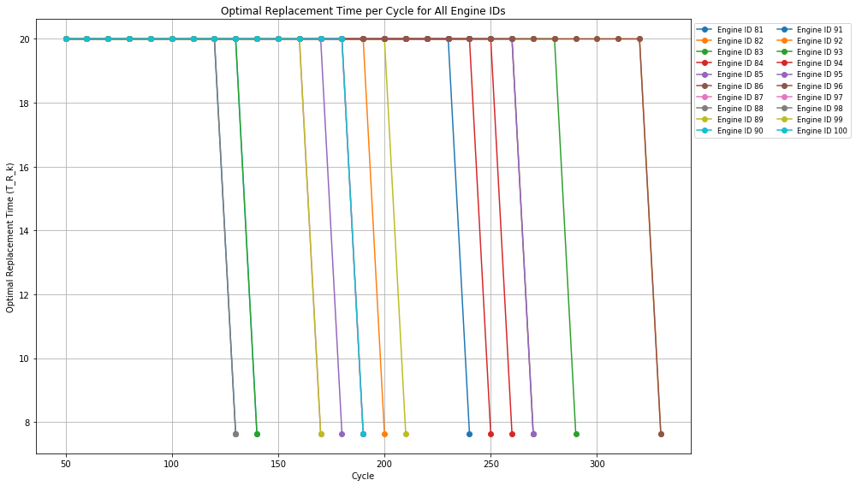
Objective Function Plot for Policy2
Notes:
use the returned optimal_replacement_times to visualize the replacement times over cycles:
$a_{rep,k}$=$\left\{\begin{aligned}PR, if \text{t}\text{k} \text{+}∆\text{T}≥ T_{R,k}^{∗} \\ DN , else\end{aligned}\right.$
$\left(T_{R,k}\right)$ = $\frac{E\left[C_{rep}\left(T_{R,k}\right)\right]}{E\left[T_{lc}\left(T_{R, k}\right)\right]}$ = $\frac{P_{PR} •c_{p}+\left(1−P_{PR}\right)•c_{c}}{P_{PR} •\left(T_{R, k}\right)+\int_{t}^{T_{R, k}}{\text{t}\text{•} f_{RU L_{pred,k}} (\text{t}\text{ − }t_{k}) \text{dt}} }$ ,
Where:
$P_{PR}$= $\int_{T_{R, k}}^{∞}{f_{RU L_{pred,k}} (\text{t}\text{ − }t_{k}) \text{dt}}$

Slide 29
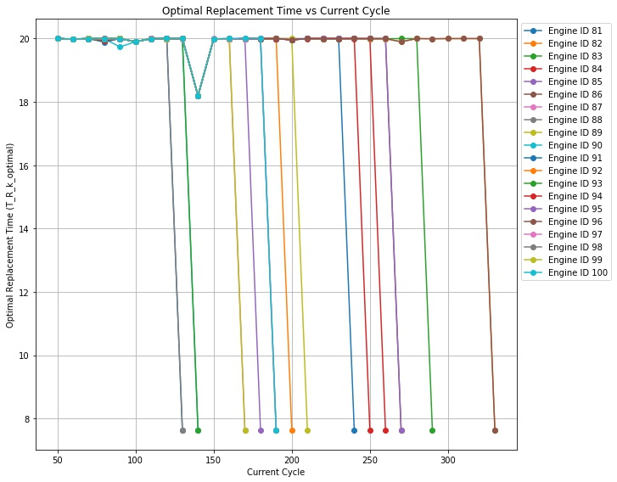
Objective Function Plot for Policy3
Notes:
$a_{rep,k}$=$\left\{\begin{aligned}PR, if \text{t}\text{k} \text{+}∆\text{T} ≥ T_{R,k}^{∗} \\ DN , else\end{aligned}\right.$
$f\left(T_{R,k}\right)$ = $P_{PR} •c_{p}+\left(1−P_{PR}\right)•c_{c}$ +$\frac{E_{{\overline{T}}_{F}}\left[C_{rep}\right]}{E_{{\overline{T}}_{F}}\left[T_{lc}\right]}\int_{T_{R, k}}^{∞}{{(t−T_{R,k})f}_{RU L_{pred,k}} (\text{t}\text{ − }t_{k}) \text{dt}}$
,
Where:
$P_{PR}$= $\int_{T_{R, k}}^{∞}{f_{RU L_{pred,k}} (\text{t}\text{ − }t_{k}) \text{dt}}$

Slide 30
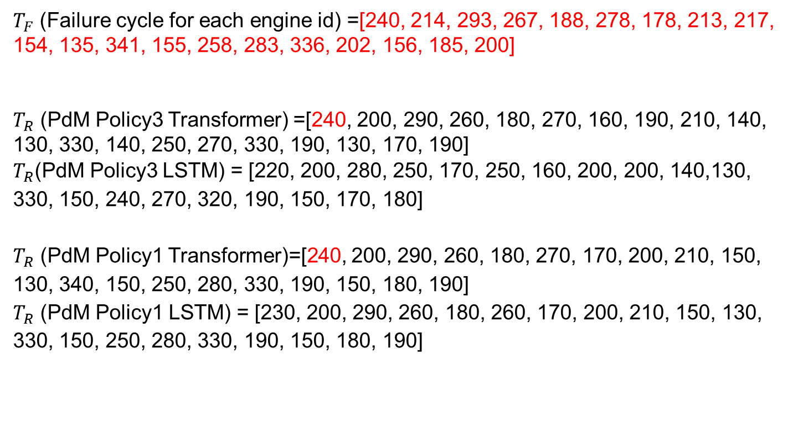
Comparison of${ T}_{R}$ values when $c_{p}/c_{c}$= 0.1
$T_{F}$ (Failure cycle for each engine id) =[240, 214, 293, 267, 188, 278, 178, 213, 217, 154, 135, 341, 155, 258, 283, 336, 202, 156, 185, 200]
$T_{R}$ (PdM Policy3 Transformer) =[240, 200, 290, 260, 180, 270, 160, 190, 210, 140, 130, 330, 140, 250, 270, 330, 190, 130, 170, 190]
$T_{R}$(PdM Policy3 LSTM) = [220, 200, 280, 250, 170, 250, 160, 200, 200, 140,130, 330, 150, 240, 270, 320, 190, 150, 170, 180]
$T_{R}$ (PdM Policy1 Transformer)=[240, 200, 290, 260, 180, 270, 170, 200, 210, 150, 130, 340, 150, 250, 280, 330, 190, 150, 180, 190]
$T_{R}$ (PdM Policy1 LSTM) = [230, 200, 290, 260, 180, 260, 170, 200, 210, 150, 130, 330, 150, 250, 280, 330, 190, 150, 180, 190]
Notes:
$T_{R}$ is replacement cycles for each engine id.

Slide 31
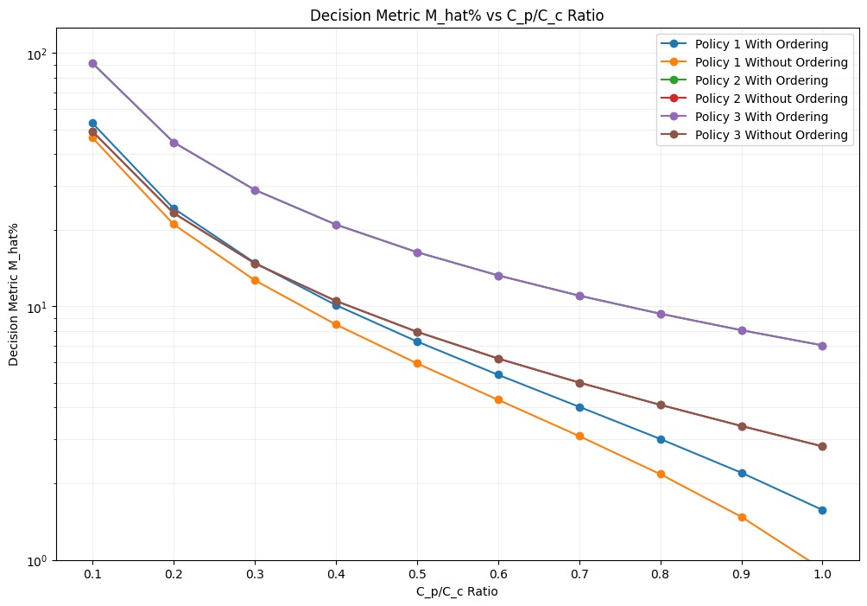
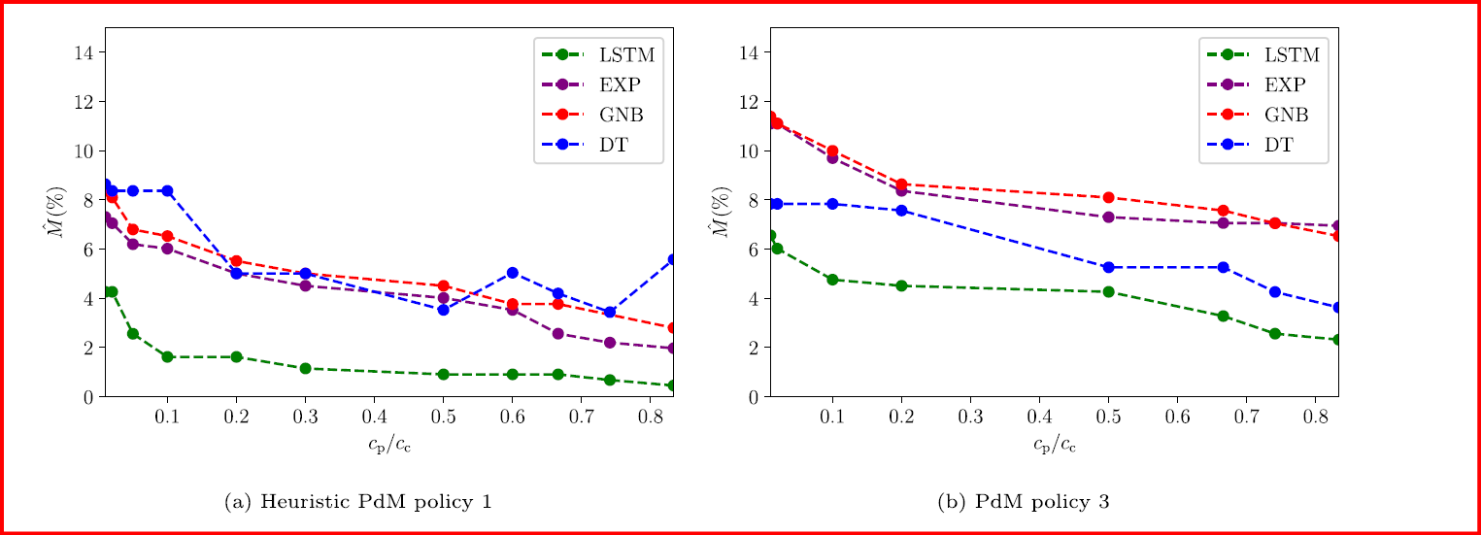
Decision Metric Plot

Slide 32
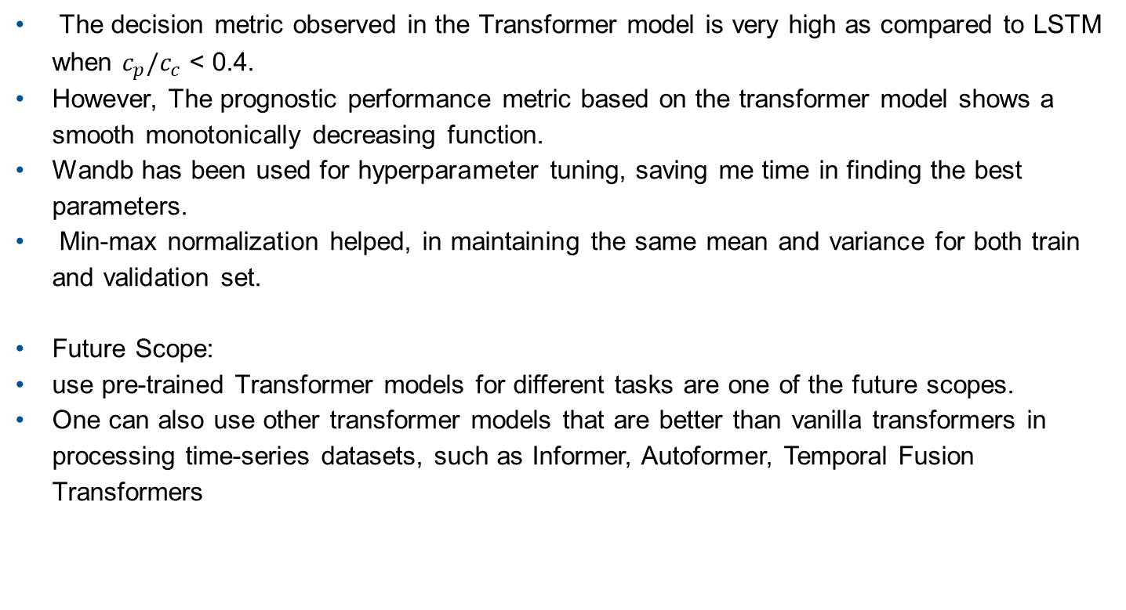
Conclusions
The decision metric observed in the Transformer model is very high as compared to LSTM when $c_{p}/c_{c}$ < 0.4.
However, The prognostic performance metric based on the transformer model shows a smooth monotonically decreasing function.
Wandb has been used for hyperparameter tuning, saving me time in finding the best parameters.
Min-max normalization helped, in maintaining the same mean and variance for both train and validation set.
Future Scope:
use pre-trained Transformer models for different tasks are one of the future scopes.
One can also use other transformer models that are better than vanilla transformers in processing time-series datasets, such as Informer, Autoformer, Temporal Fusion Transformers
Notes:
Metric M is testing prognostic algorithms with respect to how well it can predict the exact RUL.
Two heuristic thresholds have been used which were optimized on the training set using the LSTM model.
Key differences from vanilla transformers:
Specialized positional encodings for time
Mechanisms to handle longer sequences efficiently
Incorporation of time-specific features and patterns
Adaptations to output distributions rather than point estimates
Ability to handle multivariate time series data
The heuristic thresholds I used were optimized using LSTM model, which is one of the possible reasons for the poor performance of the Transformer model.

Slide 33
References
Lei Y, Li N, Guo L, Li N, Yan T, Lin J. Machinery health prognostics: A´systematic review from data acquisition to RUL prediction. Mech Syst Signal Process 2018;104:799–834.
Kamariotis, Antonios, Konstantinos Tatsis, Eleni Chatzi, Kai Goebel, and Daniel Straub (2024a).“A metric for assessing and optimizing data-driven prognostic algorithms for predictive maintenance”. In: Reliability Engineering & System Safety 242, p. 109723
Nguyen KT, Medjaher K. A new dynamic predictive maintenance framework using deep learning for failure prognostics. Reliab Eng Syst Saf 2019;188:251–62.
Snoek, Jasper, Hugo Larochelle, and Ryan P Adams (2012). “Practical Bayesian optimization of machine learning algorithms”. In: Advances in neural information processing systems 25.
Vaswani, A (2017). “Attention is all you need”. In: Advances in Neural Information Processing Systems.

