Slide 1

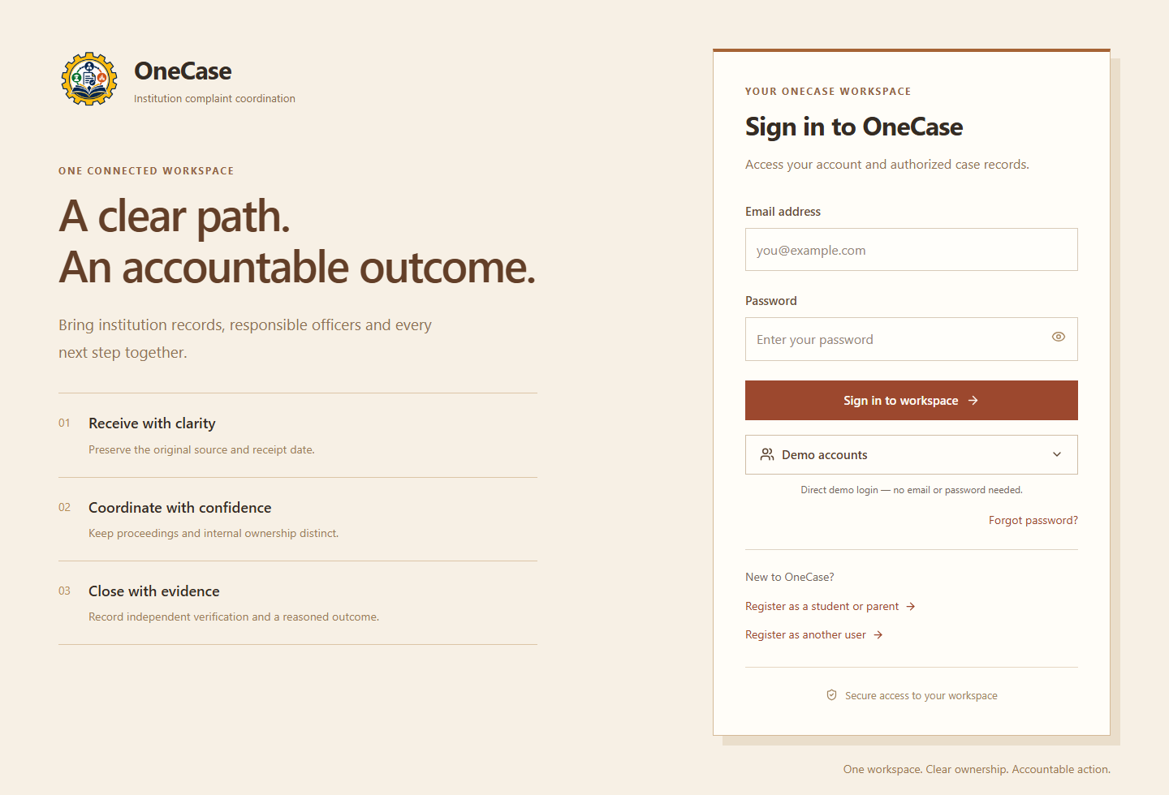
ONECASE
TEAM MODEST
A connected workspace for institution-related complaints
Coordinate ownership, proceedings, evidence and outcomes across AICTE bureaus and cells.
Complaint
intake
Accountable
ownership
Proceeding
records
Semantic
overlap review
Deadline
monitoring
Evidence &
closure PDFs
COMPLAINT JOURNEY
Register → assign → coordinate → verify → communicate → close
WHO USES IT
Students, parents, faculty, staff and other stakeholders; approved officers, leads, reviewers and appointed participants.
Original receipt, source, ownership and action history stay connected.
Live: sih-solution-kappa.vercel.app
MODEST | ONECASE | SIH26264
01
Notes:
OneCase overview and complaint journey. The application preserves source/receipt, next action, transfer acknowledgements and original complaints. Public users see their own authorized records. Staff registration requests access rather than granting privileges. Team MODEST is user-supplied. This is a team prototype, not an official AICTE service or endorsement. The provided live link reached sign-in after waking during review.
OneCase is a working complaint-coordination application. SIH26264 is the project problem-statement identifier supplied in project requirements; this is a team prototype, not an official AICTE service or endorsement. Public intake, staff access requests and synthetic demo roles are implemented. The live sign-in page was reached after a cold start during this review.
Implementation evidence (working tree reviewed 28 October 2026):
• backend/app/intake.py: submit, intake_owner
• backend/app/api.py: detail, transfer, add_action
• frontend/src/App.tsx
• frontend/src/features/ComplaintIntake.tsx
Website: https://sih-solution-kappa.vercel.app/
Repository: https://github.com/jitendrachoudhary1401-hue/SIH-Solution
Screenshots use disposable local synthetic records. They are actual application screens, not design mockups.
Stakeholders can register and submit their own complaints, choose an institution, retain source information, upload proof and track the authorized timeline. New staff registrations request access rather than granting staff privileges. Administrators approve accounts and assign bounded access. Intake requires a configured accountable officer or remains in an inactive intake queue for assignment. Transfers preserve the original receipt and deadlines. Closure requires an available outcome document and recorded communication. A report snapshot is frozen; the record can be reopened through an authorized transition.
Implementation evidence (working tree reviewed 28 October 2026):
• backend/app/intake.py
• backend/app/api.py: signup, upload, transfer, change_status
• backend/app/complaint_reports.py
• frontend/src/features/Registration.tsx
• frontend/src/features/ComplaintRecord.tsx
Website: https://sih-solution-kappa.vercel.app/
Repository: https://github.com/jitendrachoudhary1401-hue/SIH-Solution
Screenshots use disposable local synthetic records. They are actual application screens, not design mockups.
Implementation evidence (working tree reviewed 28 October 2026):
• backend/app/intake.py
• backend/app/api.py
• frontend/src/features/Registration.tsx
• frontend/src/features/ComplaintRecord.tsx
Website: https://sih-solution-kappa.vercel.app/
Repository: https://github.com/jitendrachoudhary1401-hue/SIH-Solution
Screenshots use disposable local synthetic records. They are actual application screens, not design mockups.

Slide 2
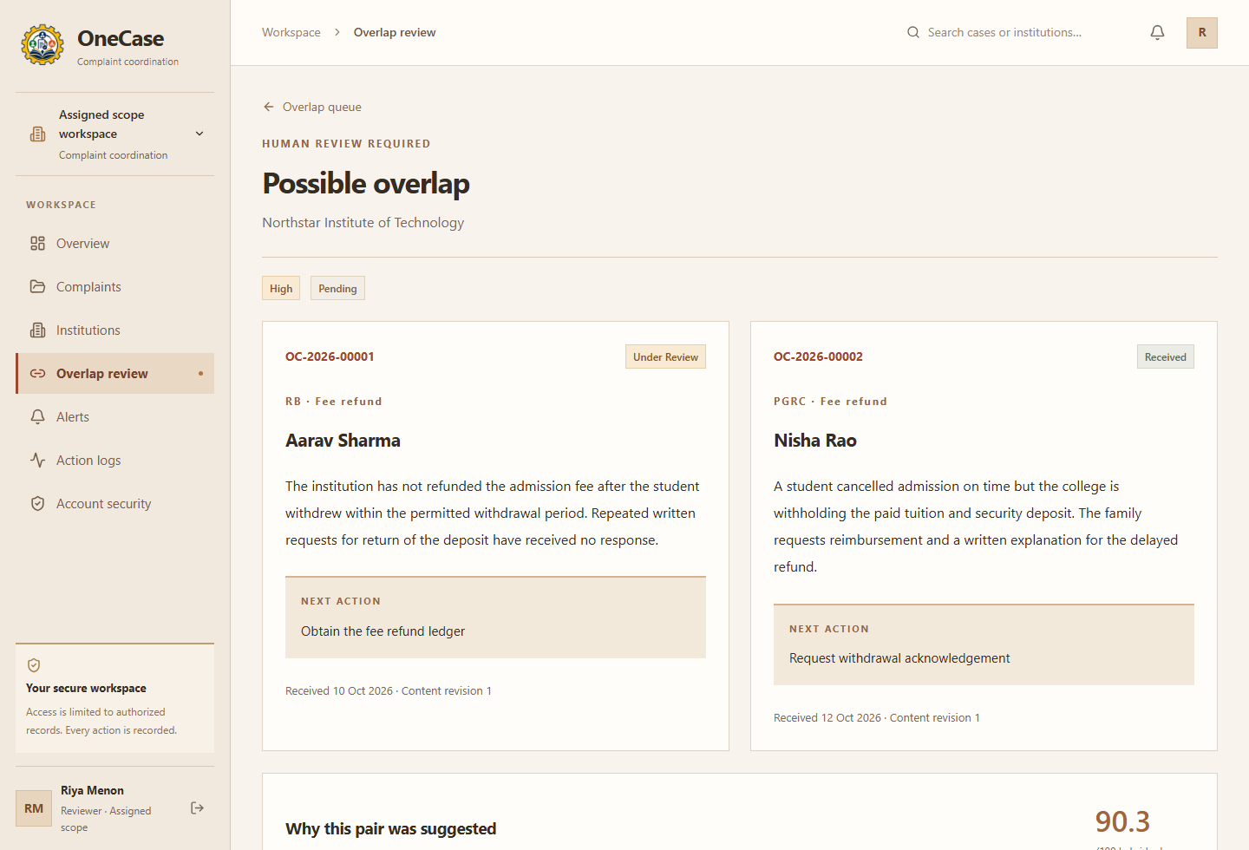
TECHNICAL APPROACH
TEAM MODEST
FRONTEND · VERCEL
Browser → Vercel proxy → Render API
React + TypeScript + Vite
LOCAL AI: DESCRIPTION-LEVEL OVERLAP REVIEW
API · RENDER
Flask + SQLAlchemy + Waitress
Normalize
MiniLM
embeddings
Retrieve
top 20
Cross-encoder
rerank
Human
review
PERSISTENCE · NEON
Bounded candidates
PostgreSQL + private S3 bucket
Match within the same verified institution. Original complaints stay separate.
BACKGROUND WORKER
Local models + reminders
Signals, not decisions
Similarity, reranker output and category support triage; scores are not probabilities.
SUPPORTING SERVICES
Redis limits; SendGrid email
Pinned models run locally. Revision changes invalidate stale decisions.
Actual model output; synthetic complaints
API and worker share database/private storage; service credentials stay server-side.
MODEST | ONECASE | SIH26264
02
Notes:
This diagram reflects current source rather than the older Express/MongoDB roadmap. The Vercel function only proxies API traffic and forwards the existing shared proxy credential server-side. Core services run on Render. Models load locally in the separate worker with pinned revisions; no hosted LLM is required. PostgreSQL is required by production startup checks, while local synthetic checks use SQLite. Neon bucket configuration is private, server-only. Redis is rate-limit storage, not an inference service. SendGrid is used for password-reset delivery. Provisioning and deployment configuration still determine whether each service is available.
Implementation evidence (working tree reviewed 28 October 2026):
• frontend/api/proxy.js
• frontend/vercel.json
• backend/render.yaml
• backend/serve.py
• backend/worker.py
• backend/app/__init__.py
• backend/app/storage.py
• backend/app/rate_limits.py
• backend/app/mail.py
Website: https://sih-solution-kappa.vercel.app/
Repository: https://github.com/jitendrachoudhary1401-hue/SIH-Solution
Screenshots use disposable local synthetic records. They are actual application screens, not design mockups.
Source model identifiers: sentence-transformers/all-MiniLM-L6-v2 and cross-encoder/ms-marco-MiniLM-L6-v2, with committed revision hashes. Normalization strips markup and masks common email/phone patterns. Candidate comparisons are restricted to the same verified institution. Top-k is 20; default weights are 0.35 semantic, 0.55 reranker and 0.10 category. These are explicitly unvalidated demo weights, not probabilities. Truncation and model versions are recorded. Content revisions invalidate stale decisions. The current matcher operates on complaint descriptions; comprehensive issue-level matching and multilingual/domain accuracy benchmarks are not implemented. No automatic merging or AI adjudication occurs.
Research: https://aclanthology.org/D19-1410/
https://sbert.net/examples/sentence_transformer/applications/retrieve_rerank/README.html
Implementation evidence (working tree reviewed 28 October 2026):
• backend/app/matching.py
• backend/model-bundle.json
• backend/app/api.py: review, retry_matching
• frontend/src/App.tsx: OverlapDetail
Website: https://sih-solution-kappa.vercel.app/
Repository: https://github.com/jitendrachoudhary1401-hue/SIH-Solution
Screenshots use disposable local synthetic records. They are actual application screens, not design mockups.
Implementation evidence (working tree reviewed 28 October 2026):
• frontend/api/proxy.js
• backend/render.yaml
• backend/worker.py
• backend/app/storage.py
• backend/app/matching.py
• backend/model-bundle.json
Website: https://sih-solution-kappa.vercel.app/
Repository: https://github.com/jitendrachoudhary1401-hue/SIH-Solution
Screenshots use disposable local synthetic records. They are actual application screens, not design mockups.

Slide 3
FEASIBILITY AND VIABILITY
TEAM MODEST
IMPLEMENTED WORKFLOWS
SECURITY IN THE CODE
Public intake, ownership/transfers, action history, deadline policies, proceeding records, institution review and closure reports.
Authentication
Argon2, hashed sessions, MFA and one-time recovery codes.
Authorization
DEPLOYMENT REALITY
Case/document/field scope, expiring grants and conflict denial.
Vercel frontend; Render API and separate worker. Free API can sleep; the wake flow waits up to 90 seconds. Worker/model compute needs separate resources.
Request protection
CSRF, shared proxy secret and rate limits.
VALIDATION STILL REQUIRED
Private evidence
Neon storage, SHA-256 checksums, file limits and bounded parsing.
Domain accuracy, multilingual performance, load/uptime benchmarks and live configuration. No measured savings or certification is claimed.
Antivirus bypass active
Unscanned files; parser and access checks remain. Malware protection is reduced.
The wake flow runs on visits; it does not make Render Free an always-on service.
MODEST | ONECASE | SIH26264
03
Notes:
The code implements server-side CSRF checks, HTTPS-cookie requirements in production, Argon2 hashing, opaque hashed sessions, secret encryption for MFA, recovery codes and recent-authentication gates. First-time non-demo privileged users must enroll MFA before workspace access. Scope is checked on case and document requests and field serialization redacts history. The current Render Blueprint explicitly sets MALWARE_SCAN_ENABLED=false at the user's request. New bypassed uploads still undergo signature/extension/size checks and bounded parsing; they are stored as unscanned, not clean. Rejected files remain blocked. Enabling scanning again blocks unscanned evidence pending worker scanning. This is not a security certification or a statement that the live host's configuration has been independently audited.
Security reference: https://cheatsheetseries.owasp.org/cheatsheets/Authorization_Cheat_Sheet.html
Implementation evidence (working tree reviewed 28 October 2026):
• backend/app/auth.py
• backend/app/security.py
• backend/app/documents.py
• backend/app/storage.py
• backend/app/api.py: upload, download
• backend/render.yaml
• frontend/src/features/MfaEnrollment.tsx
Website: https://sih-solution-kappa.vercel.app/
Repository: https://github.com/jitendrachoudhary1401-hue/SIH-Solution
Screenshots use disposable local synthetic records. They are actual application screens, not design mockups.
Feasibility claims describe implemented components, not measured production uptime or user adoption. Render Free currently documents an idle spin-down after 15 minutes and a cold start of about a minute. GET /api/wake is public liveness without database/Redis/model work; /api/health still checks database readiness. Initial browser startup retries temporary wake failures for up to 90 seconds and never replays mutations. Signed-out sessions remain subject to revocation. No new environment key was introduced for wake-up. Worker hosting remains separate and is paid in the current Blueprint. The removed scanner is not provisioned by current YAML; existing cloud resources are not automatically deleted by local code edits.
Hosting source: https://render.com/docs/free
Implementation evidence (working tree reviewed 28 October 2026):
• backend/app/__init__.py: wake, health
• backend/app/rate_limits.py
• frontend/src/lib/api.ts: wakeBackend
• frontend/src/features/BackendStarting.tsx
• backend/render.yaml
Website: https://sih-solution-kappa.vercel.app/
Repository: https://github.com/jitendrachoudhary1401-hue/SIH-Solution
Screenshots use disposable local synthetic records. They are actual application screens, not design mockups.
Implementation evidence (working tree reviewed 28 October 2026):
• backend/app/auth.py
• backend/app/security.py
• backend/app/documents.py
• backend/app/__init__.py
• frontend/src/lib/api.ts
• backend/render.yaml
Website: https://sih-solution-kappa.vercel.app/
Repository: https://github.com/jitendrachoudhary1401-hue/SIH-Solution
Screenshots use disposable local synthetic records. They are actual application screens, not design mockups.

Slide 4
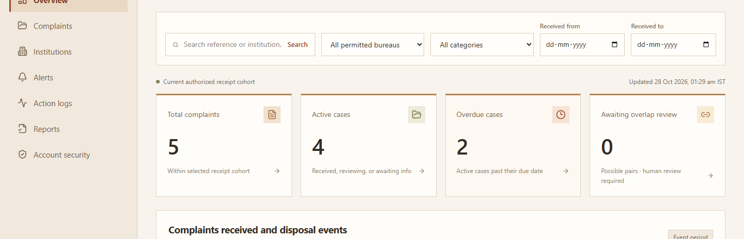
IMPACT AND BENEFITS
TEAM MODEST
Expected benefits: clearer ownership, traceable decisions and fewer disconnected case records
Complainants
PROCEEDINGS AND VERIFIED CLOSURE
One reference, authorized tracking and closure PDFs.
Route authority → appoint → record milestones → independently verify compliance → record dispatch/acknowledgement → communicate outcome → freeze PDF
Officers and bureau leads
Owners, transfers, next actions and deadline reminders.
Reviewers and committees
Related-case suggestions and bounded proceeding access.
Administrators and monitoring roles
Approved access, institution review, scoped totals and CSV reports.
Implemented: access administration, scoped reports and browser install metadata.
Next: bulk CSV import, official registry integration, issue-level matching and domain/load benchmarks.
MODEST | ONECASE | SIH26264
04
Notes:
Workflow routes support different proceeding kinds rather than treating every complaint as one legally interchangeable path. The code records authority, records, milestone policy snapshots, notices/orders, compliance submissions and independent verifications. A respondent cannot verify its own compliance; disposition checks outstanding obligations. Prepared packets are distinct from actual external dispatch and acknowledgement. An internal complaint can be administratively disposed while recorded external proceedings continue. Existing records are not silently rewritten; corrections and timeline events retain history. Closure PDFs freeze a snapshot with timestamps, evidence metadata and scan state; they do not cryptographically prove database immutability. The screenshot shows the actual proceeding interface with synthetic data, not a claim of any real external filing.
Implementation evidence (working tree reviewed 28 October 2026):
• backend/app/workflow.py
• backend/app/complaint_reports.py
• backend/app/models.py
• frontend/src/features/WorkflowPanel.tsx
Website: https://sih-solution-kappa.vercel.app/
Repository: https://github.com/jitendrachoudhary1401-hue/SIH-Solution
Screenshots use disposable local synthetic records. They are actual application screens, not design mockups.
The expected benefits are design inferences from the implemented workflow. No user study, quantified savings, institutional adoption, accuracy benchmark or proven SLA improvement is asserted. The dashboard tracks scoped totals, case ageing, overdue records, matching states, attention lists and recent history. CSV and cohort reports are implemented with authorization. Aggregated monitoring access is separate from detailed case/document access. The current dashboard uses request/refetch behavior, not a claimed realtime subscription system.
Implementation evidence (working tree reviewed 28 October 2026):
• backend/app/api.py: dashboard, report_metrics, export
• backend/app/auth.py: scope, has_content
• backend/app/jobs.py: monitor
• frontend/src/App.tsx: Dashboard, Reports
Website: https://sih-solution-kappa.vercel.app/
Repository: https://github.com/jitendrachoudhary1401-hue/SIH-Solution
Screenshots use disposable local synthetic records. They are actual application screens, not design mockups.
The status table follows source inspection, not README assertions alone. The older roadmap's Express/MongoDB stack has not been used to describe the current app. Existing normalized issue/person tables do not imply a completed issue-level matcher. Administrative institution verification is manual and approved; an official registry integration is absent. CSV export exists; a staged bulk CSV importer does not. The app includes a manifest and a native browser install button when the browser offers installation, with no private offline-cache claim. Deployed secrets, sender verification, workers, resource memory, database/bucket policies, backups, production uptime and scanner provisioning remain operational prerequisites. The live frontend was observed waking and reaching sign-in; this does not verify every production feature.
Implementation evidence (working tree reviewed 28 October 2026):
• backend/app/api.py
• backend/app/workflow.py
• backend/app/administration.py
• backend/app/matching.py
• backend/app/documents.py
• frontend/public/manifest.webmanifest
• frontend/src/components/InstallApp.tsx
• backend/render.yaml
Website: https://sih-solution-kappa.vercel.app/
Repository: https://github.com/jitendrachoudhary1401-hue/SIH-Solution
Screenshots use disposable local synthetic records. They are actual application screens, not design mockups.
Screenshot is the actual local website using synthetic records. Benefits remain expected, not measured. Prepared packets do not prove external filing. Administrative disposal does not automatically end external proceedings. Browser installation depends on the browser offering a native prompt; no private offline cache is claimed.
Implementation evidence (working tree reviewed 28 October 2026):
• backend/app/workflow.py
• backend/app/complaint_reports.py
• backend/app/api.py: dashboard, export, report_metrics
• backend/app/administration.py
• frontend/public/manifest.webmanifest
Website: https://sih-solution-kappa.vercel.app/
Repository: https://github.com/jitendrachoudhary1401-hue/SIH-Solution
Screenshots use disposable local synthetic records. They are actual application screens, not design mockups.

Slide 5
RESEARCH AND REFERENCES
TEAM MODEST
Research | Summary | Limitation | Implements
Grievance routes [1] AICTE Handbook 2024–27 | SGRC and Ombudsperson provide staged grievance redressal. | Student grievance rules do not cover every institution-case workflow. | Proceeding routes with authority records and milestones.
Ownership and routing [2] DARPG guidelines 2024 | Integrated handling needs nodal officers and departmental coordination. | A transfer needs a clear recipient and acknowledgement of receipt. | Accountable owner, next action and acknowledged transfers.
Delay and closure [3] CPGRAMS review 2024 | Timely redressal requires escalation and attention to citizen feedback. | A disposed status alone cannot establish verified, communicated closure. | Deadline alerts, independent compliance checks and closure PDFs.
Grievance patterns [4] IGMS 2.0 2023 | Grievance analytics helps officials investigate underlying causes. | Shared wording or institution does not establish a duplicate complaint. | Institution grouping, overlap suggestions and human review.
Limitations describe coordination needs, not audited failures. Implements lists features verified in OneCase.
[1] AICTE Approval Process Handbook 2024–27
[2] DARPG grievance guidelines, 26 Aug 2024
[3] CPGRAMS redressal review, 11 Dec 2024
[4] IGMS 2.0 launch, 11 Oct 2023
MODEST | ONECASE | SIH26264
05
Notes:
Problem-focused research and references. Sources accessed 28 October 2026.
[1] AICTE Approval Process Handbook 2024–27, student grievance redressal provisions. https://fliphtml5.com/jfjx/zbte/APH-2024-27/ The handbook describes institution SGRC and Ombudsperson routes. It supplies sector context rather than a complete specification for every AICTE bureau case. OneCase proceeding routes, authorities and milestone records are in backend/app/api.py and workflow services.
[2] DARPG, Comprehensive Guidelines for Handling Public Grievances, PIB, 26 August 2024. https://www.pib.gov.in/PressReleaseIframePage.aspx?PRID=2048939&lang=2&reg=48 Integrated handling, nodal officers and coordination support the ownership research row. The receipt/next-owner limitation is a design implication, not a claim that CPGRAMS lacks acknowledgement. OneCase records an accountable owner, next action, transfer and acknowledgement, with events in backend/app/api.py.
[3] Enhancing Complaint Redressal through CPGRAM, parliamentary answer, PIB, 11 December 2024. https://www.pib.gov.in/PressReleaseIframePage.aspx?PRID=2083263 The answer discusses escalation, closure guidelines and feedback. The need to verify communicated closure is a design implication. OneCase validates disposition and independent compliance in backend/app/workflow.py, monitors deadlines in backend/app/jobs.py and generates closure PDFs. CPGRAMS guidance is contextual research. No general CPGRAMS deadline is asserted as automatically applicable to every AICTE proceeding.
[4] IGMS 2.0 Public Grievance portal launch, PIB, 11 October 2023. https://www.pib.gov.in/Pressreleaseshare.aspx?PRID=1966498&lang=2&reg=48 The dashboard supports grievance analysis and root-cause investigation. The distinction between similar and duplicate complaints is a OneCase design constraint. backend/app/matching.py gates matches on verified institution identity and supplies overlap suggestions for human review. No automatic merge or domain accuracy claim is made.
Limitations describe scope and coordination needs inferred for this project. They are not audited failures of AICTE, DARPG or CPGRAMS. Implements identifies functionality present in the current code. Production configuration and deployment readiness are separate from code implementation.

