Slide 1
Data Science Capstone Project
Coursera IBM Data Science Capstone Project
Victor Pagan Rubio
vpaganrubio@gmail.com

Slide 2

Tourism Agency Activities

Slide 3
City Neighborhoods
PARIS
BRUSSELS
ROME
MADRID

Slide 4
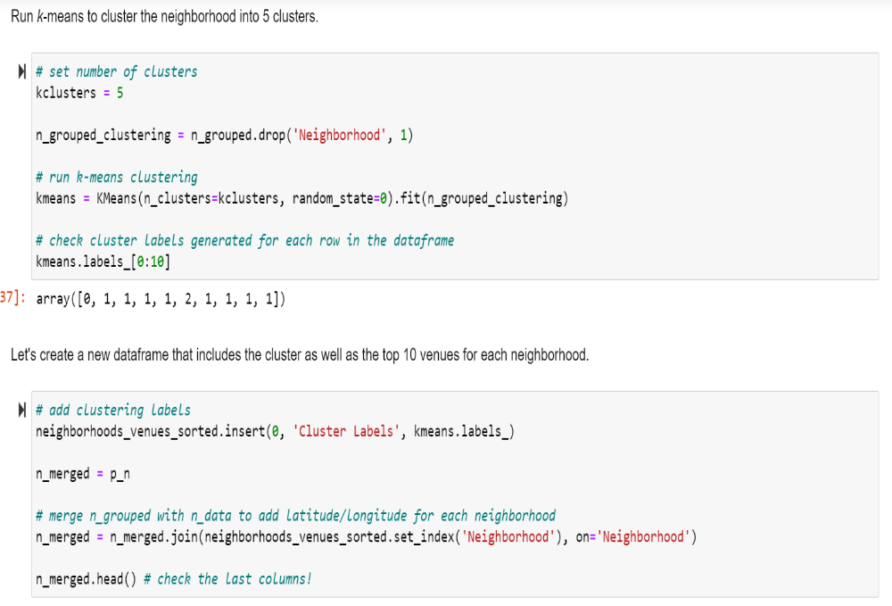
kMeans

Slide 5
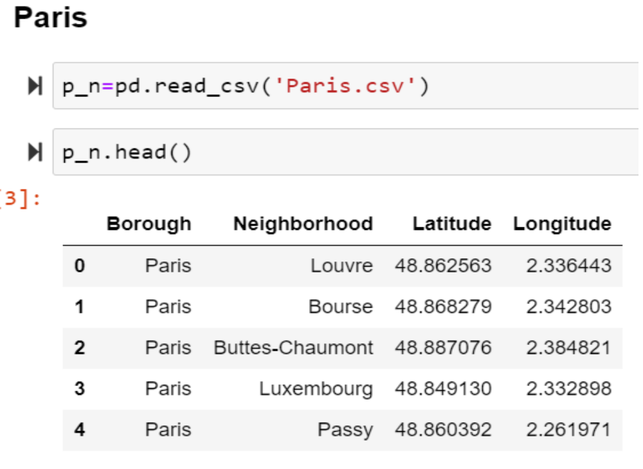
City, Neighborhood, Latitude, Longitude.

Slide 6
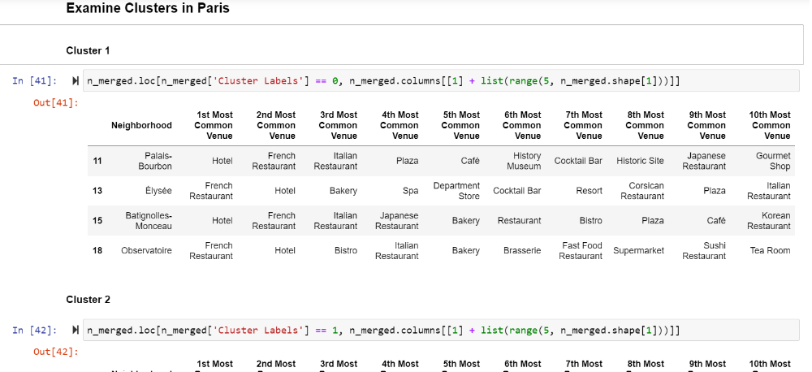
Kmeans Clusters

Slide 7
Unique Activities
CITY | Number of Unique Activites
PARIS | 204
BRUSSELS | 166
ROME | 80
MADRID | 132

Slide 8
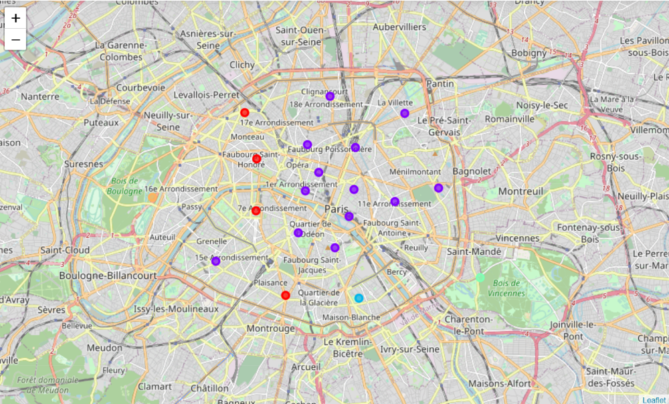
Neighborhood Clusters

