Slide 1
CQRS

Slide 2
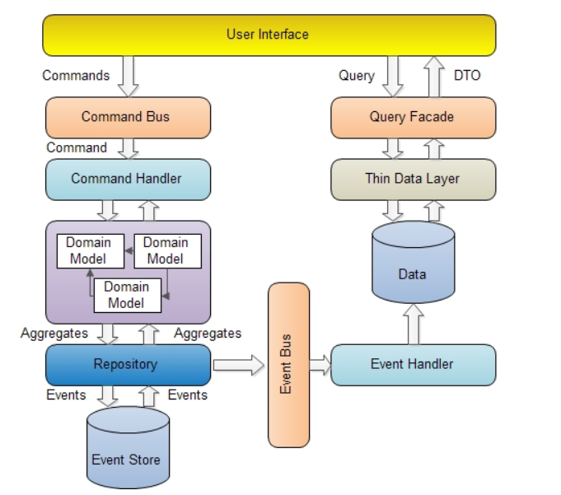
CQRS
https://www.codeproject.com/Articles/555855/Introduction-to-CQRS

Slide 3
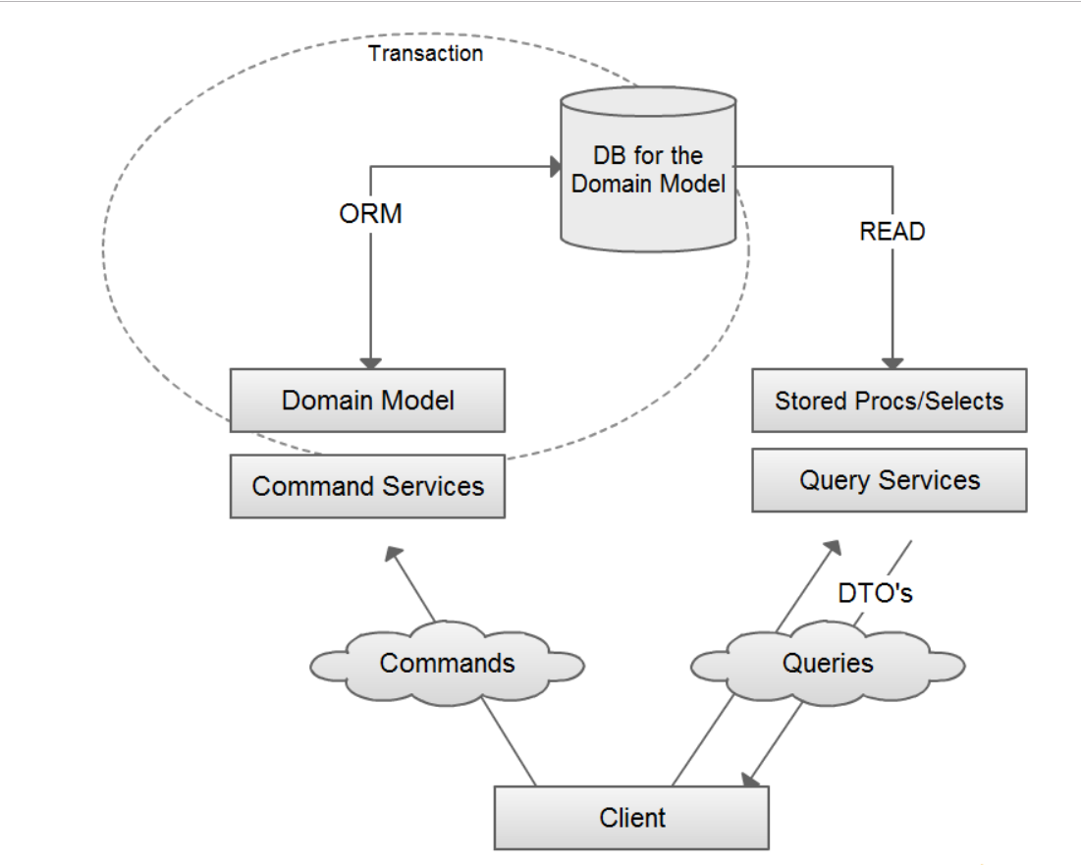
UML Diagram

Slide 4
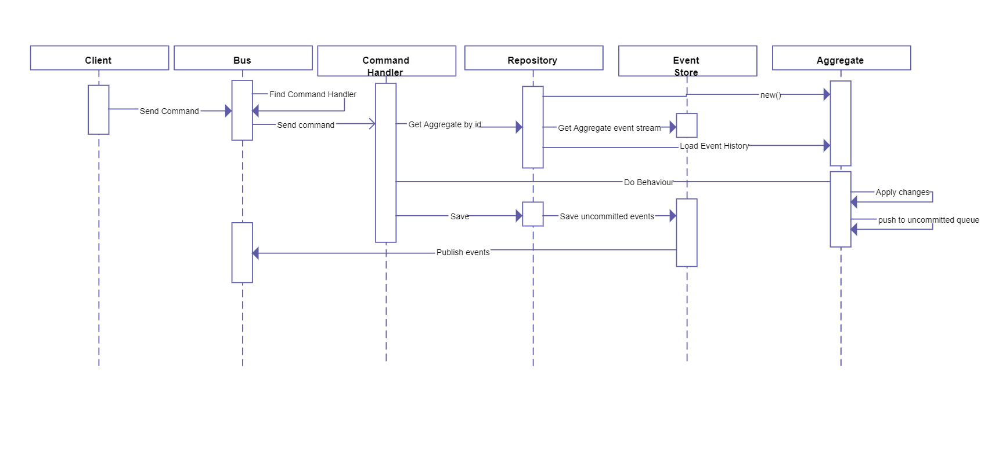
Sequential Diagram
It’s a pattern not the architecture.

Slide 5
Simple MVC
UI- MVC
Controller
View
Connect to DB and get the data
SQL DB

Slide 6
UI- MVC
Controller
View
Service Locator - Query
ViewBag.Model = ServiceLocator.ReportDatabase.GetItems();
Service Locator will manage all dependencies
private static IReportDatabase _reportDatabase;
x.For<IReportDatabase>().Use<ReportDatabase>();
public interface IReportDatabase
{
DiaryItemDto GetById(Guid id);
void Add(DiaryItemDto item);
void Delete(Guid id);
List<DiaryItemDto> GetItems();
}
public class ReportDatabase : IReportDatabase
{
public List<DiaryItemDto> GetItems()
{
return items;
}
}
static List<DiaryItemDto> items = new List<DiaryItemDto>();

Slide 7
UI- MVC
Controller
View
Service Locator - Add
ServiceLocator.CommandBus.Send(new CreateItemCommand(Guid.NewGuid(),item.Title,item.Description,-1,item.From,item.To));
CommandBus
private static ICommandBus _commandBus;
x.For<ICommandBus>().Use<CommandBus>();
x.For<ICommandHandlerFactory>().Use<StructureMapCommandHandlerFactory>();
public class CommandBus:ICommandBus
{
private readonly ICommandHandlerFactory _commandHandlerFactory;
public CommandBus(ICommandHandlerFactory commandHandlerFactory)
{
_commandHandlerFactory = commandHandlerFactory;
}
public void Send<T>(T command) where T : Command
{
var handler = _commandHandlerFactory.GetHandler<T>();
if (handler != null)
{
handler.Execute(command);
}
else
{
throw new UnregisteredDomainCommandException("no handler registered");
}
}
}
public class StructureMapCommandHandlerFactory : ICommandHandlerFactory
{
public ICommandHandler<T> GetHandler<T>() where T : Command
{
var handlers = GetHandlerTypes<T>().ToList();
var cmdHandler = handlers.Select(handler =>
(ICommandHandler<T>)ObjectFactory.GetInstance(handler)).FirstOrDefault();
return cmdHandler;
}
private IEnumerable<Type> GetHandlerTypes<T>() where T : Command
{
var handlers = typeof(ICommandHandler<>).Assembly.GetExportedTypes()
.Where(x => x.GetInterfaces()
.Any(a => a.IsGenericType && a.GetGenericTypeDefinition() == typeof(ICommandHandler<>) ))
.Where(h=>h.GetInterfaces()
.Any(ii=>ii.GetGenericArguments()
.Any(aa=>aa==typeof(T)))).ToList();
return handlers;
}
}

Slide 8
public interface ICommand
{
Guid Id { get; }
}
public class CreateItemCommand:Command
{
public string Title { get; internal set; }
public string Description { get;internal set; }
public DateTime From { get; internal set; }
public DateTime To { get; internal set; }
public CreateItemCommand(Guid aggregateId, string title,
string description,int version,DateTime from, DateTime to)
: base(aggregateId,version)
{
Title = title;
Description = description;
From = from;
To = to;
}
}
public class CreateItemCommandHandler : ICommandHandler<CreateItemCommand>
{
private IRepository<DiaryItem> _repository;
public CreateItemCommandHandler(IRepository<DiaryItem> repository)
{
_repository = repository;
}
public void Execute(CreateItemCommand command)
{
if (command == null)
{
throw new ArgumentNullException("command");
}
if (_repository == null)
{
throw new InvalidOperationException("Repository is not initialized.");
}
var aggregate = new DiaryItem(command.Id, command.Title, command.Description, command.From, command.To);
aggregate.Version = -1;
_repository.Save(aggregate, aggregate.Version);
}
}
[Serializable]
public class Command : ICommand
{
public Guid Id { get; private set; }
public int Version { get; private set; }
public Command(Guid id,int version)
{
Id = id;
Version = version;
}
}

Slide 9
Facts
Commands - change the state of an object or entire system (sometimes called as modifiers or mutators).
Queries - return results and do not change the state of an object.

