Slide 1
CQRS

Slide 2
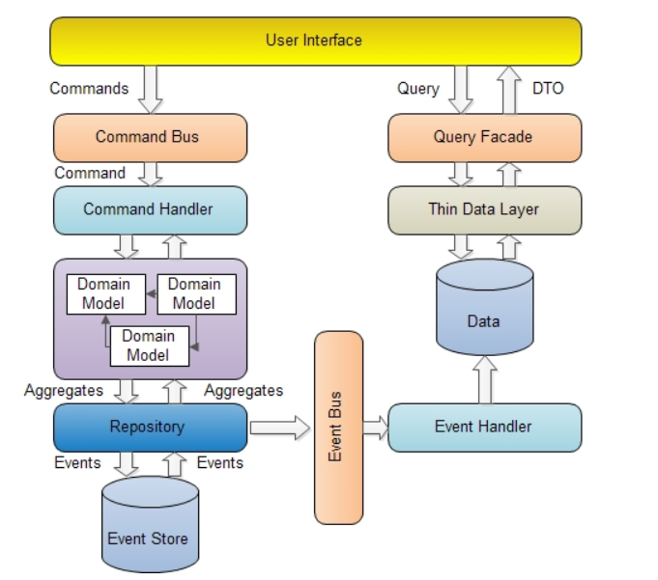
CQRS
https://www.codeproject.com/Articles/555855/Introduction-to-CQRS

Slide 3
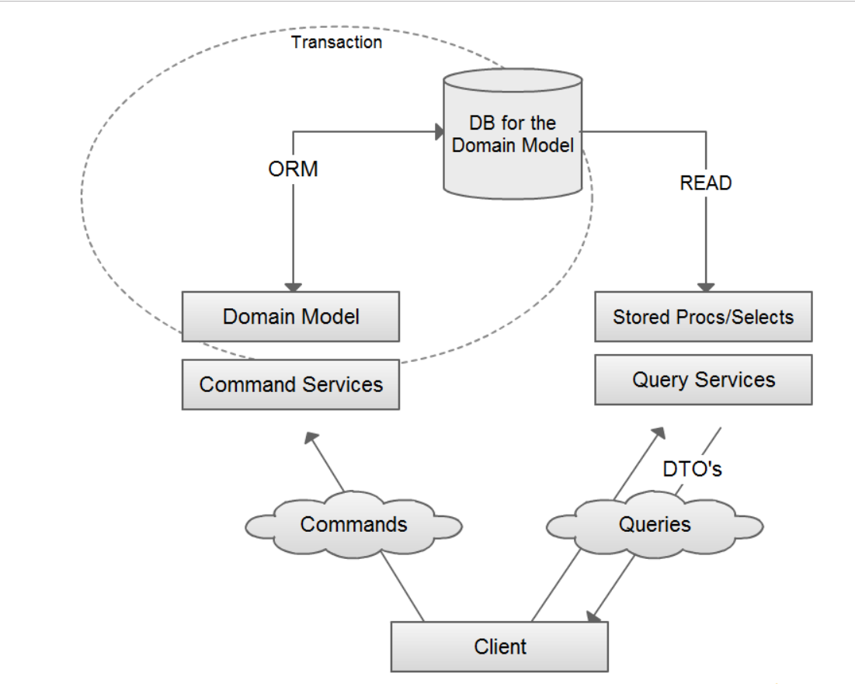
UML Diagram

Slide 4
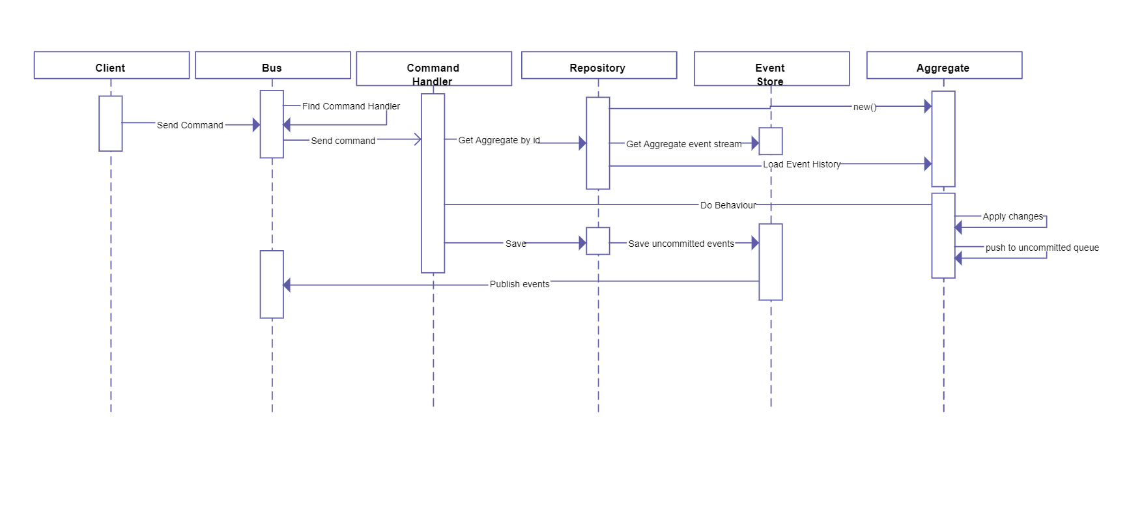
Sequential Diagram
It’s a pattern not the architecture.

Slide 5
Facts
It’s a pattern not the architecture.

Slide 6
Facts
Commands - change the state of an object or entire system (sometimes called as modifiers or mutators).
Queries - return results and do not change the state of an object.

