Slide 1
Linux
By
Jitendra Singh Tomar || Jeetu

Slide 2
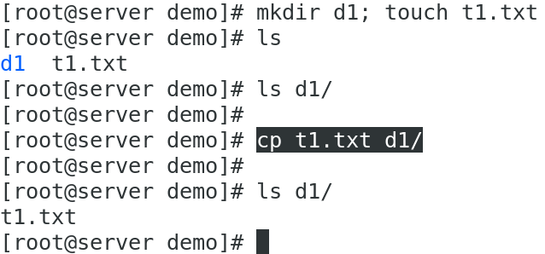
COPY
Command: “cp”
Usage: Copy files & folders.
Syntax: # cp <source-path> <destination-path>

Slide 3
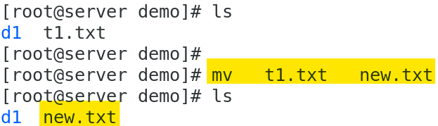
MOVE - Rename
Command: “mv”
Usage: Move & Rename files & directory
Syntax for moving file : mv <source> <destination>
Syntax for renaming: mv <old-name> <new-name>

Slide 4
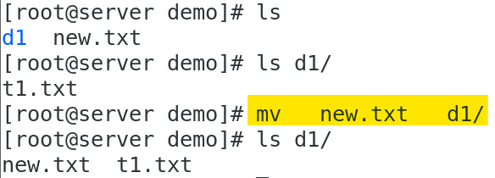
MOVE – Moving file

Slide 5

“.” & “..” in linux

Slide 6
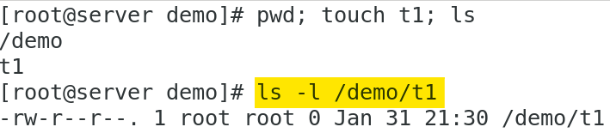
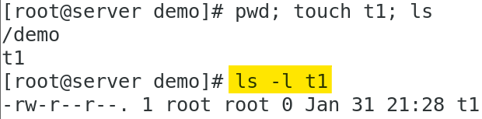
Path
Absolute path
An absolute path is the location of a file or directory specified from the root directory.
Relative path
Do not start with the root directory and are usually shorter than absolute paths

Slide 7
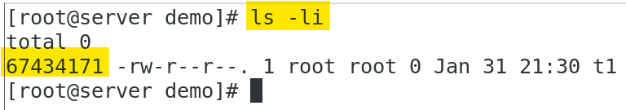
INODE
An Inode number is a uniquely existing number for all the files in Linux and all Unix type systems.
When a file is created on a system, a file name and Inode number is assigned to it.
Generally, to access a file, a user uses the file name but internally file name is first mapped with respective Inode number stored in a table.

Slide 8
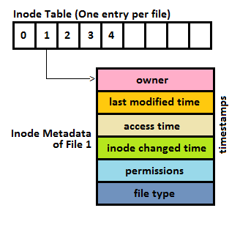
Inode Contents
User ID of file
Group ID of file
Device ID
File size
Date of creation
Permission
Owner of the file
File protection flag
Link counter to determine number of hard links

Slide 9

Linux File System

Slide 10
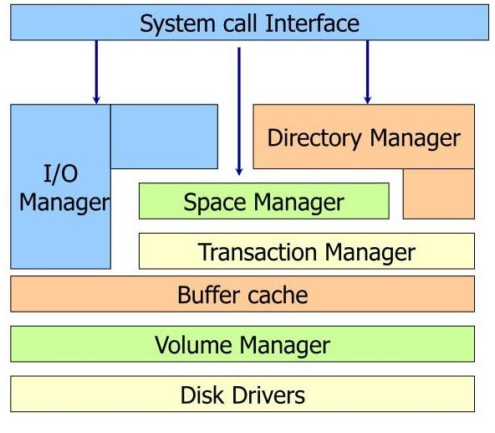
Partitioning file systems - XFS

Slide 11
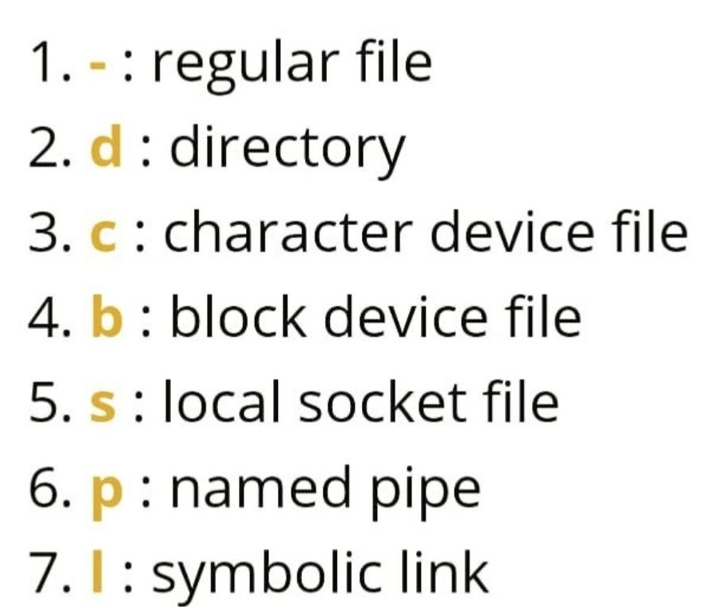
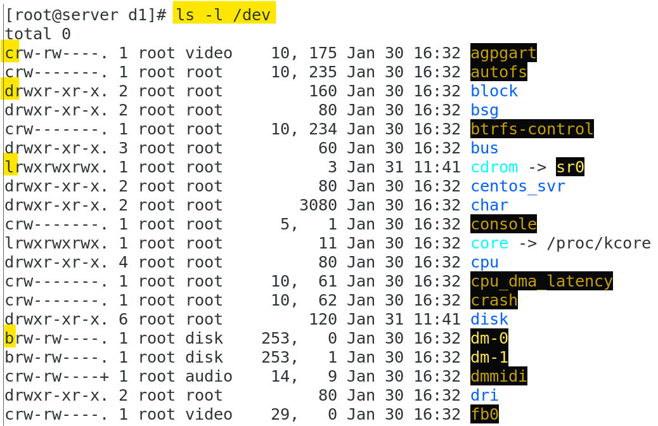
Fundamental file types

Slide 12
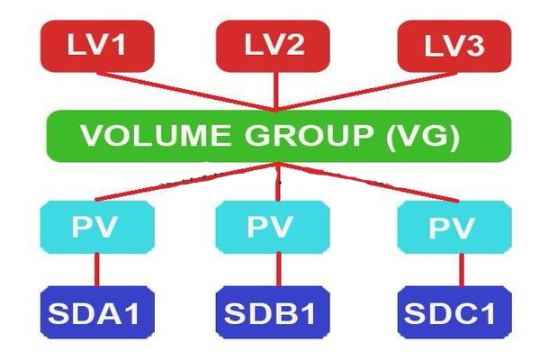
Logical Volume Manager

Slide 13
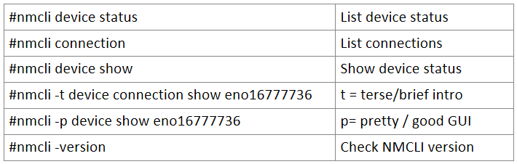
NMCLI
Network Manager Command Line Interface
NMCLI id used for creating, configuring and managing NIC card.

Slide 14
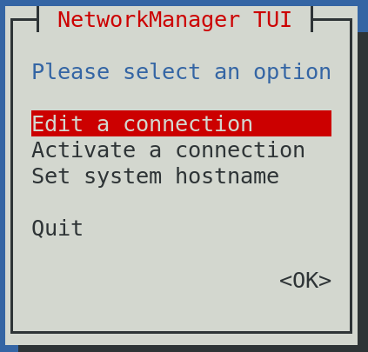
NMTUI
Network Manager Text User Interface.
The NMTUI utility is part of the NetworkManager package.

