Slide 1

Descriptive statistics
By Jiten Sahoo

Slide 2




What is Statistics
Study of the collection, analysis, interpretation, presentation, and organization of data
two important and basic ideas involved in statistics are uncertainty and variation.

Slide 3
Types of Statistics
Basically, there are two types of statistics.
1.Descriptive Statistics
2. Inferential Statistics

Slide 4
Descriptive Statistics
Descriptive statistics are brief informational coefficients that summarize a given data set, which can be either a representation of the entire population or a sample of a population. Descriptive statistics are broken down into measures of central tendency and measures of variability (spread). Measures of central tendency include the mean, median, and mode, while measures of variability include standard deviation, variance, minimum and maximum variables, kurtosis, and skewness.
It is describing the features of a data set by generating summaries about data samples. It's often depicted as a summary of data shown that explains the contents of data.
e.g Population census

Slide 5
What Is the Main Purpose of Descriptive Statistics?
The main purpose of descriptive statistics is to provide information about a data set.
For example , there are hundreds of baseballs players that engage in thousands of games. Descriptive statistics summarizes the large amount of data into several useful bits of information.

Slide 6
Types of Descriptive Statistics
All descriptive statistics are either measures of central tendency or measures of variability, also known as measures of dispersion.
1- Central Tendency
2- Measure of Variability

Slide 7
Central Tendency
Measures of central tendency focus on the average or middle values of data sets, whereas measures of variability focus on the dispersion of data. These two measures use graphs, tables and general discussions to help people understand the meaning of the analyzed data.
Measures of central tendency describe the center position of a distribution for a data set. A person analyzes the frequency of each data point in the distribution and describes it using the mean, median, or mode, which measures the most common patterns of the analyzed data set.

Slide 8
Mean ,Median & Mode
Mean is the most commonly used measure of central tendency. It actually represents the average of the given collection of data. It is applicable for both continuous and discrete data.
Median represents the mid-value of the given set of data when arranged in a particular order.
The most frequent number occurring in the data set is known as the mode.

Slide 9
Measures of Variability
Measures of variability (or the measures of spread) aid in analyzing how dispersed the distribution is for a set of data. For example, while the measures of central tendency may give a person the average of a data set, it does not describe how the data is distributed within the set.
So while the average of the data maybe 65 out of 100, there can still be data points at both 1 and 100. Measures of variability help communicate this by describing the shape and spread of the data set. Range, quartiles, absolute deviation, and variance are all examples of measures of variability.

Slide 10
Distribution
Distribution (or frequency distribution) refers to the quantity of times a data point occurs. Alternatively, it is the measurement of a data point failing to occur. Consider a data set: male, male, female, female, female, other. The distribution of this data can be classified as:
The number of males in the data set is 2.
The number of females in the data set is 3.
The number of individuals identifying as other is 1.
The number of non-males is 4.

Slide 11
Univariate vs. Bivariate
For example, imagine a room full of high school students. Say you wanted to gather the average age of the individuals in the room. This univariate data is only dependent on one factor: each person's age. By gathering this one piece of information from each person and dividing by the total number of people, you can determine the average age.
Let's say each high school student in the example above takes a college assessment test, and we want to see whether older students are testing better than younger students. In addition to gathering the age of the students, we need to gather each student's test score. Then, using data analytics, we mathematically or graphically depict whether there is a relationship between student age and test scores.

Slide 12
Variance
The term variance refers to a statistical measurement of the spread between numbers in a data set. More specifically, variance measures how far each number in the set is from the mean (average), and thus from every other number in the set. Variance is often depicted by this symbol: σ². It is used by both analysts and traders to determine volatility and market security.
Key points :
Variance is a measurement of the spread between numbers in a data set.
It measures the degree of dispersion of data around the sample's mean.
Investors use variance to see how much risk an investment carries and whether it will be profitable.
Variance is also used in finance to compare the relative performance of each asset in a portfolio to achieve the best asset allocation.
The square root of the variance is the standard deviation.

Slide 13

Variance calculation

Slide 14
Steps
Calculate the mean of the data.
Find each data point's difference from the mean value.
Square each of these values.
Add up all of the squared values.
Divide this sum of squares by n – 1 (for a sample) or N (for the population).

Slide 15
Standard deviation
Standard Deviation is a measure which shows how much variation (such as spread, dispersion, spread,) from the mean exists. The standard deviation indicates a “typical” deviation from the mean. It is a popular measure of variability because it returns to the original units of measure of the data set. Like the variance, if the data points are close to the mean, there is a small variation whereas the data points are highly spread out from the mean, then it has a high variance. Standard deviation calculates the extent to which the values differ from the average. Standard Deviation, the most widely used measure of dispersion, is based on all values. Therefore a change in even one value affects the value of standard deviation. It is independent of origin but not of scale. It is also useful in certain advanced statistical problems.
It is calculated by taking square root of Variance.

Slide 16
Calculate using Numpy and simple function
A=np.array([2,3,4,5,6,7])
np.std(A)
np.var(A)

Slide 17
Covariance
covariance is a measure of the relationship between two random variables. The metric evaluates how much – to what extent – the variables change together. In other words, it is essentially a measure of the variance between two variables. However, the metric does not assess the dependency between variables.
Positive covariance: Indicates that two variables tend to move in the same direction.
Negative covariance: Reveals that two variables tend to move in inverse directions.

Slide 18
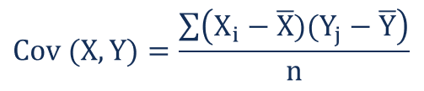
Calculation formula

Slide 19
Correlation
Correlation is a statistical measure that expresses the extent to which two variables are linearly related (meaning they change together at a constant rate). It’s a common tool for describing simple relationships without making a statement about cause and effect.
The sample correlation coefficient, r, quantifies the strength of the relationship. Correlations are also tested for statistical significance.

Slide 20

Calculation formula

Slide 21
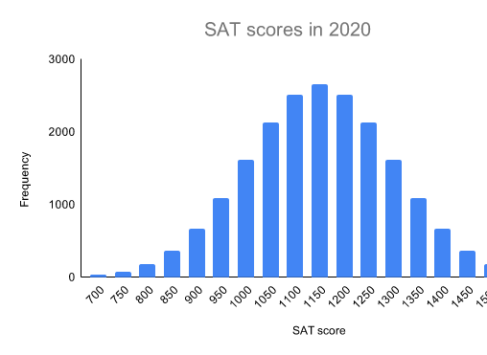
Normal distribution
In a normal distribution, data is symmetrically distributed with no skew. When plotted on a graph, the data follows a bell shape, with most values clustering around a central region and tapering off as they go further away from the center.
Normal distributions are also called Gaussian distributions or bell curves because of their shape.

Slide 22
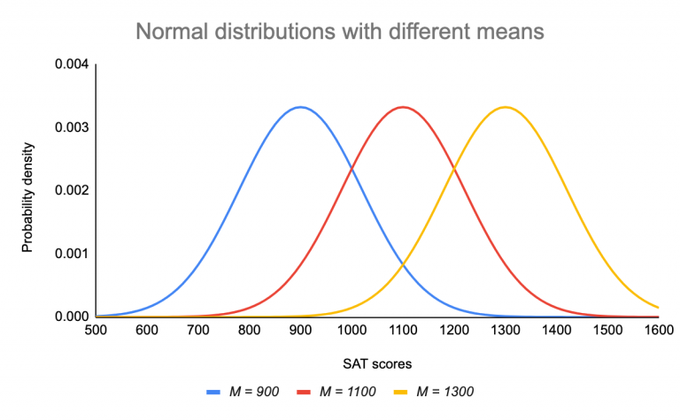
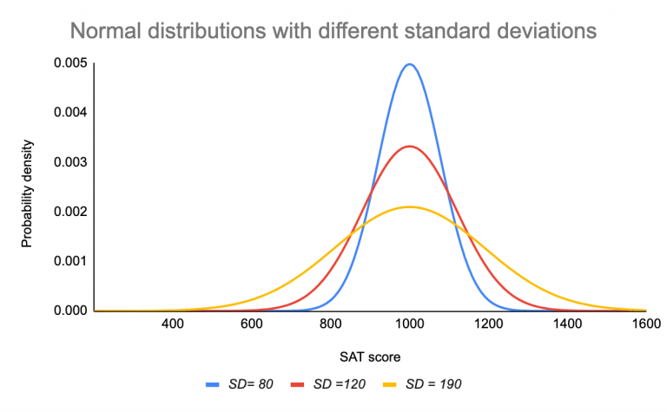

Slide 23
Pearson Correlation coefficient
Pearson correlation coefficient (r) is the most common way of measuring a linear correlation. It is a number between –1 and 1 that measures the strength and direction of the relationship between two variables.

Slide 24
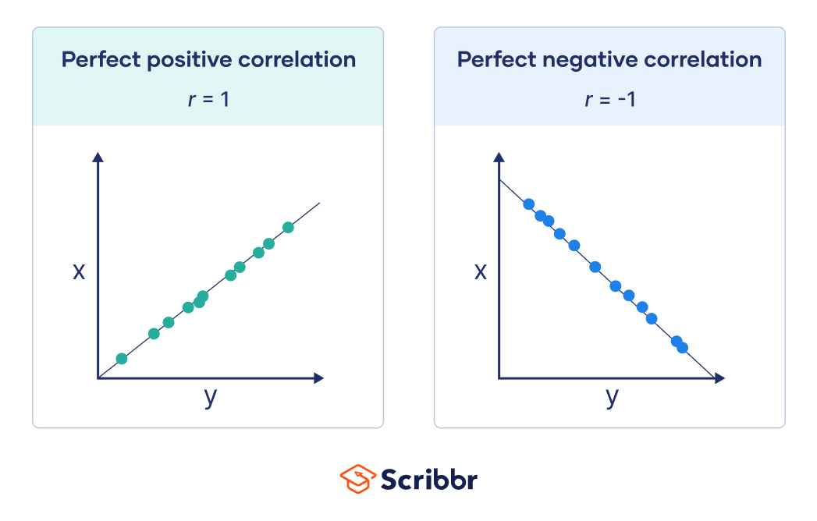
Graphical representation

Slide 25
Correlation vs causation
Two or more variables considered to be related, in a statistical context, if their values change so that as the value of one variable increases or decreases so does the value of the other variable (although it may be in the opposite direction).
Causation indicates that one event is the result of the occurrence of the other event; i.e. there is a causal relationship between the two events. This is also referred to as cause and effect.
e.g smoking causes an increase in the risk of developing lung cancer, or it can correlate with another (e.g. smoking is correlated with alcoholism, but it does not cause alcoholism).

Slide 26
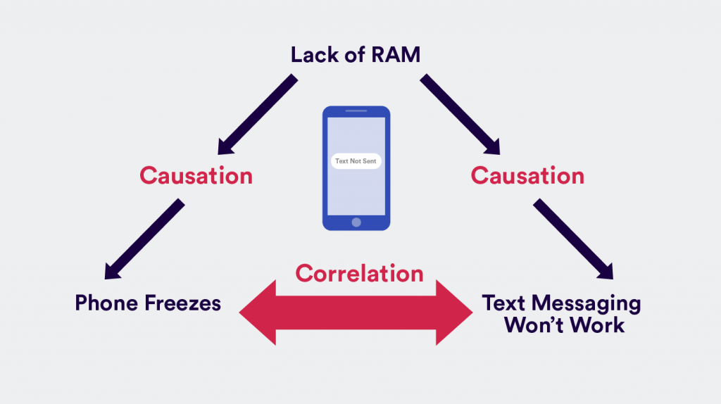
Example

Slide 27
Correlation vs Covariance
Basis for comparison | Covariance | Correlation
Definition | Covariance is an indicator of the extent to which 2 random variables are dependent on each other. A higher number denotes higher dependency. | Correlation is a statistical measure that indicates how strongly two variables are related.
Values | The value of covariance lies in the range of -∞ and +∞. | Correlation is limited to values between the range -1 and +1
Change in scale | Affects covariance | Does not affect the correlation
Unit-free measure | No | Yes

Slide 28
Plots for Continuous and discrete data
Bar Graph
Pie Chart
Line Graph
Pictograph
Histogram
Frequency Distribution

Slide 29
Probability
Probability is a measure of the likelihood of an event to occur. Many events cannot be predicted with total certainty. We can predict only the chance of an event to occur i.e., how likely they are going to happen, using it. Probability can range from 0 to 1, where 0 means the event to be an impossible one and 1 indicates a certain event.
The probability of all the events in a sample space adds up to 1.

Slide 30
Probability vs Likelihood
Probability is a branch of mathematics that deals with the possibility of a random experiment occurring. The term "probability" refers to the possibility of something happening.
The term Likelihood refers to the process of determining the best data distribution given a specific situation in the data.
When calculating the probability of a given outcome, you assume the model's parameters are reliable.
However, when you calculate the likelihood, you’re attempting to determine whether the parameters in a model can be trusted based on the sample data you have observed.

Slide 31
Probability corresponds to finding the chance of something given a sample distribution of the data, while on the other hand, Likelihood refers to finding the best distribution of the data given a particular value of some feature or some situation in the data.

Slide 32
Example
For example, when we toss a coin, either we get Head OR Tail, only two possible outcomes are possible (H, T). But when two coins are tossed then there will be four possible outcomes, i.e {(H, H), (H, T), (T, H), (T, T)}.
Q. There are 6 pillows in a bed, 3 are red, 2 are yellow and 1 is blue. What is the probability of picking a yellow pillow?

Slide 33
Probability of an Event
Assume an event E can occur in r ways out of a sum of n probable or possible equally likely ways. Then the probability of happening of the event or its success is expressed as;
P(E) = r/n
The probability that the event will not occur or known as its failure is expressed as:
P(E’) = (n-r)/n = 1-(r/n)
E’ represents that the event will not occur.
Therefore, now we can say;
P(E) + P(E’) = 1
This means that the total of all the probabilities in any random test or experiment is equal to 1.

Slide 34
Complementary Events
The possibility that there will be only two outcomes which states that an event will occur or not. Like a person will come or not come to your house, getting a job or not getting a job, etc. are examples of complementary events. Basically, the complement of an event occurring in the exact opposite that the probability of it is not occurring. Some more examples are:
It will rain or not rain today
The student will pass the exam or not pass.
You win the lottery or you don’t.

Slide 35
Mutually Exclusive Event
In probability theory, two events are said to be mutually exclusive if they cannot occur at the same time or simultaneously. In other words, mutually exclusive events are called disjoint events. If two events are considered disjoint events, then the probability of both events occurring at the same time will be zero.
If A and B are the two events, then the probability of disjoint of event A and B is written by:
Probability of Disjoint (or) Mutually Exclusive Event = P ( A and B) = 0

Slide 36
Examples
When tossing a coin, the event of getting head and tail are mutually exclusive. Because the probability of getting head and tail simultaneously is 0.
In a six-sided die, the events “2” and “5” are mutually exclusive. We cannot get both the events 2 and 5 at the same time when we threw one die.
In a deck of 52 cards, drawing a red card and drawing a club are mutually exclusive events because all the clubs are black.

Slide 37
Term | Definition | Example
Sample Space | The set of all the possible outcomes to occur in any trial | Tossing a coin, Sample Space (S) = {H,T} Rolling a die, Sample Space (S) = {1,2,3,4,5,6}
Sample Point | It is one of the possible results | In a deck of Cards: 4 of hearts is a sample point. The queen of clubs is a sample point.
Experiment or Trial | A series of actions where the outcomes are always uncertain. | The tossing of a coin, Selecting a card from a deck of cards, throwing a dice.
Event | It is a single outcome of an experiment. | Getting a Heads while tossing a coin is an event.
Outcome | Possible result of a trial/experiment | T (tail) is a possible outcome when a coin is tossed.
Complimentary event | The non-happening events. The complement of an event A is the event, not A (or A’) | In a standard 52-card deck, A = Draw a heart, then A’ = Don’t draw a heart
Impossible Event | The event cannot happen | In tossing a coin, impossible to get both head and tail at the same time

Slide 38
Question
A vessel contains 4 blue balls, 5 red balls and 11 white balls. If three balls are drawn from the vessel at random, what is the probability that the first ball is red, the second ball is blue, and the third ball is white?

Slide 39
Basic Count based Probability
An efficient way of counting is necessary to handle large masses of statistical data (e.g. the level of inventory at the end of a given month, or the number of production runs on a given machine in a 24 hour period, etc.), and for an understanding of probability.

Slide 40
How to calculate
the number of ways,
the number of samples, or
the number of outcomes.
e.g
Consider a set of numbers S={−4,−2,1,3,5,6,7,8,9,10}
Let the events E₁, E₂ and E₃ be defined as:
E = choosing a negative or an odd number from S;
E₁= choosing a negative number from S;
E₂ = choosing an odd number from S.
Find n(E) &n(E1)?

Slide 41
e.g
In how many ways can a number be chosen from 1 to 22 such that
(a) it is a multiple of 3 or 8?
(b) it is a multiple of 2 or 3?
Answer?

Slide 42
Conditional Probability
Conditional probability is defined as the likelihood of an event or outcome occurring, based on the occurrence of a previous event or outcome. Conditional probability is calculated by multiplying the probability of the preceding event by the updated probability of the succeeding, or conditional, event.
Conditional probability is often portrayed as the "probability of A given B," notated as P(A|B).

Slide 43
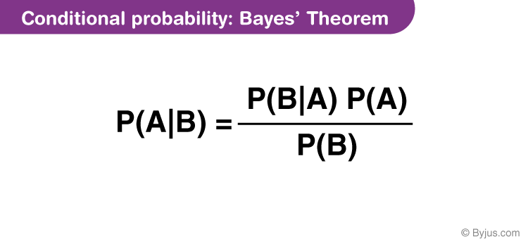

Slide 44
Bayes Rule
Bayes’ theorem defines the probability of occurrence of an event associated with any condition. It is considered for the case of conditional probability. Also, this is known as the formula for the likelihood of “causes”.

Slide 45
Example
Two dies are thrown simultaneously, and the sum of the numbers obtained is found to be 7. What is the probability that the number 3 has appeared at least once?

Slide 46
Probability Distribution: Discrete and Continuous
Probability distribution yields the possible outcomes for any random event. It is also defined based on the underlying sample space as a set of possible outcomes of any random experiment. These settings could be a set of real numbers or a set of vectors or a set of any entities.
A probability distribution is a statistical function that describes all the possible values and likelihoods that a random variable can take within a given range.

Slide 47
How Probability Distributions Work
Perhaps the most common probability distribution is the normal distribution, or "bell curve," although several distributions exist that are commonly used. Typically, the data generating process of some phenomenon will dictate its probability distribution. This process is called the probability density function.
Probability distributions can also be used to create cumulative distribution functions (CDFs), which adds up the probability of occurrences cumulatively and will always start at zero and end at 100%.

Slide 48
Types of Probability Distribution
There are two types of probability distribution which are used for different purposes and various types of the data generation process.
Normal or Cumulative Probability Distribution
Binomial or Discrete Probability Distribution

Slide 49
Continuous Probability Distribution
The cumulative probability distribution is also known as a continuous probability distribution. In this distribution, the set of possible outcomes can take on values in a continuous range.
For example, a set of real numbers, is a continuous or normal distribution, as it gives all the possible outcomes of real numbers. Similarly, a set of complex numbers, a set of prime numbers, a set of whole numbers etc. are examples of Normal Probability distribution. Also, in real-life scenarios, the temperature of the day is an example of continuous probability. Based on these outcomes we can create a distribution table. A probability density function describes it. The formula for the normal distribution is;

Slide 50
Normal Distribution Examples
Since the normal distribution statistics estimates many natural events so well, it has evolved into a standard of recommendation for many probability queries. Some of the examples are:
Height of the Population of the world
Rolling a dice (once or multiple times)
To judge the Intelligent Quotient Level of children in this competitive world
Tossing a coin
Income distribution in countries economy among poor and rich
The sizes of females shoes
Weight of newly born babies range
Average report of Students based on their performance

Slide 51
Discrete Probability Distribution
A distribution is called a discrete probability distribution, where the set of outcomes are discrete in nature.
For example, if a dice is rolled, then all the possible outcomes are discrete and give a mass of outcomes. It is also known as the probability mass function.

Slide 52

Formula
n = Total number of events
r = Total number of successful events.
p = Success on a single trial probability.
^{n}C_{r} = [n!/r!(n−r)]!
1 – p = Failure Probability

Slide 53
Probability distribution function
A function which is used to define the distribution of a probability is called a Probability distribution function. Depending upon the types, we can define these functions. Also, these functions are used in terms of probability density functions for any given random variable.
In the case of Normal distribution, the function of a real-valued random variable X is the function given by;
F_{X}(x) = P(X ≤ x)
Where P shows the probability that the random variable X occurs on less than or equal to the value of x.

Slide 54
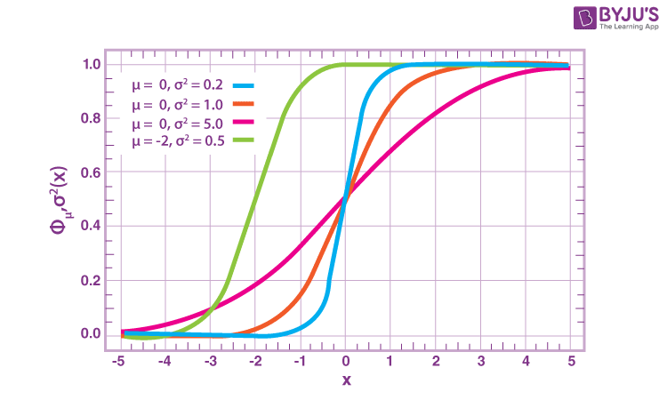

Slide 55
Normal distribution
The Normal Distribution is defined by the probability density function for a continuous random variable in a system. Let us say, f(x) is the probability density function and X is the random variable. Hence, it defines a function which is integrated between the range or interval (x to x + dx), giving the probability of random variable X, by considering the values between x and x+dx.

Slide 56
Normal Distribution Standard Deviation
Generally, the normal distribution has any positive standard deviation. We know that the mean helps to determine the line of symmetry of a graph, whereas the standard deviation helps to know how far the data are spread out. If the standard deviation is smaller, the data are somewhat close to each other and the graph becomes narrower. If the standard deviation is larger, the data are dispersed more, and the graph becomes wider. The standard deviations are used to subdivide the area under the normal curve. Each subdivided section defines the percentage of data, which falls into the specific region of a graph.
Using 1 standard deviation, the Empirical Rule states that,
Approximately 68% of the data falls within one standard deviation of the mean. (i.e., Between Mean- one Standard Deviation and Mean + one standard deviation)
Approximately 95% of the data falls within two standard deviations of the mean. (i.e., Between Mean- two Standard Deviation and Mean + two standard deviations)
Approximately 99.7% of the data fall within three standard deviations of the mean. (i.e., Between Mean- three Standard Deviation and Mean + three standard deviations)

Slide 57
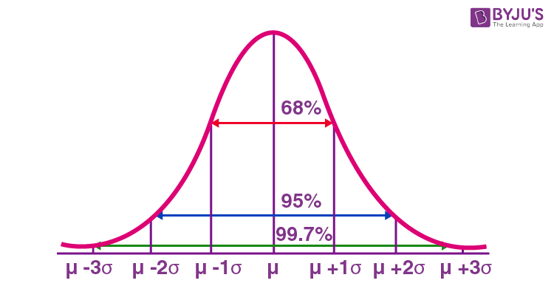

Slide 58
Log normal distribution
A normal distribution can be converted to a log-normal distribution using logarithmic mathematics.
A lognormal (log-normal or Galton) distribution is a probability distribution with a normally distributed logarithm. A random variable is lognormally distributed if its logarithm is normally distributed.
Skewed distributions with low mean values, large variance, and all-positive values often fit this type of distribution. Values must be positive as log(x) exists only for positive values of x.

Slide 59
A lognormal distribution is a continuous probability distribution of a random variable in which logarithm is normally distributed. Thus, if the random variable X has a lognormal distribution, then Y=ln(X) has a normal distribution. Likewise, if Y has a normal distribution, then X=exp(Y) has a lognormal distribution. A random variable that is lognormally distributed takes only positive real values.

Slide 60
Bernouli and Binomial Distribution
The main difference between the binomial distribution and the normal distribution is that binomial distribution is discrete, whereas the normal distribution is continuous. It means that the binomial distribution has a finite amount of events, whereas the normal distribution has an infinite number of events. In case, if the sample size for the binomial distribution is very large, then the distribution curve for the binomial distribution is similar to the normal distribution curve.
Properties of Binomial Distribution
The properties of the binomial distribution are:
There are two possible outcomes: true or false, success or failure, yes or no.
There is ‘n’ number of independent trials or a fixed number of n times repeated trials.
The probability of success or failure remains the same for each trial.
Only the number of success is calculated out of n independent trials.
Every trial is an independent trial, which means the outcome of one trial does not affect the outcome of another trial.

Slide 61
Formula
P(x:n,p) = ^{n}C_{x} p^{x} (1-p)^{n-x}
Or
P(x:n,p) = ^{n}C_{x} p^{x} (q)^{n-x}

Slide 62
Example 1: If a coin is tossed 5 times, find the probability of:
(a) Exactly 2 heads
(b) At least 4 heads.
Solution:
(a) The repeated tossing of the coin is an example of a Bernoulli trial. According to the problem:
Number of trials: n=5
Probability of head: p= 1/2 and hence the probability of tail, q =1/2
For exactly two heads:
x=2
P(x=2) = ⁵C2 p² q⁵⁻² = 5! / 2! 3! × (½)²× (½)³
P(x=2) = 5/16

Slide 63
(b) For at least four heads,
x ≥ 4, P(x ≥ 4) = P(x = 4) + P(x=5)
Hence,
P(x = 4) = 5C4 p4 q5-4 = 5!/4! 1! × (½)4× (½)1 = 5/32
P(x = 5) = 5C5 p5 q5-5 = (½)5 = 1/32
Therefore,
P(x ≥ 4) = 5/32 + 1/32 = 6/32 = 3/16

Slide 64
Create a numpy array having 10 random numbers.
Find the mean of that array
Find variance and std deviation.
Create another array and find the covariance and correlation matrix.

Slide 65
Population and Sample
A population is the entire group that you want to draw conclusions about.
A sample is the specific group that you will collect data from. The size of the sample is always less than the total size of the population.

Slide 66
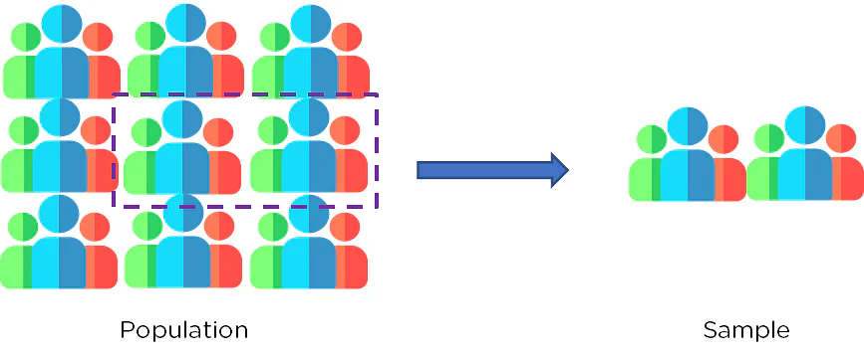

Slide 67
Example
Population | Sample
All residents of a country would constitute the Population set | All residents who live above the poverty line would be the Sample
All residents above the poverty line in a country would be the Population | All residents who are millionaires would make up the Sample
All employees in an office would be the Population | Out of all the employees, all managers in the office would be the Sample

Slide 68
Central Limit Theorem
Central limit theorem is a statistical theory which states that when the large sample size has a finite variance, the samples will be normally distributed and the mean of samples will be approximately equal to the mean of the whole population.
The central limit theorem states that whenever a random sample of size n is taken from any distribution with mean and variance, then the sample mean will be approximately normally distributed with mean and variance. The larger the value of the sample size, the better the approximation to the normal.
As the sample size gets bigger and bigger, the mean of the sample will get closer to the actual population mean. If the sample size is small, the actual distribution of the data may or may not be normal, but as the sample size gets bigger, it can be approximated by a normal distribution.

Slide 69
Assumptions
The data must adhere to the randomization rule. It needs to be sampled at random.
The samples should be unrelated to one another. One sample should not impact the others.
When taking samples without replacement, the sample size should not exceed 10% of the population.

Slide 70
Why we need this Theorem?
Consider there are 15 sections in class X, and each section has 50 students. Our task is to calculate the average marks of students in class X.
The standard approach will be to calculate the average simply:
Calculate the total marks of all the students in Class X
2. Add all the marks
3. Divide the total marks by the total number of students
But what if the data is extremely large? Is this a good approach?

Slide 71
Select groups of students from the class at random. This will be referred to as a sample. Create several samples, each with 30 students.
Calculate each sample's individual mean.
Calculate the average of these sample means.
The value will give us the approximate average marks of the students in Class X.
The histogram of the sample means marks of the students will resemble a bell curve or normal distribution.

Slide 72
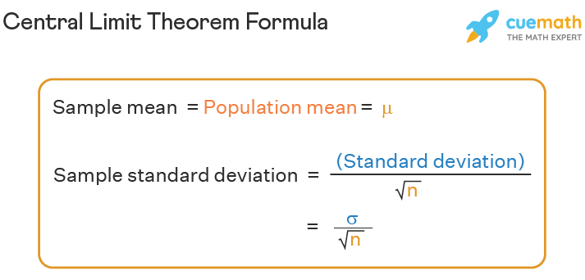

Slide 73
Standard error
The standard error (SE) of a statistic is the approximate standard deviation of a statistical sample population.

Slide 74
The standard error of an estimate can be calculated as the standard deviation divided by the square root of the sample size:
SE = σ / √n
where
σ = the population standard deviation
√n = the square root of the sample size

Slide 75
Standard Error vs. Standard Deviation
The standard error normalizes the standard deviation relative to the sample size used in an analysis. Standard deviation measures the amount of variance or dispersion of the data spread around the mean. The standard error can be thought of as the dispersion of the sample mean estimations around the true population mean. As the sample size becomes larger, the standard error will become smaller, indicating that the estimated sample mean value better approximates the population mean.

Slide 76
Calculate SE
Step 1: Note the number of measurements (n) and determine the sample mean (μ). It is the average of all the measurements.
Step 2: Determine how much each measurement varies from the mean.
Step 3: Square all the deviations determined in step 2 and add altogether: Σ(x_{i} – μ)²
Step 4: Divide the sum from step 3 by one less than the total number of measurements (n-1).
Step 5: Take the square root of the obtained number, which is the standard deviation (σ).
Step 6: Finally, divide the standard deviation obtained by the square root of the number of measurements (n) to get the standard error of your estimate. Go through the example given below to understand the method of calculating standard error.

Slide 77
Confidence Interval
The confidence interval is the range of values that you expect your estimate to fall between a certain percentage of the time if you run your experiment again or re-sample the population in the same way.
The confidence level is the percentage of times you expect to reproduce an estimate between the upper and lower bounds of the confidence interval, and is set by the alpha value.

Slide 78
A confidence interval is the mean of your estimate plus and minus the variation in that estimate. This is the range of values you expect your estimate to fall between if you redo your test, within a certain level of confidence.
Confidence, in statistics, is another way to describe probability. For example, if you construct a confidence interval with a 95% confidence level, you are confident that 95 out of 100 times the estimate will fall between the upper and lower values specified by the confidence interval.

Slide 79

CI = the confidence interval​
X̄ = the population mean​
Z* = the critical value of the z distribution​
σ = the population standard deviation​
√n = the square root of the population size

Slide 80
When do you use confidence intervals?
You can calculate confidence intervals for many kinds of statistical estimates, including:
Proportions
Population means
Differences between population means or proportions
Estimates of variation among groups

Slide 81
Hypothesis Testing
Hypothesis Testing is a type of statistical analysis in which you put your assumptions about a population parameter to the test. It is used to estimate the relationship between 2 statistical variables.

Slide 82
Null Hypothesis and Alternate Hypothesis
The Null Hypothesis is the assumption that the event will not occur. A null hypothesis has no bearing on the study's outcome unless it is rejected.
Represented by H0
The Alternate Hypothesis is the logical opposite of the null hypothesis. The acceptance of the alternative hypothesis follows the rejection of the null hypothesis. H1 is the symbol for it.

Slide 83
What is the Null Hypothesis?
The null hypothesis is always the accepted fact. Simple examples of null hypotheses that are generally accepted as being true are:
DNA is shaped like a double helix.
There are 8 planets in the solar system (excluding Pluto).
Taking Vioxx can increase your risk of heart problems (a drug now taken off the market).

Slide 84
A sanitizer manufacturer claims that its product kills 95 percent of germs on average.
To put this company's claim to the test, create a null and alternate hypothesis.
H0 (Null Hypothesis): Average = 95%.
Alternative Hypothesis (H1): The average is less than 95%.

Slide 85
One-Tailed and Two-Tailed Hypothesis Testing
The One-Tailed test, also called a directional test, considers a critical region of data that would result in the null hypothesis being rejected if the test sample falls into it, inevitably meaning the acceptance of the alternate hypothesis.
In a one-tailed test, the critical distribution area is one-sided, meaning the test sample is either greater or lesser than a specific value.
In two tails, the test sample is checked to be greater or less than a range of values in a Two-Tailed test, implying that the critical distribution area is two-sided.
If the sample falls within this range, the alternate hypothesis will be accepted, and the null hypothesis will be rejected.

Slide 86
Example
Suppose H0: mean = 50 and H1: mean not equal to 50
According to the H1, the mean can be greater than or less than 50. This is an example of a Two-tailed test.
In a similar manner, if H0: mean >=50, then H1: mean <50
Here the mean is less than 50. It is called a One-tailed test.

Slide 87
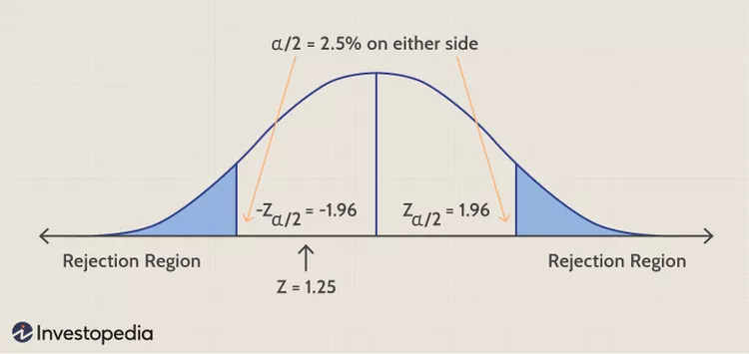

Slide 88
Example
Blood glucose levels for obese patients have a mean of 100 with a standard deviation of 15. A researcher thinks that a diet high in raw cornstarch will have a positive or negative effect on blood glucose levels. A sample of 30 patients who have tried the raw cornstarch diet have a mean glucose level of 140. Test the hypothesis that the raw cornstarch had an effect.

Slide 89
Step 1: State the null hypothesis: H0:μ=100 Step 2: State the alternate hypothesis: H1:≠100 Step 3: State your alpha level. We’ll use 0.05 for this example. As this is a two-tailed test, split the alpha into two. 0.05/2=0.025

Slide 90

Step 4: Find the z-score associated with your alpha level. You’re looking for the area in one tail only. A z-score for 0.75(1-0.025=0.975) is 1.96. As this is a two-tailed test, you would also be considering the left tail (z = 1.96)
Step 5: Find the test statistic using this formula:
z = (140 – 100) / (15/√30) = 14.60. Step 6: If Step 5 is less than -1.96 or greater than 1.96 (Step 3), reject the null hypothesis. In this case, it is greater, so you can reject the null.

Slide 92
Type 1 and Type 2 Error
A hypothesis test can result in two types of errors.
Type 1 Error: A Type-I error occurs when sample results reject the null hypothesis despite being true.
Type 2 Error: A Type-II error occurs when the null hypothesis is not rejected when it is false, unlike a Type-I error.

Slide 93
Example
Example:
Suppose a teacher evaluates the examination paper to decide whether a student passes or fails.
H0: Student has passed
H1: Student has failed
Type I error will be the teacher failing the student [rejects H0] although the student scored the passing marks [H0 was true].
Type II error will be the case where the teacher passes the student [do not reject H0] although the student did not score the passing marks [H1 is true].

Slide 94
P-Value
A p-value is a metric that expresses the likelihood that an observed difference could have occurred by chance. As the p-value decreases the statistical significance of the observed difference increases. If the p-value is too low, you reject the null hypothesis.
Here you have taken an example in which you are trying to test whether the new advertising campaign has increased the product's sales. The p-value is the likelihood that the null hypothesis, which states that there is no change in the sales due to the new advertising campaign, is true. If the p-value is .30, then there is a 30% chance that there is no increase or decrease in the product's sales. If the p-value is 0.03, then there is a 3% probability that there is no increase or decrease in the sales value due to the new advertising campaign. As you can see, the lower the p-value, the chances of the alternate hypothesis being true increases, which means that the new advertising campaign causes an increase or decrease in sales.

Slide 95
Z-test & T-test
Z-test is the statistical hypothesis used to determine whether the two samples’ means calculated are different if the standard deviation is available and the sample is large. In contrast, the T-test determines how averages of different data sets differ in case the standard deviation or the variance is unknown.
Sample size is large in case of Z-test where as sample size is small in T-test.

Slide 96
Basis | Z Test | T-Test
Basic Definition | Z-test is a kind of hypothesis test which ascertains if the averages of the 2 datasets are different from each other when standard deviation or variance is given. | The t-test can be referred to as a kind of parametric test that is applied to an identity, how the averages of 2 sets of data differ from each other when the standard deviation or variance is not given.
Population Variance | The Population variance or standard deviation is known here. | The Population variance or standard deviation is unknown here.
Sample Size | The Sample size is large. | Here the Sample Size is small.
Key Assumptions | All data points are independent. Normal Distribution for Z, with an average zero and variance = 1. | All data points are not dependent. Sample values are to be recorded and taken accurately.
Based upon (a type of distribution) | Based on Normal distribution. | Based on Student-t distribution

