Slide 1
Image Classification

Slide 2

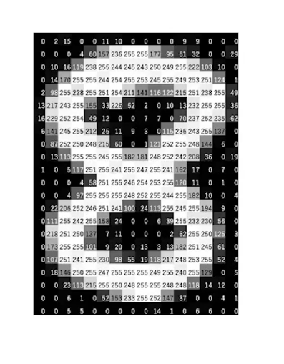
Image as Matrix
We can represent image in the form of matrix .
e.g

Slide 3
Each of these pixels is denoted as the numerical value and these numbers are called Pixel Values. These pixel values denote the intensity of the pixels. For a grayscale or b&w image, we have pixel values ranging from 0 to 255.
The smaller numbers closer to zero represent the darker shade while the larger numbers closer to 255 represent the lighter or the white shade.

Slide 4
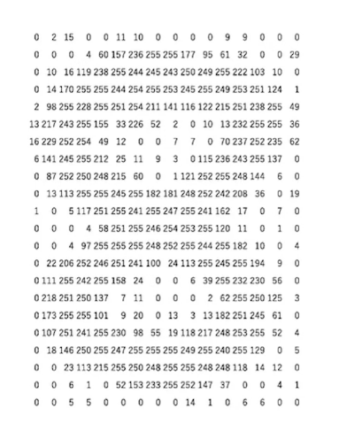

Slide 5
Points to remember
Images are stored in the form of a matrix of numbers in a computer where these numbers are known as pixel values.
These pixel values represent the intensity of each pixel.
0 represents black and 255 represents white.
The matrix of numbers is known as the channel and in the case of a grayscale image, we have only one channel.
https://towardsdatascience.com/introduction-to-image-processing-with-python-representation-of-images-for-beginners-b95725b523ca

Slide 6
Image as histogram
An image histogram is a gray-scale value distribution showing the frequency of occurrence of each gray-level value. For an image size of 1024 × 1024 × 8 bits, the abscissa ranges from 0 to 255; the total number of pixels is equal to 1024 × 1024.

Slide 7
Basic filters applied on the images
Filtering techniques are used to enhance and modify digital images. Also, images filters are used to blurring and noise reduction , sharpening and edge detection. Image filters are mainly use for suppress high (smoothing techniques) and low frequencies(image enhancement, edge detection).

Slide 8
Laplacian Filter
Laplace smoothing technique is mainly use to detect image edges. It highlights gray level discontinuities.
Laplace edge detector use only one kernel
Gaussian Filter
This filter is a 2-D convolutional operator. It is used to blur images. Also, it removes details and noises.

Slide 9
What is convolution
Convolution is a mathematical tool to combining two signals to form a third signal. Therefore, in signals and systems, the convolution is very important because it relates the input signal and the impulse response of the system to produce the output signal from the system

Slide 10
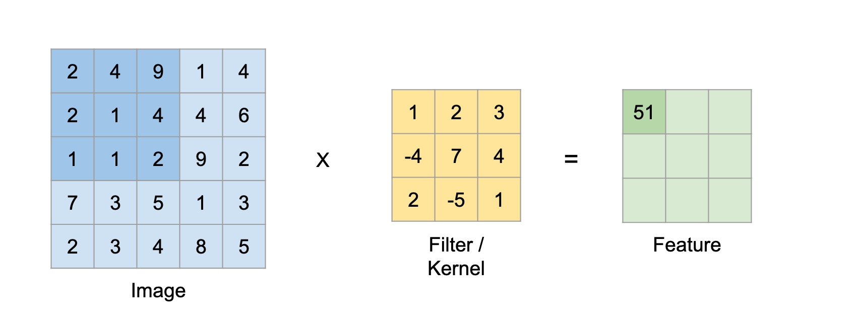

Slide 11
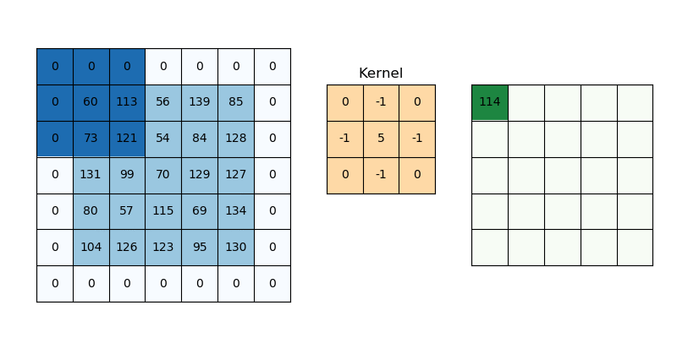
Padding
https://www.analyticsvidhya.com/blog/2020/10/what-is-the-convolutional-neural-network-architecture/

Slide 12
Convolutional Neural Networks (CNN)
A deep learning CNN consists of three layers: a convolutional layer, a pooling layer and a fully connected (FC) layer. The convolutional layer is the first layer while the FC layer is the last.
From the convolutional layer to the FC layer, the complexity of the CNN increases. It is this increasing complexity that allows the CNN to successively identify larger portions and more complex features of an image until it finally identifies the object in its entirety.

Slide 13
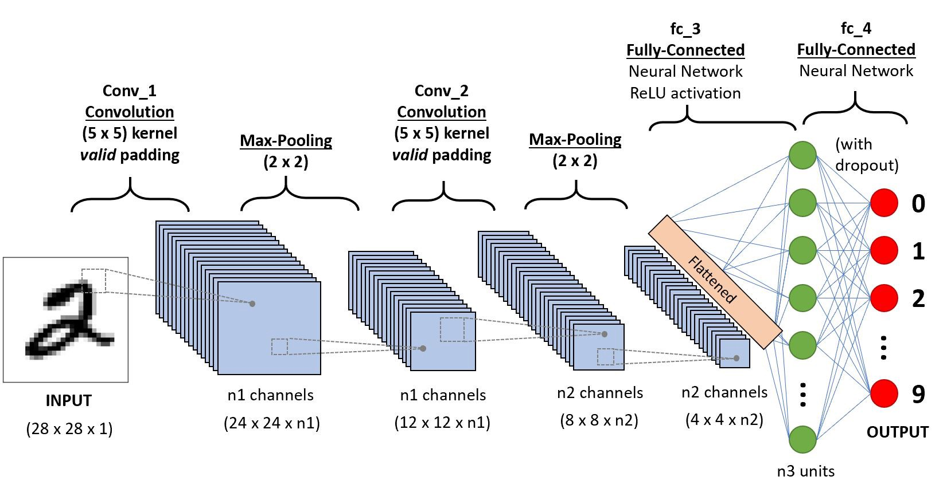

Slide 14
Different types of CNN architectures
Convolution Layer
Pooling Layer ( average Pooling and Ma
Fully Connected Layer

Slide 15
Convolution Layer
The majority of computations happen in the convolutional layer, which is the core building block of a CNN. A second convolutional layer can follow the initial convolutional layer. The process of convolution involves a kernel or filter inside this layer moving across the receptive fields of the image, checking if a feature is present in the image.
Over multiple iterations, the kernel sweeps over the entire image. After each iteration a dot product is calculated between the input pixels and the filter. The final output from the series of dots is known as a feature map or convolved feature. Ultimately, the image is converted into numerical values in this layer, which allows the CNN to interpret the image and extract relevant patterns from it.

Slide 16
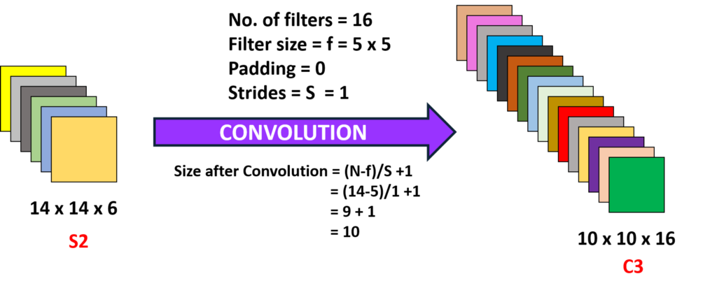

Slide 17
Pooling layer
Like the convolutional layer, the pooling layer also sweeps a kernel or filter across the input image. But unlike the convolutional layer, the pooling layer reduces the number of parameters in the input and also results in some information loss. On the positive side, this layer reduces complexity and improves the efficiency of the CNN.
It may be maxpooling or Average pooling

Slide 18
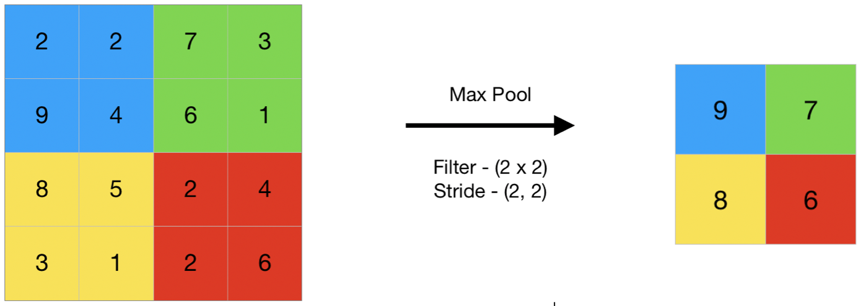

Slide 19
Fully Connected Layer
The FC layer is where image classification happens in the CNN based on the features extracted in the previous layers. Here, fully connected means that all the inputs or nodes from one layer are connected to every activation unit or node of the next layer.
All the layers in the CNN are not fully connected because it would result in an unnecessarily dense network. It also would increase losses and affect the output quality, and it would be computationally expensive.

Slide 20
Image Data Augmentation
Image data augmentation is a technique that creates new images from existing ones. To do that, you make some small changes to them, such as adjusting the brightness of the image, or rotating the image, or shifting the subject in the image horizontally or vertically.
Image augmentation techniques allow you to artificially increase the size of your training set, thereby providing much more data to your model for training. This allows you to improve the accuracy of your model by enhancing the ability of your model to recognize new variants of your training data.

Slide 21
Pre trained Models
VGG Net
ResNet
Dense Net
Inception Net
Xception Net

Slide 22
What is transfer learning
Transfer learning for machine learning is often used when the training of a system to solve a new task would take a huge amount of resources. The process takes relevant parts of an existing machine learning model and applies it to solve a new but similar problem. A key part of transfer learning is generalisation. This means that only knowledge that can be used by another model in different scenarios or conditions is transferred. Instead of models being rigidly tied to a training dataset, models used in transfer learning will be more generalised. Models developed in this way can be utilised in changing conditions and with different datasets.

Slide 23
Transfer learning is generally used
To save time and resources from having to train multiple machine learning models from scratch to complete similar tasks.
As an efficiency saving in areas of machine learning that require high amounts of resources such as image categorisation or natural language processing.
To negate a lack of labelled training data held by an organisation, by using pre-trained models.

Slide 24
When to use
1. TRAINING A MODEL TO REUSE IT
Utilize the deep neural network to train on task B and then use the model to solve task A. The problem you’re seeking to solve will decide whether you need to employ the entire model or just a few layers.
If the input in both jobs is the same, you might reapply the model and make predictions for your new input. Changing and retraining distinct task-specific layers and the output layer, on the other hand, is an approach to investigate.

Slide 25
2. USING A PRE-TRAINED MODEL
The second option is to employ a model that has already been trained. There are a number of these models out there, so do some research beforehand. The number of layers to reuse and retrain is determined by the task.
Keras consists of nine pre-trained models used in transfer learning, prediction, fine-tuning. These models, as well as some quick lessons on how to utilise them, may be found here. Many research institutions also make trained models accessible.

Slide 26
Another option is to utilise deep learning to identify the optimum representation of your problem, which comprises identifying the key features. This method is known as representation learning, and it can often produce significantly better results than hand-designed representations.
Feature creation in machine learning is mainly done by hand by researchers and domain specialists. Deep learning, fortunately, can extract features automatically. Of course, this does not diminish the importance of feature engineering and domain knowledge; you must still choose which features to include in your network.
EXTRACTION OF FEATURES

Slide 27
Training of CNN in TensorFlow
https://www.analyticsvidhya.com/blog/2021/10/understanding-transfer-learning-for-deep-learning/

