Slide 1
Basic Terminologies
Internet :
The Internet is a global network of interconnected computer networks that use standardized communication protocols to link devices worldwide. It is a massive, decentralized infrastructure that facilitates the exchange of data and information among billions of devices, including computers, smartphones, servers, and other networked devices. It is a vast network of networks, where LANs, WANs, and MANs are interconnected using standardized protocols like TCP/IP.
Hypertext Documents :
Hypertext documents are documents that contain links, known as hyperlinks, which allow users to navigate between different parts of the document or to other documents. The term "hypertext" refers to text that is linked to other text, creating a non-linear structure where users can choose their own path through the information.

Slide 2
Basic Terminologies
Web : The term "web" is commonly used to refer to the World Wide Web, which is a specific system of interlinked hypertext documents and multimedia content that is accessed via the Internet.
Webpage: A "webpage" is a single document within the World Wide Web. It's like a digital page that can contain text, images, videos, and other multimedia elements.
Website : It is a collection of related webpages that share a common domain and are designed to be part of a cohesive experience.

Slide 3
Basic Terminologies
URL (Uniform Resource Locator) : It is a specific type of URI that provides the means to locate and retrieve a resource on the web. URLs typically include information about the protocol to be used (e.g., http, https), the domain name or IP address of the server, and the path to the resource on that server.
Domain : A domain is a part of a URL where a group of related resources, such as web pages or services, is identified by a unique human-readable name. The domain serves as a user-friendly label, allowing people to access specific content on the Internet without needing to remember numeric IP addresses
Web browser : It is a software application for retrieving, presenting, and traversing information resources on the World Wide Web. A web browser lets our computer communicate with web servers around the world and giving you the right information with just a few clicks away. Different web browsers have different way of retrieving information, but one thing they have in common is web communication protocols.

Slide 4
HTML
HTML is the standard markup language used to create and design documents on the World Wide Web. It is the backbone of web content and provides a structured way to describe the content of web pages. HTML uses a system of tags and attributes to define various elements such as headings, paragraphs, links, images, and more.
Key points about HTML :
Markup Language: HTML is a markup language, meaning it uses tags to annotate text with information about its structure. These tags define elements on a web page.
Structure of a Web Page: HTML is responsible for defining the structure of a web page. It specifies headings, paragraphs, lists, images, links, and other elements, allowing browsers to render the content properly.
Tags and Attributes: HTML elements are surrounded by tags (e.g., <p> for paragraphs) and may have attributes (e.g., href in <a> tags for hyperlinks) that provide additional information about the element.
Hierarchy and Nesting: HTML elements can be nested within one another, creating a hierarchy that represents the structure of the content. Proper nesting is crucial for ensuring accurate rendering by web browsers.
Versioning: HTML has evolved over time, with different versions introducing new features and improvements. HTML5 is the latest version and is widely used for modern web development.

Slide 5
HTML Tags
Element :
An HTML element is an individual component of an HTML document or web page.
Tag :
Element along with the enclosing <> angular brackets . Each tag has some predefined implementation related to view. (Paired tags vs empty tags)
Attribute:
Modifier of an HTML element type.
Either modifies the default functionality of an element type or provides functionality to certain element.

Slide 6
HTML Page Structure
HEAD:
This contains the information about the HTML document. For Example, the title of the page, version of HTML, meta Data, scripts , styles .
BODY:
This contains everything you want to display on the Web Page.

Slide 7
HTML Page Structure : Head & Meta
<!DOCTYPE html>
<html lang=“en”>
<head>
<meta charset="UTF-8">
<meta name="viewport" content="width=device-width, initial-scale=1.0">
<meta name="author" content="Mr.X">
<meta name="description" content=“Details about the page">
<title>Title of the page</title>
</head>
</html>

Slide 8
Applying Fav Icon
<link rel="icon" href="favicon.png">

Slide 9
Understanding “viewport” meta
The browser's viewport is the area of the window in which web content can be seen.
Viewport is often not the same size as the rendered page, in which case the browser provides scrollbars for the user to scroll around and access all the content.
Some mobile devices and other narrow screens render pages in a virtual window or viewport, which is usually wider than the screen, and then shrink the rendered result down so it can all be seen at once.
For example, if a mobile screen has a width of 640px, pages might be rendered with a virtual viewport of 980px, and then it will be shrunk down to fit into the 640px space.
This is done because not all pages are optimized for mobile and break (or at least look bad) when rendered at a small viewport width. This virtual viewport is a way to make non-mobile-optimized sites in general look better on narrow screen devices.
this mechanism is not so good for pages that are optimized for narrow screens using media queries — if the virtual viewport is 980px for example, media queries that kick in at 640px or 480px or less will never be used, limiting the effectiveness of such responsive design techniques.
The viewport meta tag mitigates this problem of virtual viewport on narrow screen devices.

Slide 10
Commonly used HTML Elements
<p> , <span>
<br> tag
<hr> tag
<h1> to <h6> heading tags
Lists : unordered and ordered lists
Table and img tag
<div> and <section>
Text modifiers like <b> ,<i>, <u> ,<em> , <strong> etc.

Slide 11
HTML Graphics
HTML works in conjunction with other technologies to include graphics in web pages. The primary technologies used for graphics in HTML include:
CSS
SVG
<img> tag
Canvas
Image Maps
External Libraries (D3.js , svg.js , Three.js)

Slide 12
HTML Graphics : SVG
SVG( Scalable Vector Graphics) is a vector image format, which means that the graphics are described using mathematical equations to represent geometric shapes like paths, circles, rectangles, and more.
Unlike raster images (e.g., JPEG or PNG), SVG images can be scaled to any size without losing quality, making them suitable for responsive web design.
SVG files are written in XML (eXtensible Markup Language), a markup language that is both human-readable and machine-readable.
The "Scalable" in SVG refers to its ability to scale seamlessly to different sizes without pixelation or loss of detail.
This makes SVG ideal for responsive web design, where images need to adapt to different screen sizes and resolutions.
SVG files are essentially text files, and their source code can be viewed and edited using a simple text editor.
This text-based nature facilitates version control, collaboration, and integration with other web technologies
SVG supports accessibility features, allowing authors to provide text descriptions for elements within the graphic, ensuring compatibility with screen readers and other assistive technologies.
SVG graphics can be embedded directly within HTML documents using the <svg> element. They can also be referenced as external files.
This seamless integration with HTML makes it easy to combine SVG graphics with other web content

Slide 13
HTML Graphics : SVG
Integration with HTML : Example generating circle
<svg width="100" height="100" xmlns="http://www.w3.org/2000/svg">
<circle cx="50" cy="50" r="40" stroke="black" stroke-width="3" fill="red" />
</svg>
Example generating rectangle
<svg width="200" height="100">
<rect x=“20” y=“30” width="150" height="80" fill="blue" stroke="red" stroke-width="2" />
</svg>

Slide 14
Hyperlinks
Linking text or an image on a web page creates a way for our website viewers to travel from one page to another.
Created using <a> (anchor tag)
Default style is color blue and underlined, when a link is visited the color changes to violet , css can be used to change the behavior.
Attributes : href , id , target(_blank , _self(default), _parent , _top)
Linking to other page.
Linking to same page specific element.
Linking to other page specific target.
Email links :
<a href="mailto:acb@mno.com">Send email to abc</a>

Slide 15
Communication Protocols
Communication protocols are technology used to transfer information across the internet. For example, a web browser uses these protocols to request information from a web server, which is then displayed on the browser screen in the form of text and images. The degree to which users can interact with that information depends on the protocol.
Protocols are a set of rules that governs the communication and exchange of data over the internet.
Both the sender and receiver should follow the same protocols in order to communicate the data.
Any language has its own set of vocabulary and grammar which we need to know if we want to communicate in that language. Similarly, over the internet whenever we access a website or exchange some data with another device then these processes are governed by a set of rules called the internet protocols.

Slide 16
Internet Protocol (IP)
The Internet Protocol (IP) is a protocol, or set of rules, for routing and addressing packets of data so that they can travel across networks and arrive at the correct destination
Data traversing the Internet is divided into smaller pieces, called packets.
IP information is attached to each packet, and this information helps routers to send packets to the right place.
Every device or domain that connects to the Internet is assigned an IP address, and as packets are directed to the IP address attached to them, data arrives where it is needed.

Slide 17
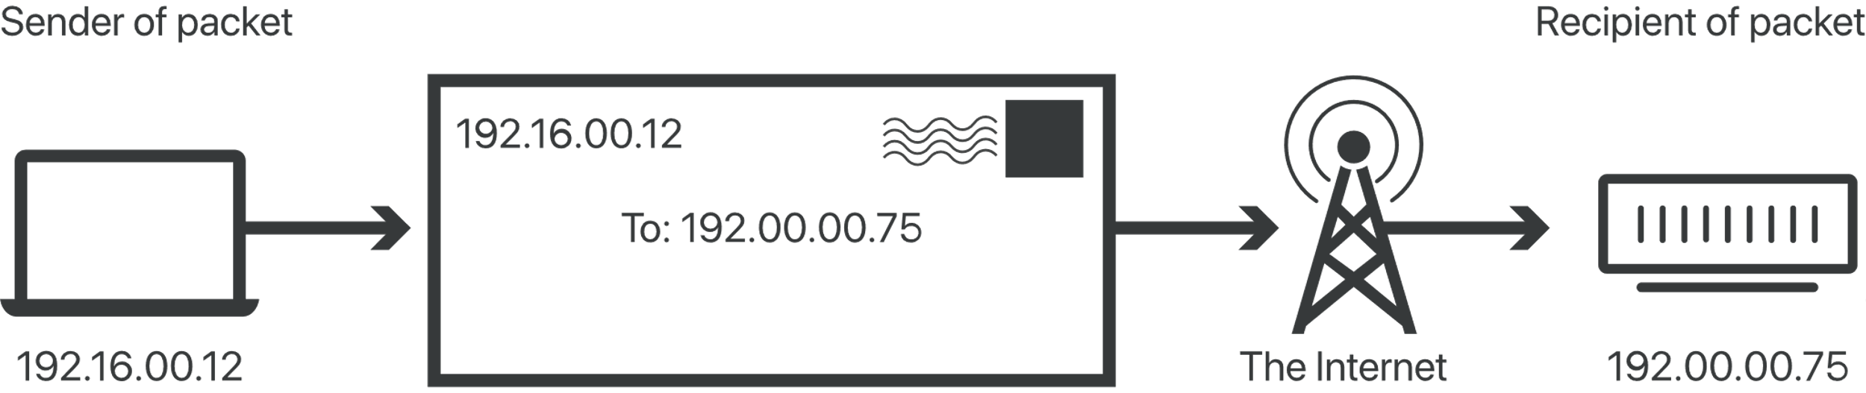
IP Address
Each IP address is a series of characters, such as '192.168.1.1’
Via DNS resolvers, which translate human-readable domain names into IP addresses, users are able to access websites without memorizing this complex series of characters.
Each IP packet will contain both the IP address of the device or domain sending the packet and the IP address of the intended recipient, much like how both the destination address and the return address are included on a piece of mail.

Slide 18
IP Address
IPV4 and IPV6 are the versions of internet protocol.
IPv4 was implemented in 1983 and is still in use today.
The format for IPv4 addresses is four sets of numbers separated by dots, for example: ‘192.0.2.1’.
This is a 32-bit format, which means that it allows for 2³², or about 4.3 billion, unique IP addresses, which it turns out is not enough for the amount of devices that are now on the Internet
The need for more IP addresses led to the implementation of IPv6. IPv6 addresses use a more complex format that utilizes sets of numbers and letters separated by single or double colons, for example:
An IPv6 (Normal) address has the following format: y : y : y : y : y : y : y : y where y is called a segment and can be any hexadecimal value between 0 and FFFF. The segments are separated by colons - not periods. An IPv6 normal address must have eight segments.

Slide 19
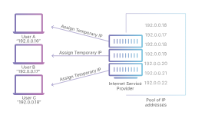
Static vs Dynamic IP
The limited supply of IPv4 addresses led to the introduction of dynamically assigning IP addresses, which is still a very common practice. Most devices connected to the Internet are assigned temporary IP addresses.
For example, when a home user connects to the Internet on their laptop, that user’s ISP assigns them a temporary IP address from a pool of shared IP addresses.
This is known as a dynamic IP address. This is more cost-effective for the ISP than assigning each user a permanent, or static, IP address.

Slide 20
Static vs Dynamic IP
Some ISP customers, such as large enterprises, will pay to maintain a static IP address (for example, Cloudflare’s 1.1.1.1)
For most users, having a dynamic IP address is sufficient
When hosting a web server, such as a self-hosted website, API, or gaming server, a dynamic IP address can create problems.
A change in IP address can cause their DNS queries to fail, effectively taking the resource offline.

Slide 21
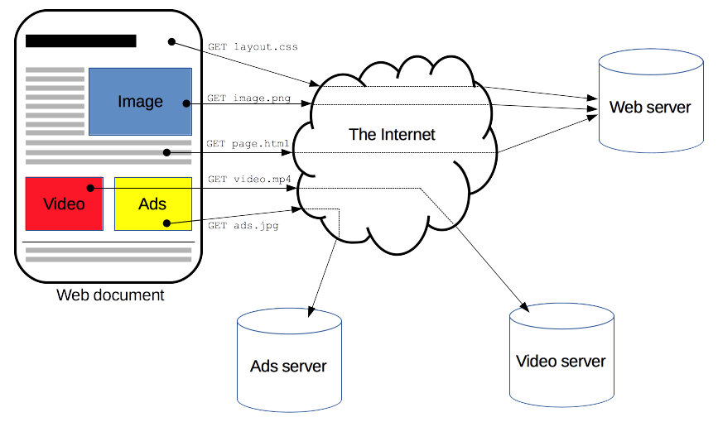
HTTP Protocol
HTTP is a protocol for fetching resources such as HTML documents.
It is the foundation of any data exchange on the Web.
it is a client-server protocol and application layer protocol.
Requests are initiated by the recipient, usually the Web browser. A complete document is reconstructed from the different sub-documents fetched, for instance, text, layout description, images, videos, scripts, and more.

Slide 22
HTTP Protocol
Clients and servers communicate by exchanging individual messages (as opposed to a stream of data). The messages sent by the client, usually a Web browser, are called requests and the messages sent by the server as an answer are called responses.
It is used to not only fetch hypertext documents, but also images and videos or to post content to servers, like with HTML form results. HTTP can also be used to fetch parts of documents to update Web pages on demand.

Slide 23
HTTP Protocol : Features
HTTP is an application layer protocol.
Simple : HTTP messages can be read and understood by humans, providing easier testing for developers, and reduced complexity for newcomers.
HTTP is extensible : HTTP headers make this protocol easy to extend and experiment with. New functionality can even be introduced by a simple agreement between a client and a server about a new header's semantics.
HTTP is stateless,but not session less . Session managed by cookies

Slide 24
HTTP Protocol : Flow
1. Open a TCP connection
2. Send an HTTP message:
3. Read the response sent by the server
4. Close or reuse the connection for further requests.

Slide 25
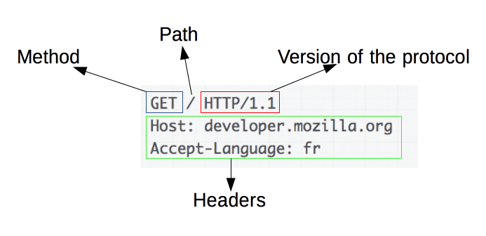
HTTP Message : Request

Slide 26
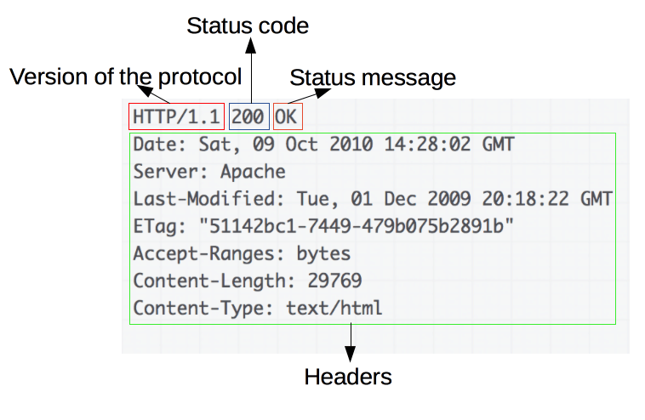
HTTP Message : Response

Slide 27
HTTPS
Hypertext Transfer Protocol Secure (HTTPS) is an extension of the Hypertext Transfer Protocol (HTTP).
It uses encryption for secure communication over a computer network, and is widely used on the Internet.
The communication protocol is encrypted using Transport Layer Security (TLS) or, formerly, Secure Sockets Layer (SSL). The protocol is therefore also referred to as HTTP over TLS, or HTTP over SSL.
HTTPS creates a secure channel over an insecure network. This ensures reasonable protection from eavesdroppers and man-in-the-middle attacks
Eavesdropping is the act of secretly or stealthily listening to the private conversation or communications of others without their consent in order to gather information.
a man-in-the-middle^{[a]} (MITM) attack is a cyberattack where the attacker secretly relays and possibly alters the communications between two parties who believe that they are directly communicating with each other, as the attacker has inserted themselves between the two parties.

Slide 28
SSL/TLS
SSL is presentation layer(lies between application and transport layer) protocol establishing an encrypted link between a server and a client—typically a web server (website) and a browser, or a mail server and a mail client (e.g., Outlook).
SSL allows sensitive information such as credit card numbers, social security numbers, and login credentials to be transmitted securely. Normally, data sent between browsers and web servers is sent in plain text—leaving you vulnerable to eavesdropping. If an attacker is able to intercept all data being sent between a browser and a web server, they can see and use that information.
All browsers have the capability to interact with secured web servers using the SSL protocol. However, the browser and the server need what is called an SSL Certificate to be able to establish a secure connection.
SSL secures millions of peoples’ data on the Internet every day, especially during online transactions or when transmitting confidential information

Slide 29
SSL/TLS : How it works
When a browser attempts to access a website that is secured by SSL, the browser and the web server establish an SSL connection using a process called an “SSL Handshake”
Three keys are used to set up the SSL connection: the public, private, and session keys.
Anything encrypted with the public key can only be decrypted with the private key, and vice versa.
Encrypting and decrypting with private and public key takes a lot of processing power, they are only used during the SSL Handshake to create a symmetric session key.
After the secure connection is made, the session key is used to encrypt all transmitted data.

Slide 30
SSL/TLS : How it works
Browser connects to a web server (website) secured with SSL (https). Browser requests that the server identify itself.
Server sends a copy of its SSL Certificate, including the server’s public key.
Browser checks the certificate root against a list of trusted CAs and that the certificate is unexpired, unrevoked, and that its common name is valid for the website that it is connecting to. If the browser trusts the certificate, it creates, encrypts, and sends back a symmetric session key using the server’s public key.
Server decrypts the symmetric session key using its private key and sends back an acknowledgement encrypted with the session key to start the encrypted session.
Server and Browser now encrypt all transmitted data with the session key.

Slide 31
FTP
File Transfer Protocol(FTP) is an application layer protocol that moves files between local and remote file systems.
It runs on top of TCP, like HTTP. To transfer a file, 2 TCP connections are used by FTP in parallel: control connection and data connection.
There are various other protocols like HTTP which are used to transfer files between computers, but they lack clarity and focus as compared to FTP.
The systems involved in connection are heterogeneous systems, i.e. they differ in operating systems, directories, structures, character sets etc.FTP shields the user from these differences and transfers data efficiently and reliably.
FTP can transfer ASCII, EBCDIC, or image files.

Slide 32
Web Standards Model
“Web standards" refers to a set of guidelines and best practices established by standardization organizations to ensure consistency, compatibility, and interoperability in web development.
Adhering to web standards helps developers create websites and web applications that work well across different browsers and devices.
The primary organizations responsible for defining web standards include the World Wide Web Consortium (W3C) and the Internet Engineering Task Force (IETF).

Slide 33
Web Standards Model
Here are key aspects of the web standards model that developers are encouraged to follow when creating web applications:
HTML (Hypertext Markup Language):
Standard: Use the latest version of HTML (currently HTML5) to structure the content of your web pages. HTML provides semantic elements for headings, paragraphs, lists, images, and more.
Best Practices: Follow proper HTML syntax, semantics, and document structure. Use elements and attributes according to their intended purposes. Validate your html using w3c html validator.
CSS (Cascading Style Sheets):
Standard: Utilize CSS for styling and layout. CSS3 is the latest version, offering enhanced capabilities for design and presentation.
Best Practices: Separate content (HTML) from presentation (CSS). Use external style sheets, practice efficient selectors, and apply responsive design principles for cross-device compatibility.
JavaScript:
Standard: Use JavaScript for client-side interactivity and dynamic behavior. Follow ECMAScript standards (e.g., ECMAScript 6 or later).
Best Practices: Employ unobtrusive JavaScript techniques, avoid browser-specific code, and consider accessibility in scripting. Use modern frameworks or libraries where appropriate.

Slide 34
Web Standards Model
4. Accessibility:
Standard: Ensure web content is accessible to all users, including those with disabilities. Follow the Web Content Accessibility Guidelines (WCAG) provided by the W3C.
Best Practices: Use semantic HTML, provide text alternatives for non-text content, ensure keyboard navigation, and use ARIA (Accessible Rich Internet Applications) roles and attributes.
5. Responsive Design:
Standard: Implement responsive web design to create a seamless user experience across various screen sizes and devices.
Best Practices: Use flexible grids and layouts, media queries, and fluid images. Test applications on different devices to ensure responsiveness.
6. Web Performance:
Standard: Optimize web performance for faster loading times. Follow best practices outlined by organizations like Google's Page Speed Insights.
Best Practices: Minimize HTTP requests, leverage browser caching, compress and optimize images, and use efficient coding practices.

Slide 35
Web Standards Model
7. Security:
Standard: Implement security best practices to protect against common vulnerabilities. Follow guidelines from organizations like the Open Web Application Security Project (OWASP).
Best Practices: Use secure coding practices, validate input, protect against cross-site scripting (XSS) and cross-site request forgery (CSRF), implement secure connections (HTTPS), and keep software dependencies updated.
Adhering to web standards not only ensures a consistent and reliable user experience but also contributes to a more sustainable and maintainable web ecosystem. It helps developers create web applications that are accessible, responsive, performant, and secure across different platforms and devices.

Slide 36
Semantic Tags over non-semantic
Semantic HTML elements are those that clearly describe their meaning in a human- and machine-readable way.
Benefits of semantic tags over non-semantic :
It is much easier to read.
It has greater accessibility : Search engines and assistive technologies (like screen readers for users with a sight impairment) are also able to better understand the context and content of your website, meaning a better experience for your users.
Semantic elements also lead to more consistent code. <div class="header">, <div id="header">, <div class="head">, or simply <div>

Slide 37
New Semantic Tags in HTML5
<article>
<aside>
<details>
<summary>{Used with details tag}
<figcaption>
<figure>
<footer>
<header>
<main>
<mark>
<nav>
<section>
<time>, <address> , <code>

Slide 38
Physical/Presentation Character Effects
Physical tags define the way a text should be displayed in the browser, controlling their physical characteristics.
They don’t care about the description or nature of the content to be displayed.
These tags straight forward define how the text will be shown on page.
Example :
<b>
<i>
<u>
<sub>
<sup>

Slide 39
Logical/Semantic Character effects
Logical tags describe the behavior, nature of the content for the enclosed text.
They present the functions of text.
Logical tags are used to indicate to the visually impaired person that there is something more important in the text or to emphasize the text ie, logical tags can be used for styling purposes as well as to give special importance to text content
<abbr>
<address>
<cite> , <code>
<blockquote> & <q>
<dfn>
<ins> & <del>
<pre>
<strong> & <em>

Slide 40
Managing html spaces
&nbsp;
This tag is used for displaying only one space between the text.
&ensp;
This tag is used for displaying two spaces.
&emsp;
This tag is used for displaying four spaces.
<br> tag :
To generate space below an html element using line break
<pre> tag to provide custom spaces
Using Css ( Later)

Slide 41
List
Numbered List/Ordered list
a. Default numbering
b. Changing the start number
b. Alphabetical order
c. Italics ordering
Bulleted List/Un ordered list
a. default/disc
b. circle
c. square

Slide 42
Image
Role of images in webpage
Adding image in web page
Sizing the image
Providing alt text
Using Image as hyperlinks
Floating image

Slide 43
Font-awesome Icons
STEP : Link the minified css of font awesome
<link href="https://cdnjs.cloudflare.com/ajax/libs/font-awesome/4.7.0/css/font-awesome.min.css" rel="stylesheet" type="text/css">
Step 2 : Go to the font-awesome 4.7 website ,search for the icon , select it and copy its snapshot.
Eg :
<i class="fa fa-user-circle-o" aria-hidden="true"></i>
Font awesome fonts can be customized by using font property of css.

Slide 44
Google Fonts
Benefit :
Uniformity of our website throughout all the computers on which whether a particular font is installed or not.
Steps :

Slide 45
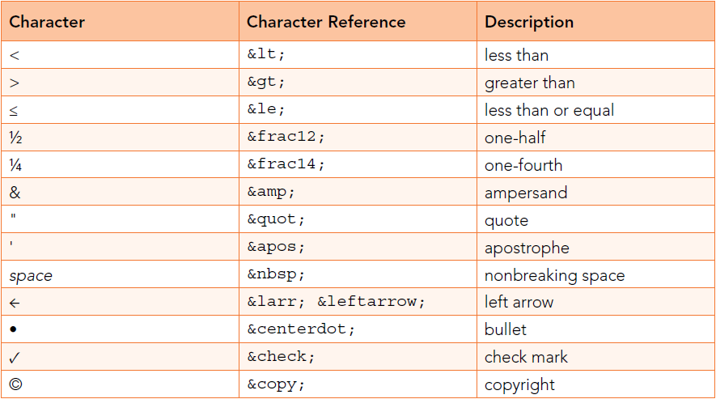
Special Characters

Slide 46
Table
A table is a structured set of data made up of rows and columns (tabular data).
Allows quickly and easily look up values that indicate some kind of connection between different types of data,
for example a person and their age
Don’t use tables for laying out the web page of form.
table tag
Using td , tr tags to create rows and columns
Adding headers with th tag.
rowspan and colspan
Practice problems

Slide 47
ImageMap
An image map is an image with clickable areas
<map> tag defines an image map
The areas are defined with one or more <area> tags.
<map name=“sample”>
<area cords = “x1,y1,x2,y2”>//square x1,y1 : left top cords , x2y2 , right bottom cords
<area cords = “x1,y1,radius”> //circle x1,y1 : left top cords , x2y2 , right bottom cords
<map>
<img src=“….” usemap=“#sample”/>

Slide 48
Forms
What
Why
Creating forms
Form elements
Label
Placeholders
Text field
Password field
Radio button and check box
Text Area
Dropdown
File Dialogue (accept attribute:image/png , image/jpeg , capture attribute:user/environment)
New form elements ( color, date ,time, tel , number , hidden, email , range , input list with datalist , search , datetime-local, month, week, url)

Slide 49
Web APIs
Application Programming Interfaces (APIs) are constructs made available in programming languages to allow developers to create complex functionality more easily.
APIs may be used to extend the functionalities of any applications like browsers(Browser API) , applications like Facebook, twitter (Third party APIs).
A Web API is an application programming interface for the Web.
A Browser API can extend the functionality of a web browser.
A Server API can extend the functionality of a web server.

Slide 50
HTML APIs
Web Socket
Server Sent Events (SSE)
Canvas
Audio/Video
Drag & Drop

Slide 51
Web Socket
The WebSocket API is an advanced technology that makes it possible to open a two-way interactive communication session between the user's browser and a server.
With this API, you can send messages to a server and receive event-driven responses without having to poll the server for a reply.
A WebSocket is a standard bidirectional TCP socket between the client and the server.

Slide 52
Web Socket
The socket starts out as a HTTP connection and then "Upgrades" to a TCP socket after a HTTP handshake. After the handshake, either side can send data.
Once you get a Web Socket connection with the web server, you can send data from browser to server by calling a send() method.
Client receives data from server to browser by an onmessage event handler

Slide 53
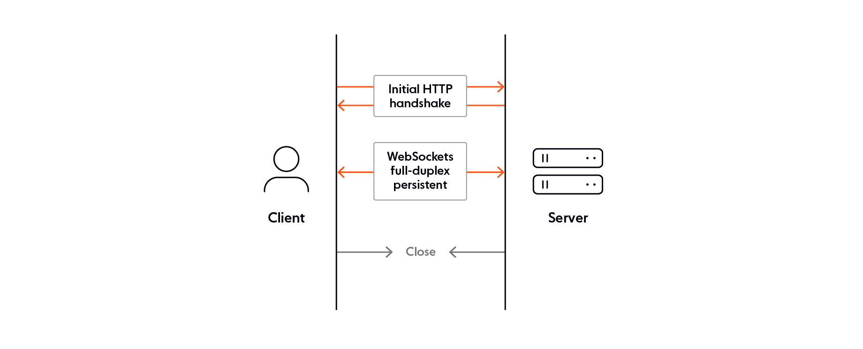
Web Socket

Slide 54
Web Socket : Live Example
Open connection :
ws=new WebSocket("wss://ws.postman-echo.com/raw");
Binding events
ws.onopen=function() {}
ws.onmessage=function(evt){}
ws.onerror=function(error){}
ws.onclose = function() { }
Close connection :
ws.close();

Slide 55
Web Socket : Applications
Live Chat :
Customer support chat to enhance online customer experience.
Livestream chat enabling participants to interact during live events.
Team messaging to increase connection and engagement.
Data broadcast :
a. Streaming live score updates.
b. Sending traffic updates.
c. Transmitting financial information, such as stock quotes and market updates.
d. Distributing news alerts.

Slide 56
Web Socket : Applications
Data synchronization refers to the process of ensuring that data is consistent and up-to-date across multiple devices or systems. Many realtime experiences rely on a flow from a database or datastore to frontend clients. Think, for example, of features like multi-user live polls and quizzes. Whenever a user votes in a poll, this event may be recorded in a database. And whenever there’s an update to the DB, the change needs to be propagated to all other connected clients.
In-app alerts and notifications
Realtime alerts and notifications are prevalent in today’s digital world. They’re basically used in every kind of app, whether it’s a social media/chat platform, an online marketplace, or a travel app. Due to their event-driven nature, WebSockets are the protocol of choice for many organizations implementing notification systems.

Slide 57
SSE (Server Sent Events)
How to send messages/updates from server to client”.
Three different ways to perform server-to-client updates:
Client polling
Web Socket,
Server-Sent Events (SSE).

Slide 58
SSE (Server Sent Events)
SSE is a technology that provides asynchronous communication with event stream from server to the client over HTTP for web applications
It is unidirectional unlike websocket( which is bidirectional)
It uses http ( unlike websocket (ws/wss))
The server can send un-directional messages/events to the client and can update the client asynchronously.

Slide 59
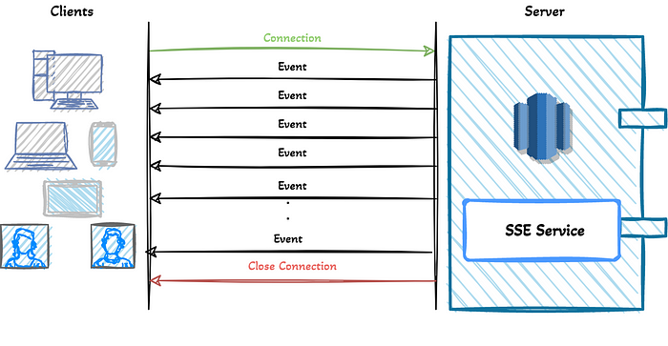
SSE (Server Sent Events)

Slide 60
SSE (Server Sent Events)
E-commerce Projects (notify whenever the user needs the information)
Tracking system
Alarm/Alert Projects
IoT Projects (Alarm, notify, events, rules, actions)
Stock Markets (Bitcoin etc.)
Breaking news, Sports Score Updates
Delivery projects
In-app notifications

Slide 61
SSE (Server Sent Events) : Technicals
The server-sent events streaming can be started by the client’s GET request to Server.
GET /api/v1/live-scores
Accept: text/event-stream
Cache-Control: no-cache
Connection: keep-alive

Slide 62
SSE (Server Sent Events) : Technicals
Server can send messages when the events are ready to send by the server. The important thing is that events are text messages in UTF-8 encoding.
List of pre-defined SSE field names include:
event: the event type defined by application
data: the data field for the event or message.
retry: The browser attempts to reconnect to the resource after a defined time when the connection is lost or closed.
id: id for each event/message
id: 1
event: score
data: GOAL Liverpool 1 - 1 Arsenal
data: GOAL Manchester United 3 - 3 Manchester City

Slide 63
Web Storage APIs
The Web Storage API provides mechanisms by which browsers can store key/value pairs, in a much more intuitive fashion than using cookies.
The two mechanisms within Web Storage are sessionStorage and localStorage

Slide 64
Web Storage APIs
sessionStorage maintains a separate storage area for each given origin that's available for the duration of the page session (as long as the browser is open, including page reloads and restores)
* Origin here refers to domain, port and protocol. i.e same app running on http vs https have different storage

Slide 65
Web Storage APIs
Stores data only for a session, meaning that the data is stored until the browser (or tab) is closed.
Data is never transferred to the server.
Storage limit is larger than a cookie (at most 5MB

Slide 66
Web Storage : localStorage
localStorage does the same thing, but persists even when the browser is closed and reopened.
Stores data with no expiration date, and gets cleared only through JavaScript, or clearing the Browser cache / Locally Stored Data.
Storage limit is the maximum amongst the two.

Slide 67
Canvas
The Canvas API provides a means for drawing graphics via JavaScript and the HTML <canvas> element.
It can be used for animation, game graphics, data visualization, photo manipulation, and real-time video processing.

Slide 68
Canvas
getContext(2d) : default size : 300x150
fallback content
skeleton example
ex2 : fillStyle = rgb(r,g,b)
fillRect(x,y,width,height)
strokeRect(x,y,width,height)
clearRect(x,y,width,height)

Slide 69
Canvas : Drawing Paths/Triangle eg.
function draw() {
const canvas = document.getElementById("canvas");
if (canvas.getContext) {
const ctx = canvas.getContext("2d");
ctx.beginPath();
ctx.moveTo(75, 50);
ctx.lineTo(100, 75);
ctx.lineTo(100, 25);
ctx.fill();
}
}

Slide 70
Canvas : Drawing Paths/Smiley eg.
function draw() {
const canvas = document.getElementById("canvas");
if (canvas.getContext) {
const ctx = canvas.getContext("2d");
ctx.beginPath();
ctx.arc(75, 75, 50, 0, Math.PI * 2, true); // Outer circle
ctx.moveTo(110, 75);
ctx.arc(75, 75, 35, 0, Math.PI, false); // Mouth (clockwise)
ctx.moveTo(65, 65);
ctx.arc(60, 65, 5, 0, Math.PI * 2, true); // Left eye
ctx.moveTo(95, 65);
ctx.arc(90, 65, 5, 0, Math.PI * 2, true); // Right eye
ctx.stroke();
}
}
Ctx.arc(x,y,radius, startingAngle, endingAngle, isAntiClockwise)

Slide 71
Canvas : Text
const ctx = document.getElementById("canvas").getContext("2d");
ctx.font = "48px serif";
a.) ctx.fillText("Hello world", 10, 50);
b.) ctx.strokeText(“Hello world”,10,50);

Slide 72
Drag & Drop
HTML Drag and Drop interfaces enable applications to use drag-and-drop features in browsers.
The user may select draggable elements with a mouse, drag those elements to a droppable element, and drop them by releasing the mouse button.
A translucent representation of the draggable elements follows the pointer during the drag operation.
We can customize which elements can become draggable, the type of feedback the draggable elements produce, and the droppable elements.

Slide 73
Drag & Drop : Events
drag A dragged item is dragged.
dragend A drag operation ends (such as releasing a mouse button or hitting the Esc key)
dragenter A dragged item enters a valid drop target.
dragleave A dragged item leaves a valid drop target.
dragover .A dragged item is being dragged over a valid drop target,
dragstart The user starts dragging an item.
drop An item is dropped on a valid drop target.

Slide 74
Drag & Drop : Technicals
Making an element draggable requires adding the draggable attribute and the dragstart event handler
An element becomes a drop zone or is droppable, the element must have both ondragover and ondrop event handler attributes.
We should prevent the default behavior of browser ie. Disallowing drops on any element inside the handler functions of ondragover and ondrop so that the particular element becomes droppable item.
event.dataTransfer.setData(“type”,value) : drag event
event.dataTransfer.getData(“type”); : drop event
append the element of given id(got from getData) : inside drop event handler

Slide 75
Audio & Video
Influx of online videos and audio were made possible by plugin-based technologies like Flash and Silverlight.
Both of these had security and accessibility issues, and are now obsolete.
Now to integrate audio and video we have native HTML solutions <video> and <audio> elements.
These elements can be controlled by JavaScript APIs.
We can instead also embed videos/audios provided by OVM’s like youtube( embed iframe code is provided by them)

Slide 76
Audio & Video
Video Element
“controls” attribute
Drawback with controls :
a. One big issue with the native browser controls is that they are different in each browser — not very good for cross-browser support!
b. Another big issue is that the native controls in most browsers aren't very keyboard-accessible.
Solution : These problems can be solved by hiding the native controls (by removing the controls attribute), and programming our own with HTML, CSS, and JavaScript

Slide 77
Audio & Video
Fallback content ( Include a link )
Formats like MP3, MP4 and WebM are called container formats
They define a structure in which the audio and/or video tracks that make up the media are stored, along with metadata describing the media, what codecs are used to encode its channels, and so forth.

Slide 78
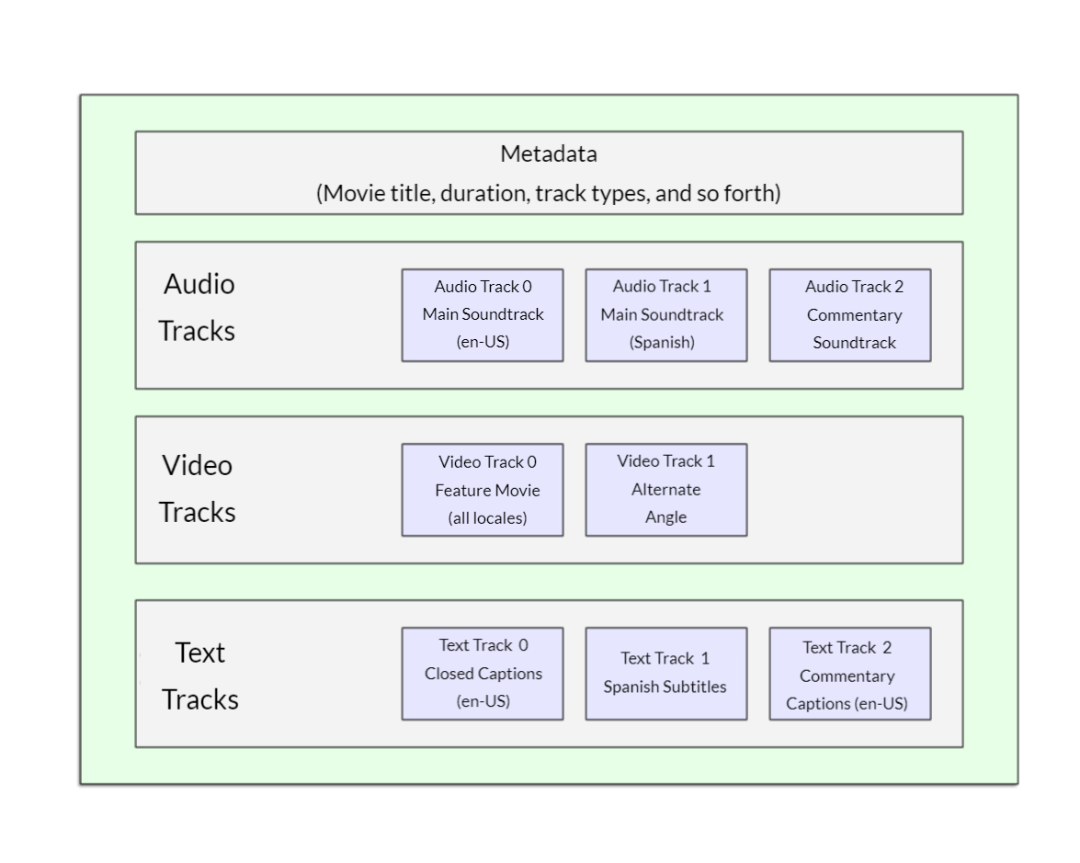
Sample Video Format
A WebM file containing a movie which has a main video track and one alternate angle track, plus audio for both English and Spanish, in addition to audio for an English commentary track can be conceptualized as shown in the diagram below. Also included are text tracks containing closed captions for the feature film, Spanish subtitles for the film, and English captions for the commentary.

Slide 79
Sample Video Format
Each audio track is encoded using an audio codec, while video tracks are encoded using a video codec.
Different browsers support different video and audio formats, and different container formats
A WebM container typically packages Vorbis or Opus audio with VP8/VP9 video. This is supported in all modern browsers, though older versions may not work.
An MP4 container often packages AAC or MP3 audio with H.264 video. This is also supported in all modern browsers.
The Ogg container tends to use Vorbis audio and Theora video. This is best supported in Firefox and Chrome, but has basically been superseded by the better quality WebM format.
for some types of audio, a codec's data is often stored without a container, or with a simplified container. One such instance is the FLAC codec
An audio player will tend to play an audio track directly, e.g. an MP3 or Ogg file. These don't need containers

Slide 80
Video : Features
Src
Video tag with source tag and multiple source tags
Width
Height
Controls
Loop
Muted
Poster
Autoplay(in modern browsers works only with muted)
Preload (none, auto:buffers media ,metadata : buffers metadata only)

Slide 81
Audio Element
The <audio> element works just like the <video> element, with a few small differences.
Multiple source tags nested in audio tag
There is no visual component
There is no width and height attribute on audio tag
There is no poster attribute on audio element.

Slide 82
Displaying video text tracks
WebVTT is a format for writing text files containing multiple strings of text along with metadata such as the time in the video at which each text string should be displayed, and even limited styling/positioning information.
These text strings are called cues, and there are several kinds of cues which are used for different purposes.
Common Cues :
subtitles
Translations of foreign material, for people who don't understand the words spoken in the audio.
captions
Synchronized transcriptions of dialog or descriptions of significant sounds, to let people who can't hear the audio understand what is going on.
timed descriptions
Text which should be spoken by the media player in order to describe important visuals to blind or otherwise visually impaired users.
<track kind="subtitles" src="subtitles_es.vtt" srclang="es" label="Spanish" />

Slide 83
Media
Audio / Video Tag
audio tag
video tag
source tag
showing controls
src attribute
loop
autoplay
muted

Slide 84
Embedding
frames to create websites — small parts of a website stored in individual HTML pages. These were embedded in a master document called a frameset, which allowed you to specify the area on the screen that each frame filled, rather like sizing the columns and rows of a table.
Later , plugin technologies became very popular, such as Java Applets and Flash — these allowed web developers to embed rich content into webpages such as videos and animations, which just weren't available through HTML alone. Embedding these technologies was achieved through elements like <object>, and the lesser-used <embed>, and they were very useful at the time.
Outdated because of many problems, including accessibility, security, file size, and more
Finally, the <iframe> element appeared (along with other ways of embedding content, such as <canvas>, <video>, etc.) This provides a way to embed an entire web document inside another one, as if it were an <img> or other such element, and is used regularly today.

Slide 85
Embedding
Try embedding any youtube video
Try embedding any google map
<iframe> elements are designed to allow you to embed other web documents into the current document.
Clickjacking : Clickjacking is one kind of common iframe attack where hackers embed an invisible iframe into your document (or embed your document into their own malicious website) and use it to capture users' interactions. This is a common way to mislead users or steal sensitive data.
X-Frame-Options headers /directive set to "DENY“ to disallow any web document from being embedded

Slide 86
CSS
Cascading style sheet
Used to modify or style the html elements.
CSS is the code that styles web content.
CSS is neither programming language, nor markup language, it is stylesheet.
Syntax :
selector
{
property : property_value;
}

Slide 87
How to apply css / Types of css
There are 3 ways :
Element Level (Inline CSS)
Document Level (Internal CSS)
Global (External CSS)

Slide 88
Selectors
Element Selector
Class Selector
Id Selector
Attribute Selector
Child selector ( >)
Descendant selector ( space )
Grouping multiple selectors
Pseudo-class selector
Universal selector ( * )

Slide 89
Attribute Selectors
[attr] | a[title] | Matches elements with an attr attribute (whose name is the value in square brackets).
[attr=value] | a[href="https://example.com"] | Matches elements with an attr attribute whose value is exactly value — the string inside the quotes.
[attr~=value] | p[class~="special"] | Matches elements with an attr attribute whose value is exactly value, or contains value in its (space separated) list of values.
[attr|=value] | div[lang|="zh"] | Matches elements with an attr attribute whose value is exactly value or begins with value immediately followed by a hyphen.

Slide 90
Attribute Selectors
Example :
<div>
<ul>
<li class='one'>One</li>
<li class='two'>Two</li>
<li class='one two'>Three</li>
<li class='one-two'>Four</li>
</ul>
</div>
With all four variations in css

Slide 91
Attribute Selectors : Substring Matching
[attr^=value] | li[class^="box-"] | Matches elements with an attr attribute, whose value begins with value.
[attr$=value] | li[class$="-box"] | Matches elements with an attr attribute whose value ends with value.
[attr*=value] | li[class*="box"] | Matches elements with an attr attribute whose value contains value anywhere within the string.

Slide 92
Pseudo class Selectors
Pseudo-classes are used to select and style elements based on their state or position, such as :hover, :active, :focus, :first-child, :nth-child, etc.
They are added to the selector and represent a specific state or condition that an element might be in.
Pseudo-classes are keywords that start with a colon. For example, :hover is a pseudo-class.

Slide 93
Pseudo class Selectors
First-child (of its parent)
Last-child (of its parent)
nth-child(value) (of its parent)
Only-child (of its parent)
not()
User action pseudo classes :
hover
focus
blur
Anchor tag : link , :visited
https://developer.mozilla.org/en-US/docs/Web/CSS/:modal

Slide 94
Pseudo Element Selectors
Pseudo-elements, allow us to style specific parts of an element. They are denoted by double colons (::) and are used to create virtual elements or target specific portions of an element, like ::before or ::after.
::first-line , ::first-letter ( only applicable to block level elements)
::before , ::after ( h1::before { content : url(<img-url>)}
::marker { markers of list items)
::selection ( to modify selected content)

Slide 95
Combinators
Descendant combinators ( space )
Child Combinator ( > )
Next Adjacent Sibling Combinator ( + )
Next siblings combinator ( ~ )

Slide 96
Resolving Conflicting Declarations
Highest
Priority
Declarations marked ! important
Inline style (style attribute in HTML)
ID (#) selector
Class (.) or pseudo-class (:) selector
Element selector (p, div, li, etc.)
Lowest
Priority
Universal selector (*)

Slide 97
Cascade , Specificity, Inheritance
Cascade : Inline > (Internal /External : latest in declaration will get priority)
Specificity : Class is more specific than element , Id is more specific than class.
Inheritance : Some properties are derived from parent (like color, font-size/family)

Slide 98
Inheritance
Inheritance is a fundamental concept in CSS that allows styles to be passed down from parent elements to their child elements. When you apply a style to a parent element, its children will inherit that style unless overridden by a more specific style. This makes it easier to create consistent and maintainable styles throughout a webpage.
Not all styles are inherited by default. Properties like border, margin, padding, etc., are not inherited. However, other properties like color, font-family, and text-align are inherited.
To explicitly inherit a property, you can use the inherit keyword:

Slide 99
Controlling inheritance
CSS provides some special universal property values for controlling inheritance.
Inherit : Sets the property value applied to a selected element to be the same as that of its parent element. Effectively, this "turns on inheritance".
Initial : Sets the property value applied to a selected element to the initial value of that property defined on a per-property basis by the CSS specifications
Unset : Set a property to its inherited value if it inherits or to its initial value if not.

Slide 100
Absolute Units
cm | Centimeters | 1cm = 37.8px = 25.2/64in
mm | Millimeters | 1mm = 1/10th of 1cm
Q | Quarter-millimeters | 1Q = 1/40th of 1cm
in | Inches | 1in = 2.54cm = 96px
pc | Picas | 1pc = 1/6th of 1in
pt | Points | 1pt = 1/72nd of 1in
px | Pixels | 1px = 1/96th of 1in

Slide 101
Relative Units
em : Font size of the parent, in the case of typographical properties like font-size, and font size of the element itself, in the case of other properties like width.
rem : Font size of the root element.
% : with respect to immediate parent

Slide 102
Styling Text : Basic
Text inside an element is laid out inside the element's content box.
Starts at the top left of the content area and flows towards the end of the line.
Once it reaches the end, it goes down to the next line and flows to the end again.

Slide 103
Styling Text : Text Formatting
color
alignment(left, right , center , justify)
decoration( underline, overline, line-through,none)
Transformation( uppercase , lowercase , capitalize)
Indentation
Spacing (letter and word)
Line height
Text-direction (direction:ltr, rtl)
Text-shadow

Slide 104
CSS : Overflow
Auto
Scroll
Hidden
Visible

Slide 105
CSS : Multi Column Layout
column-count
column-gap
column-width
When column-count and column-width both are specified, then column-count works as max no. of columns.
columns : shorthand for column count and width

Slide 106
CSS : Multi Column(Styling columns)
column-rule-width (thin,medium,thick, px val)
column-rule-style (solid dotted dashed double ridge)
column-rule-color
column-rule (shorthand for above prop.)

Slide 107
CSS : Multi Column
column-span( none / all)

Slide 108
CSS : Float Layout
The float property was introduced to allow web developers to implement layouts involving an image floating inside a column of text, with the text wrapping around the left or right of it. The kind of thing you might get in a newspaper layout.
Later started being used for multi column layout.
After Introduction of flex and grid for layout , again used for its original purpose.

Slide 109
Float Layout: How it works
Eg. Having single box and 3 paras after that
The element with the float set on it is taken out of the normal layout flow of the document and stuck to the left/right-hand side of its parent container.
Any content that would come below the floated element in the normal layout flow will now wrap around it instead, filling up the space to the right-hand/left-hand side of it as far up as the top of the floated element.
Floating the content to the right has exactly the same effect, but in reverse: the floated element will stick to the right, and the content will wrap around it to the left. Try changing the float value to right and replace margin-right with margin-left.

Slide 110
Float Layout: How it works
We can add a margin to the float to push the text away, we can't add a margin to the text to move it away from the float. This is because a floated element is taken out of normal flow and the boxes of the following items actually run behind the float
Change the margin-right on our float to margin so you get space all around the float. You'll be able to see the background on the paragraph running right underneath the floated box, as in the example below.
The line boxes of our following element have been shortened so the text runs around the float, but due to the float being removed from normal flow the box around the paragraph still remains full width.
If we want to stop the following element from moving up, we need to clear it; this is achieved with the clear property. ( Try clear:left on following paras)
(left: Clear items floated to the left , right: Clear items floated to the right ,both: Clear any floated items, left or right.)
Display : flow-root on container box of div and p to clear float on following para(2nd)

Slide 111
Responsive Design: Meaning
Responsive web design (RWD) is a web design approach to make web pages render well on all screen sizes and resolutions while ensuring good usability.
It is the way to design for a multi-device web.
HTML is fundamentally responsive, or fluid. If you create a web page containing only HTML, with no CSS, and resize the window, the browser will automatically reflow the text to fit the viewport.
But in default responsive way , long lines of text displayed full screen on a wide monitor can be difficult to read.
Creating a non-resizable web page by setting a fixed width doesn't work either; that leads to scroll bars on narrow devices and too much empty space on wide screens.
Responsive web design isn't a separate technology — it is an approach. It is a term used to describe a set of best practices used to create a layout that can respond to any device being used to view the content.

Slide 112
Responsive Design : Media Query
Media queries allow us to run a series of tests (e.g. whether the user's screen is greater than a certain width, or a certain resolution) and apply CSS selectively to style the page appropriately for the user's needs.
First Example :
@media screen and (min-width: 80rem) {
.container {
margin: 1em 2em;
}
}

Slide 113
Responsive Design : Media Query
We can add multiple media queries within a stylesheet, tweaking your whole layout or parts of it to best suit the various screen sizes.
The points at which a media query is introduced, and the layout changed, are known as breakpoints.
A common approach when using Media Queries is to create a simple single-column layout for narrow-screen devices (e.g. mobile phones), then check for wider screens and implement a multiple-column layout when you know that you have enough screen width to handle it. Designing for mobile first is known as mobile first design.
layout methods, including Multiple-column layout, Flexbox, and Grid are responsive by default. They all assume that you are trying to create a flexible grid and give you easier ways to do so.
Eg : 2 paras responsive(mobile-first) using a. float b. flex c. grid

Slide 114
Responsive Design : Media Query
Media Types : all , print , screen
We can apply CSS if the viewport is above or below a certain width — or an exact width — using the min-width, max-width, and width media features.
Eg : @media screen and (width: 600px) { }
@media (orientation : landscape){}
Complex queries : and , or (,) , not

Slide 115
Responsive Design : Media
To ensure media is never larger than its responsive container, the following approach can be used:
img,picture,video {
max-width: 100%;
}
Responsive Images, using the <picture> element and the <img> srcset and sizes attributes enables serving images targeted to the user's viewport and the device's resolution. For example, you can include a square image for mobile, but show the same scene as a landscape image on desktop.
<picture>
<source media="(max-width: 799px)" srcset="elva-480w-close-portrait.jpg" />
<source media="(min-width: 800px)" srcset="elva-800w.jpg" />
<img src="elva-800w.jpg" alt="Chris standing up holding his daughter Elva" />
</picture>

Slide 116
Responsive Design : Typography
Using media queries for responsive typography
Viewport units vw can also be used to enable responsive typography, without the need for setting breakpoints with media queries. 1vw is equal to one percent of the viewport width, meaning that if you set your font size using vw, it will always relate to the size of the viewport.
the user loses the ability to zoom any text set using the vw unit, as that text is always related to the size of the viewport. Therefore you should never set text using viewport units alone.
If we add the vw unit to a value set using a fixed size such as ems or rems then the text will still be zoomable. Essentially, the vw unit adds on top of that zoomed value:
h1 {
font-size: calc(1.5rem + 3vw);
}

Slide 117
SEO : Metadata vs Microdata
Metadata – We can think of metadata as telling searchers what the page content is about. For example, the meta description might say, "This blog post will tell you five tools to improve your data server's efficiency." Some common metadata tags include the title, the URL slug, and the page description. These are mostly for the searcher's benefit, hinting at what they are about to read.
Microdata – We can think of microdata as telling search engines what the page elements are. In other words, microdata gives labels to individual content chunks. Then, a search engine will highlight these chunks in searches. For example, we may use microdata to say, "Hey, Google, this following text is the author's name," or "This next chunk of information is a star rating." This is like speaking directly to Google or Bing, but it benefits the searcher in the end.
Note : The significance of metadata is decreasing for ranking power. In other words, just because you include a page description sprinkled with keywords doesn't mean your page will rank higher . But on the other hand, microdata is preferred by search engines because it makes their crawling easier for your website.

Slide 118
SEO : Metatags
Title tags (unique,keep around 50-60 long chars, include brand , and imp keywords)
Meta description tag(appear along with title on search results, describes the page , google snippets around 150-160 chars)
Heading tags (h1-h6) (imp for content organization on page)
Image alt attribute (provide context because search engines can’t “see” images.)
Nofollow attribute ( a href=‘’ rel=‘nofollow’) on links( those which you want google to avoid visiting) (signin/register links , sponsor links , untrusted links , links which can be spammed and beyond our controls)
Use meta tag “<meta name="robots" content="noindex">” on those pages that you don’t want to index ( like those with thin content, under progress/draft etc)

Slide 119
SEO : Metatags
Canonical Link : <link rel="canonical" href="https://example.com/preferred-url-here/" /> in the head section
schema markup
viewport meta tag
Social media meta tags : og for facebook, twitter for twitter cards.
og:title – here you put the title which you want to be displayed when your page is linked to.
og:url – your page’s URL.
og:description – your page’s description. Remember that Facebook will display only about 300 characters of description.
og:image – here you can put the URL of an image you want to be shown when your page is linked to.

Slide 120
SEO : Microdata
Where to use Micro data : Specifically, we need to identify these chunks using the Schema language:
Image
Author
Opening Hours , Closing Hours
Date published
Date last modified
Headline
Events
Format (i.e. blog) etc.
visit Schema.org and search for business and education example category microdata

Slide 121
Web Accessibility
accessible", means that any user can use all its features and content, regardless of how the user accesses the web ,even and especially users with physical or mental impairments.
Sites should be accessible to keyboard, mouse, and touch screen users, and any other way users access the web, including screen readers and voice assistants like Alexa and Google Home.
usable by people regardless of auditory, visual, physical, or cognitive abilities.
Sites should also not cause harm: web features like motion can cause migraines or epileptic seizures.
Making webpage accessible also benefits other groups such as those using mobile devices, or those with slow network connections.

Slide 122
Web Accessibility
A great deal of web content can be made accessible just by making sure the correct Hypertext Markup Language elements are used for the correct purpose at all times.
Using semantic HTML
Example of div vs button for button click event ( keyboard access using tab and enter and space)
Good semantics : https://mdn.github.io/learning-area/accessibility/html/good-semantics.html
Bad semantics : https://mdn.github.io/learning-area/accessibility/html/bad-semantics.html

Slide 123
WAI - ARIA
Web Accessibility Initiative - Accessible Rich Internet Applications
Set of roles and attributes that define ways to make web content and web applications (especially those developed with JavaScript) more accessible to people with disabilities
Before semantic tags if users had to create custom components like date picker, sliders , they used js and css with only divs and nested divs on html , screen readers can't make any sense of what they are at all, and their users just get told that they can see a jumble of elements with no semantics to describe what they mean.
WAI-ARIA is a specification written by the W3C, defining a set of additional HTML attributes that can be applied to elements to provide additional semantics and improve accessibility wherever it is lacking.

Slide 124
WAI - ARIA
There are three main features defined in the spec
Roles :
a. These define what an element is or does.
b. Many of these are so-called landmark roles, which largely duplicate the semantic value of structural elements, such as role="navigation" (<nav>) or role="complementary" (<aside>).
c. Some other roles describe different page structures, such as role="banner", role="search", role="tablist", and role="tabpanel", which are commonly found in UIs.

Slide 125
WAI - ARIA
Properties :
These define properties of elements, which can be used to give them extra meaning or semantics
example, aria-required="true" specifies that a form input needs to be filled in order to be valid, or eg , aria-labelledby=‘some id of p’ can be used as alternate to alt tag on image for screen readers
( Take example of : https://mdn.github.io/learning-area/accessibility/html/accessible-image.html)

Slide 126
WAI - ARIA
States :
Special properties that define the current conditions of elements, such as aria-disabled="true", which specifies to a screen reader that a form input is currently disabled.
States differ from properties in that properties don't change throughout the lifecycle of an app, whereas states can change, generally programmatically via JavaScript
ARIA Roles : https://developer.mozilla.org/en-US/docs/Web/Accessibility/ARIA/Roles
ARIA States and Properties : https://developer.mozilla.org/en-US/docs/Web/Accessibility/ARIA/Attributes#states_and_properties_defined_on_mdn
https://developer.mozilla.org/en-US/docs/Learn/Accessibility/Multimedia#simple_images

Slide 127
WAI - ARIA
States :
Special properties that define the current conditions of elements, such as aria-disabled="true", which specifies to a screen reader that a form input is currently disabled.
States differ from properties in that properties don't change throughout the lifecycle of an app, whereas states can change, generally programmatically via JavaScript
ARIA Roles : https://developer.mozilla.org/en-US/docs/Web/Accessibility/ARIA/Roles
ARIA States and Properties : https://developer.mozilla.org/en-US/docs/Web/Accessibility/ARIA/Attributes#states_and_properties_defined_on_mdn
https://developer.mozilla.org/en-US/docs/Learn/Accessibility/Multimedia#simple_images

Slide 128
Web Services &APIs
Web services are a technology that enables different software applications to communicate and interact with each other over the internet or a network, regardless of the programming languages or platforms they are built on. They serve as a bridge between distributed systems, allowing them to exchange data and functionality seamlessly.
"Imagine web services as a universal language for software applications. Just like people from different countries can communicate using a common language like English, web services provide a standardized way for software programs to talk to each other, even if they were created using different programming languages or run on different types of computers.
web service as a menu at a restaurant. The menu lists the dishes you can order, along with descriptions of each dish. In this analogy, the menu is like the web service, and the dishes are the functions or data that another software program can request.

Slide 129
Web Services &APIs
Web services encompass a variety of communication protocols and architectural styles, including:
SOAP (Simple Object Access Protocol): SOAP is a protocol commonly associated with web services. It uses XML as the message format and can be transported over various protocols, including HTTP, SMTP, and more. SOAP services often have strict contracts and are used in enterprise-level integrations.
REST (Representational State Transfer): REST is an architectural style for designing networked applications. It uses HTTP methods (GET, POST, PUT, DELETE, etc.) to interact with resources identified by URLs. RESTful APIs, often referred to simply as web APIs, are a type of web service that follows REST principles.
XML-RPC and JSON-RPC: These are remote procedure call (RPC) protocols that use XML or JSON for data encoding. They allow one system to invoke methods or functions on another system over a network.
GraphQL: GraphQL is a query language for APIs that allows clients to request exactly the data they need, making it a more flexible alternative to traditional REST APIs. GraphQL services can be considered a type of web API.
WebSockets:

Slide 130
Web Services &APIs
Web Service: Web services are a broader category of technologies that include APIs. Web services are a standardized way for different software applications to communicate with each other over a network, and they can use various communication protocols, including SOAP (Simple Object Access Protocol), REST, XML-RPC, and others.
Web API: A web API is a specific type of web service that is based on the principles of REST (Representational State Transfer) or other conventions for structuring URLs and requests. It provides a more standardized and lightweight way for applications to interact over the web.

Slide 131
Web Services &APIs
SOAP (Simple Object Access Protocol) and REST (Representational State Transfer) are two different approaches for building web services,
While SOAP is still used in certain scenarios, REST has gained popularity for several reasons
a. Ease of Use: REST is simpler and easier to understand than SOAP.
b. Lightweight: REST has a lightweight architecture compared to SOAP. It doesn't require as much overhead in terms of message size and processing, making it more efficient for network communication. This efficiency is especially important for mobile devices and low-bandwidth environments.
c. Statelessness:This makes RESTful services scalable and easy to maintain, as servers don't need to store client session information.
d. JSON

Slide 132
CSS Models : Box Model
Everything in CSS has a box around it
Block vs Inline boxes
Boxes have an inner display type and an outer display type.
Outer display type : block , inline , inline-block
Inner display type : flex , grid

Slide 133
MultiColumn Layout
Column-count
Column-width
Using both together
Column-rule-style
Column-rule-color
Coloumn-rule-width
Column-rule shorthand ( column-rule : solid 6px blue)

Slide 134
Outer Display : Block
The box will break onto a new line.
The width and height properties are respected.
Padding, margin and border will cause other elements to be pushed away from the box.
If width is not specified, the box will extend in the inline direction to fill the space available in its container. In most cases, the box will become as wide as its container, filling up 100% of the space available.
Eg : div , h1 , p , section , etc.

Slide 135
Outer Display : Inline
The box will not break onto a new line.
The width and height properties will not apply.
Top and bottom padding, margins, and borders will apply but will not cause other inline boxes to move away from the box.
Left and right padding, margins, and borders will apply and will cause other inline boxes to move away from the box.

Slide 136
Inner Display : Flex
By default and without any other instruction, the elements inside a box are also laid out in normal flow and behave as block or inline boxes.
We can change the inner display type for example by setting display: flex;. The element will still use the outer display type block but this changes the inner display type to flex. Any direct children of this box will become flex items and behave according to the Flexbox specification.
Flexbox is a one-dimensional layout method for arranging items in rows or columns. Items flex (expand) to fill additional space or shrink to fit into smaller spaces.

Slide 137
Inner Display : Why Flex
For a long time, the only reliable cross-browser compatible tools available for creating CSS layouts were features like floats and positioning.
These work, but in some ways they're also limiting and frustrating.
Scenarios where flexbox is needed and floats and position is difficult :
Vertically centering a block of content inside its parent.
Making all the children of a container take up an equal amount of the available width/height, regardless of how much width/height is available.
Making all columns in a multiple-column layout adopt the same height even if they contain a different amount of content.

Slide 138
Inner Display : Example
Example having single section having 3 articles
The parent having display flex is called flex container and its child are flex items
Without display flex , the child articles will layout one by one each in new row
Observe the difference with flex.
With display flex, they should be arranged as equal width equal height columns in single row
Display : flex means child will be flex items parent will be block level , respect to external elements to it whereas if display : inline-flex , then parent will be inline with respect to external world and its child will be flex.

Slide 139
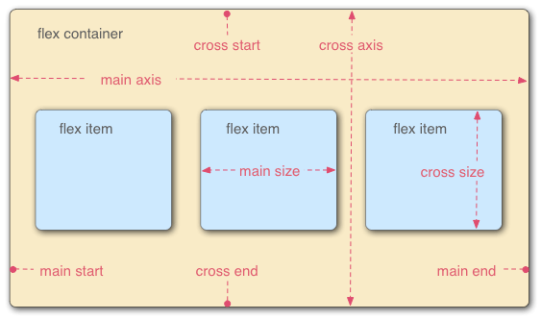
Inner Display : Flex Model

Slide 140
Inner Display : Flex Model
flex-direction : by default row . Other values are column, row-reverse, column-reverse.
One issue that arises when you have a fixed width or height in your layout is that eventually your flexbox children will overflow their container, breaking the layout( example of 8 articles in the example)
To solve this problem , to the parent apply property flex-wrap : wrap/wrap-reverse and to flex items apply property flex : width value( eg 200px)
Order property on flex item

Slide 141
Inner Display : Flex Model
Flex-flow shorthand
Combining flex-direction: row;flex-wrap: wrap; into a single line flex-flow : row wrap
Relative size of each flex item can be managed by property flex : 1 or flex : 2 or so on .
Example of scaling 3rd article out of 3 to 2 and remaining to 1.

Slide 142
Inner Display : Flex Model
Horizontal and Vertical Alignment
Main-axis : justify-content : left , right , center, space-around , space-between , space-around
Cross-axis : align-items : flex-start , center , flex-end, stretch
Individually if a flex-item needs to be aligned separately then on flex-item we will apply align-self property
Example of single div multiple buttons in it for demo of horizontal and vertical alignments. In next eg. Nested flex eg.

Slide 143
Inner Display : Flex Model
flex: shorthand versus longhand
flex is a shorthand property that can specify up to three different values:
flex : 1 , flex : 2
The unitless proportion value we discussed above. This can be specified separately using the flex-grow longhand property.
A second unitless proportion value, flex-shrink, which comes into play when the flex items are overflowing their container. This value specifies how much an item will shrink in order to prevent overflow. This is quite an advanced flexbox feature and we won't be covering it any further in this article.
The minimum size value we discussed above. This can be specified separately using the flex-basis longhand value.

Slide 144
Inner Display : Grid
CSS Grid Layout is a two-dimensional layout system for the web
It lets us lay content out in rows and columns.
It makes building complex layouts straightforward.
A grid is a collection of horizontal and vertical lines creating a pattern against which we can line up our design elements
They help us to create layouts in which our elements won't jump around or change width as we move from page to page, providing greater consistency on our websites.
A grid will typically have columns, rows, and then gaps between each row and column. The gaps are commonly referred to as gutters.

Slide 145
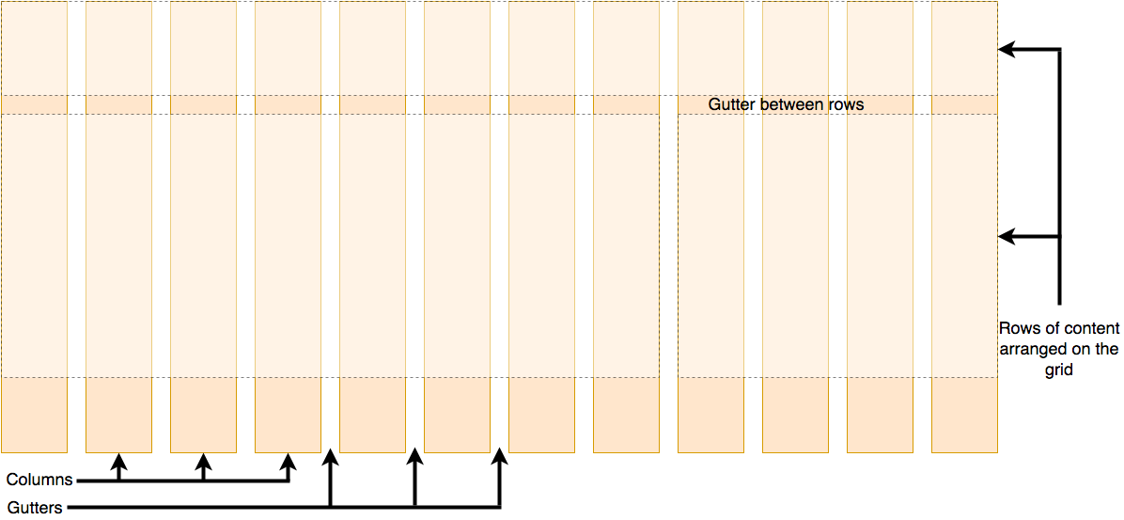
Inner Display : Grid

Slide 146
Inner Display : Grid
use display:grid on container element,( single container 7 child divs)
all of the direct children of the container become grid items
display: grid gives a one column grid, so grid items will continue to display one below the other as they do in normal flow.
To see something that looks more grid-like, we'll need to add some columns to the grid. Using grid-template-columns: 200px 200px 200px;
Flexible grids with the fr unit , fr means one fraction of available space ( instead of 200px , use 1fr)
grid-template-columns: 2fr 1fr 1fr will make the first column always twice the size of second and third columns.
We can compose the view with set of columns out of which some are fixed and some are flexible( will respond according to available space)

Slide 147
Inner Display : Grid
Gaps Between the tracks
column-gap for gaps between columns
row-gap for gaps between rows
gap as a shorthand for both
display: grid;
grid-template-columns: 2fr 1fr 1fr;
gap: 20px;
Gap can be pixel , percentage but cant be fr.

Slide 148
Inner Display : Grid
grid-template-columns: repeat(3, 1fr);
will be equivalent to
grid-template-columns :1fr 1fr 1fr

Slide 149
Inner Display : Grid
Explicit grid: Created using grid-template-columns or grid-template-rows.
Implicit grid: Extends the defined explicit grid when content is placed outside of that grid, such as into our rows by drawing additional grid lines.
By default, tracks created in the implicit grid are auto sized, which in general means that they're large enough to accommodate their content. If we wish to give implicit grid tracks a size, we can use the grid-auto-rows and grid-auto-columns properties. If we add grid-auto-rows with a value of 100px to your CSS, we see that those created rows are now 100 pixels tall.
minmax(100px,auto) means minimum height will be 100px and if content increases then height will be adjusted as per content needs.

Slide 150
Inner Display : Grid
Line Based Placement
Our grid always has lines
For example, column line 1 in English (written left-to-right) would be on the left-hand side of the grid and row line 1 at the top
We can arrange things in accordance with these lines by specifying the start and end line. We do this using the following properties:
grid-column-start
grid-column-end
grid-row-start
grid-row-end
Short hand are grid-row and grid-column
grid-row : 1 / 3 is equivalent to grid-row-start : 1 ; grid-row-end:3
Implement over this example : https://github.com/mdn/learning-area/blob/main/css/css-layout/grids/8-placement-starting-point.html

Slide 151
Css Properties
background-color
Color
Font-size
Font-weight
Font-family
Border(solid , dotted, dashed)
Width&height(pixels→absolute, percentage→relative to parent container)
Padding
Border-radius

Slide 152
CSS Properties
Min-width
Min-height
Margin
float

Slide 153
Commonly used Units
% (relative to parent container)
em( relative to current font size,1 em= font-size)
rem (relative to root element)
cm (absolute)
in(absolute in inches)
mm(absolute in millimeter)
Pt(point , 1point= 1/72 inches)

Slide 154
Text Properties
direction
Letter spacing
Word spacing
Text-align
Text-decoration(line-through,overline,underline,none)
Text-align
Text-shadow:(x y color)

Slide 155
Colors
Hex Code #RRGGBB p{color:#FF0000;}
Short Hex Code#RGB p{color:#6A7;} / 6A7 is equivalent to 66AA77
RGB%
syntax :rgb(rrr%,ggg%,bbb%)
Absolutergb
syntax : rgb(rrr,ggg,bbb)
Predefined values
aqua, black, etc.p{color:teal;}

Slide 156
Backgrounds
background-color
background-image
background-repeat(repeat,repeat-x,repeat-y, no-repeat)
background-position (predefined values, Xpx Ypx, x% y%)
background-attachment (scroll, fixed)
Background-size(values : absolute, relative, predefined : eg cover)

Slide 157
Common Positions Used
Position property of css element can be used to set the position type of that element
static (Default value) . Render in order, as they appear in the document flow
absolute : Positioned relative to its first positioned ancestor element
fixed : The element is positioned relative to the browser window
relative : The element is positioned relative to its normal position.
Sticky : float between relative and fixed.

Slide 158
Display Property
Specifies the display behavior of an element.
Default display property value is taken from the HTML specifications or from the browser.
Different html elements may have different display properties.
Commonly Used values
a. none b. block c. inline d. inline-block

Slide 159
Box Properties
Box Shadow
Box-sizing
border box
content box

Slide 160
Flex Model
Makes it easier to design flexible responsive structure without using float or positioning.
Elements must be contained in a element with class flex-container applied on it.
<div class="flex-container"> <div>child1</div> <div>child2</div> <div>child3</div> </div>
Display property of parent must be flex.

Slide 161
Flex Model : Properties
flex-direction
row , row-reverse
column, column-reverse
flex-wrap
wrap
nowrap
wrap-reverse

Slide 162
Filters
blur()
brightness()
Contrast()
Grayscale
Sepia()
Invert()
Opacity()

Slide 163
CSS Transforms
Transformation changes the state of any html element.
Allows to translate, rotate, scale, and skew elements.
A transformation is an effect that lets an element change shape, size and position.
CSS supports 2D and 3D transformations.

Slide 164
CSS Transforms
2D transformation methods:
translate()
rotate() , rotateX (),Y
scale(),X,Y : fraction and percentage
skewX()
skewY()
matrix() : take six parameters, containing mathematic functions, which allows to rotate, scale, move (translate), and skew elements. as follow:
matrix(scaleX(),skewY(),skewX(),scaleY(),translateX(),translateY())
Example
transform: matrix(1, -0.3, 0, 1, 0, 0);

Slide 165
3D Transformations
translateX(x)
translateY(y)
translateZ(z)
scaleX(x)
scaleY(y)
scaleZ(z)
rotate3d(x,y,z,angle) , x , y , z are vectors which can be 0 or 1
rotateX(angle)
rotateY(angle)
rotateZ(angle)

Slide 166
3D Transformations : Perspective
The perspective property defines how far the object is away from the user
A lower value will result in a more intensive 3D effect than a higher value.
When defining the perspective property for an element, it is the CHILD elements that get the perspective view, NOT the element itself.

Slide 167
3D Transformations
#div1 {
position: relative;
height: 150px;
width: 150px;
margin-left: 60px;
border: 1px solid blue;
perspective: 100px;
}
#div2{
padding: 50px;
position: absolute;
border: 1px solid black;
background: rgba(100,100,100,0.5);
transform-style: preserve-3d;
transform: rotateX(45deg);
}
<div id="div1">DIV1
<div id="div2">DIV2</div>
</div>

Slide 168
Transition
Allows to change property values smoothly
transition
transition-delay
transition-duration
transition-property
transition-timing-function
TO change multiple properties
transition: width 2s, height 4s;

Slide 169
Transition
The transition-timing-function property specifies the speed curve of the transition effect.
The transition-timing-function property can have the following values:
ease - specifies a transition effect with a slow start, then fast, then end slowly (this is default)
linear - specifies a transition effect with the same speed from start to end
ease-in - specifies a transition effect with a slow start
ease-out - specifies a transition effect with a slow end
ease-in-out - specifies a transition effect with a slow start and end

Slide 170
Transition + Transformation
transform : scaleX(2) scaleY(2)
transition : transform 2s

Slide 171
CSS Animations
CSS allows animation of HTML elements without using JavaScript or Flash!
It allows an element smoothly change from one set of style to another set of style.
Any number of property changes can be done.
Makes use of key frames
Key frames hold what styles the element will have at certain stage of the complete animation.

Slide 172
Animation-Example1
@keyframes example { from {background-color: red;} to {background-color: yellow;} } div { background-color: red; animation-name: example; animation-duration: 4s; }
Or else we can divide the animation into further many number of stages , defined in keyframes

Slide 173
Animation-Example 2
@keyframes example { 25% {background-color: blue;} 75% {background-color: green;} 50% {background-color: red;} 100% {background-color: yellow;} } div { background-color: red; animation-name: example; animation-duration: 4s; }

Slide 174
Animation
animation-name
animation-duration
animation-delay ( if given negative , it will start animation assuming that it already had been done for n seconds)
animation-iteration-count : number of times to run animation , infinite value forever animation.
animation-direction : normal ,reverse, alternate, reverse-alternate

Slide 175
Preprocessors: Sass & Less
Stylesheets are getting larger, more complex, and harder to maintain.
Sass has features that don’t exist in css yet like nesting, mixins, inheritance, and other nifty goodies that help us write robust, maintainable css.
Installations : a. Download zip and set path ( Dart Implementation , fastest )
b. Install via npm ( wrapper of js around dart , slower compared to a.)
Compilation : sass <inputfile.sass/scss> outputfile.css
Compile in watch mode : sass --watch input.scss output.css
Compile in watch mode in batch : sass --watch app/sass:public/stylesheets
Sass will watch for all files in app/sass folder for changes and update output in public/stylesheets folder

Slide 176
Sass: Variables
Variables is a way to store information that we want to reuse throughout our stylesheet.
Colors, font stacks, or any CSS value can be used as variables
We can use the $ symbol to make something a variable.
Example :
$font-stack: Helvetica, sans-serif;
$primary-color: #333;
body {
font:-family $font-stack;
color: $primary-color;
}

Slide 177
Sass: Nesting
Why Needed : HTML has a clear nested and visual hierarchy. CSS, on the other hand, doesn’t.
So it is a bit confusing in CSS for developers.
Sass allows us to nest CSS selectors in a way that follows the same visual hierarchy of your HTML.
In the example of next 2 slides , we could see how easy it becomes to write in SASS compared to that in CSS.
But we should keep in mind that overly nested rules will result in over-qualified CSS that could prove hard to maintain and is generally considered bad practice.

Slide 178
Sass: Nesting : Sass version
nav {
ul {
margin: 0;
padding: 0;
list-style: none;
}
li { display: inline-block; }
a {
display: block;
padding: 6px 12px;
text-decoration: none;
}
}

Slide 179
Sass: Nesting : Css version
nav ul {
margin: 0;
padding: 0;
list-style: none;
}
nav li {
display: inline-block;
}
nav a {
display: block;
padding: 6px 12px;
text-decoration: none;
}

Slide 180
Sass: Partials
Sass files that contain little snippets of CSS that you can include in other Sass files
Great way to modularize your CSS and help keep things easier to maintain.
Partial is a Sass file named with a leading underscore , eg _test.sass.
The underscore lets Sass know that the file is only a partial file and that it should not be generated into a CSS file
Sass partials are used with the @use rule

Slide 181
Sass: Modules
Using partials we can code our styling code modular
Not all of the css code needs to be written in single file, instead we can write reusable style code in separate files and re-use them in our main file using @use rule.
This rule loads another Sass file as a module, which means you can refer to its variables, mixins, and functions in your Sass file with a namespace based on the filename.

Slide 182
Sass: Modules
Example
// _base.sass
$font-stack: Helvetica, sans-serif
$primary-color: #333
body
font: 100% $font-stack
color: $primary-color
// styles.sass
@use 'base'
.inverse
background-color: base.$primary-color
color: white

Slide 183
Sass: Modules
Output File (CSS)
body {
font: 100% Helvetica, sans-serif;
color: #333;
}
.inverse {
background-color: #333;
color: white;
}

Slide 184
Sass: Mixins
A mixin lets us make groups of CSS declarations that we want to reuse throughout the site.
Mixins are flexible as they can accept values as arguments , similar to typical functions.
Mixins can be used at desired place ,using @include mixin_name(argument)

Slide 185
Sass: Mixin Example
@mixin theme($theme: DarkGray) {
background: $theme;
box-shadow: 0 0 1px rgba($theme, .25);
color: #fff;
}
.info {
@include theme;
}
.alert {
@include theme($theme: DarkRed);
}
.success {
@include theme($theme: DarkGreen);
}

Slide 186
Sass: Few Mixin Use Cases
Using a Mixin For Vendor Prefixes:
@mixin prefixer($property)
{
-webkit-transform: $property;
-ms-transform: $property;
-moz-transform: $property;
transform: $property; }
.box { @include prefixer(rotate(20deg)); }

Slide 187
Sass: Special Selectors
Parent Selector (&)
.alert {
&:hover {
font-weight: bold;
:not(&) {
opacity: 0.8;
}
}
CSS equivalent : .alert:hover {
font-weight: bold;
}
:not(.alert) {
opacity: 0.8;
}

Slide 188
Sass: Special Selectors
% : Placeholder Selector
It looks and acts a lot like a class selector, but it starts with a % and it’s not included in the CSS output
.alert:hover, %strong-alert {
font-weight: bold;
}
%strong-alert:hover {
color: red;
}
CSS Output :
alert : hover {
font-weight:bold
}
Use : They are meant to be extended! Unlike class selectors, placeholders don’t clutter up the CSS if they aren’t extended

Slide 189
Sass: Inheritance
/* This CSS will print because %message-shared is extended. */
%message-shared
border: 1px solid #ccc
paddin/* This CSS will print because %message-shared is extended. */g: 10px
color: #333
// This CSS won't print because %equal-heights is never extended.
%equal-heights
display: flex
flex-wrap: wrap
.message
@extend %message-shared
.success
@extend %message-shared
border-color: green
.error
@extend %message-shared
border-color: red
.warning
@extend %message-shared
border-color: yellow

Slide 190
Sass: Inheritance/Output
/* This CSS will print because %message-shared is extended. */
.warning, .error, .success, .message {
border: 1px solid #ccc;
padding: 10px;
color: #333;
}
.success {
border-color: green;
}
.error {
border-color: red;
}
.warning {
border-color: yellow;
}

Slide 191
Sass: Operators
In Css , we have to provide values to the properties , we cant assign expressions.
There will be cases where expressions needs to be assigned to a css property, we can do that in SASS with the help of operators.
== and != are used to check if two values are the same.
+, -, *, /, and % have their usual mathematical meaning for numbers, with special behaviors for units that matches the use of units in scientific math.
<, <=, >, and >= check whether two numbers are greater or less than one another.
and, or, and not have the usual boolean behavior. Sass considers every value “true” except for false and null.
+, -, and / can be used to concatenate strings.
Refer operators.scss for practical

Slide 192
Sass : Relational Rules
<expression> < <expression> returns whether the first expression’s value is less than the second’s.
<expression> <= <expression> returns whether the first expression’s value is less than or equal to the second’s.
<expression> > <expression> returns whether the first expression’s value is greater than to the second’s.
<expression> >= <expression>, returns whether the first expression’s value is greater than or equal to the second’s.

Slide 193
Sass : Conditional
If
If else
If elseif else
Refer conditional.scss for example

Slide 194
Sass : Loops
For loop
While loop
For example , refer loop.scss file

Slide 195
LESS
Less (which stands for Leaner Style Sheets) is a backwards-compatible language extension for CSS
First version of less was written in ruby but later in javascript.
Less.js is the JavaScript tool that converts your Less styles to CSS styles.
LESS easily generates CSS that works across the browsers.
LESS enables you to write better and well-organized code by using nesting.
Maintenance can be achieved faster by the use of variables.
LESS enables you to reuse the whole classes easily by referencing them in your rule sets.
LESS provides the use of operations that makes coding faster and saves time.

Slide 196
LESS
Installation : npm i –g less
First program with variables

Slide 197
LESS
Variables ( @var-name)
Nesting and Parent Selector( &)
Merge ( with comma (+) , with space (+_) : Refer merge.less
Mixins : Refer mixin_demo.less and mixin_demo2.less
@import rule ( using rules from other css files @import ‘filename.less’
Inheritance ( extend rules , Refer extend_demo and extend_demo2.less)
Interpolation and Foreach loop ( refer list_each.less)

